Slide 1
CLIMATE FINANCE
AN OVERVIEW
ROBERT J. DOBIAS, Advisor, National Research Council of Thailand
AIT, 15 March 2022

Slide 2
SESSION OUTLINE
Overview of Global CC Financial Architecture
CC Finance Supply and Demand
Examples of Climate Funds
New and Emerging Initiatives
Takeaways

Slide 3
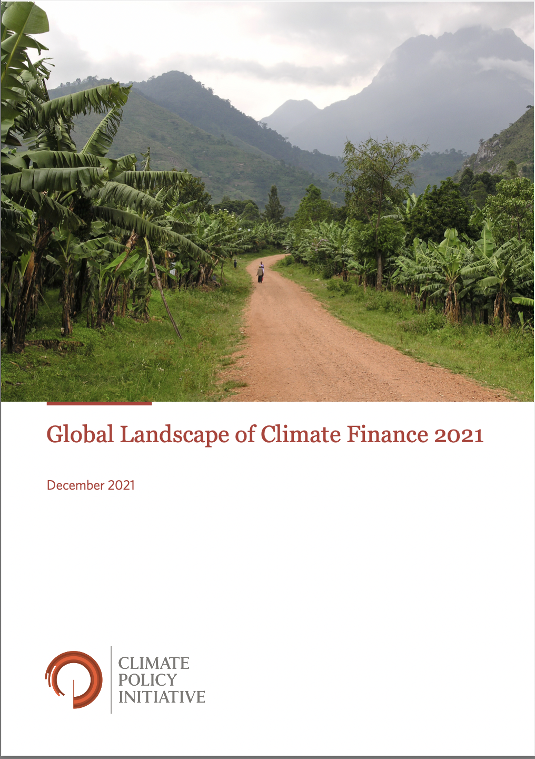
PRIMARY DATA SOURCE
Climate Policy Initiative. 2021. “Global Landscape of Climate Finance 2021.”
The primary source for this presentation. CPI’s report is among the most reliable and comprehensive available on climate finance.
https://www.climatepolicyinitiative.org/wp-content/uploads/2021/10/Global-Landscape-of-Climate-Finance-2021.pdf
Notes:
CPI has been tracking climate finance for over a decade and is a reliable and comprehensive source.

Slide 4
What does the climate finance architecture look like?

Slide 5
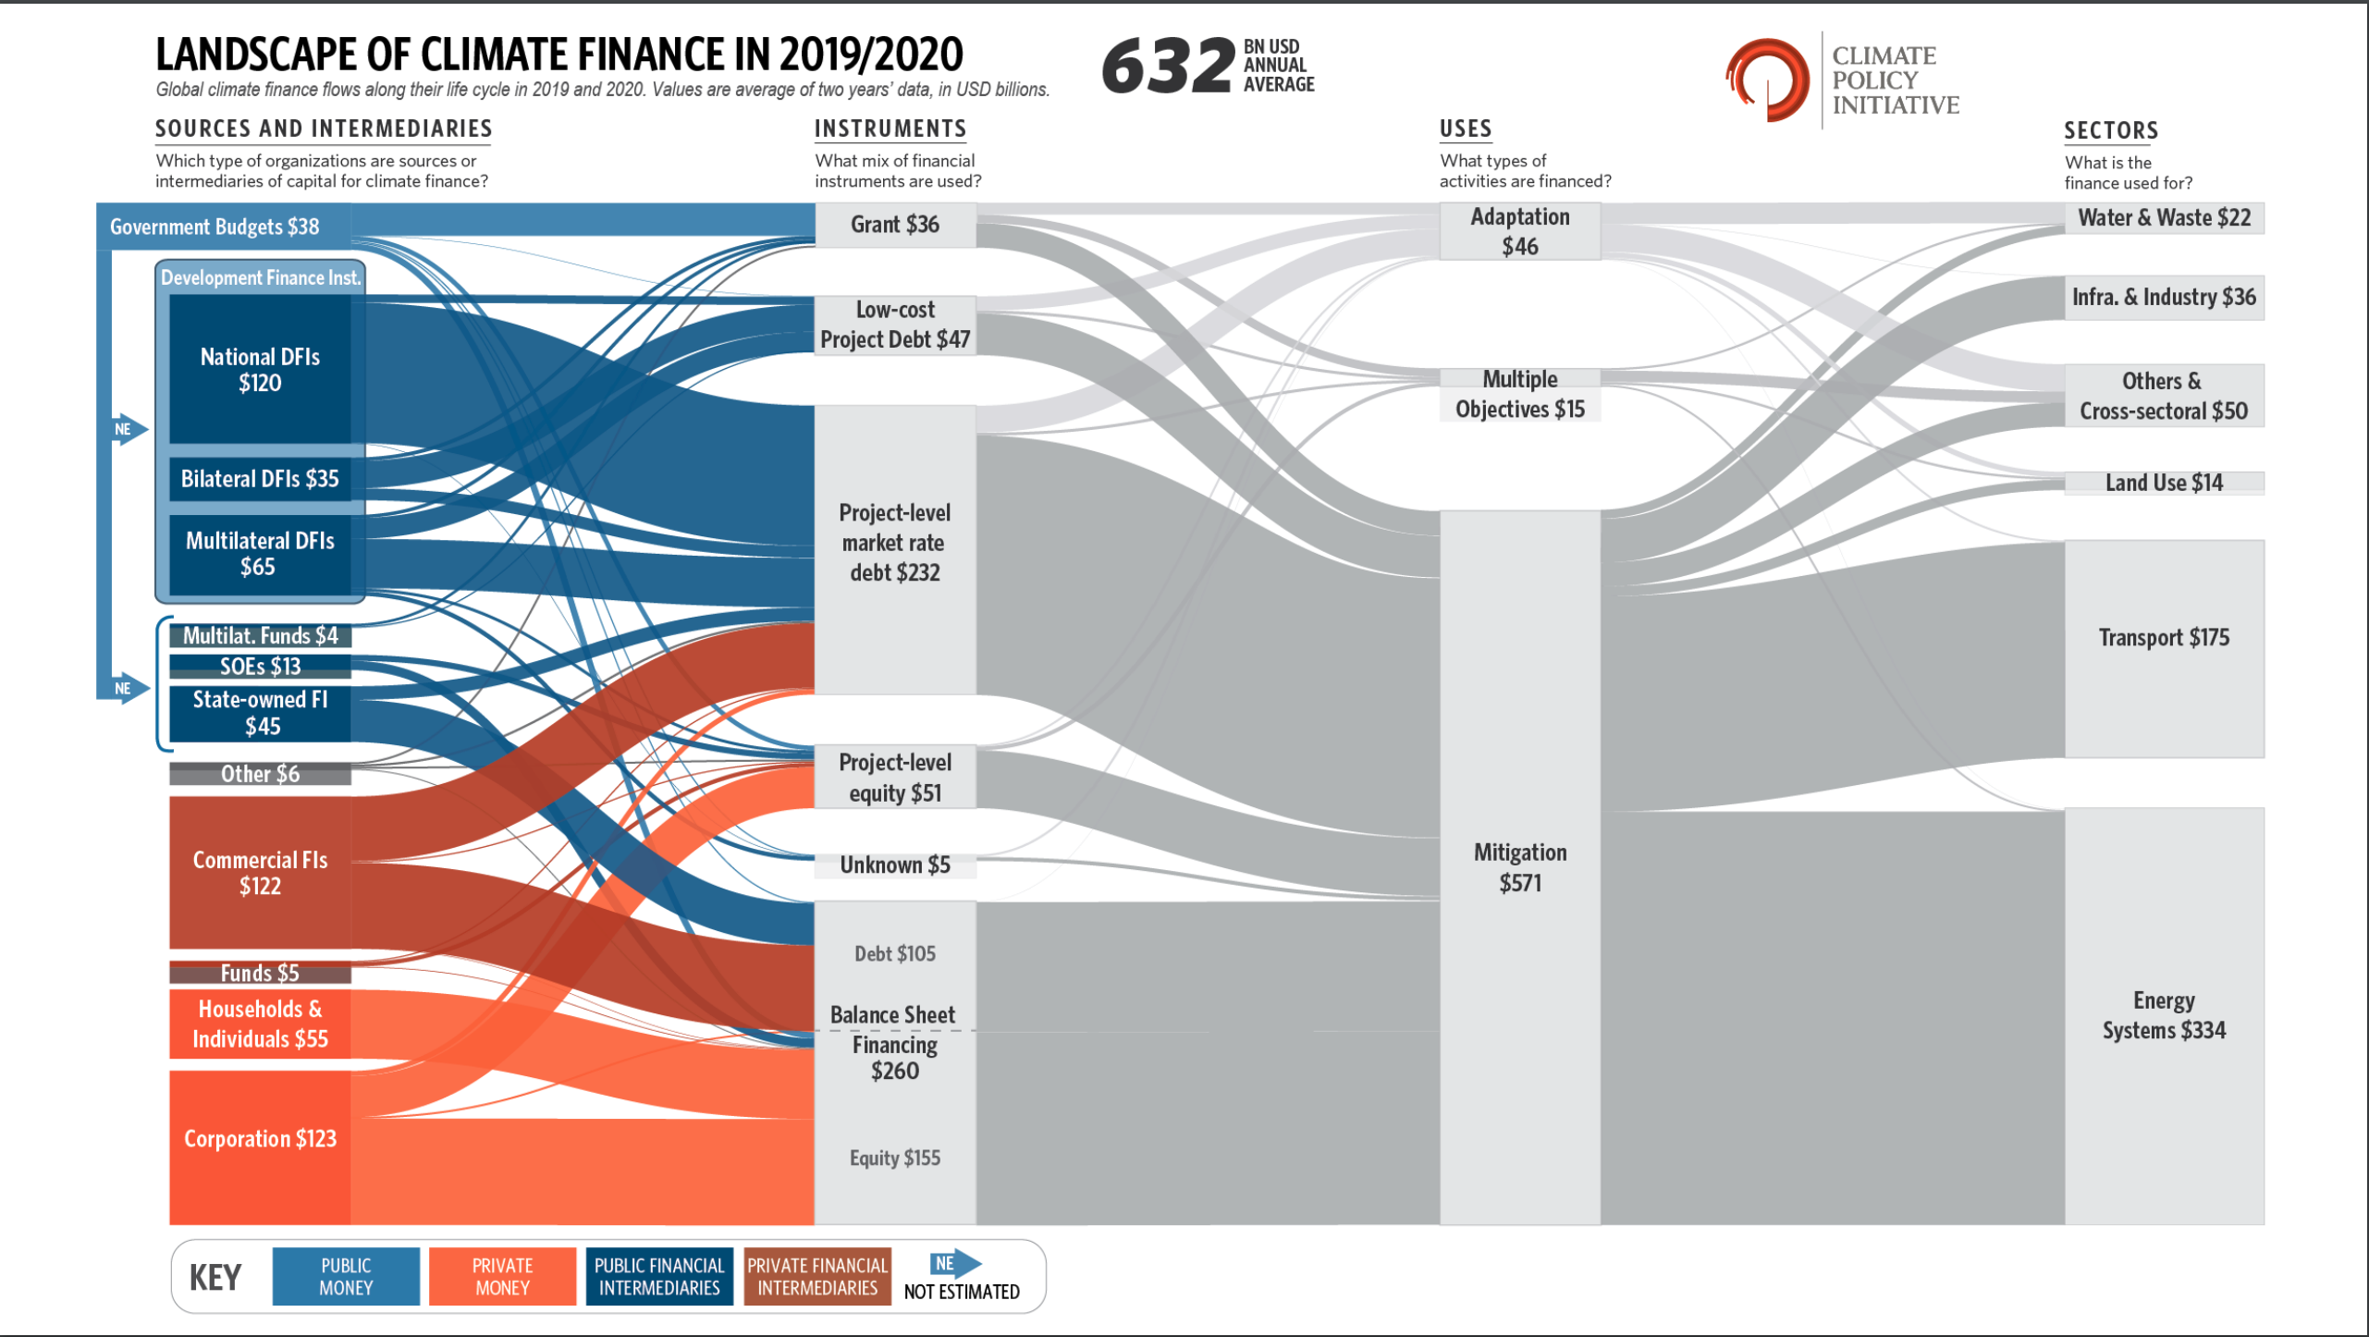
Notes:
Somewhat like an octypus to me.
But this isn’t as complex as it first appears.
It breaks finance down into four categories (on top): 1. sources and intermediaties, 2. instruments, 3. uses and 4. sectors. I’ll overview each of these in my presentation.
Like many of the upcoming slides in my presentation, graphs are displayed that normally require a few minutes of study to fully understand. I’ve provided them so that those who have more of an interest can go back to them at a later time if they wish. For the rest of you, I will simply provide the main one or two points that the respective graph represents.

Slide 6
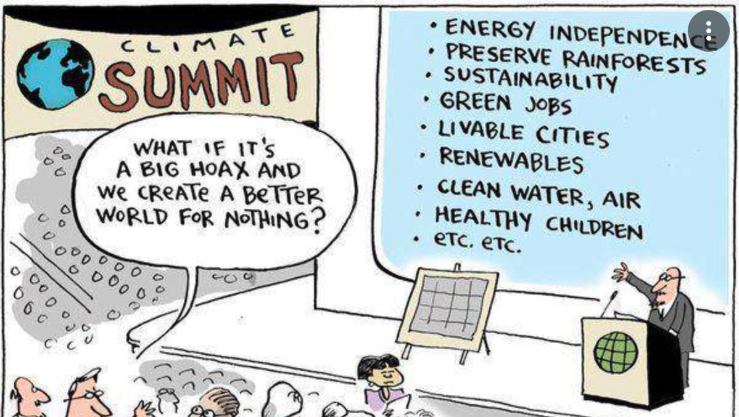
Can you believe what I am telling you?

Slide 7
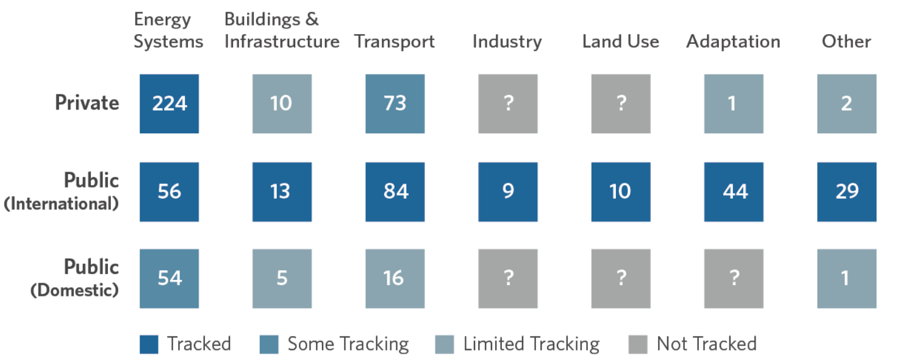
DATA GAPS
Quantitative information can be dispersed & scarce.
Metrics & taxonomy often non-standardized.
E.g., finance for green buildings is growing fast but lacks transparency.
Notes:
Hopefully, yes.
There are still significant data gaps.
But trends rather than absolute numbers are often what is important here.

Slide 8
What does the Paris Agreement say about finance? And what happened at CoP 26 in Glasgow?

Slide 9
PARIS AGREEMENT
No agreed definition of climate finance
Article 9 (Finance)
mandates developed countries to provide $, but there are no concrete figures or a timetable
requires developed countries to submit “transparent and consistent” biennial reports on levels of assistance
cooperative approaches (reworked CDM) and REDD+
* Now changed to 2020 reassessment
http://unfccc.int/paris_agreement/items/9485.php
Notes:
Article 9
Developed and developing countries agree developing countries need financial help
Agree there are several ways to skin a cat in CC finance
Note the “significant role of public funds” in climate finance
Developed countries are asked ”to take the lead in mobilizing climate finance”
But all Parties are “encouraged to provide or continue to provide such support voluntarily”
In the end developing countries didn’t get firm commitment on amounts or timetable or over and above ODA, etc.
The reassessment (now to be done in 2020) will be in the context of $100B/yr as the floor
But no agreed methodology on defining and tracking CC finance. OECD says $62B in 2014 but strongly disputed by developing countries.
Cooperative approaches have an impact on finance and include:
Formulate joint NDCs within a regional economic integration organization (e.g., EU states; ASEAN?)
Form voluntary partnerships to support mitigation efforts including transfer of mitigation outcomes
Formal emissions trading or results-based payments without a transfer of a carbon unit
Sustainable development mechanism allowing public and private entities to support mitigation projects that generate transferrable GHG emissions
Like CDM offsets

Slide 10
PARIS AGREEMENT
Language:
Provide finance on “the basis of equity and in accordance with their common but differentiated responsibilities and respective capabilities”
Polluter pays
New and additional finance
Predictable finance
Adequate and precautionary (1.5ºC)
Transparent and accountable
http://unfccc.int/paris_agreement/items/9485.php
https://climatefundsupdate.org/wp-content/uploads/2021/03/CFF1-ENG-2020-Digital.pdf

Slide 11
Pre-CoP 26
Taskforce on Access to Climate Finance created in May 2021
To facilitate coherent and effective support for developing countries in mitigation and adaptation
Glasgow Financial Alliance for Net-Zero
$5 b pledge from 9 philanthropic organizations for nature-positive investments, including for climate change
Contribution to funds
$350 m to Adaptation Fund (a record amount)
$413 m to Least Developed Countries Fund
More than before; still well below demand
https://ukcop26.org/cop26-goals/finance/
https://www.business-standard.com/article/current-affairs/cop26-draft-decision-shifts-the-goalpost-on-climate-financing-121111001193_1.html
https://www.wri.org/insights/what-cop26-means-forests-climate
https://wwf.panda.org/wwf_news/?3762941/WWF-hails-largest-ever-private-funding-commitment-for-biodiversity-as-a-momentous-move-for-a-nature-positive-world

Slide 12
CoP 26
Joint Statement by the Multilateral Development Banks: Nature, People and Planet
Nearly 500 global financial services firms to align $130 t (40% of global financial assets) to Paris Agreement
Over 30 FIs managing $9 t in assets committed to help eliminate agriculture deforestation risks in investment & lending portfolios
$100 b annual funding from developed countries now delayed from 2020 to 2023
$8.5 b from USA, UK, EU, others to help South Africa transition from coal
https://ukcop26.org/mdb-joint-statement/
https://news.un.org/en/story/2021/11/1104812

Slide 13
CoP 26
Raise in adaptation finance commitments
Japan & Australia to double their finance
USA, Switzerland, Canada significant increases
CoP 26 Global Forest Finance pledge
12 countries to collectively provide $12 b for forest-related finance 2021-2025
https://ukcop26.org/mdb-joint-statement/
https://news.un.org/en/story/2021/11/1104812
https://unfccc.int/news/cop26-pivotal-progress-made-on-sustainable-forest-management-and-conservation

Slide 14
CoP 26
Paris Rulebook agreed
Established fundamental norms related to Article 6 on carbon markets – probably like CDM
Makes Paris Agreement fully operational
Agreed to Enhanced Transparency Framework
Agreed tables and formats to report finance and other targets
https://ukcop26.org/mdb-joint-statement/
https://news.un.org/en/story/2021/11/1104812
https://unfccc.int/news/cop26-pivotal-progress-made-on-sustainable-forest-management-and-conservation
https://unfccc.int/news/cop26-reaches-consensus-on-key-actions-to-address-climate-change

Slide 15
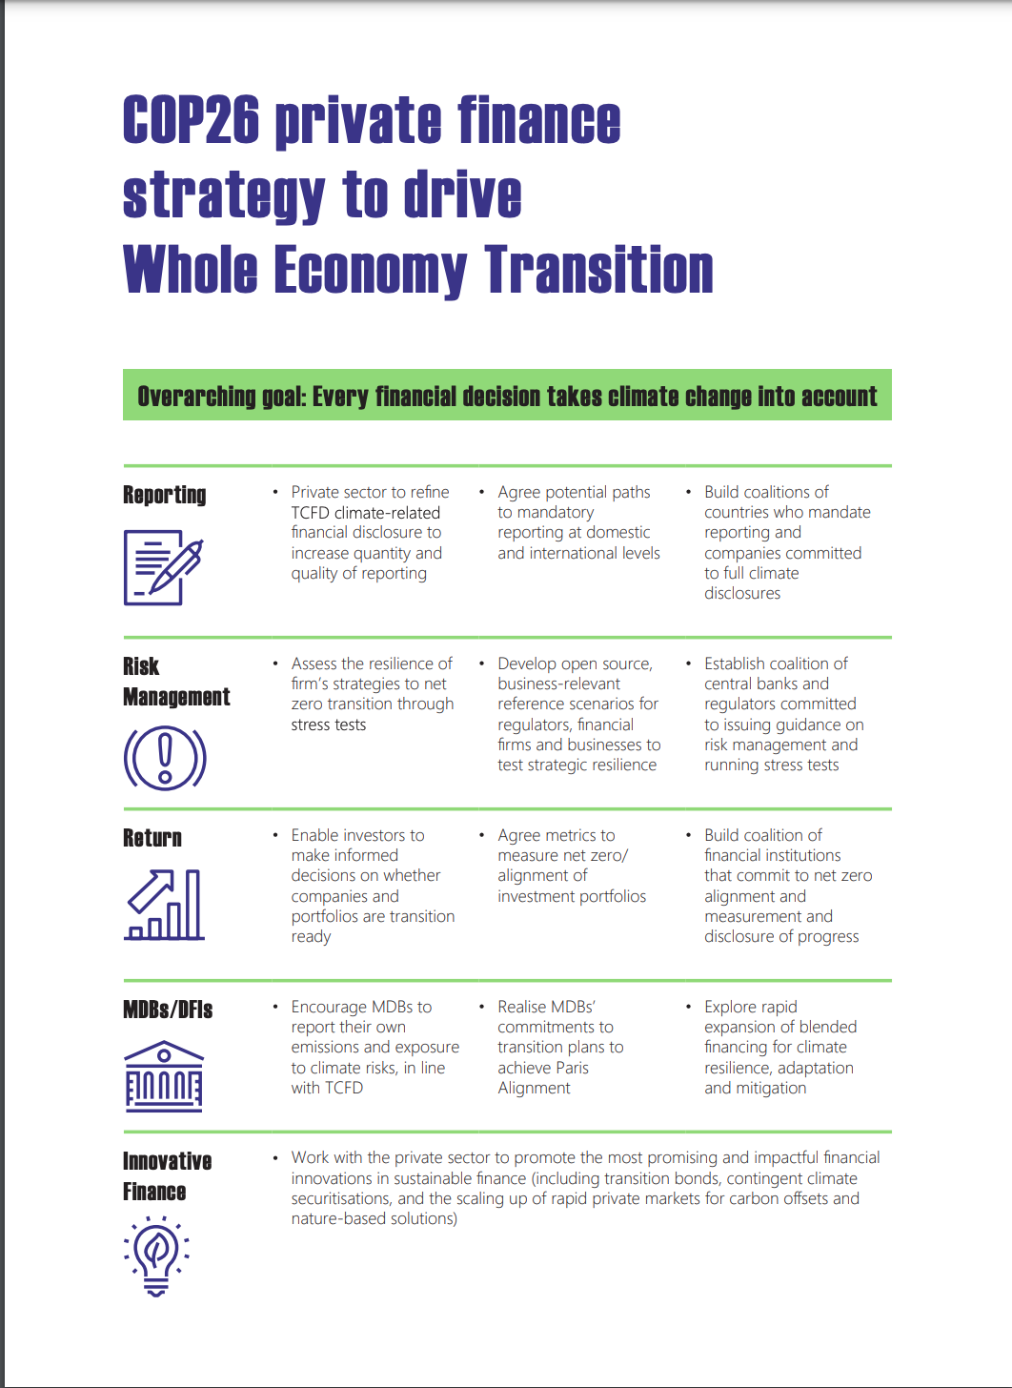
CoP 26
https://www.bankofengland.co.uk/-/media/boe/files/events/2020/february/cop26-private-finance-strategy.pdf?la=en&hash=4D961E25E8E80EAB2108EEA09628DBA461D60750

Slide 16
How much has the world been spending on climate change mitigation and adaptation?

Slide 17
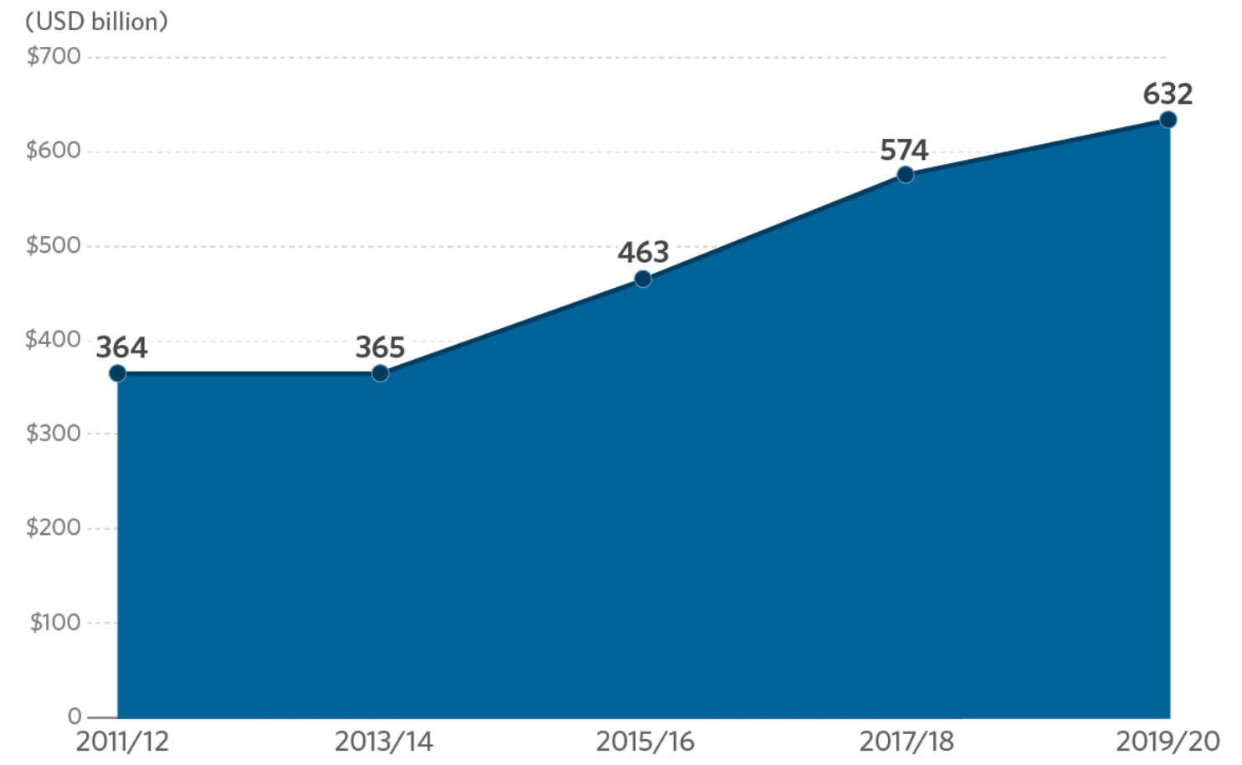
GLOBAL CC FINANCE 2011/12-2019/20
The total finance in 2019/20 was $632 B.
Rate of increase is worrying:
24% - 2013-2018
10% - 2017-2020
Notes:
CPI has been able to track an annual average of $632 billion of climate finance 2019-20
This is considerably more than a decade ago, but the drop in the annual rate of increase is worrying.

Slide 18
Where does the money come from?

Slide 19
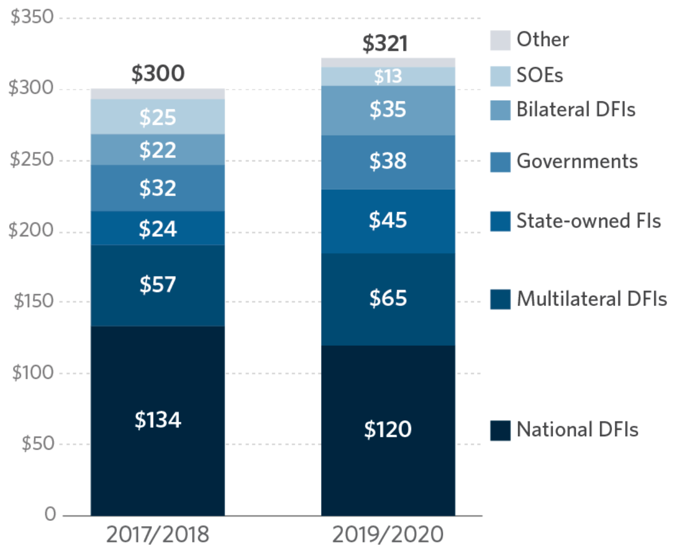
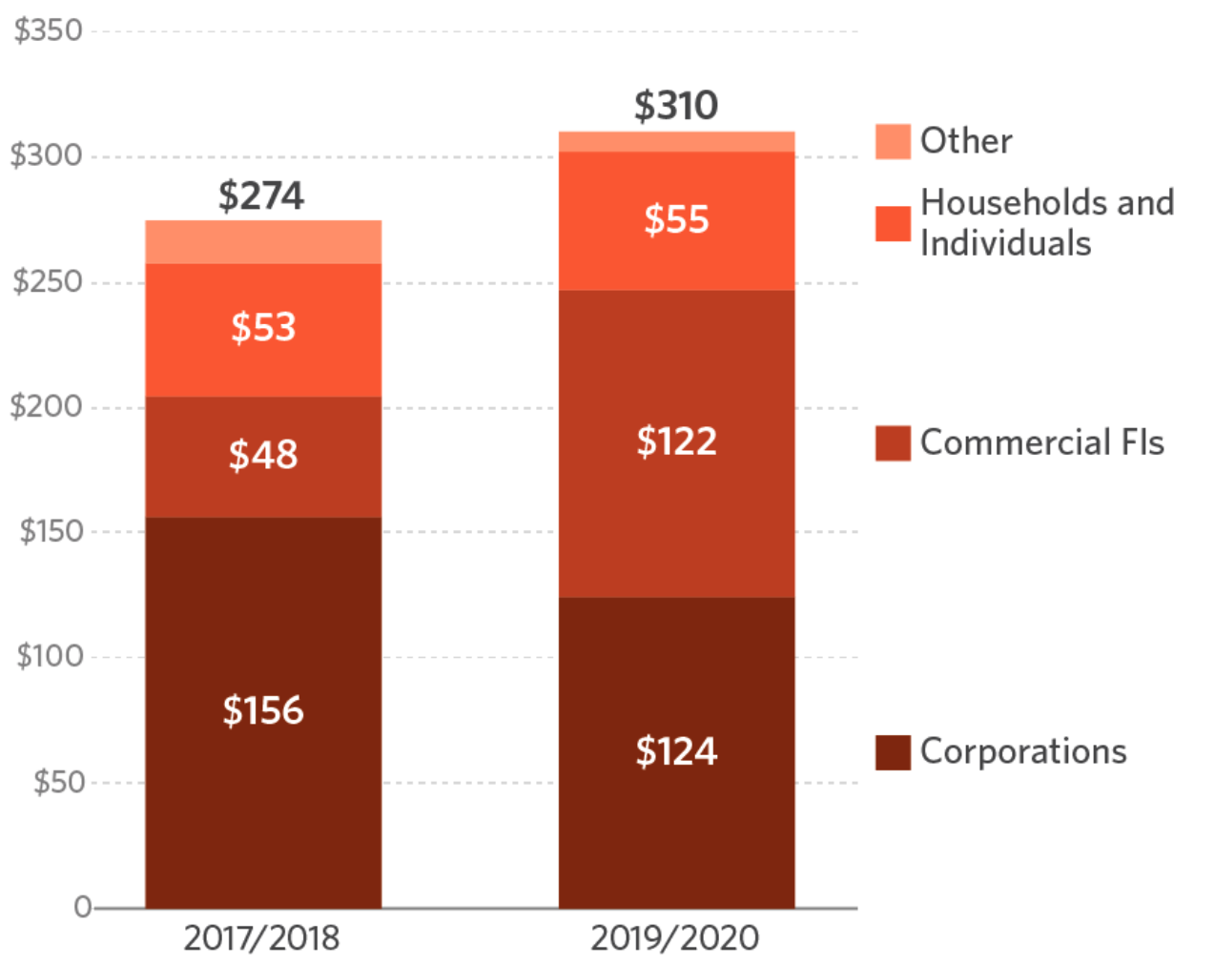
WHERE DOES THE MONEY COME FROM?
51% ($321 B) from public sources
49% ($310 B) from private sources
Notes:
It’s pretty much an equal split between public sources and private sources.

Slide 20
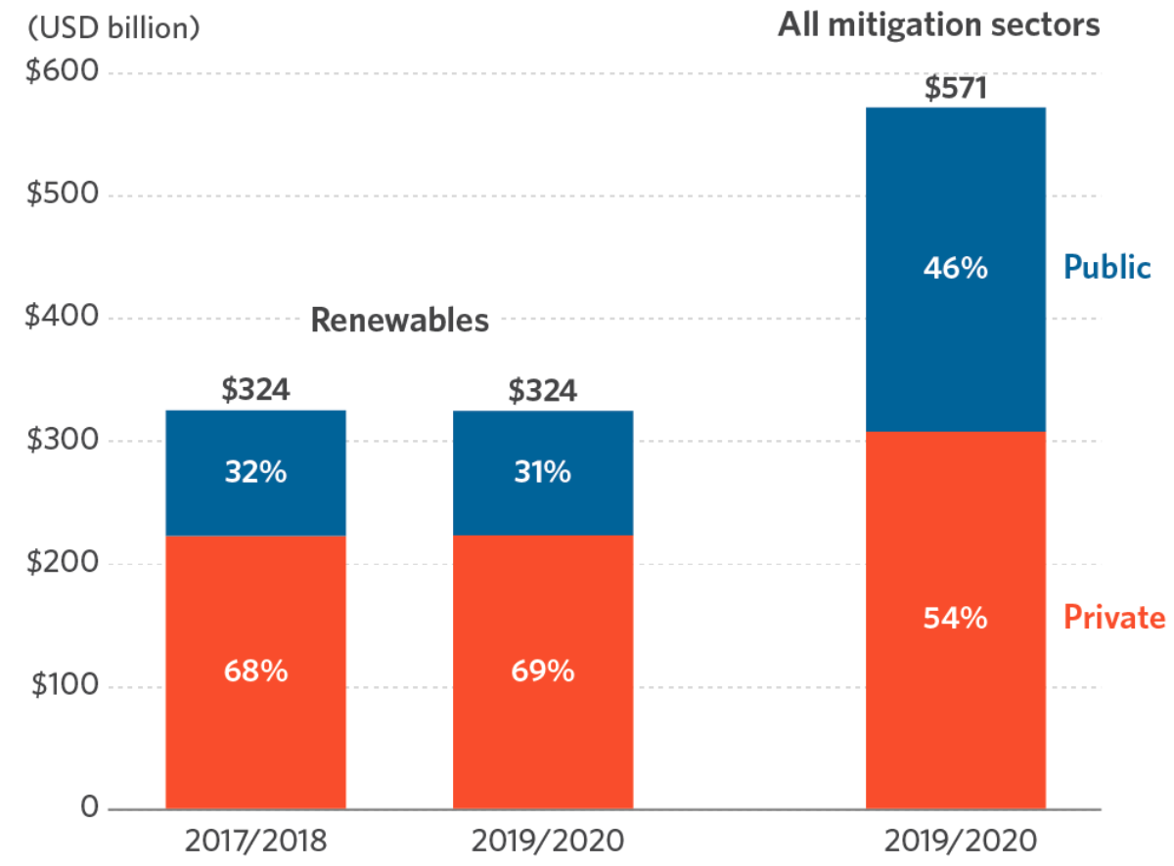
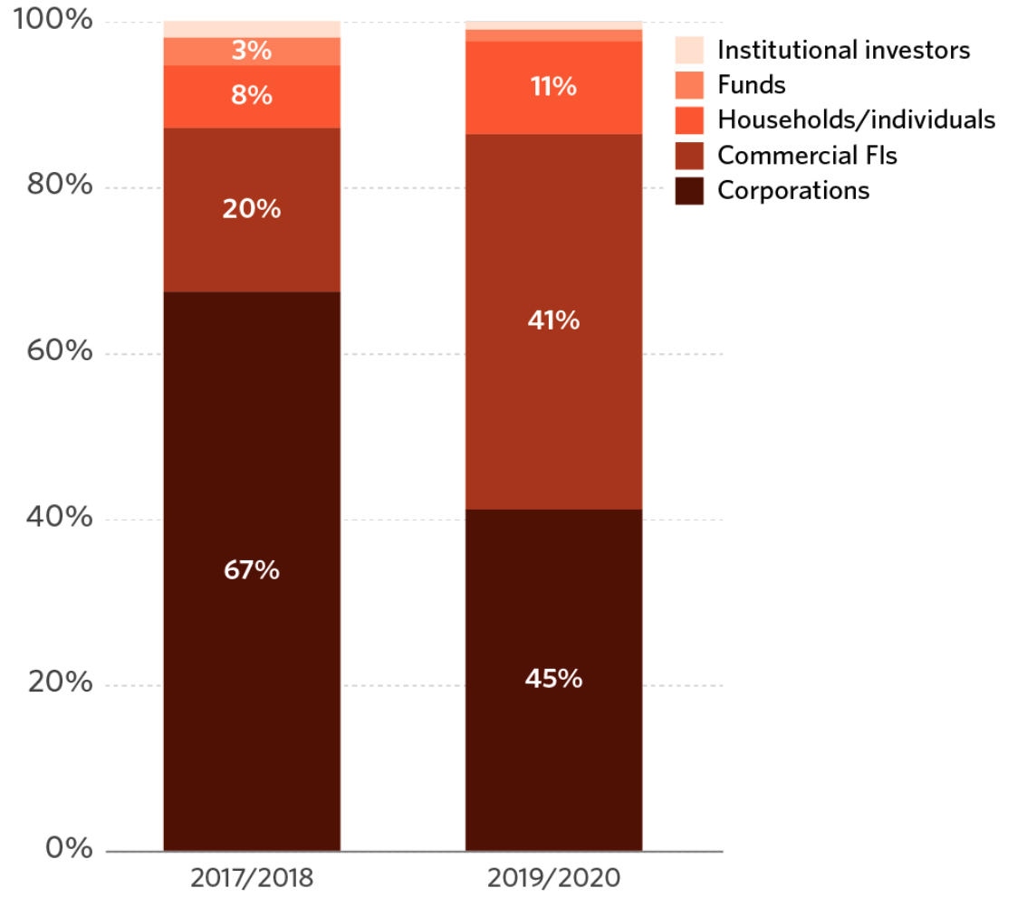
WHERE DOES THE MONEY COME FROM?
But 54% of all mitigation finance and 69% of finance for renewable energy projects came from the private sector.
Commercial financial institutions provided 45% of the total finance for renewables, then corporations (41%) and households & individuals (11%).
Notes:
But most mitigation finance comes from the private sector.
In particular, it’s interesting to note that almost half of the total finance for renewable energy came from commercial financial institutions.

Slide 21
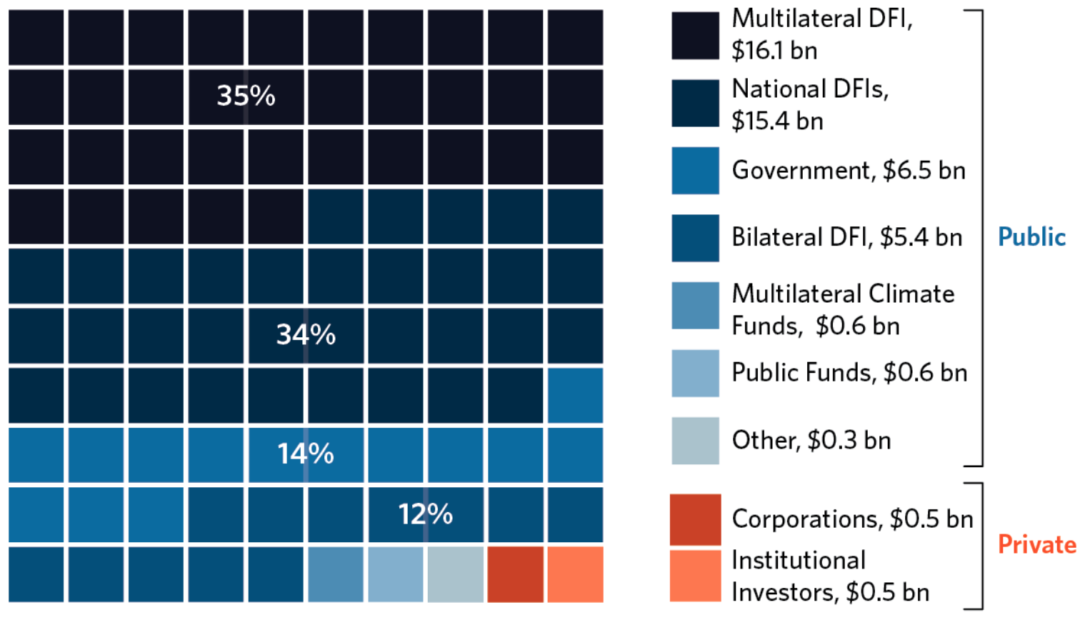
WHERE DOES THE MONEY COME FROM?
Nearly all adaptation finance was from the public sector.
Notes:
As I noted early, nearly all adaptation finance is from the public sector, notably the multilateral banks and national development banks.
The bilateral and multilateral climate finance, while relatively small, is important because it is a source of grant finance which can be blended with market rate loans to make adaptation project proposals more attractive.

Slide 22
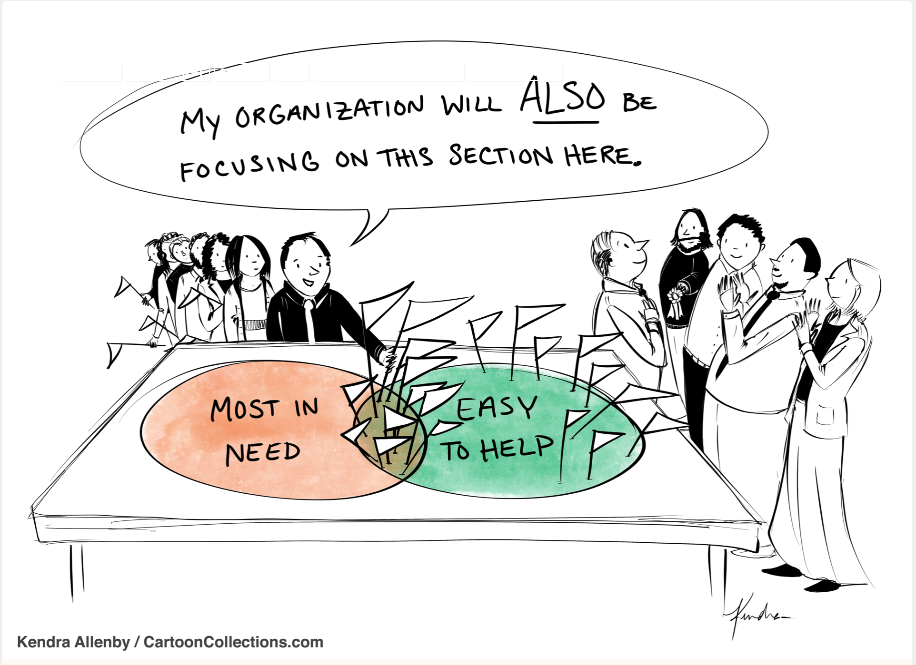
Where does all the climate change money go?

Slide 23
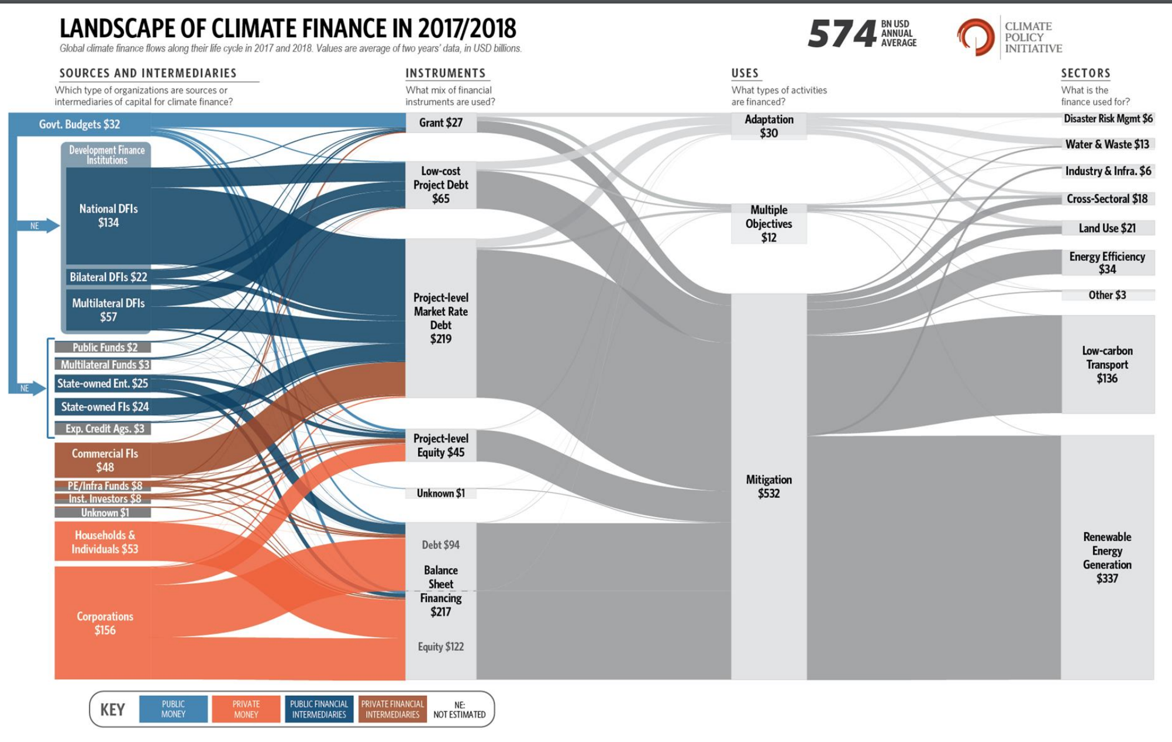
https://www.climatepolicyinitiative.org/publication/updated-view-on-the-global-landscape-of-climate-finance-2019/

Slide 24
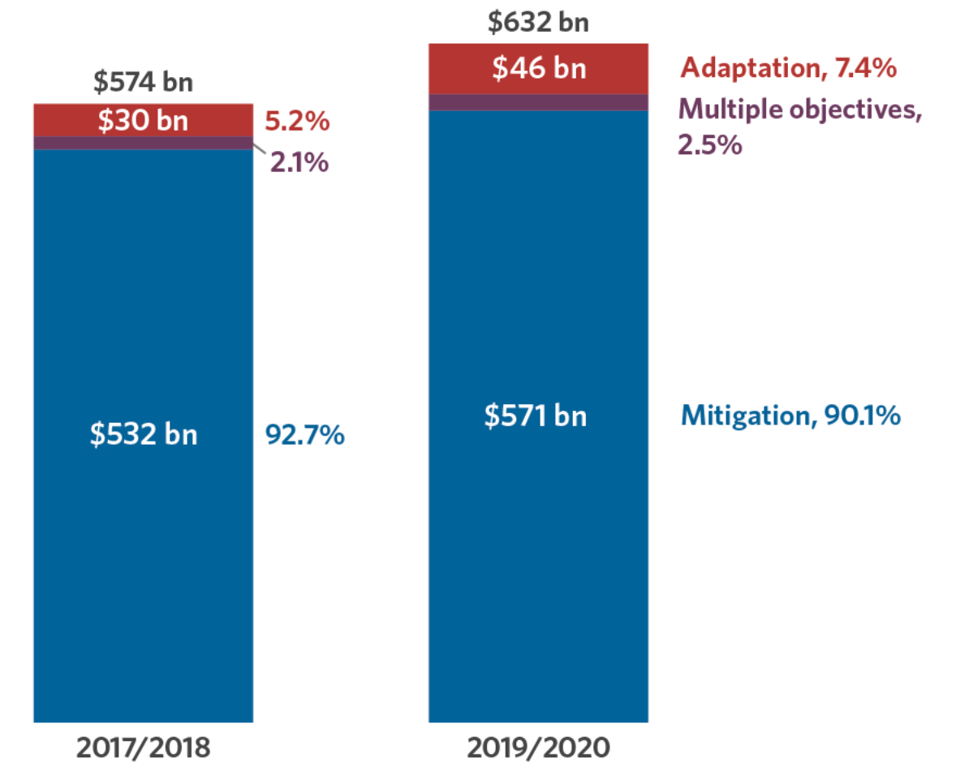
WHERE DOES THE MONEY GO?
Finance for mitigation again was vastly higher than that for adaptation (and dual mitigation/adaptation) 9 to 1.
Notes:
Finance for mitigation is 9 to 1 over adaptation.
The international goal has been to achieve closer to a 50:50 split.
The need for adaptation finance is growing as climate change impacts become more severe.

Slide 25
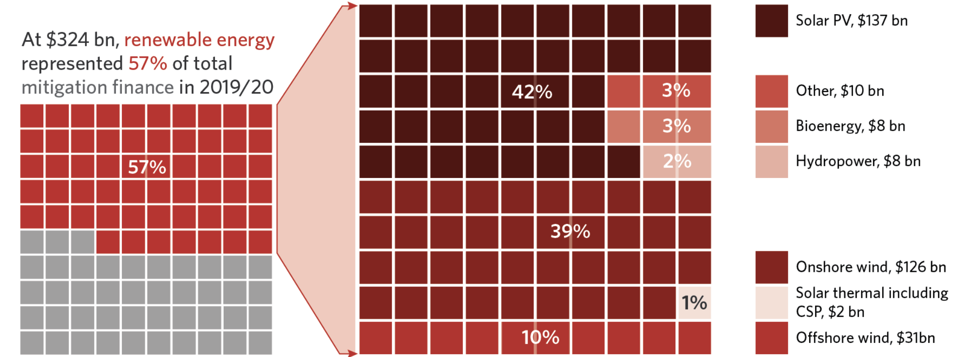
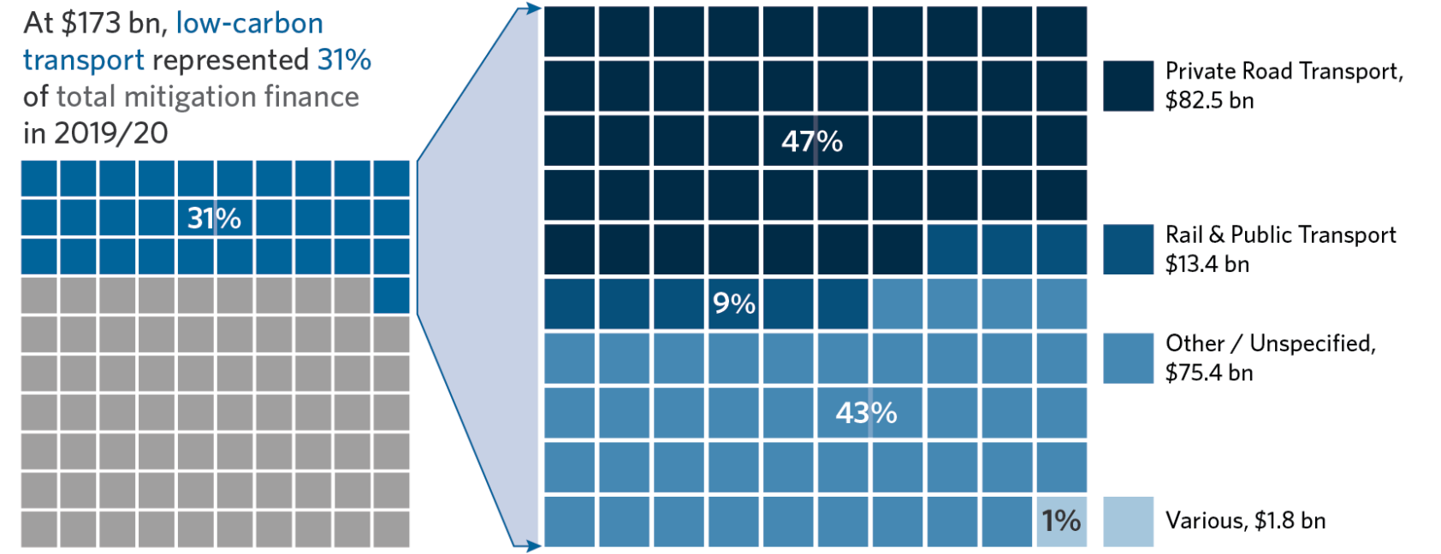
WHERE DOES THE MONEY GO?
Renewable energy remains the largest mitigation sector
Low-carbon transport is the fastest-growing sector
Notes:
Renewable energy has always attracted the most mitigation finance.
Of that, low-carbon transport, e.g., electric vehicles, is now the fastest growing sector.

Slide 26
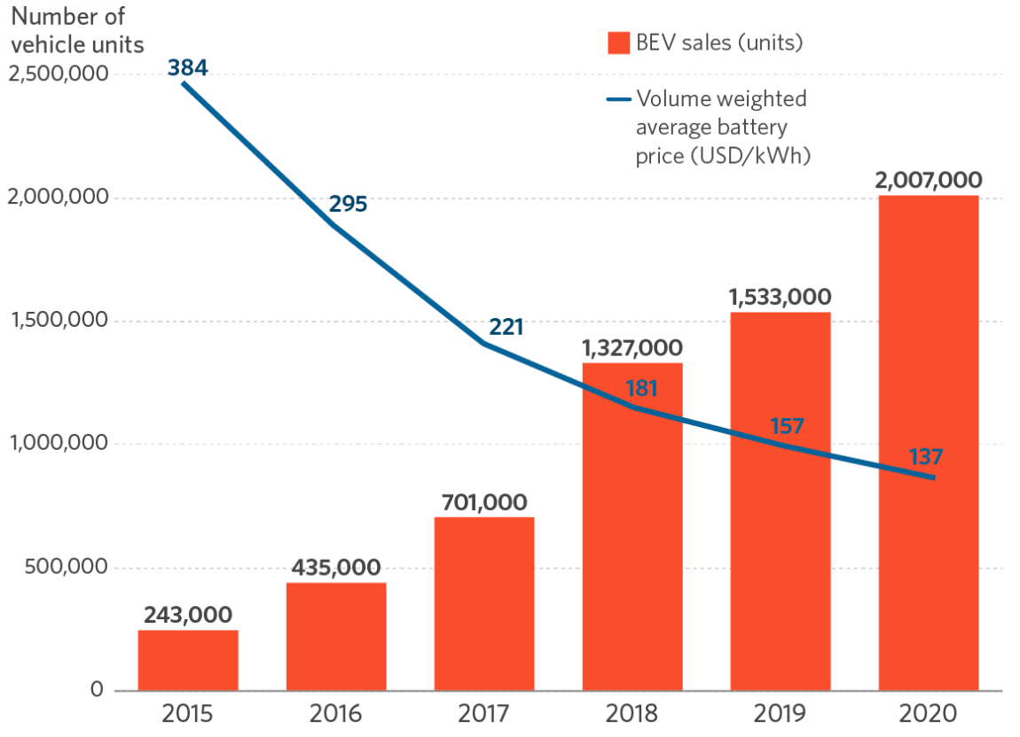
WHERE DOES THE MONEY GO?
Battery electric vehicle (BEV) growth was +31% year-on-year while global vehicle market fell by 16%.
Global BEV sales could double this year.
Notes:
Battery electric vehicle growth was 31% over this period due largely to falls in battery costs, even as the global vehicle market fell by 16%.

Slide 27
WHERE DOES THE MONEY GO?
Adaptation finance 2015/16 and 2017/18
Water, natural resources & agriculture, and disaster risk management sectors were lead adaptation finance recipients in 2017/18.
https://www.climatepolicyinitiative.org/publication/global-landscape-of-climate-finance-2019/
Notes:
This slide shows the sectors receiving adaptation finance.
Not surprisingly, the top three are water and wastewater management, Agr/forestry/NR and disaster risk management
Surprisingly to me, little adaptation finance goes to “infrastructure, energy and other built environment – climate proofing

Slide 28
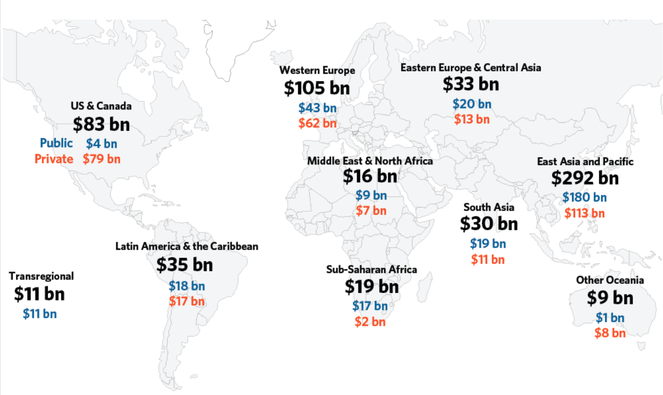
WHERE DOES THE MONEY GO?
About 75% ($479 B) of investments were raised and spent domestically.
More than half of tracked global investments went to Asia and the Pacific region.
Almost three-fourths of A-P investments were in China.
https://www.climatepolicyinitiative.org/publication/global-landscape-of-climate-finance-2019/
Notes:
This is the headline for the region: more than half of tracked global investments went to Asia and the Pacific region.
However, keep in mind that almost three-quarters of these investments were in China.
Another stunning statistic is that roughly 75% of global climate investments are raised and spent domestically. This has implications for how finance is raised and for the importance of local financial governance and regulation as this pertains to climate change.

Slide 29
How does spending on climate change finance compare to actual funding needs?

Slide 30
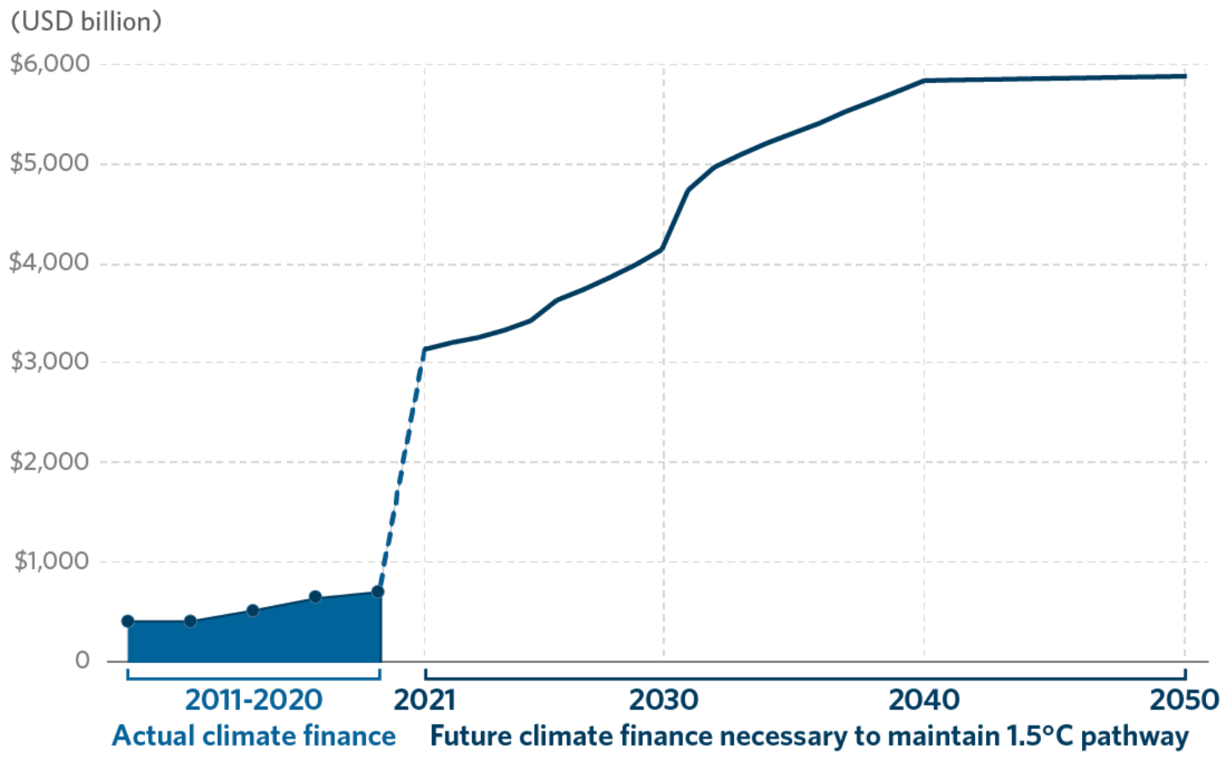
GLOBAL FINANCE REQUIRED TO MEET 1.5C
Based on an analysis of aggregated sources, annual climate finance must increase by 588% to $4.35 T by 2050.
Notes:
There’s a huge gap between what’s available and what’s needed.
Overall, finance needs to increase by around 600% if we are to meet the Paris Agreement goal of 1.5C.

Slide 31
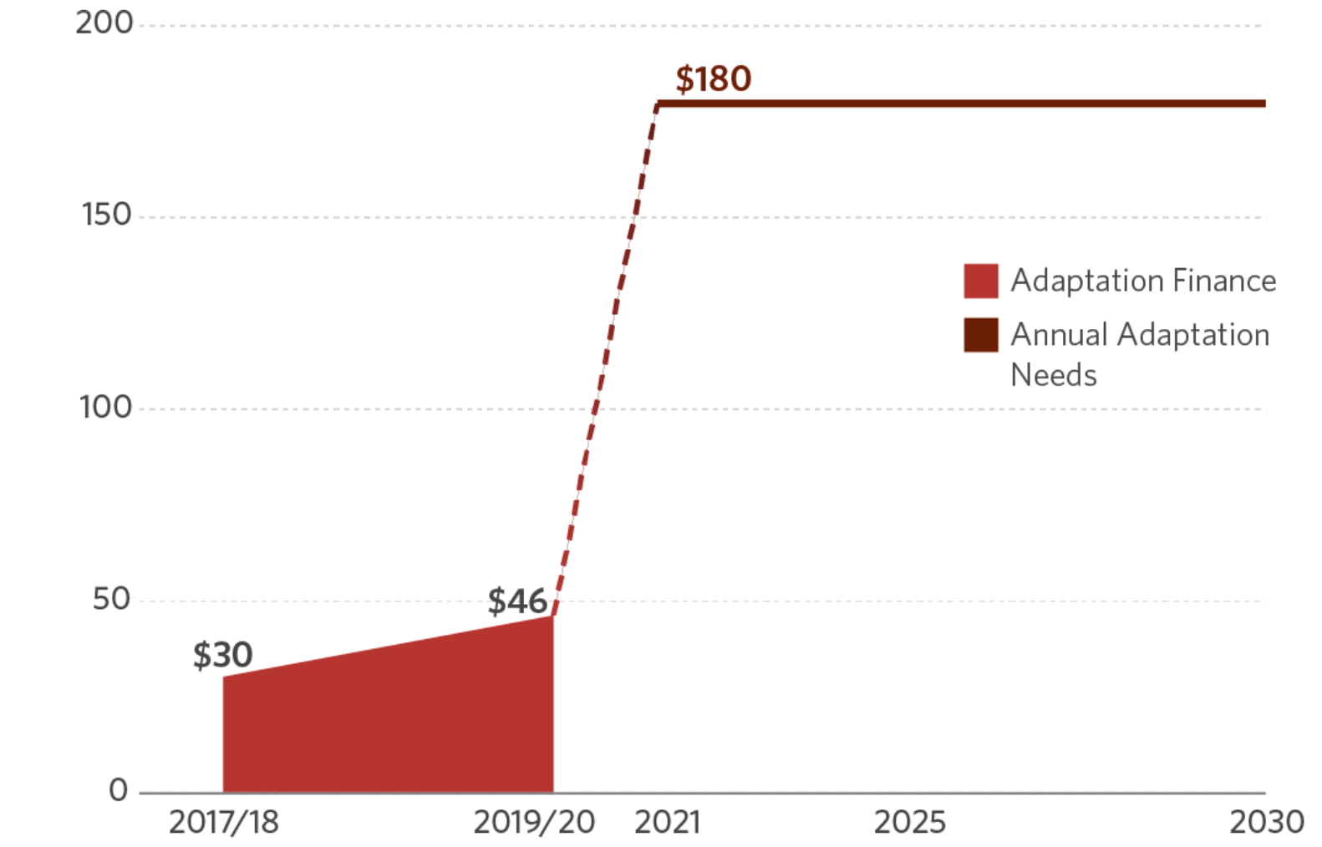
ADAPTATION FINANCE SUPPLY VS NEED
Adaptation finance picked up during the past 2 years, but it is woefully short of meeting estimated needs.
https://www.un.org/sustainabledevelopment/blog/2016/05/unep-report-cost-of-adapting-to-climate-change-could-hit-500b-per-year-by-2050/
https://climatepolicyinitiative.org/wp-content/uploads/2019/11/2019-Global-Landscape-of-Climate-Finance.pdf
https://ourworldindata.org/how-much-will-it-cost-to-mitigate-climate-change
Notes:
The gap is large for both adaptation finance…

Slide 32
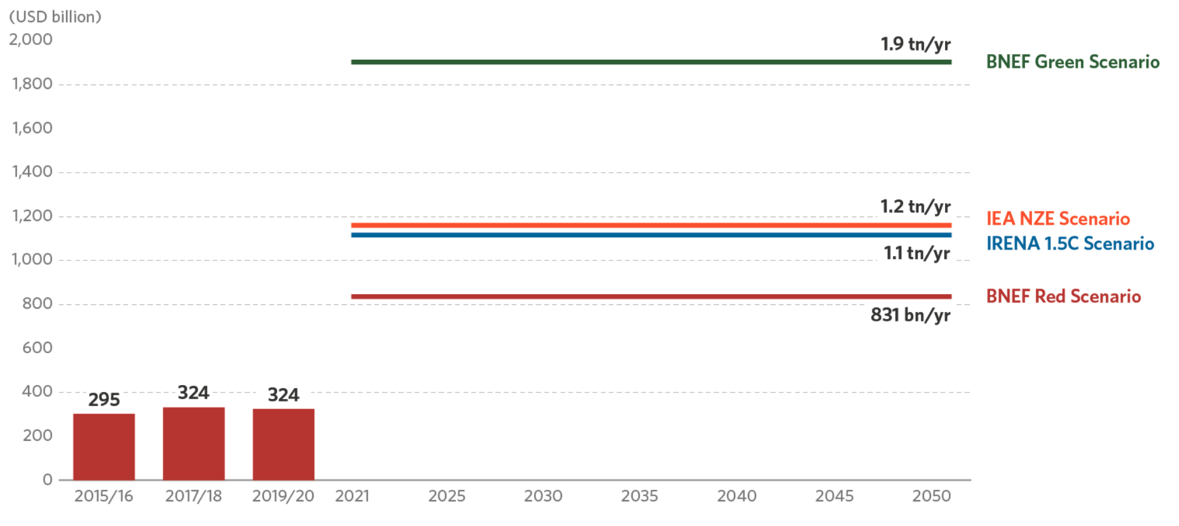
RENEWABLE ENERGY INVESTMENT NEEDS
Annual investment ranging from $832 B to $1.9 T is needed to the year 2050 to meet the Paris Agreement’s 1.5C goal.
Notes:
… and mitigation finance.
Here , you can see what we are providing in terms of renewable energy and what is actually needed according to various scenarios.

Slide 33
EXAMPLES OF ESTIMATED NEEDS
India’s climate action plan estimated budget - $2.5 t by 2030
African nations - $1.3 t per year by 2030
UNFCCC needs assessment - $6 t needed to fund just 40% of climate plans submitted
https://www.business-standard.com/article/current-affairs/cop26-draft-decision-shifts-the-goalpost-on-climate-financing-121111001193_1.html
Notes:
There’s a huge gap between what’s available and what’s needed.
Overall, finance needs to increase by around 600% if we are to meet the Paris Agreement goal of 1.5C.

Slide 34
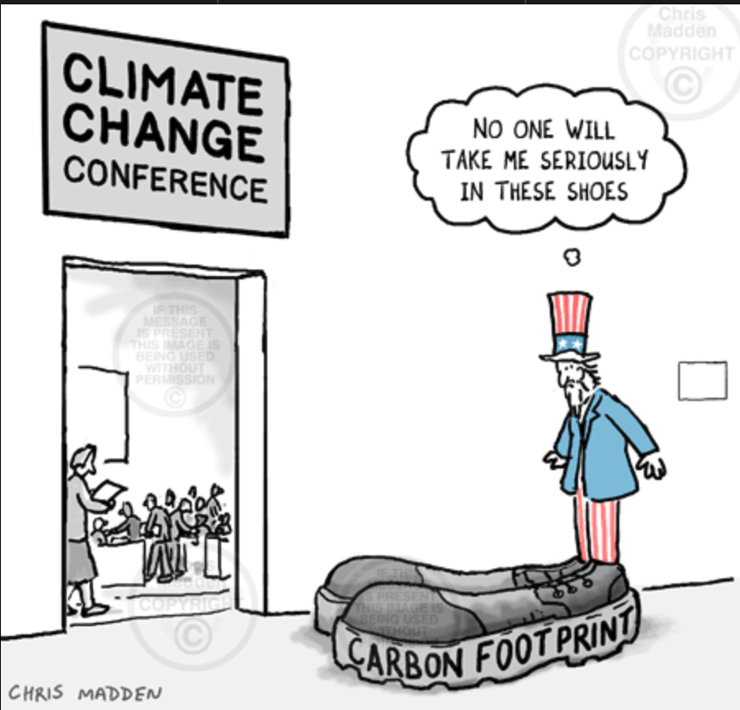
Does any of this matter if we are unable to abandon our reliance on fossil fuels and other GHG sources?

Slide 35
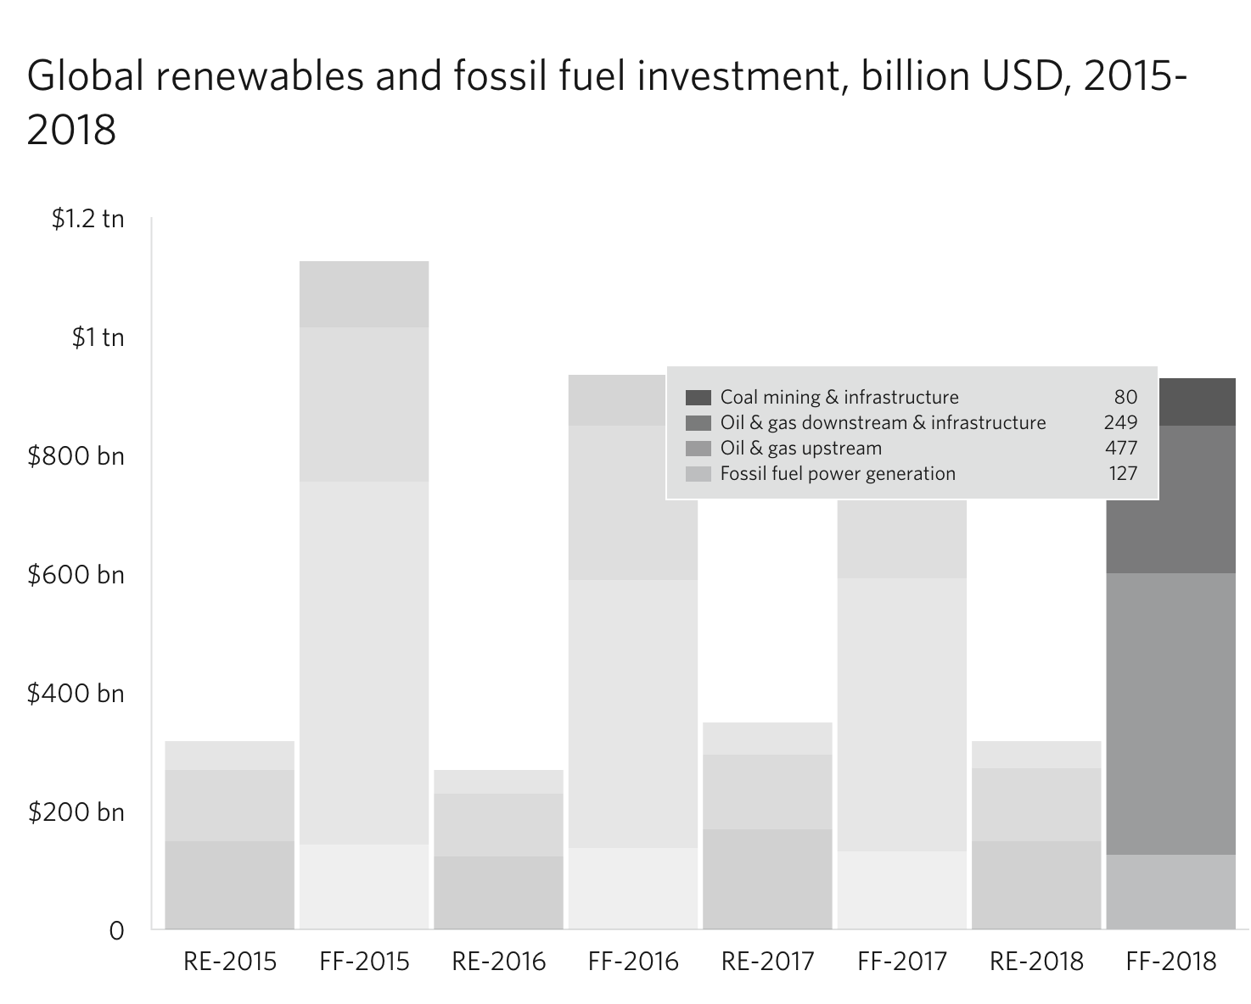
https://www.climatepolicyinitiative.org/publication/global-landscape-of-climate-finance-2019/
Notes:
This slide shows annual spending for renewable energy of the left and fossil fuels on the right.
To me, this is a profound slide, which sums up the climate finance story as we now are living it. A lot of money for renewable energy but so much more for fossil fuels

Slide 36
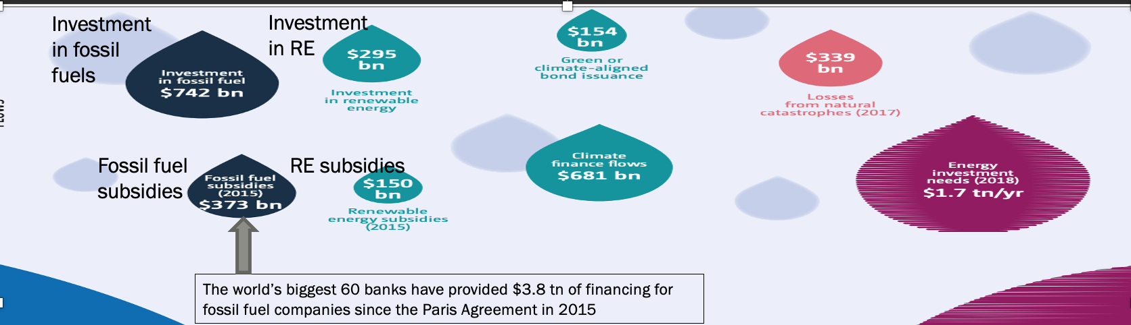
https://unfccc.int/sites/default/files/resource/2018%20BA%20Technical%20Report%20Final.pdf
Notes:
This UNFCCC publication from 2018 shows that the world’s biggest banks provided $3.8 trillion of financing for fossil fuel companies in the 3 years following the Paris Agreement.
This mirrors a general trend of investing far more in fossil fuels than in renewable energy.
In addition, the subsidies for fossil fuels dwarf that for renewable energy.
This also highlights one of the serious risks of investing in fossil fuels – about half of the world’s fossil fuel assets will be worthless by 2036 under a net-zero transition.
ALSO STRANDED ASSETS
About half of the world’s fossil fuel assets will be worthless by 2036 under a net zero transition, according to research. Countries that are slow to decarbonise will suffer but early movers will profit; the study finds that renewables and freed-up investment will more than make up for the losses to the global economy.
$11tn-$14tn (£8.1tn-£10.3tn) in so-called stranded assets – infrastructure, property and investments where the value has fallen so steeply they must be written off.
Need to be handled carefully to prevent regional pockets of misery and possible global instability.
Then we could see a financial crisis on the scale of 2008,” he said, warning oil capitals such as Houston could suffer the same fate as Detroit after the decline of the US car industry unless the transition is carefully managed.

Slide 37
What happened to the multilateral dedicated climate change funds and the promise of $100bn per year?

Slide 38
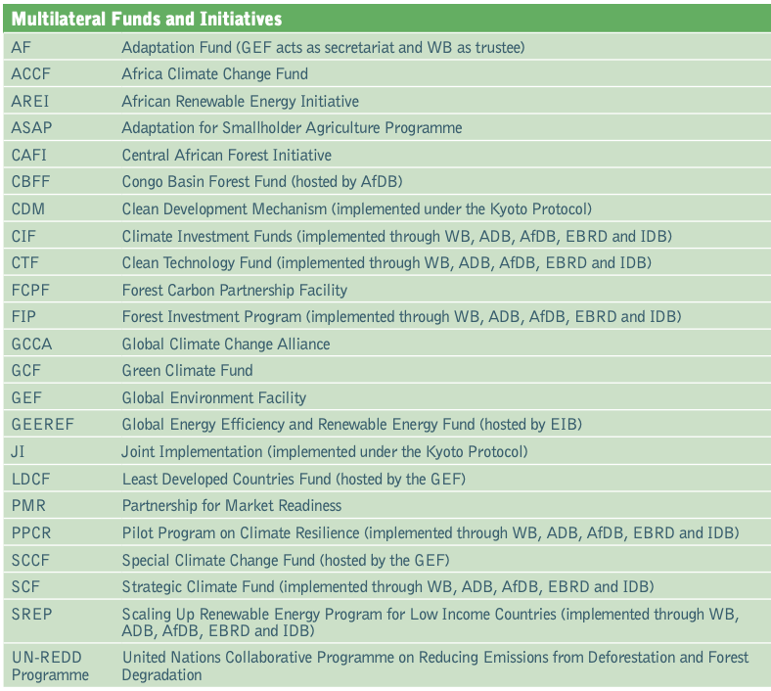
https://climatefundsupdate.org/wp-content/uploads/2021/03/CFF2-ENG-2020-Digital.pdf

Slide 39
UNFCCC FINANCIAL MECHANISM
Global Environment Facility & Green Climate Fund are operating entities
Special Climate Change Fund (SCCF)& Least Developed Countries Fund (LDCF)
GEF managed
Adaptation Fund
2% of certified emission reductions (CERs) from CDM projects & contributions
(Standing Committee on Finance)

Slide 40
GREEN CLIMATE FUND
Est 2010; 1st project 2015; 190 total projects, 155 implemented
48 (38)% adaptation; 69% for LDCs, SIDS and Africa
$10 bn in financing committed; 42% grants, 44% loans
New Global Subnational Climate Fund – LDCs, SIDS, private sector
>200 accredited implementing entities
E-learning course on Simplified Approval Process at https://ilearn.greenclimate.fund/thematicarea/category?id=2
Adaptation Fund in prep 5-year strategy: https://www.adaptation-fund.org/adaptation-fund-invites-broad-input-from-stakeholders-as-it-begins-development-of-next-five-year-strategy/
https://www.greenclimate.fund/
https://www.wri.org/blog/2020/02/insider-four-ways-green-climate-fund-can-strengthen-its-next-strategic-plan
https://www.greenclimate.fund/news/gcf-signs-public-private-partnership-agreements-launch-global-subnational-climate-fund
https://www.wri.org/blog/2020/02/insider-four-ways-green-climate-fund-can-strengthen-its-next-strategic-plan
Notes:
The new Global Subnational Climate Fund aims to use blended finance to crowd in private sector support for proojects that would be too risky or small without such an incentive. 70% of climate solutions are within the boundaries of sub-national authorities. Projects on the order of $5-70mn.

Slide 41
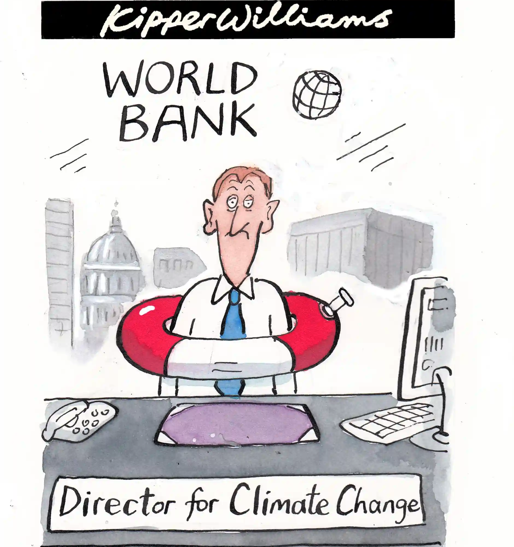
And what about the multilaterals and bilaterals?

Slide 42
MULTILATERALS
$111 bn – CC finance mobilized by 6 MDBs in 2018
Asian Development Bank
Sustainable Development and Climate Change Dept.
$17 bn – ADB approved CC financing 2019-21
$100 bn – committed by ADB for CC financing 2019-2030
12 CC finance funds and facilities, e.g.,
Fund for the Private Sector, Future Carbon Fund, Urban Resilience Trust, Private Infrastructure Fund, Integrated Disaster Risk Mgt Fund
https://www.adb.org/what-we-do/themes/climate-change-disaster-risk-management/main
Notes:
An advantage connected to multilateral financing is you can attach CC elements, subprojects, conditions to major infrastructure, education, health and other projects.
ADB promises 75% of total number of operations support climate action by 2030

Slide 43
BILATERALS
$30 bn – approx. direct bilateral contribution to $100 bn goal
Japan
Diffusion of advanced low carbon technologies, e.g. Joint Crediting Mechanism, research cooperation, eco-city development
Mobilization and sharing of adaptation knowledge, e.g., Asia-Pacific Adaptation Information Platform (AP-PLAT), support for adaptation planning, resilient infrastructure development
Transparency capacity development, e.g., GHG inventories, A-P seminar on CC, MRV capacity development
Management of fluorocarbons
Support to implement climate-related SDGs
https://www.env.go.jp/press/files/en/698.pdf
https://donortracker.org/insights/financing-future-climate-finance-and-role-oda

Slide 44
BLENDED CLIMATE FINANCE
Most money is with the private sector. They tend to be risk averse and may require financial incentives to overcome risks.
Blended finance ”sweetens the pot”. It can deploy limited public resources to effect change in how the private sector deals with climate change.
It incorporates different types of development finance, such as grants, concessional loans, equity investment, insurance and guarantees, into a project or fund in order to deal with project/program risks and mobilize commercial finance.
One estimate: 150 blended transactions since 2000 worth $40B. DFIs have much experience (see link)
http://www.ifc.org/wps/wcm/connect/30635fde-1c38-42af-97b9-2304e962fc85/DFI+Blended+Concessional+Finance+for+Private+Sector+Operations_Summary+R....pdf?MOD=AJPERES
https://www.economist.com/news/finance-and-economics/21697263-fad-mixing-public-charitable-and-private-money-trending-blending
Notes:
Long used in development circles but recently prominent in climate finance
Use private sector example, but also true for the public sector

Slide 45
BLENDED CLIMATE FINANCE - EXAMPLES
Khun Wandee rejected by commercial banks for a loan to establish solar farms in the Northeast.
IFC provided $8M commercial loan with $4M low-interest loan in 2011.
Gave banks confidence. $800M investments by 2015.
Expanding telecommunications into remote Pakistan: GaurantCo (backed by aid agencies) guaranteed an Islamic bond denominated in Pakistan rupees
Impact Investment in India: Children Investment Fund Foundation pays a return of 10% if girls’ school enrolment, literacy and numeracy improve as agreed after 3 years.
Notes:
When Wandee Khunchornyakong, a Thai entrepreneur, wanted to build solar farms in sunny north-east Thailand, commercial lenders were unwilling to take a leap into such an untested market. In 2011 the IFC, an arm of the World Bank, provided an $8m commercial loan blended with a low-interest loan of $4m from CTF, a climate investment fund backed by several governments. This gave three local banks the confidence to lend a further $14m. By 2015 the company had attracted $800m of investment, all but the initial loan from the private sector.
AATIF, a $146m fund which invests in sustainable African agriculture, goes even further to protect private investors. It has three categories of shareholders. The first two, comprising the German Ministry of Development, KfW, a development bank owned by the German government, and Deutsche Bank, which also manages the fund, agree to absorb losses before the third tier—consisting only of private investors—gets hit. That means losses have to exceed 50% of the fund’s net asset value before investors in the third tranche suffer any harm.
In a similar vein GuarantCo, which is backed by aid agencies, helps make investments in infrastructure in poor countries bankable by taking on the most nettlesome risks. For every dollar it invests it has attracted $13.50 in private money. In 2014 it helped Mobilink, a telecoms firm, expand into remote parts of Pakistan by guaranteeing part of an Islamic bond denominated in Pakistani rupees. The Gates Foundation, too, has put aside $1 billion to provide loan subsidies, guarantees and other sweeteners for twitchy private creditors.
Blended finance can also be used to generate financial returns on investments that would normally only yield less tangible benefits. The most common method is the “social-impact bond”, in which “outcome funders”, such as governments and aid agencies, pay back investors who have funded projects that meet goals which, although socially desirable and delivering notional cost savings, do not yield direct profits. In one example, Children’s Investment Fund Foundation, a charity, has agreed to pay a return of 10% on a project designed to improve school attendance among Indian girls if enrolment, literacy and numeracy improve as agreed after three years. If the results exceed expectations, the return rises to as much as 15%.

Slide 46
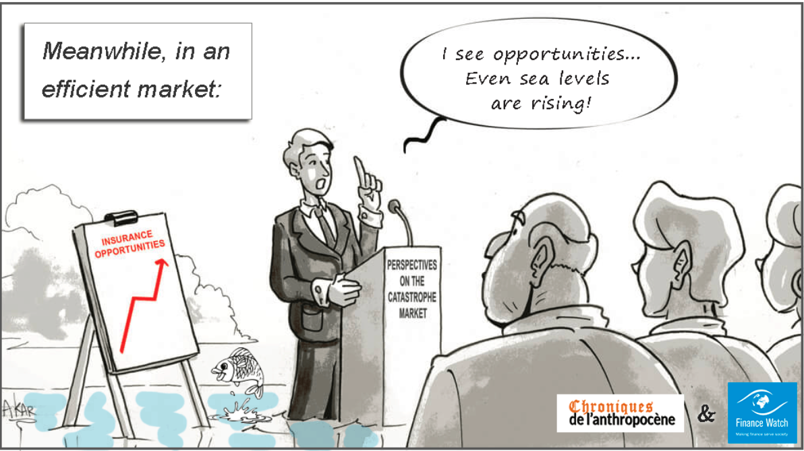
What about the market mechanism?

Slide 47
MARKET MECHANISM
Give carbon a price, a value
Kyoto Protocol created 3 “market mechanisms”
emissions trading system (cap-and-trade): EU, China, US states
Clean Development Mechanism (baseline-and-credit system for developing countries)
Joint Implementation (baseline-and-credit system for developed countries)
Paris Agreement agreed to a new market mechanism – cooperative implementation – based on lessons learned from the CDM and JI.
also a framework for non-market approaches mechanism
Carbon tax
https://unfccc.int/topics/what-are-market-and-non-market-mechanisms
Notes:
Some have called the China ETS the single most important CC mitigation program in the world
There are two main types of trading systems: “Cap-and-trade systems” and “baseline-and-credit systems”. In a cap-and-trade system, an upper limit on emissions is fixed, and emission permits are either auctioned out or distributed for free according specific criteria. Under a baseline-and-credit system, there is no fixed limit on emissions, but polluters that reduce their emissions more than they otherwise are obliged to can earn ‘credits’ that they sell to others who need them in order to comply with regulations they are subject to.
In this example, Factory B does not have enough free allowances to cover its emissions, so it can either comply with the cap by buying allowances from factory A or from the auction. If a participants
emissions of GHGs exceed the free allowances they were given at the start of the year, they can buy allowances from auctions or from other participants who have reduced their emissions and hold
surplus allowances. Participants can also decide to bank allowances for use in later years.
CDM aimed to promote sustainable development in host countries and help investor countries meet their emission targets. Certified Emission Reduction (CER) credits issued and are a commodity that can be bought and sold. They are voluntary and must not contribute to environmental decline.
The EU ETS works on the 'cap and trade' principle. A capSearch for available translations of the preceding linkEN••• is set on the total amount of certain greenhouse gases that can be emitted by the installations covered by the system. The cap is reduced over time so that total emissions fall. Within the cap, installations buySearch for available translations of the preceding linkEN••• or receiveSearch for available translations of the preceding linkEN••• emissions allowances, which they can trade with one another as needed. The limit on the total number of allowances available ensures that they have a value. After each year, an installation must surrender enough allowances to cover fully its emissions, otherwise heavy fines are imposed.
Carbon tax in 25 countries, incl Canada, Singapore, Japan,

Slide 48
What are some examples of new initiatives and innovative thinking on climate finance?

Slide 49
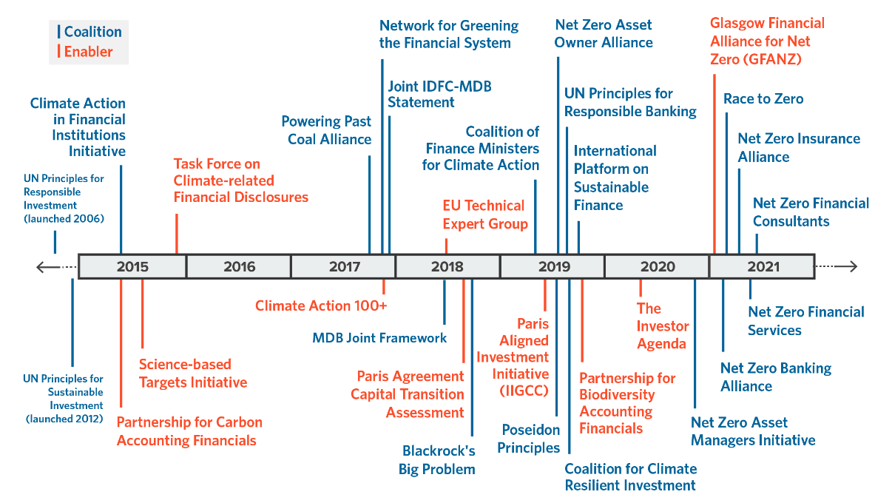
SUSTAINABLE FINANCING: PROMISING INITIATIVES
Glasgow Financial Alliance for Net-Zero
Net-Zero Banking Alliance
Task Force on Climate-related Financial Disclosures
Notes:
The purpose of this slide is to show you that there are a number of international initiatives to get financing on track.
Of most interest to you might be the Glasgow Financial Alliance for Net-Zero, and specifically the Net-Zero Banking Alliance.
Co-Chaired by Mark Carney and Mike Bloomberg.
The purpose is to rally non-state actors to take immediate action to halve global emissions by 2030. Members will reduce emissions across all scopes swiftly and fairly in line with the Paris Agreement and commit to transparent reporting and accounting.
The Net-Zero Banking Allianze is under this. There are 43 founding banks. It will reinforce, accelerate and support implementation of decarbonization strategies, providing an internationally coherent framework and guidelines in which to operate, supported by peer-learning from pioneering banks.

Slide 50
DIVESTITURES
Carbon Tracker Initiative launched global fossil fuel divestment 10 years ago
Recent study: divested portfolios “outperformed their benchmarks”
Bank of England first central bank to commit to offload brown assets
Networking for Greening the Financial System (2017)
https://lkyspp.nus.edu.sg/gia/article/asian-central-banks-are-ahead-of-the-green-curve
https://www.newyorker.com/news/daily-comment/the-powerful-new-financial-argument-for-fossil-fuel-divestment?utm_source=nl&utm_brand=tny&utm_mailing=TNY_Daily_040321&utm_campaign=aud-dev&utm_medium=email&bxid=5be9e7a72ddf9c72dc6f2dca&cndid=44337841&hasha=2529b9cfc57eb8f33bcf61fb5c4349bd&hashb=0eb46fa356aef2f52704618d7eb89e6783404c66&hashc=28a70c3036553d85bd681fd324a8904275bc9c31fe0bbbc2bf76d56439d596db&esrc=AUTO_OTHER&mbid=CRMNYR012019&utm_term=TNY_Daily
Notes:
: after examining “divestment actions by hundreds of funds worldwide,” the BlackRock analysts concluded that the portfolios “experienced no negative financial impacts from divesting from fossil fuels. In fact, they found evidence of modest improvement in fund return.” The report’s executive summary states that “no investors found negative performance from divestment; rather, neutral to positive results.” In the conclusion to the report, the BlackRock team used a phrase beloved by investors: divested portfolios “outperformed their benchmarks.”

Slide 51
MARKET INITIATIVES/PRIVATE SECTOR
Price carbon
US oil industry asks Congress to legislate price on carbon emissions
Last week EU record of EUR44. Near-term outlook for EU carbon prices > EUR50
Carbon trading
California and Guangdong Province aim to align and integrate their carbon trading markets
Align business with Paris Agreement goals
> 40 asset managers, incl world’s 2 biggest, seek to reach net zero by 2050
http://www.ifc.org/wps/wcm/connect/30635fde-1c38-42af-97b9-2304e962fc85/DFI+Blended+Concessional+Finance+for+Private+Sector+Operations_Summary+R....pdf?MOD=AJPERES
https://www.economist.com/news/finance-and-economics/21697263-fad-mixing-public-charitable-and-private-money-trending-blending

Slide 52
MARKET INITIATIVES/PRIVATE SECTOR
Blended finance to lower private sector risk
Impact investing: generate positive social & environmental impact alongside financial returns
Impact Investment Exchange Asia (IIX) in Singapore is a pioneer (12 years)
Venture capital: BlackRock and Temasek to raise billions to scale carbon-cutting startups
Green exchange-traded funds (ETF)
New $1.25bn BlackRock U.S. Carbon Transition Readiness fund
Green bonds
World Bank new blueprint for private sector and CCA
https://www.worldbank.org/en/news/feature/2021/03/04/unlocking-private-investment-in-climate-adaptation-and-resilience
Notes:
ETFs
Institutional investors have put $1.25 billion into a new U.S. exchange-traded fund that aims to identify the companies that will succeed in a more climate-friendly world. The move makes it the largest ETF launch ever and undermines the recently surging demand for environmentally sustainable investment products, the Financial Times reports.

Slide 53
GLOBAL FINANCIAL/ECONOMIC ENVIRONMENT
Environmental Economic Accounting – Ecosystem Accounting: go beyond GDP to incentivize decarbonization and resilience
Debt
factor vulnerability into debt relief – SDRs
“debt for climate and nature program swaps”
The Great Reset Initiative
Proposed UN Economic Reconstruction and Systemic Reform Summit
https://seea.un.org/ecosystem-accounting
https://www.dhakatribune.com/climate-change/2021/01/02/climate-finance-in-bangladesh-a-critical-review
https://pubs.iied.org/sites/default/files/pdfs/migrate/16674IIED.pdf
https://www.weforum.org/agenda/2020/06/now-is-the-time-for-a-great-reset/
https://www.weforum.org/agenda/archive/the-great-reset
https://www.youtube.com/watch?v=PXSufjnkSXo
https://www.climatechangenews.com/2021/04/08/climate-vulnerability-factored-debt-relief-says-imf-head/
Notes:
The Great Reset agenda would have three main components. The first would steer the market toward fairer outcomes. The second component of a Great Reset agenda would ensure that investments advance shared goals, such as equality and sustainability. The third and final priority of a Great Reset agenda is to harness the innovations of the Fourth Industrial Revolution to support the public good, especially by addressing health and social challenges.
G20 finance ministers have backed calls for the IMF to issue $650 billion of special drawing rights (SDRs) – an IMF reserve asset that has only been issued four times before to respond to crises.
The cash is traditionally allocated according to the size of countries’ economies. Vulnerable nations have urged richer countries to donate or redistribute some of their SDRs, to help them afford vaccines and a green recovery.

Slide 54
REGIONAL AND NATIONAL EFFORTS
Risk insurance: Caribbean Catastrophic Risk Insurance Facility
Climate Bridge Fund in Bangladesh provides small grants to support adaptation measures of community groups
National climate funds
e.g., Bangladesh climate funds
Maldives Green Fund (tax on tourists)
UK’s National Infrastructure Bank (CC 1 of 2 objectives)
New Zealand law requiring financial firms to report CC impacts on their business
https://seea.un.org/ecosystem-accounting
https://www.dhakatribune.com/climate-change/2021/01/02/climate-finance-in-bangladesh-a-critical-review
https://assets.publishing.service.gov.uk/government/uploads/system/uploads/attachment_data/file/966131/UKIB_Policy_Design.pdf
https://www.ccrif.org/
https://climatefinancenetwork.org/
https://www.reuters.com/article/us-climate-change-newzealand-idUSKBN2BZ2T6

Slide 55
REGIONAL AND NATIONAL EFFORTS
Climate change sensitive budgeting and planning
Climate Public Expenditure and Institutional Review
Climate budget and budget tagging
https://climatefinancenetwork.org/

Slide 56
How can my agency prepare bankable projects?

Slide 57
GUIDE TO CLIMATE CHANGE ADAPTATION PROJECT PREPARATION
How is the proposed action nested within local/national CC and sustainable development policies and strategies?
What are my government’s rules & procedures for submitting proposals internationally?
How much time & resources will I need to prepare the proposal?
Is my draft proposal clear and succinct?
https://www.weadapt.org/knowledge-base/climate-finance/guide-to-climate-change-adaptation-project-preparation
http://asiapacificadapt.net/gender-sourcebook/
Notes:
This course helps to understand what makes a good project proposal, which is key to using CC finance well.

Slide 58
Could you say that again?

Slide 59
TAKEAWAYS
Globally, climate finance is making progress, but:
- needs are an order of magnitude above current levels of finance and so we need transformative finance;
- we’re like Sisyphus and his rock: we’ll never achieve global climate goals if we roll climate change finance up the hill only to have it fall back because we’re providing even more finance for fossil fuels and the other things that drive global heating

Slide 60
TAKEAWAYS
Most climate finance is domestic, therefore it’s important for governments to:
develop high quality national climate finance policies, strategies and institutions; bankable project proposals https://www.weadapt.org/knowledge-base/climate-finance/guide-to-climate-change-adaptation-project-preparation
establish a reliable climate finance tracking system nationally and sectorally
think carefully on how to incentivize and elevate awareness/capacity among private sector actors in your country

Slide 61
TAKEAWAYS
The private sector should:
coordinate with the public sector to rapidly scale up finance beyond RE, e.g., energy efficiency, adaptation and resilience, food, technologies and R&D
accelerate portfolio and operations alignment with the Paris Agreement financial institutions, corporations)
Move toward more green financing (markets, banks)

Slide 62
TAKEAWAYS
As a rule of thumb:
- use international public climate funds for innovation and demonstration; these are catalytic
- use market mechanisms for mitigation (and maybe adaptation*)
- use domestic funds for transformation and sustainability
*Adaptation Benefit Mechanism proposed by African Development Bank. https://unfccc.int/files/parties_observers/igo/submissions/application/pdf/708.pdf

Slide 63
