Slide 1
CLIMATE CHANGE OVERVIEW, PARIS AGREEMENT & INTERNATIONAL CLIMATE NEGOTIATION, Inter-Governmental Panel on Climate Change (IPCC)
IN 00.41: Climate Change Challenges and Responses
Prof. Shobhakar Dhakal
Asian Institute of Technology
January 2021

Slide 2
Key Questions
What are/has been the historic trends of global emissions? Who are the top GHG emitters? Which sectors emit most and why?
What has been the history of climate negotiations? How it has evolved?
What is the IPCC? What are some of its key findings and messages?
This lecture focuses on the understating of the past trends of global emissions and emitters and their sources and sectors. It discusses the history of climate negotiations and its evolution to the present day. Lastly it highlights IPCC’s work, research and its reports that guide policymakers around the world.

Slide 3

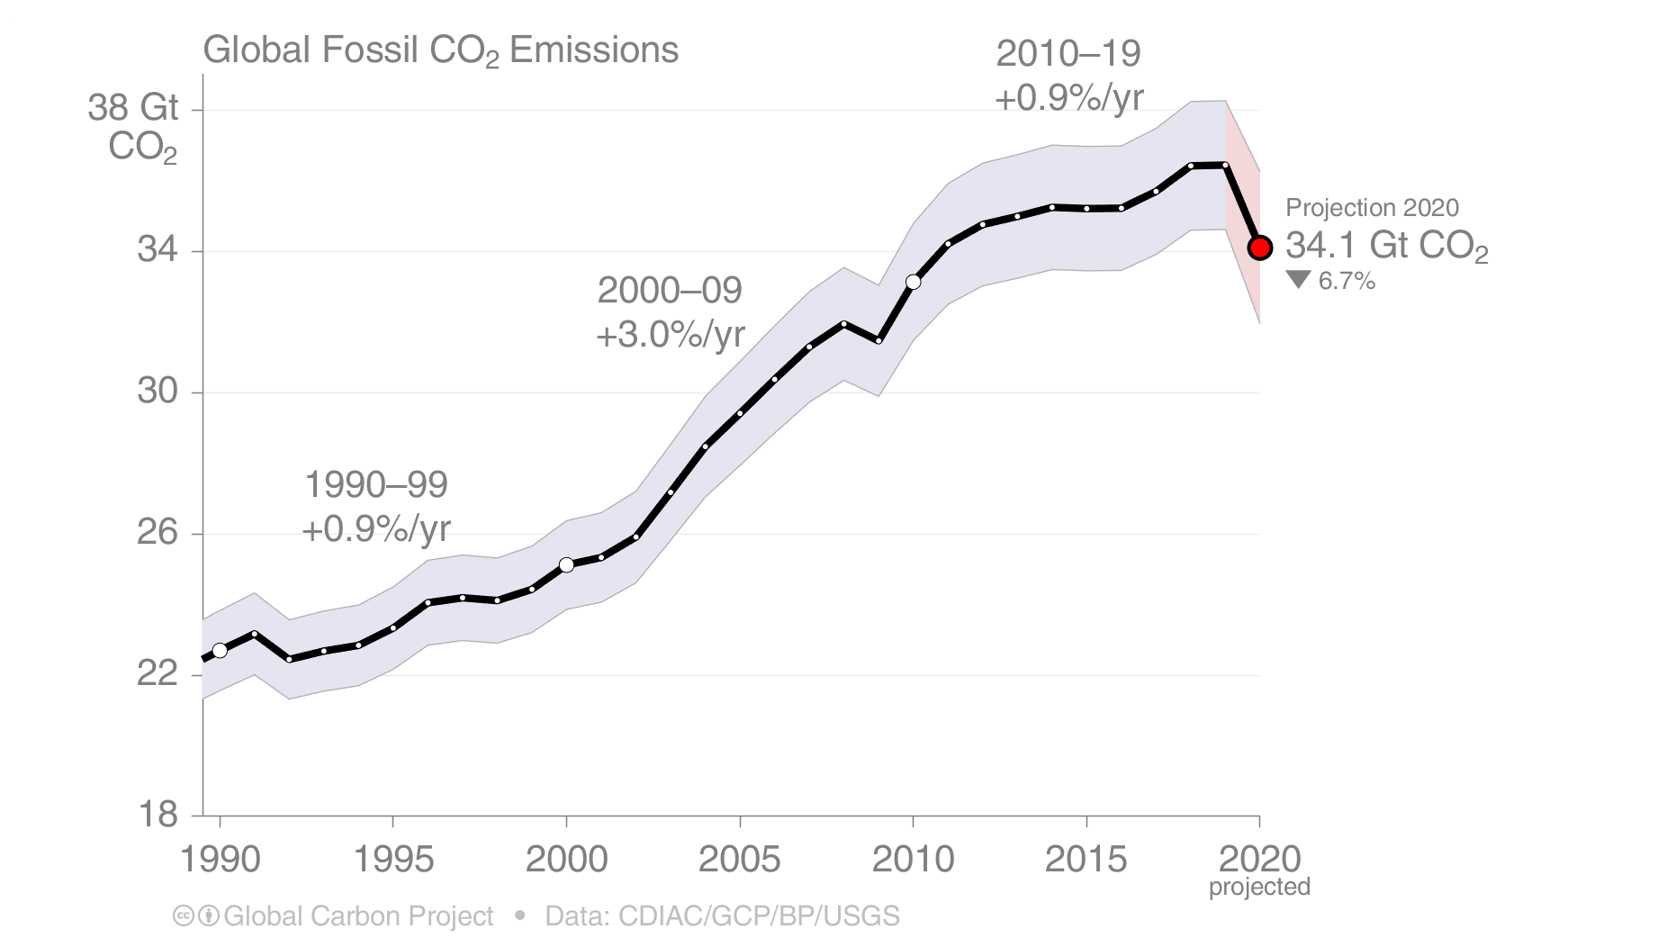
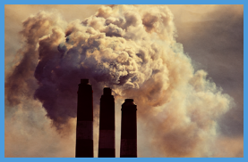
Global Fossil CO₂ Emissions
Global fossil CO₂ emissions: 36.4 ± 2 GtCO₂ in 2019, 61% over 1990
Projection for 2020: 34.1 ± 2 GtCO2, about 7% lower than 2019
Uncertainty is ±5% for one standard deviation (IPCC “likely” range)
The 2020 projection is based on preliminary data and modelling, and is the median of the four studies.
Source: CDIAC; Friedlingstein et al 2020; Global Carbon Budget 2020

Slide 4
2020 Summary
Region / Country | 2019 emissions (billion tonnes/yr) | 2019 growth (percent) | 2020 projected growth** (percent) | 2020 projected emissions** (billion tonnes/yr)
China | 10.2 | 2.2% | -1.7% | 10.0
USA | 5.3 | -2.6% | -12.2% | 4.7
EU27 | 2.9 | -4.5% | -11.3% | 2.6
India | 2.6 | 1.0% | -9.1% | 2.4
World (incl. bunkers*) | 36.4 | 0.1% | -6.7% | 34.1
*bunkers: Emissions from use of international aviation and maritime navigation bunker fuels are not usually included in national totals
**Median of the four studies
Source: Friedlingstein et al 2020; Global Carbon Budget 2020

Slide 5
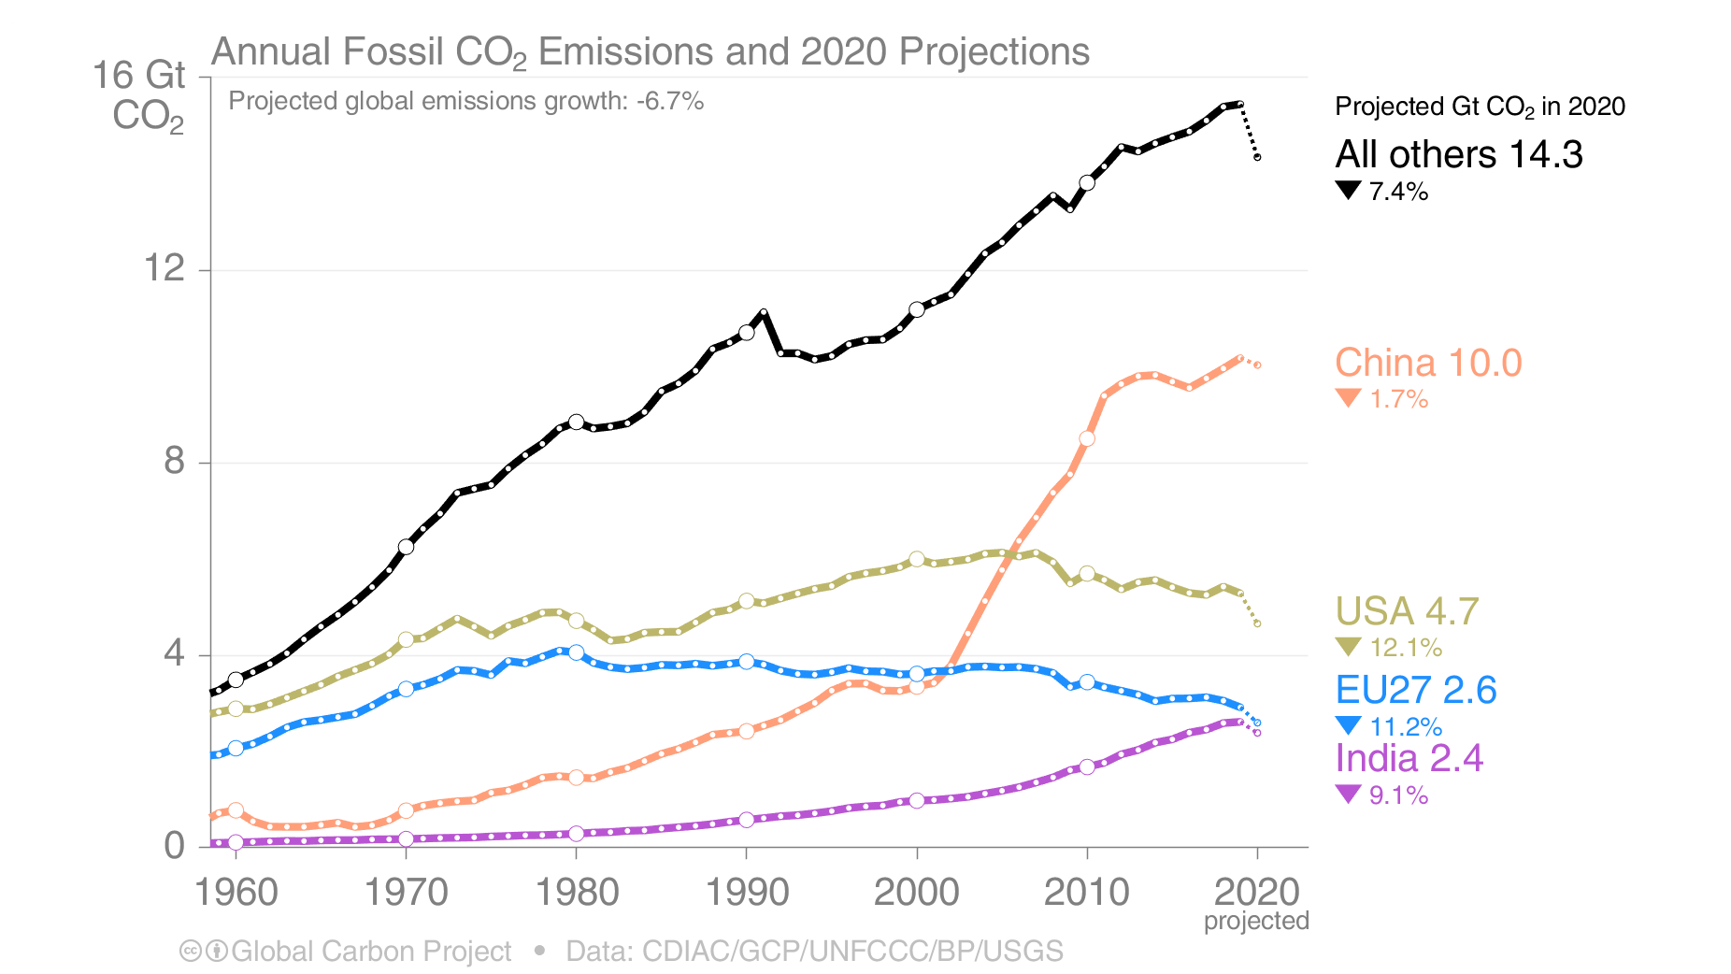
Emissions Projections for 2020
Global fossil CO₂ emissions are projected to decline by about 7% in 2020
Based on the median of four different estimates
The 2020 projections are based on preliminary data and modelling, and is the median of the four studies.
Source: CDIAC; Friedlingstein et al 2020; Global Carbon Budget 2020

Slide 6
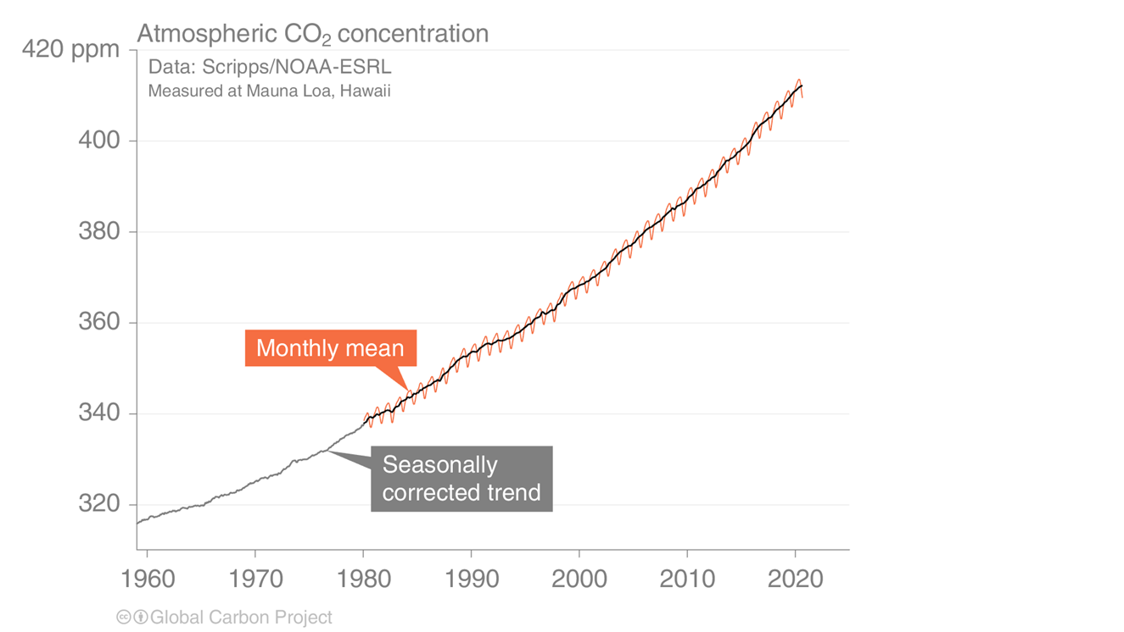
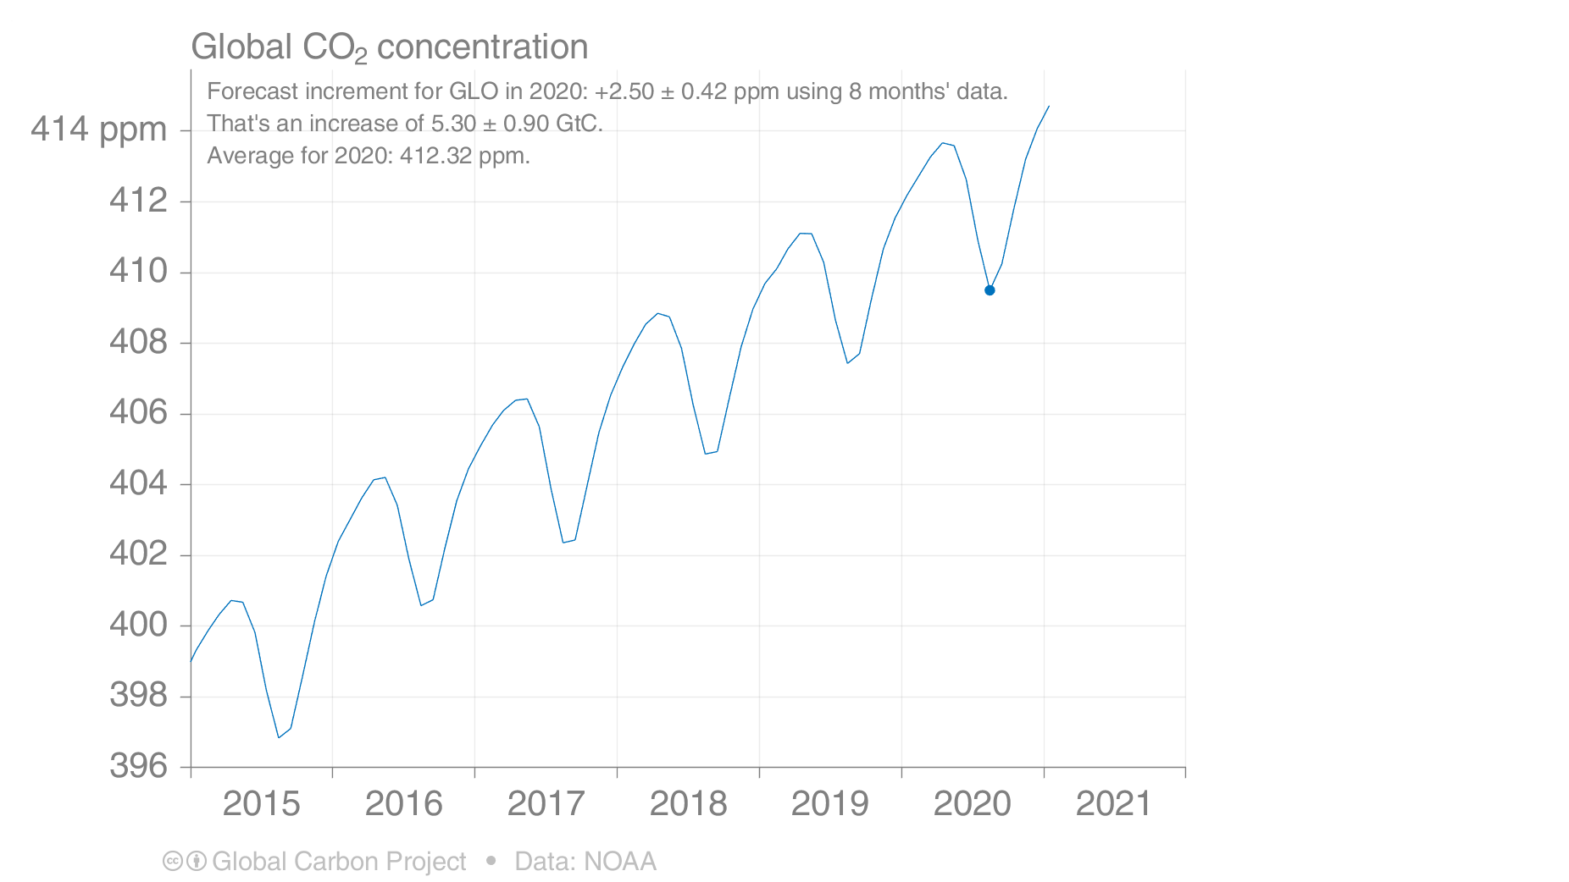
Forecast of global atmospheric CO₂ concentration
The global CO₂ concentration increased from ~277 ppm in 1750 to 410 ppm in 2019 (up 48%)
The global atmospheric CO₂ concentration is forecasted to average 412 ppm in 2020, increasing 2.5 ppm in 2020
Lower emissions in 2020 due to the COVID-19 pandemic have had little effect on the atmospheric CO₂ concentration
Globally averaged surface atmospheric CO₂ concentration. Data from: NOAA-ESRL after 1980;
the Scripps Institution of Oceanography before 1980 (harmonised to recent data by adding 0.542ppm)
Source: NOAA-ESRL; Scripps Institution of Oceanography; Friedlingstein et al 2020; Global Carbon Budget 2020
ppm: parts per million
Data source: Tans and Keeling (2020), NOAA-ESRL

Slide 7
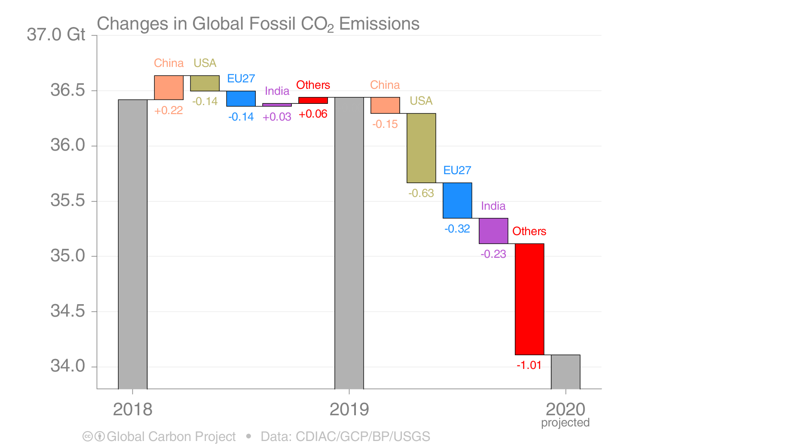
Fossil CO₂ emissions growth: 2018–2020
Emissions are likely to decline in most countries in 2020, with the largest drops in USA, EU, and India
China’s emissions have dropped less because of early recovery and significant economic stimulus
Figure shows the top four countries contributing to emissions changes
Source: CDIAC; Friedlingstein et al 2020; Global Carbon Budget 2020

Slide 8
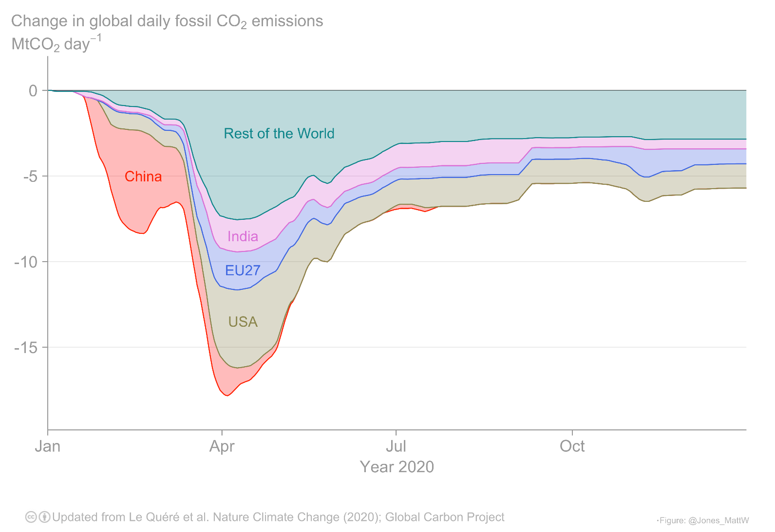
UEA Projection: Overall impact of COVID-19 on regional emissions
While China’s emissions declined strongly during February, emissions declines in the rest of the world reached their peaks in April.
Source: Le Quéré et al 2020; https://www.icos-cp.eu/gcp-covid19

Slide 9
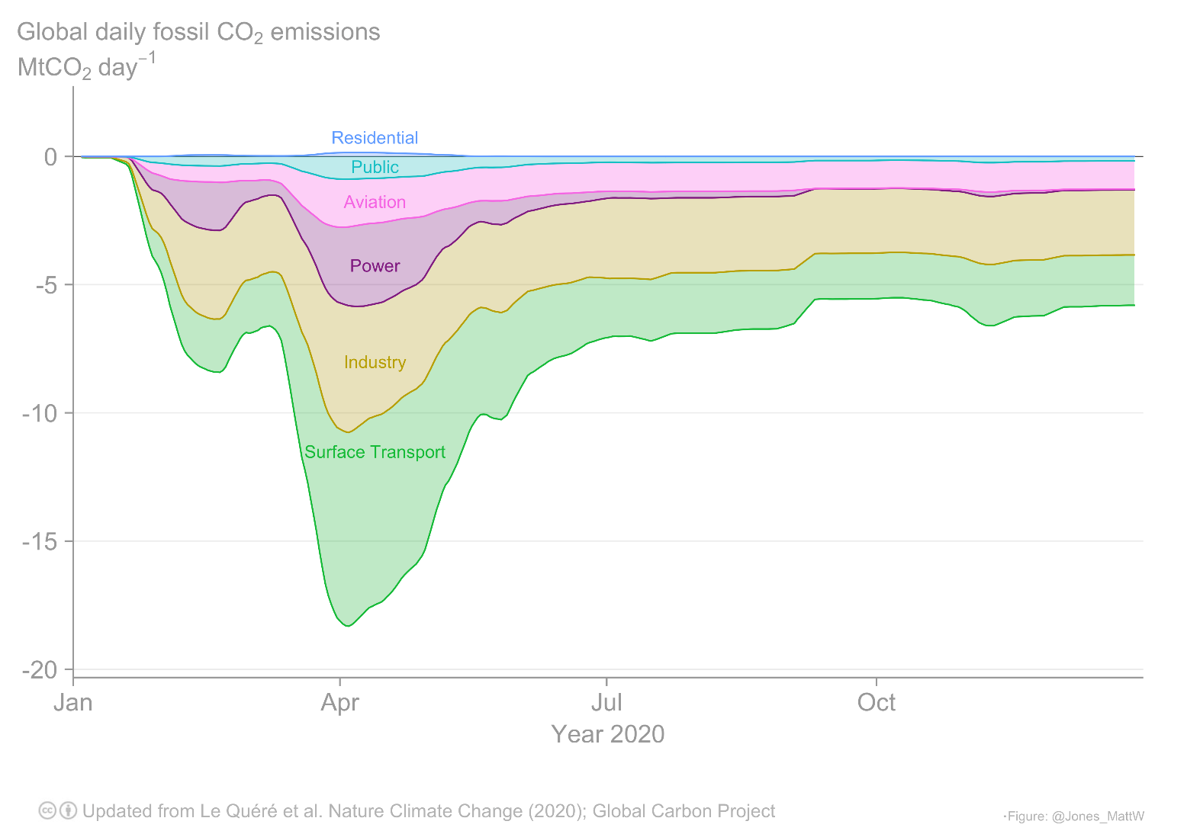
UEA Projection: Overall impact of COVID-19 on emissions by sector
Global emissions from surface transport, especially road transport,
have been affected the most by the restrictions aimed at reducing infection rates.
Source: Le Quéré et al 2020; https://www.icos-cp.eu/gcp-covid19

Slide 10
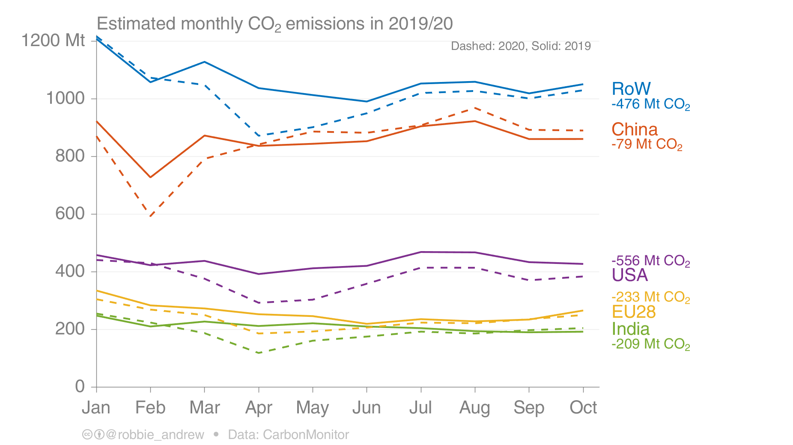
Carbon Monitor: Overall impact of COVID-19 on regional emissions
Carbon Monitor estimates absolute daily emissions in 2019 and 2020 and compares the two years
China’s emissions are already above levels of 2019, while the USA’s are still well below
Source: Liu et al 2020; https://carbonmonitor.org/

Slide 11
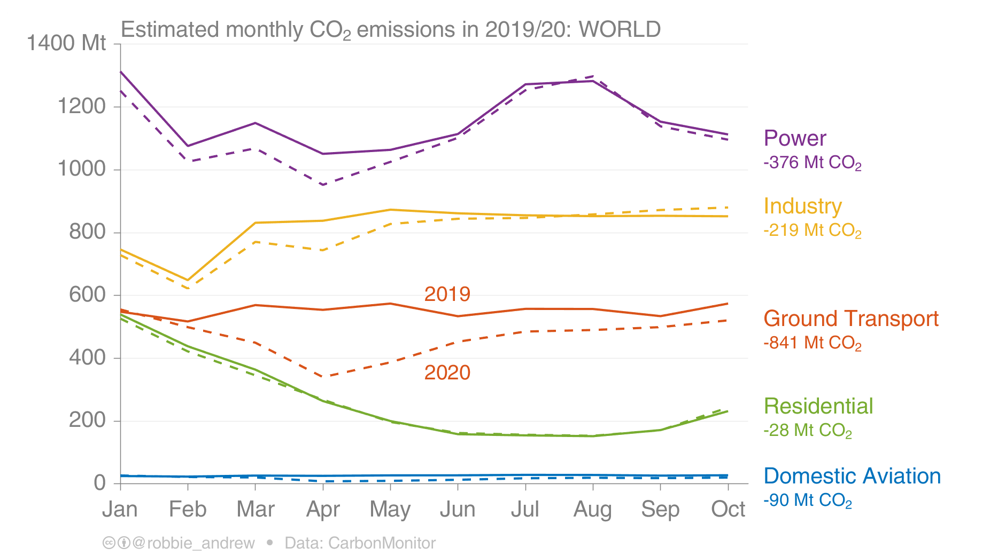
Carbon Monitor: Overall impact of COVID-19 on emissions by sector
Carbon Monitor estimates absolute daily emissions in 2019 and 2020 and compares the two years
Many sectors are already back to their pre-COVID levels, except transport where declines remain
Source: Liu et al 2020; https://carbonmonitor.org/

Slide 12
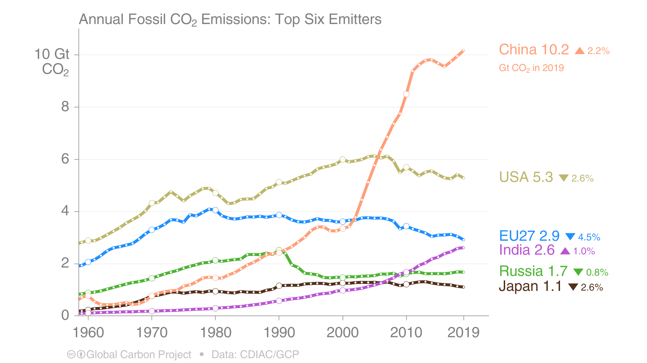
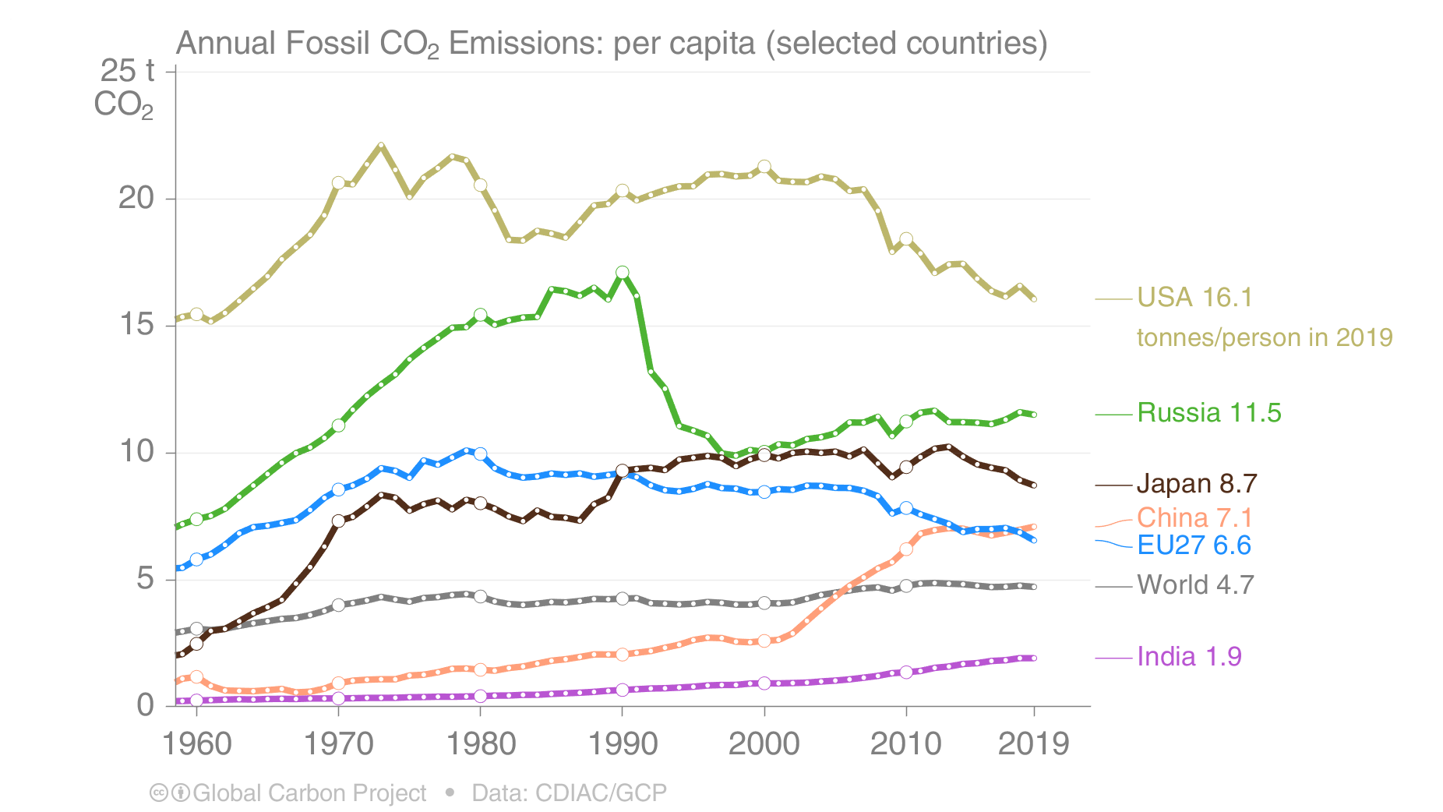
Top emitters: Fossil CO₂ Emissions to 2019
The top six emitters in 2019 covered 65% of global emissions: China 28%, United States 15%, EU27 8%, India 7%, Russia 5%, and Japan 3%
Countries have a broad range of per capita emissions reflecting their national circumstances
Bunker fuels, used for international transport, are 3.5% of global emissions.
Source: CDIAC; Peters et al 2019; Friedlingstein et al 2020; Global Carbon Budget 2020
Source: CDIAC; Friedlingstein et al 2020; Global Carbon Budget 2020

Slide 13
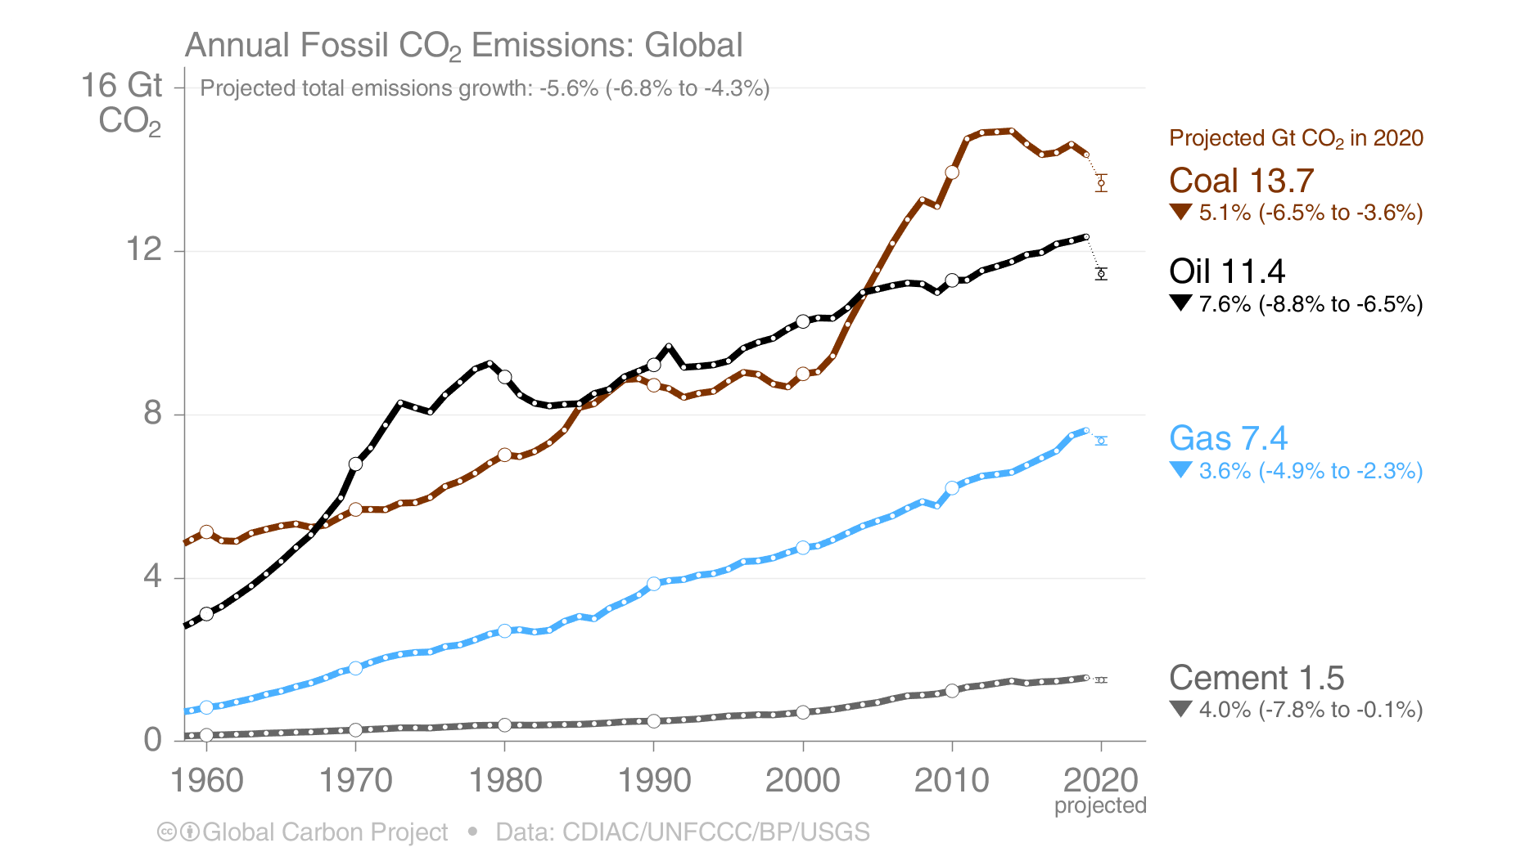
Fossil CO₂ Emissions by source
Share of global fossil CO₂ emissions in 2019: coal (39%), oil (33%), gas (21%), cement (4%), flaring (1%, not shown). Projection by fuel type is based on monthly data (GCP analysis)
Source: CDIAC; Friedlingstein et al 2020; Global Carbon Budget 2020

Slide 14
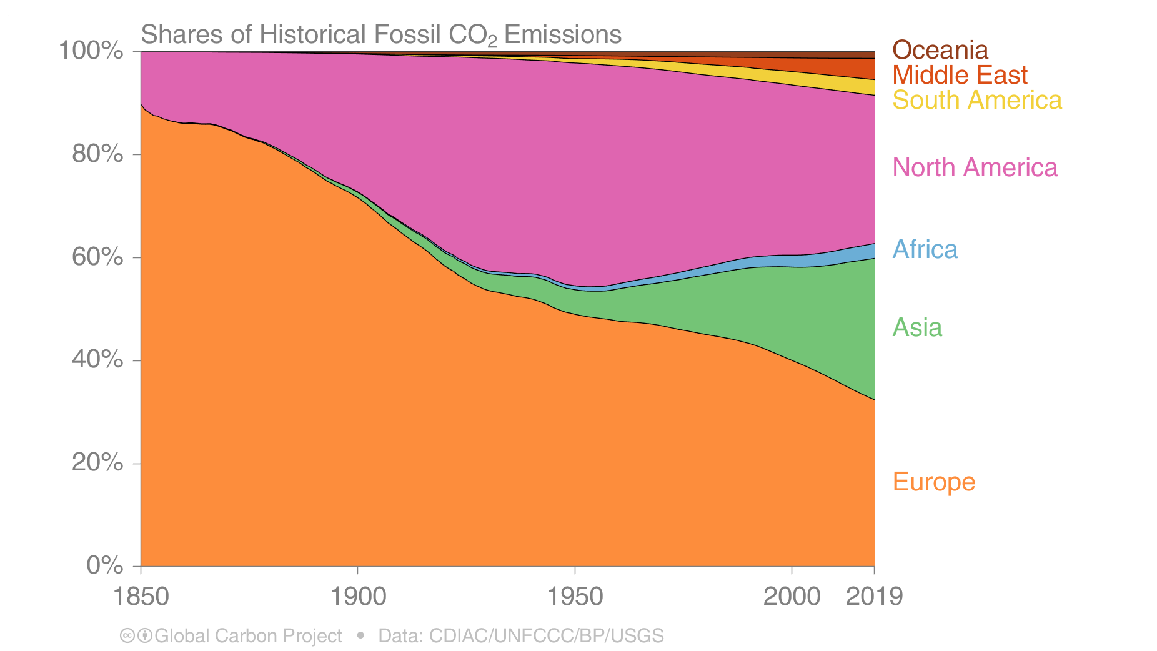
Historical cumulative emissions by continent
Cumulative fossil CO₂ emissions (1850–2019). North America and Europe have contributed the most cumulative emissions, but Asia is growing fast
The figure excludes bunker fuels
Source: CDIAC; Friedlingstein et al 2020; Global Carbon Budget 2020

Slide 15
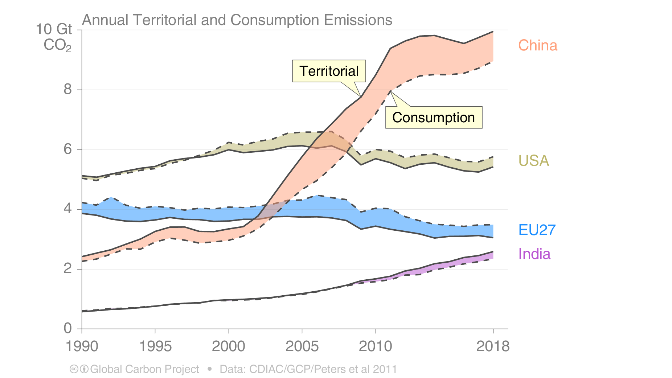
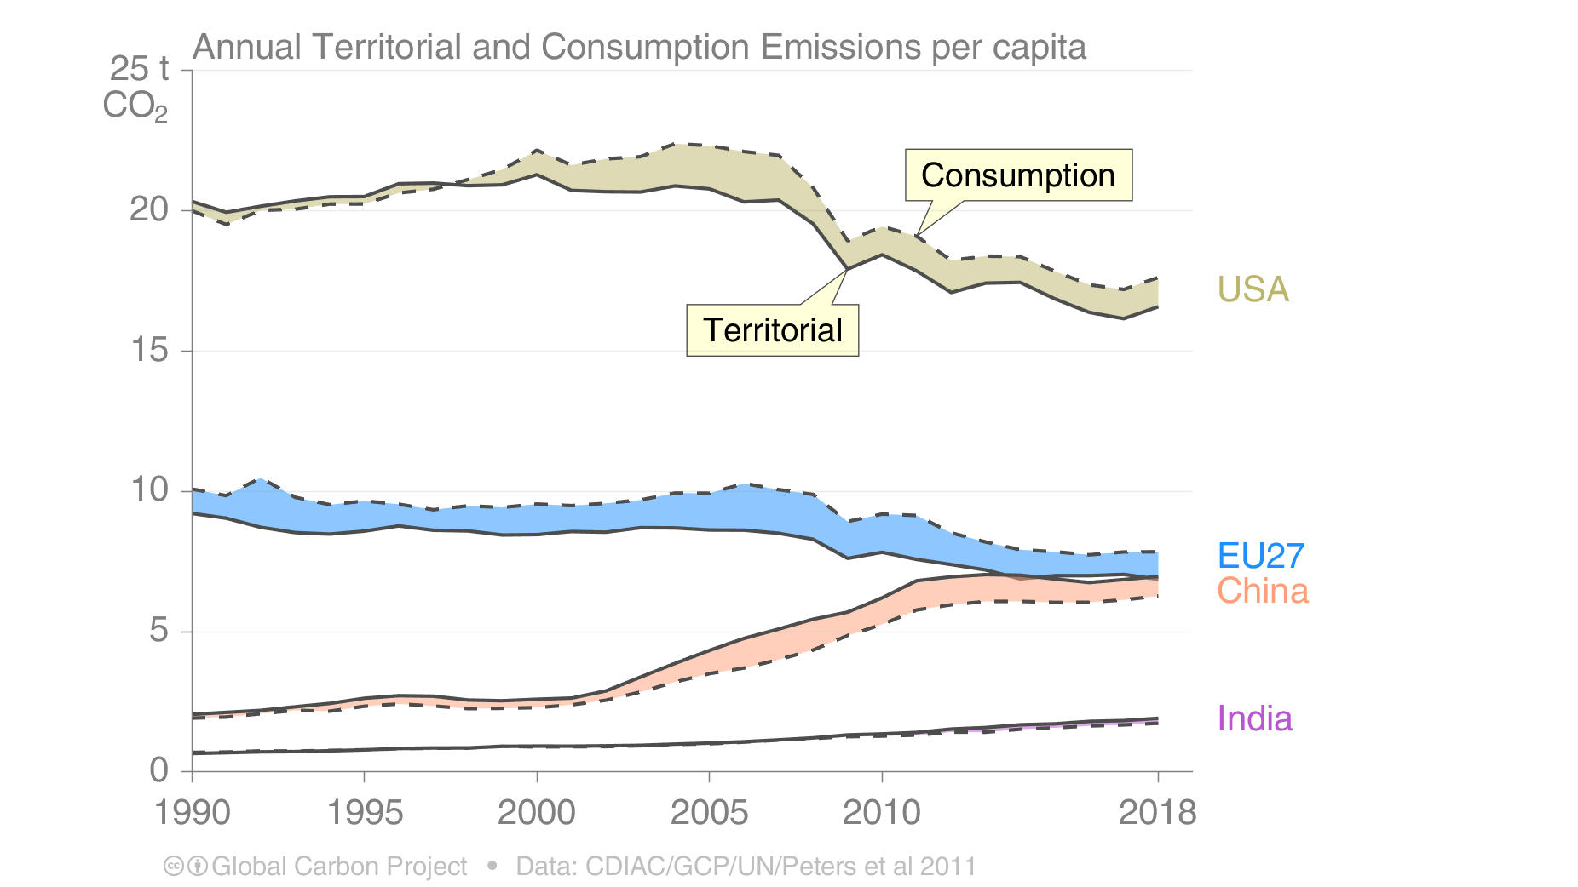
Consumption-based emissions (carbon footprint)
Allocating fossil CO₂ emissions to consumption provides an alternative perspective. USA and EU28 are net importers of embodied emissions, China and India are net exporters.
The differences between fossil CO₂ emissions per capita is larger than the differences between consumption and territorial emissions.
Consumption-based emissions are calculated by adjusting the
standard production-based emissions to account for international trade
Source: Peters et al 2011; Friedlingstein et al 2020; Global Carbon Project 2019

Slide 16
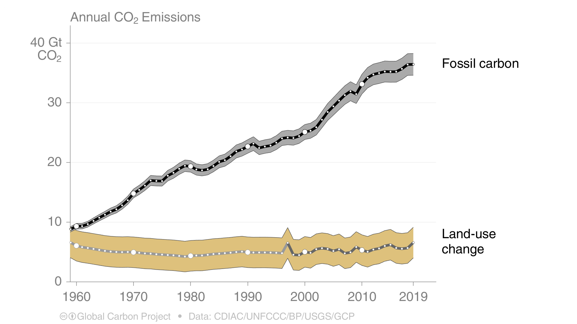
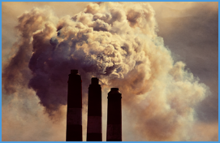
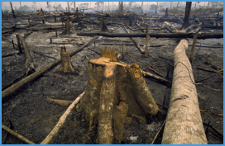
Total global emissions
Total global emissions: 43.0 ± 3.3 GtCO₂ in 2019, 56% over 1990
Percentage land-use change: 39% in 1960, 14% averaged 2010–2019
Land-use change estimates from three bookkeeping models, using fire-based variability from 1997
Source: CDIAC; Houghton and Nassikas 2017; Hansis et al 2015; Gasser et al 2020; van der Werf et al. 2017; Friedlingstein et al 2020; Global Carbon Budget 2020

Slide 17
Summary of key trends
Rising emission, following 5-6 degree C pathways
Rising coal emissions
Top few nations/regions contributing a majority of emissions
Historical contributions
Structural change in developing-developed countries contributions
Few developing countries driving most of ‘new’ emissions
Rapid emissions reduction is needed and thus early peaking
Lower emissions in 2020 due to the COVID-19 pandemic have had little effect on the atmospheric CO2 concentration
COVID-19 effect could be only transitory and could catch up → structural change ????

Slide 18
History of climate negotiation
1979 — The first World Climate Conference (WCC)
1988 — The Intergovernmental Panel on Climate Change is set up
1990 — IPCC publishes first assessment report. IPCC and second World Climate Conference call for a global treaty on climate change. United Nations General Assembly negotiations on a framework convention begin
1991 — First meeting of the Intergovernmental Negotiating Committee (INC)
1992 — The INC adopts UNFCCC text. At the Earth Summit in Rio, the UNFCCC is opened for signature along with UNCBD and UNCCD
1994 — UNFCCC enters into force
1995 — The first Conference of the Parties (COP 1) in Berlin
1996 — The UNFCCC Secretariat is set up to support the Convention
1997 – Kyoto Protocol adopted at COP-3

Slide 19
UNFCCC Article 2 (Objectives)
…… “The ultimate objective of the Convention is to stabilize greenhouse gas concentrations at a level that would prevent dangerous anthropogenic interference with the climate system….."
……"such a level should be achieved within a time-frame sufficient to allow ecosystems to adapt naturally to climate change, to ensure that food production is not threatened, and to enable economic development to proceed in a sustainable manner…….“

Slide 20
UNFCCC Article 3 (Principles)
Inter-generational equity
  “…. The Parties should protect the climate system for the benefit of present and future generations of humankind…. “
Common but differentiated responsibility
  “…. on the basis of equity and in accordance with their common but differentiated responsibilities and respective capabilities. Accordingly, the developed country Parties should take the lead in combating climate change and the adverse effects thereof…..”
Needs of developing countries
“……The specific needs and special circumstances of developing country Parties… should be given full consideration…..”

Slide 21
International Climate Regime
Berlin Mandate (1995 Dec) and The Kyoto Protocol (1997 Dec 11)
  Realization that loose emission reductions provisions in UNFCCC are inadequate
  Mandate to negotiate to strengthen the global action in Berlin to come up with an agreement in two years
Kyoto Targets
  Kyoto Protocol: Protocol “operationalizes” the Convention through specific commitments; apply to only the group that sign-up particular protocol
    Legally binding targets for 37 industrialized countries and the European community to cut average 5.2% over 2008-12 from 1990 levels
    Initiation of flexible mechanisms- Clean Development Mechanism, Emission Trading, and Joint Implementation giving rise to carbon market
Countries | Target (1990**-2008/2012)
EU-15*, Bulgaria, Czech Republic, Estonia, Liechtenstein, Lithuania, Monaco, Romania, Slovakia, Slovenia, Switzerland | -8%
US*** | -7%
Canada, Hungary, Japan | -6%
Croatia | -5%
New Zealand, Russian Federation, Ukraine | 0
Norway | 1%
Australia | 8%
Iceland | 10%
http://unfccc.int/kyoto_protocol/items/3145.php

Slide 22
Flexible Mechanisms – CDM, Joint Implementation, Emission Trading
Clean development Mechanism
  Projects in developing countries can earn certified emission reduction (CER) credits. Each CER credits are equivalent to one tonne of CO2
  CERs can be traded and sold and be used by developed-countries with emission-reduction-commitments to contribute (a part) of their Kyoto Protocol targets
  CDM projects must reduce GHG emissions, support sustainable development.
  An Adaptation Fund is financed by a 2% levy on CERs issued by CDM
Joint Implementation
  Joint Implementation allows Annex B country (with emission reduction commitment in Kyoto Protocol) to earn emission reduction units (ERUs) from emission-reduction/removal project in another Annex B country 1 ERU = One tonne of CO2
Emission Trading
  Annex B parties accepted targets are expressed as levels of allowed emissions over the commitment period (2008-12 first period); the allowed emissions are divided into “assigned amount units” (AAUs)
  Allows countries with surplus emission units but not "used" - to sell such surplus to countries that are over their targets
  Emission Trading thus creates a new ‘commodity’ in the form of emission reductions or removals. Carbon and other GHGs are now tracked and traded like any other commodity creating "carbon market”

Slide 23
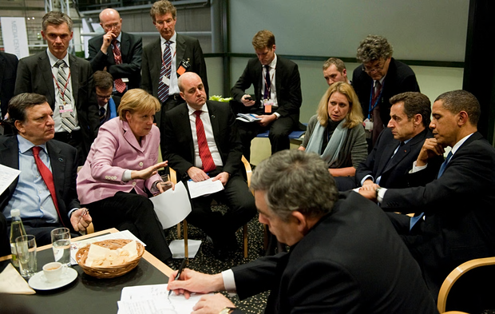
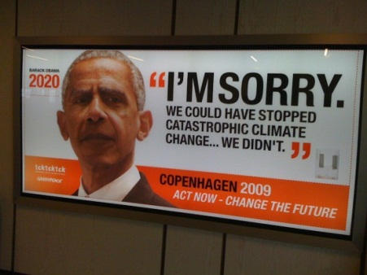
The Copenhagen (COP15) failure
No new global agreements on emission cut targets
8 draft-texts and intense talks between 115 world leaders largely failed
Reasons not to loose hope
  Voluntary emission cut pledged by few countries (too little)
  A new and additional resource, including forestry and investments through international institutions, approaching USD 30 billion for 2010-2012
US president Barack Obama along with European leaders including German chancellor Angela Merkel attend negotiations on the final night of the Copenhagen UN Climate Change summit on 18 December 2009.
Photograph: Pool/Getty Images
  Mobilizing 100 Billion US$ a year (new and additional) by 2020 to support climate change actions in developing countries
  Forestry deal (Norway and few countries)
  “Copenhagen Accord” recognized need to stay below 2⁰C despite no commitments
Photo Credit: Shobhakar Dhakal
taken during COP15

Slide 24
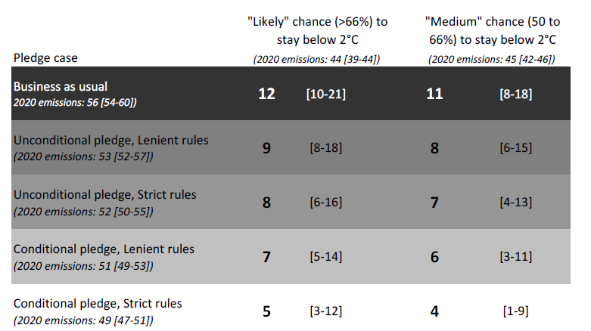
Pledge after Copenhagen
As a part of Copenhagen Accord, countries pledged to reduce GHG emissions for the year 2020
42 industrialized countries and 44 developing countries submitted pledges by Cancun meeting in Dec 2010 (conditional-unconditional)
Was it enough for emission in2020 needed for 2⁰C (>66% likelihood)? No; how big is gap? huge
Can we reduce the gaps: Yes but needs massive energy efficiency and accelerating introduction of renewables
UNEP GAP Report
UNEP Emission Gap Report 2011

Slide 25
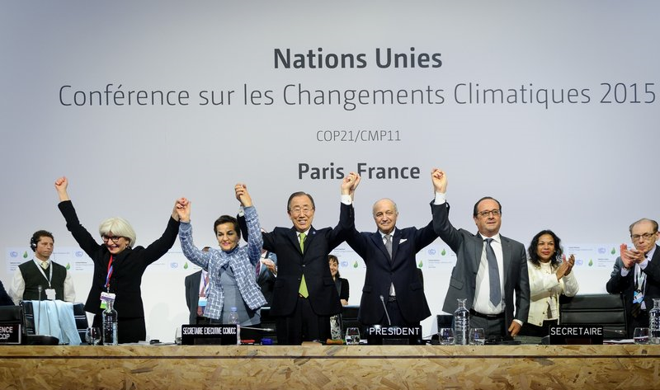
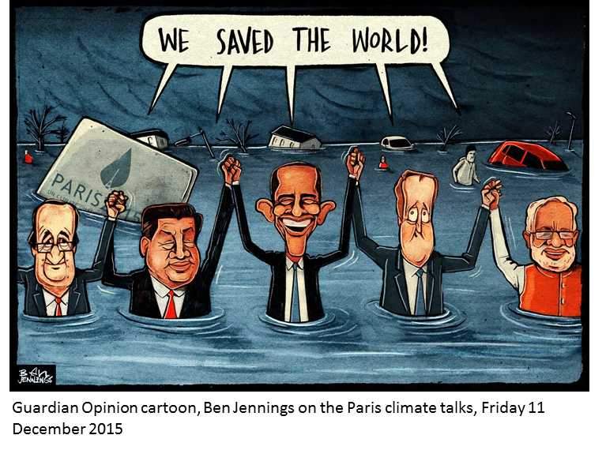
COP 21 Paris Agreement, 2015
Executive Secretary of the United Nations Framework Convention on Climate Change Christiana Figueres, Secretary General of the United Nations Ban Ki Moon, Foreign Affairs Minister and President-designate of COP21 Laurent Fabius, and France's President Francois Hollande raise hands together after adoption of a historic global warming pact at the COP21 Climate Conference in Le Bourget, north of Paris, on Dec. 12, 2015. Anadolu Agency—Getty Images
197 parties to Paris Agreement
160 Parties have ratified as of now (August 2017)
The Paris Agreement entered into force on 4 November 2016 – “thirty days after the date on which at least 55 Parties to the Convention accounting in total for at least an estimated 55 % of the total global greenhouse gas emissions have deposited their instruments of ratification, acceptance, approval or accession with the Depositary.”

Slide 26
UNFCCC COP 21 – Paris Agreement
Universal nature of mitigation agreement: For the first time, all nations irrespective of developed and developing, have agreed to the mitigation commitments
A hybrid structure of global climate governance: Composed of a mix of bottom-up pledge-based agreement structure coupled with top-down oversights, A shorter NDC review cycle, namely five years.
Successfully raising the mitigation aim to the higher bar of dangerous-climate-change threshold: The agreement aimed at ambitious climate stabilization goals, namely aimed to keep climate stabilization below 2°C and aimed 1.5°C.
A clear signal to broader stakeholders for early peaking of emissions and envisioning the world after 2050 as a GHG-neutral one: Especially to policy makers, investors and business communities for peaking of emissions as soon as possible and for decarbonizing the energy sector, that involve less/no fossil energy mix, ramping-up renewable energy deployments, carbon capture and storage, and reforestation.
The commitment of 100 billion US$ by 2020 by developed countries: The idea of 100 bn US$ as a financing ‘floor’ has opened up avenues to mobilize more support for developing countries.
Challenges: “Implementation of commitments” and “progressively moving to higher level of commitments”

Slide 27
Global State of Paris COP21 pledges
The mitigation pledges by 2030 are diverse in nature - absolute emission reduction from reference year; reduction of emissions/GDP; reduction from BAU future scenario; no quantified emissions but only policies and actions
Conditional and unconditional mitigation pledges
Priority mitigation areas: Renewable energy; Energy efficiency; Sustainable transport; Carbon capture and storage; Conservation and sustainable management of forests; Reducing non-CO2 gases
Priority adaptation areas: Long-term goals or visions guiding the adaptation; Impacts and vulnerability assessments; Legal and regulatory frameworks, strategies, programmes and plans necessary for informed adaptation actions; Measures/actions in specific areas; Loss and damage associated past and projected climate change
Focal means of implementation- finance, technology and capacity-building; Monitoring and evaluation of adaptation

Slide 28
Mitigation Pledges of Top Emitters
Country, % of global GHG emissions, 2012 | GHG emissions reduction target | Target year | Reference year | Period for implementation
USA | 26-28% | 2025 | 2005 | 2020-2025
China | 30-45% per unit of GDP | 2030 | 2007 | - 2030
EU | ≥40% | 2030 | 1990 | 2021-2030
India | 33-35% per unit of GDP | 2030 | 2005 | 2021-2030
Russia | 25-30% | 2030 | 1990 | 2020-30
Japan | 26% | 2030 | 2013 | 2020-30
South Korea | 37% | 2030 | BAU | 2020-30
12.1%
23.75%
8.97%
5.73%
5.35%
2.82%
1.28%
60% to 65% by 2030 below 2005 levels
Increase the share of non-fossil primary energy to 20%
Emission peak by 2030 or earlier
Top 5 emitters
Non-fossil power generation capacity to 40% of installed capacity by 2030
18% below 1990 levels
See all INDCs here: http://climateobserver.org/open-and-shut/indc/

Slide 29
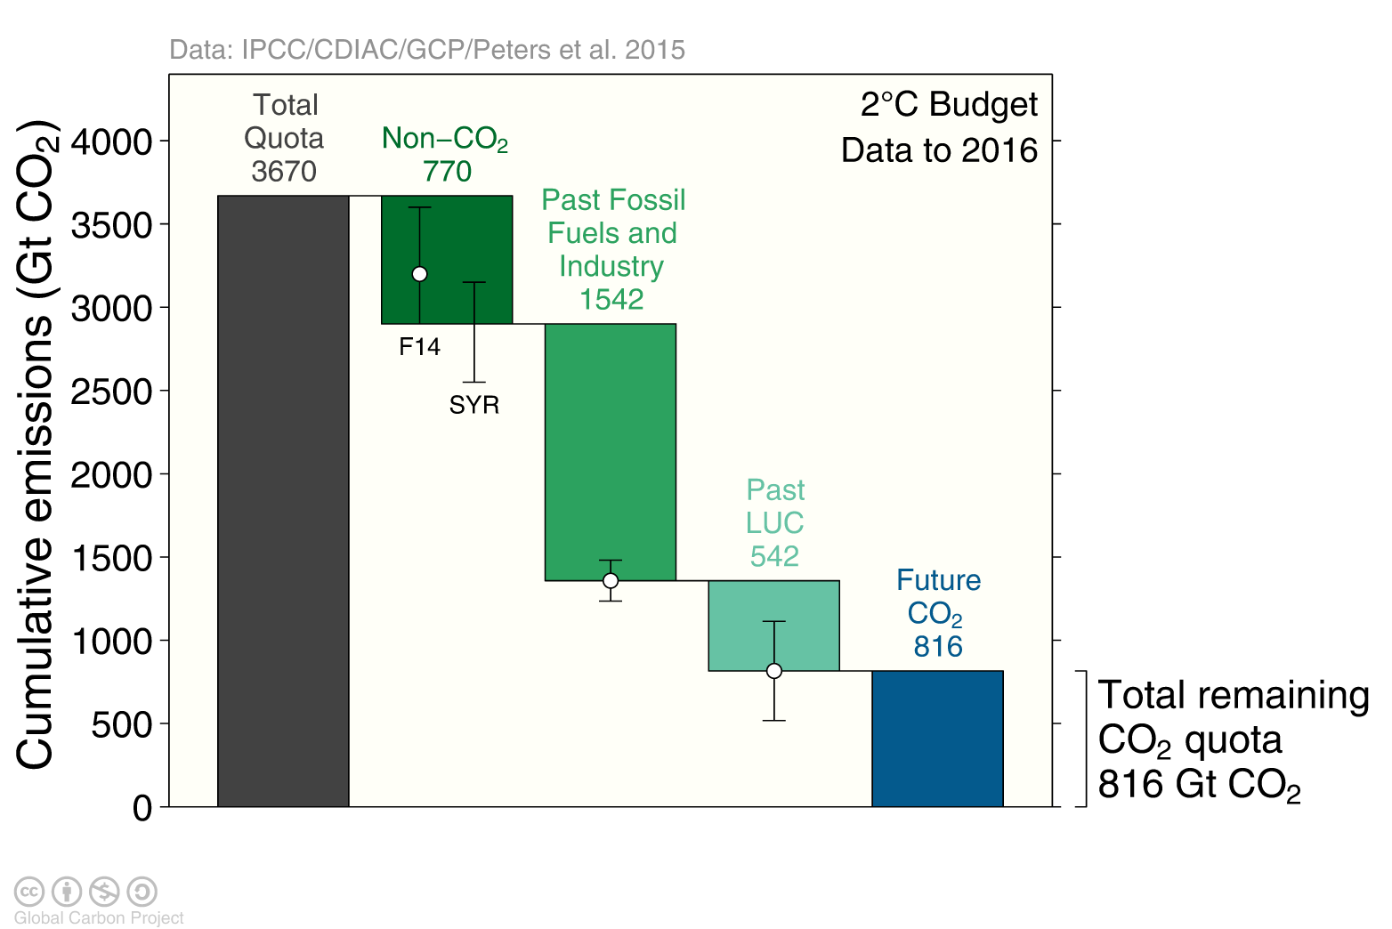
Carbon quota for a 66% chance to keep below 2°C
The total remaining emissions from 2017 to keep global average temperature below 2°C
(800GtCO₂) will be used in around 20 years at current emission rates
Grey: Total CO₂-only quota for 2°C with 66% chance. Green: Removed from CO₂ only quota. Blue: Remaining CO₂ quota.
The remaining quotas are indicative and vary depending on definition and methodology
Source: Peters et al 2015; Global Carbon Budget 2016

Slide 30
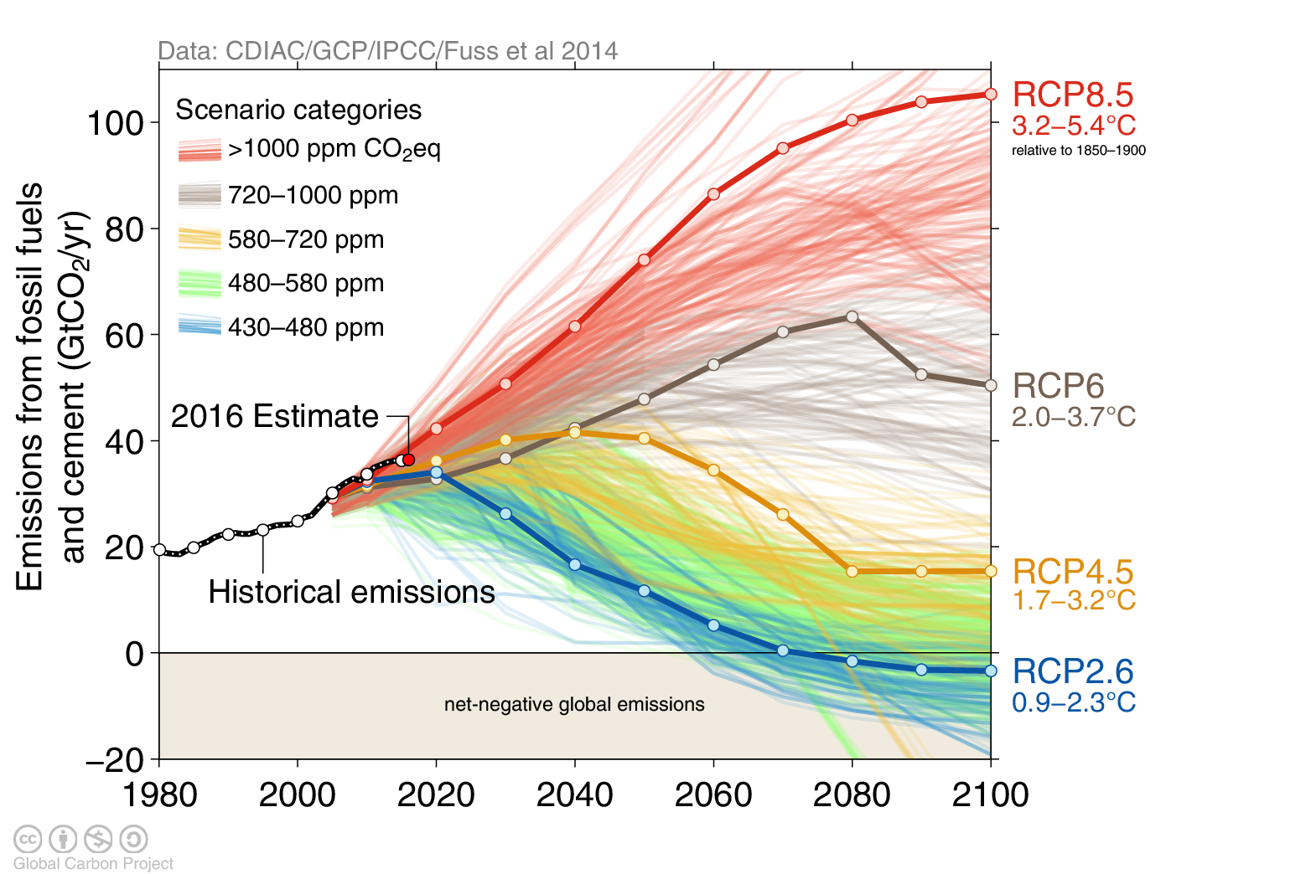
Observed emissions and emissions scenarios
The emission pledges to the Paris Agreement avoid the worst effects of climate change (4-5°C) Most studies suggest the pledges give a likely temperature increase of about 3°C in 2100

Slide 31
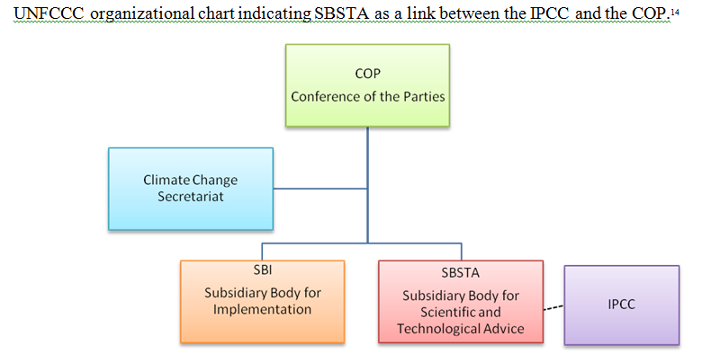
IPCC
Publications
First Assessment Report 1990
Second Assessment Report 1995
Third Assessment Report 2001
Fourth Assessment Report 2007
Fifth Assessment Report 2014
Sixth Assessment Report 2022 (ongoing)
Other Special reports
Emissions gap Report etc.
Role of IPCC
“Policy-relevant” and yet “policy-neutral”…… but never “policy-prescriptive”
Honest broker between experts and decision makers in business, politics and civil society
Exploring opportunities and synergies, making trade-offs explicit
Provide insights how policy instruments and incentives could be designed
Identifying knowledge gaps

Slide 32
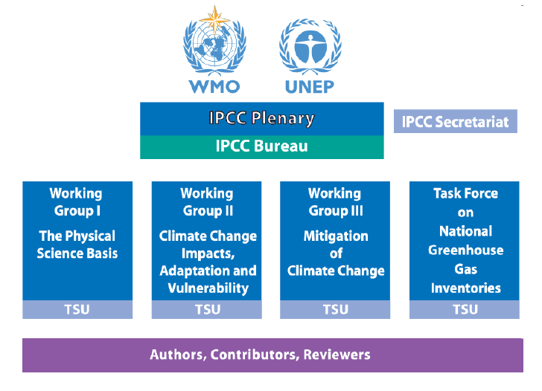
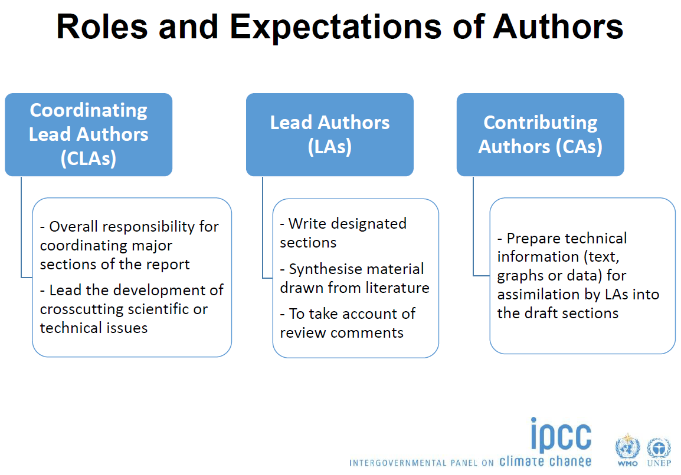
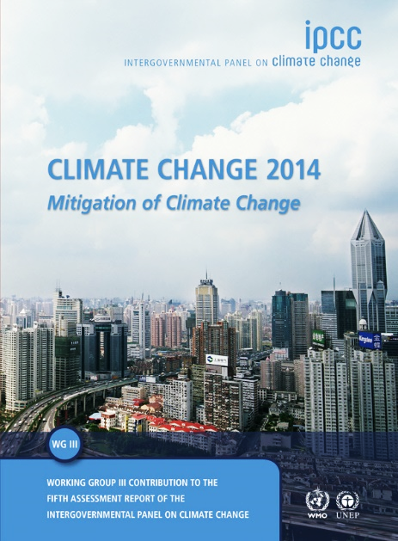
IPCC Structure
Authors
1 Summary for Policymakers
900 Reviewers
1 Technical Summary
More than 2000 pages
16 Chapters
Close to 10,000 references
235 Authors
More than 38,000 comments

Slide 33
Essence of Assessment Making
Reviewing comprehensively the relevant scientific, technical and socio-economic literature
Describing consistent transformation pathways
Evaluating costs, risks and opportunities of different pathways in a consistent way within and across Chapters and WGs
Specifying underlying value judgments and worldviews
Communicating quantitative and qualitative uncertainties
Using neutral language along good scientific practice
Making text, figures and tables accessible

Slide 34
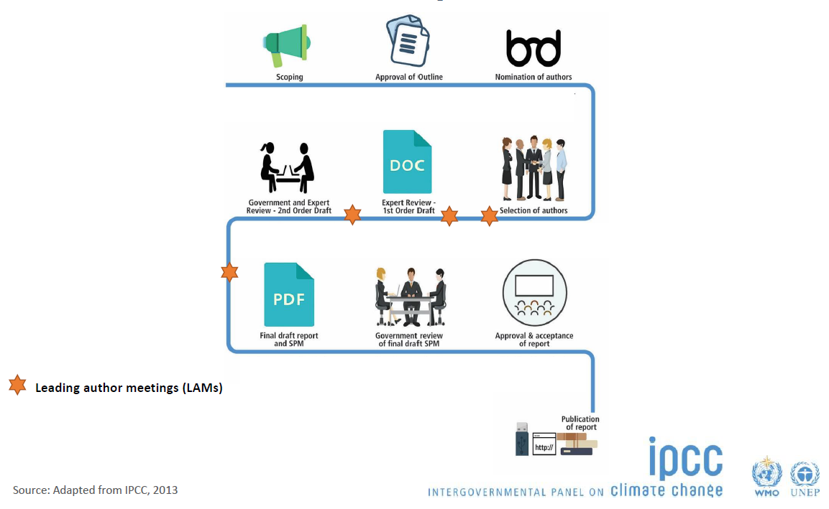
IPCC Writing and Review Process

Slide 35
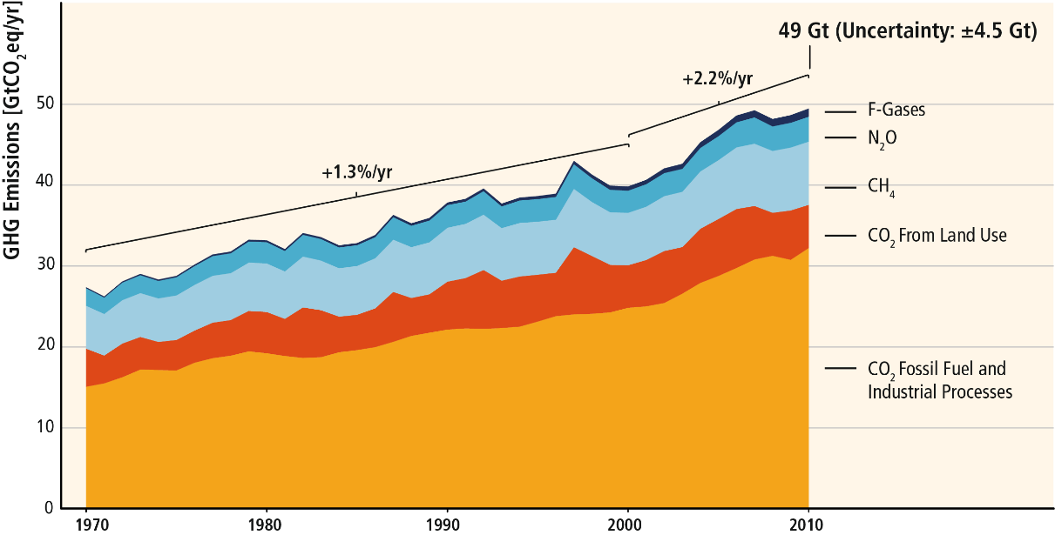
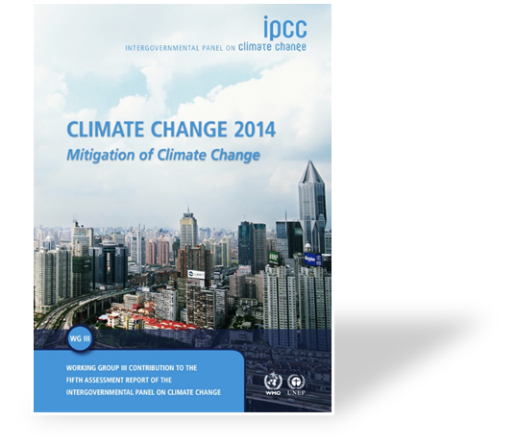
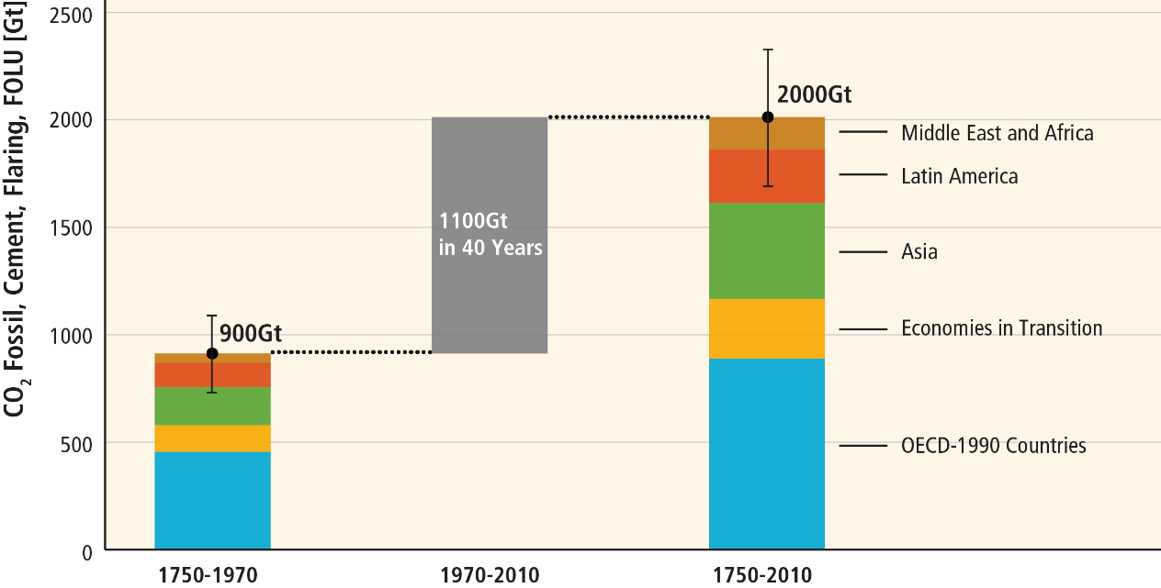
GHG Emissions Growth and Historical Emissions
GHG emissions growth between 2000 and 2010 has been larger than in the previous three decades
About half of cumulative anthropogenic CO₂ emissions between 1750 and 2010 occurred in the last 40 years

Slide 36

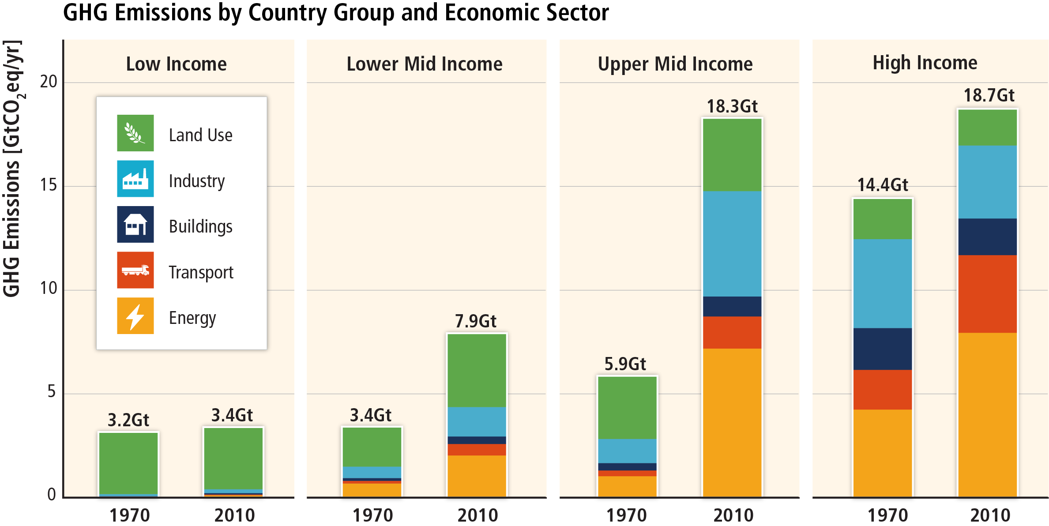
Emissions by Sector
Based on Figure 1.6

Slide 37
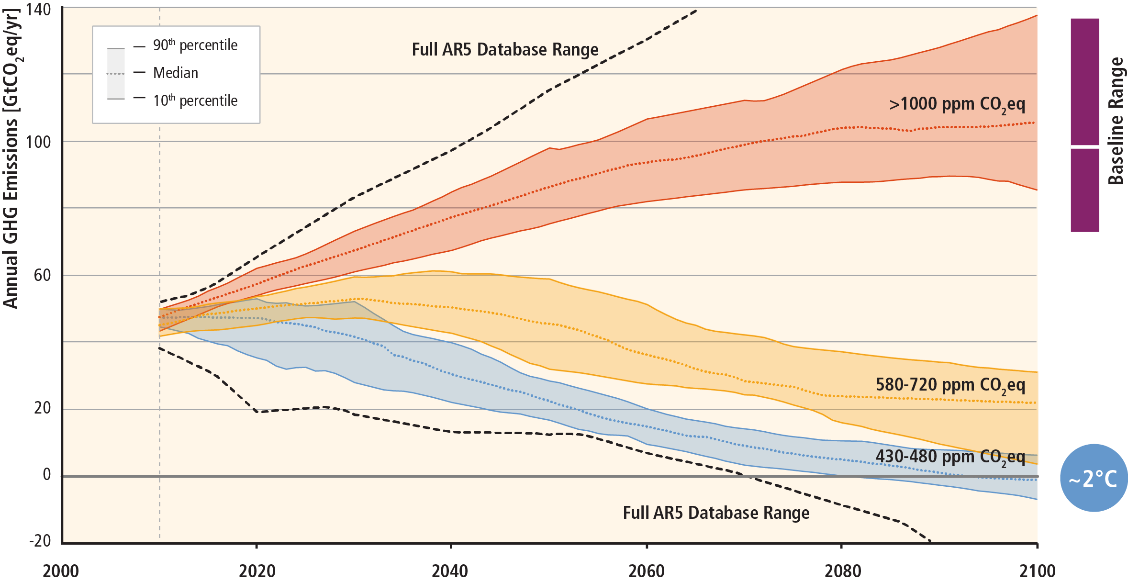

Stabilization of atmospheric concentrations requires moving away from the baseline – regardless of the mitigation goal
~3°C

Slide 38
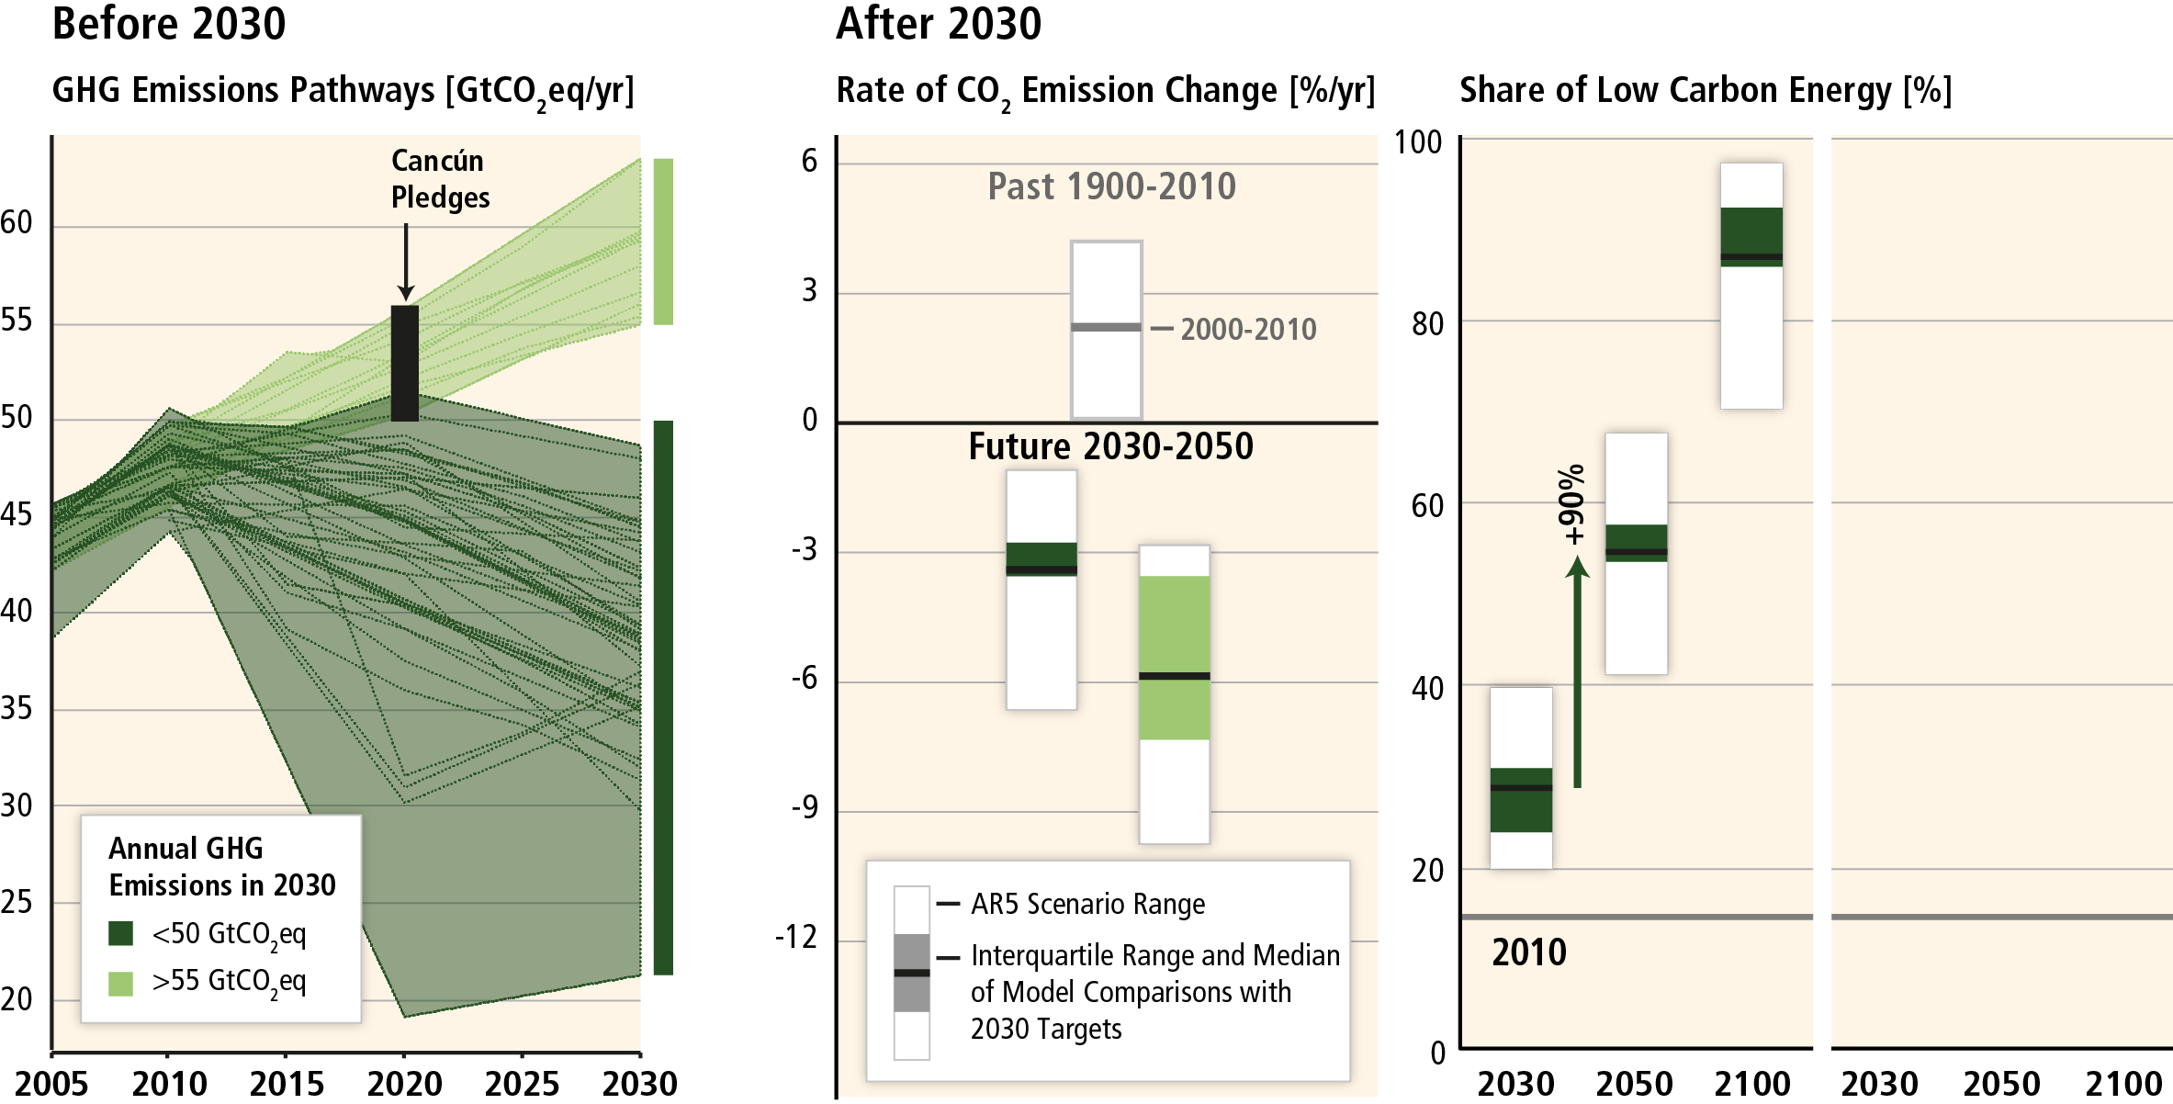

Delaying mitigation is estimated to increase the difficulty and narrow the options for limiting warming to 2°C.

Slide 39

IPCC Summary Messages
GHG emission growth have accelerated despite ongoing efforts
Climate change mitigation, if unabated, would result into 3.7-4.8⁰C world (which is undesirable)
There is a significant shift in emission structure in recent decades regionally, along income groups, and sectors
While mitigation challenges exist the low climate stabilization mitigation pathways are possible, options are there
Delaying of mitigation would entail more costs and limit options
But such pathways needs significant efforts from policies and institutions, investments and international cooperation

Slide 40
References
2020 Carbon Budget and COVID-19 impacts
  Friedlingstein et. al (2020). Global Carbon Budget 2020. Earth Syst. Sci. Data, 12, 3269–3340, 2020. https://doi.org/10.5194/essd-12-3269-2020
  Le Quéré et. al (2020). Temporary reduction in daily global CO2 emissions during the COVID-19 forced confinement. Nature Climate Change. DOI: 10.1038/s41558-020-0797-x. https://www.nature.com/articles/s41558-020-0797-x
  Forster et. al. (2020). Current and future global climate impacts resulting from COVID-19. Nature Climate Change. DOI: 10.1038/s41558-020-0883-0. https://www.nature.com/articles/s41558-020-0883-0
  Liu et. al (2020). Near-real-time monitoring of global CO2 emissions reveals the effects of the COVID-19 pandemic, Nature Communications, DOI: 10.1038/s41467-020-18922-7. https://www.nature.com/articles/s41467-020-18922-7
  Andrew, R. (2020) Timely estimates of India's annual and monthly fossil CO2 emissions. Earth System Science Data, 2020. DOI: 10.5194/essd-12-2411-2020. https://essd.copernicus.org/articles/12/2411/2020/
  Liu et al (2020). Near-real-time monitoring of global CO2 emissions reveals the effects of the COVID-19 pandemic, https://www.nature.com/articles/s41467-020-18922-7
Global Warming of 1.5 ºC https://www.ipcc.ch/sr15/
IPCC Reports: https://www.ipcc.ch/reports/
Global Carbon project: https://www.globalcarbonproject.org/carbonbudget/index.htm
lobal Carbon Atlas: A platform to explore and visualize the most up-to-date data on carbon fluxes resulting from human activities and natural processes http://www.globalcarbonatlas.org/en/content/welcome-carbon-atlas

Slide 41
Thank you
Contact: Prof. Shobhakar Dhakal (shobhakar@ait.ac.th)

Slide 42

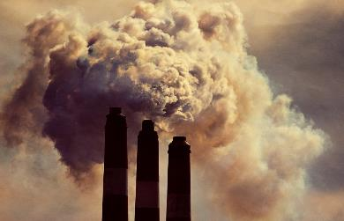

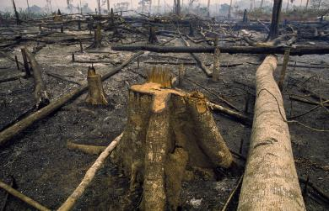

Fate of anthropogenic CO₂ emissions (2010–2019)
Sources = Sinks
18.6 GtCO₂/yr
46%
34.4 GtCO₂/yr
86%
31%
12.5 GtCO₂/yr
14%
5.7 GtCO₂/yr
23%
9.2 GtCO₂/yr
Budget Imbalance:
(the difference between estimated sources & sinks)
0.4%
0.2 GtCO₂/yr
Source: Friedlingstein et al 2020; Global Carbon Budget 2020

