Slide 1
SUSTAINABLE DEVELOPMENT :
HISTORICAL EVOLUTION AND MILESTONES
Climate Change Seminar
Bindu N. Lohani
AIT
January 2019

Slide 2
Global Milestones
1950s - Charles Keeling & “Keeling Curve”
    Roger Revelle suggested human gas emissions might create a "greenhouse effect" that would cause global warming over time
1970s - United Nations Environment Programme, US-EPA
1972 - Stockholm Conference
    Creation of UNEP
    Formulation of Environmental Legislations/Regulations (Malaysia 1974, Thailand 1975, Philippines 1977, PRC 1979)
        1982 - 10 years after Stockholm
            More environmental institutions were established/strengthened
            Formulation of environmental legislations
              UN Convention on the Law of the Sea
              Defined the rights and responsibilities of nations in their use of the world's oceans
Notes:
1970s - Environmental Protection Agency (EPA) established to enforce laws that protect the environment and public health.
1972 - the United Nations Conference on the Human Environment held in Stockholm brought the industrialized and developing nations together to delineate the ‘rights’ of the human family to a healthy and productive environment.
Formulation of Environmental Legislations/Regulations (Malaysia 1974, Thailand 1975, Philippines 1977, PRC 1979)
1982 – more environmental institutions and environment legislations formulated, including UN Convention on the Law of the Sea (UNCLOS) was signed which later came into effect in 1994

Slide 3
Global Milestones
1987 - Brundtland Commission’s “Our Common Future”
    Concept of Sustainable Development as development which “meets the needs of the present without compromising the ability of future generations to meet their own needs”
    Integration of environment into macro operations and sectoral policies and creation of environmental cells in sectoral departments or agencies
1992 - UNCED or “Rio Summit”
    Brought “the environment” to political agenda of governments
    Committed nations to implementation of Agenda 21,
    United Nations Framework Convention on Climate Change
    UN Convention on Biodiversity
    Agreements on Basic Principles for Managing and Conserving World’s Forests
Notes:
1987 - Brundtland Commission’s Report “Our Common Future” popularized the term “sustainable development, to mean “development as meeting the needs of the present generation while not compromising the potential of future generation to meet their own needs”.
1992 - Rio Earth Summit, where poverty was placed as the center of sustainable development. Brought “the environment” to political agenda of governments
Committed nations to implementation of Agenda 21,
A number of conventions were adopted including the United Nations Framework Convention on Climate Change, UN Convention on Biodiversity and Agreements on Basic Principles for Managing and Conserving World’s Forests

Slide 4
Global Milestones
1994 - Convention to Combat Desertification
1997 - Kyoto Protocol
      established legally binding obligations for developed countries to reduce GHG emissions
2002 - WSSD / Rio + 10
Stockholm Convention (POPs) in 2004
2006 - Stern Review
      Helped galvanize attention to climate change among finance ministers
    2009 - UNFCCC Copenhagen Accord (Climate Change)
      Commitments on the establishment of a
      “Green Climate Fund”
Notes:
There are several other milestones that I’d like to highlight:
1997 – creation of the Kyoto Protocol under the UNFCCC established legally binding obligations for developed countries to reduce GHG emissions.
The first commitment period applies to emissions between 2008-2012, and the second commitment period applies to emissions between 2013-2020.
2006 – The Stern Review which discussed the effect of global warming on the world economy. Although not the first economic report on climate change, it is significant as the largest and most widely known and discussed report of its kind.
2009 – At the UNFCCC COP 15 also known as the Copenhagen Accord, there was a commitment to establish a “Green Climate Fund”

Slide 5
Global Milestones
2009 - Declaration on Green Growth (OECD)
      Pursue green growth strategies as part of response to crisis and beyond
      2010 - Incheon Declaration on Green Growth (ESCAP)
  strengthen efforts to purse green growth strategies as part of response to the current crisis and beyond”
  ASEAN Leaders’ Statement on Sustained Recovery and Development – promote green growth, investments in long term sustainability and sustainable use of natural resources
  PRC, Japan and Republic of Korea pursued green growth initiatives
  2010 - Aichi Biodiversity Targets and Nagoya Protocol
  20 ambitious targets on biodiversity
  Access to Genetic Resources and the Fair and Equitable Sharing of Benefits Arising from their Utilization
Notes:
2009 - OECD members adopted the Declaration on Green Growth which tasked OECD to develop a Green Growth Strategy (released at the OECD Ministerial Meeting in 2011).
It should be noted that earlier in 2005, Ministerial Conference on Environment and Development (MCED) in Korea in 2005, then more recently in Astana, in 2010, green growth was adopted by environment ministers in the region as an objective.
2010 – UNESCAP 66th Commission Session convened in Incheon, Republic of Korea to discuss regional development policies, including green growth, and adopted the Incheon Declaration.
2010 also saw a significant update to the Convention on Biological Diversity with agreement on the Aichi Biodiversity Targets and the Nagoya Protocol on Access to Genetic Resources and the Fair and Equitable Sharing of Benefits Arising from their Utilization.

Slide 6
Global Milestones
2012 - UNCSD or “Rio + 20”
  Outcome document: “The Future We Want” (green economy as a tool for SD, stronger UNEP, CSR, beyond GDP, SD financing strategy, oceans and marine BD, SCP 10 years framework)
  Commitment to a process to establish Sustainable Development Goals to be integrated into the post 2015 development agenda
2013 - Minamata Convention
  Protect human health and environment from anthropogenic emissions and releases of mercury and mercury compounds
Notes:
More recently there were several important milestones:
2012 – Rio + 20 – endorsed "The Future We Want” and renewed their political commitment to sustainable development. The document largely reaffirms previous action plans like Agenda 21; and include support for the development of Sustainable Development Goals (SDGs).
2013 – This month in Japan, the Minamata Convention on Mercury was signed ,an international treaty designed to protect human health and the environment from releases of mercury.
Looking forward:
The UNFCCC CoP 19 is expected to continue discussions on climate financing, including the operationalization of the Green Climate Fund
Discussions are also ongoing regarding the “post-2015 agenda”, which I discuss in the next few slides.

Slide 7
MDGs 2000
8 Goals
Eradicate Poverty
Achieve universal Primary education
Promote Gender equality& Empower women
Reduce Child mortality
Improve Maternal health
Combatting HIV/AIDs, malaria, and other diseases
Ensure Environmental Sustainability
Develop Global Partnership for development

Slide 8
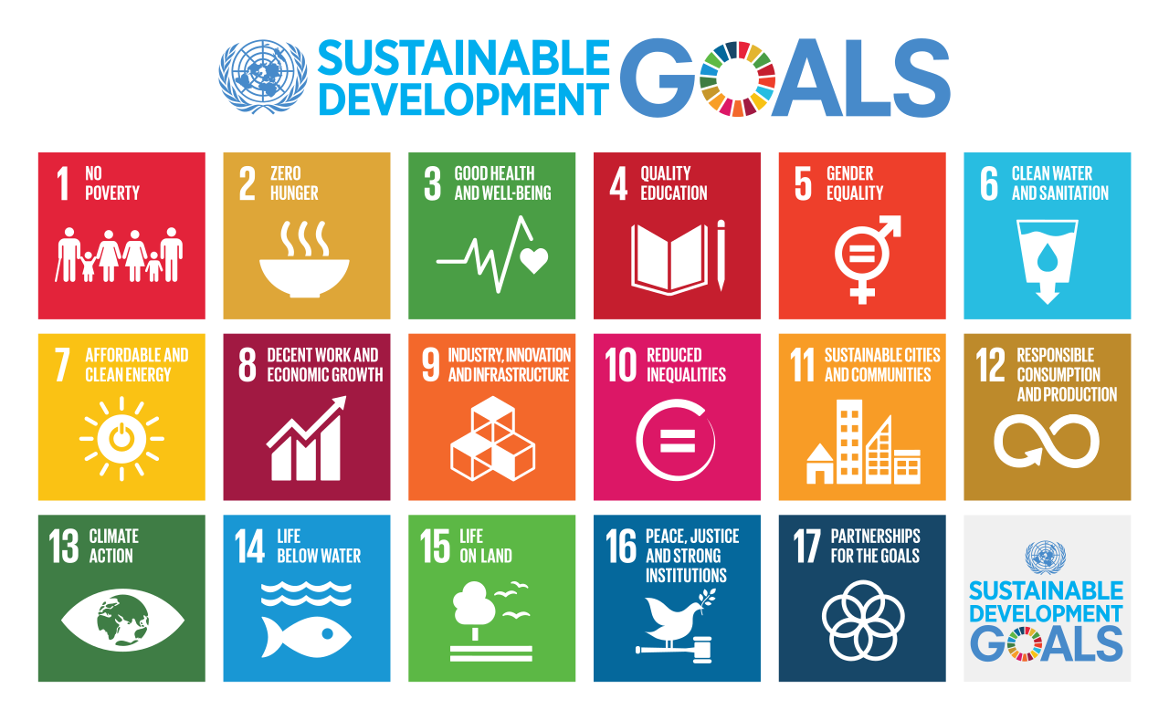
2015
SDGs( !7 Goals and 169 Targets), Sept
Paris Agreement (COP21) ,Dec

Slide 9
Related and Post 2015
New Urban Agenda ( Sustainable cities and human settlements for all ),Habitat III, October 2016
Sendai Framework for Disaster Risk reduction( 2015-30), June 2015

Slide 10
SDGs Document statement
SDGs Goals and targets are integrated and indivisible, global and universally applicable
Targets are defined as ASPIRATIONAL and GLOBAL
Each government will decide how aspirational and global targets should be incorporated in National Planning process and strategies
Challenge of translating into National Level( aspiration to actions)

Slide 11
SDGs
GOAL 6 on Water & Sanitation
Happy that Goal 6 covers
Entire Water Cycle
Including Management of WATER,WASTEWATER and ECOSYSTEM Management

Slide 12
SDGs Goal 6: Coverage
Contains 6 Targets
6.1 and 6.2 Water & sanitation
(similar to MDGs) universal and equitable access to safe water and sanitation & hygiene
6.3 to 6.6 address the broader water context which was not explicitly included in the MDG Framework

Slide 13
SDGs Goal 6 on WATER
It includes areas such as :
6.1 Water Quality: universal safe and affordable drinking water
6.2 Sanitation & hygiene: access to adequate and equitable sanitation , with special attention to women and girls

Slide 14
SDGs Goal on Water and Sanitation
6.3 Improve Water quality & Wastewater Management( includes hazardous waste): Halving untreated wastewater, increasing recycling and reuse (3R)
6.4 Water scarcity & Water-use efficiency across all sectors and sustainable withdrawal of freshwater

Slide 15
SDGs 6 on Water : Coverage
6.5 Integrated water Resources Management (IWRM)at all levels , including trans-boundary cooperation
6.6 Protection & Restoration of Ecosystem ,including mountains, forests, wetlands, rivers, aquifers and lakes

Slide 16
SDGs Goal 6 on Water & Sanitation
6.a Expand international Cooperation and capacity building to support Developing Countries , including in water harvesting ,desalination,
water efficiency, wastewater treatment ,recycling and reuse technologies

Slide 17
SDGs Goal 6 on Water & Sanitation
6b. Support and strengthen the preparation of local communities in improving water and sanitation

Slide 18
If you were the President /PM
(Illustrations)
Make water security ( including impacts of climate change ) as a National Priority
Establish a Single Institution/Organization to deal with all aspects of Water and Sanitation

Slide 19
If you were the President /PM
(Illustrations)
Establish River Basin Management Authority to deal with multiple uses of water and wastewater management
Establish a New Water Act an Appointment a Powerful and capable Minister or self manage for some time

Slide 20
How to integrate holistic SDGs into Sectoral Development Plans
Promoting Cross-sectoral thinking and planning e. g water, energy & food ( agriculture); water and gender, cities and water, energy , resilience
Incorporating into Medium term Plans ( 5 years) and Long term Planning ( until 2030)

Slide 21
How to integrate holistic SDGs into Sectoral Development
Allocating resources based on SDGs planning
Others

Slide 22
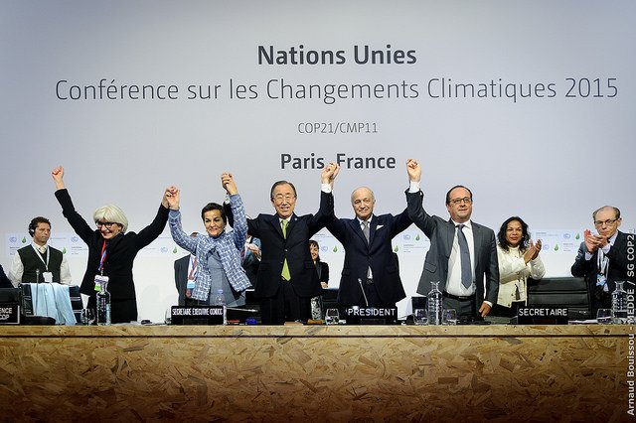
Spirit of COP 21
Key Elements
190 Countries participated
160 Intended Nationally Determined Contributions(INDCs)
Diplomatic Success but Lots of follow Actions needed
2 degree C target has not been achieved ( aspiration to 1.5 degree C above pre-industrial level)

Slide 23
Key Areas of Paris Agreement
INDCs (Intended Nationally Determined contributions)
Mitigation
Adaptation
Losses and Damages
Finance
Technology Development and Transfer
Capacity Building

Slide 24
Sustainable Development: A Timeline
1972 Stockholm conference on Human Environment
1980 World Conservation Strategy
1987 Brundtland Commission “Our common Future”
1992 Earth Summit
1997 Kyoto Protocol
2002 World Summit on Sustainable Development
2006 Stem Review
2009 Copenhagen Accord
2012 Rio+20 Summit
2015 Sustainable Development Goals (SDGs) Pairs Agreement

Slide 25
Past history of climate negotiation
1979- The first World Climate Conference (WCC)
1988- The Intergovernmental Panel on Climate Change is set up
1990- IPCC publishes first assessment report. IPCC and second world Climate Conference call for a global treaty on climate change. United Nations General Assembly negotiations on a framework convention begin
1991- First meeting of the Intergovernmental Negotiating Committee (INC)
1992- The INC adopts UNFCCC text. At the Earth Summit in Rio, the UNFCCC is opened for signature along with UNCBD and UNCCD
1994- UNFCCC enters into force
1995- The first Conference of the Parties (COP1) in Berlin
1996- The UNFCCC Secretariat is set up to support the convention
1997- Kyoto Protocol adopted at COP-3

Slide 26
Past history of climate negotiation
2001 Marrakesh- Release of IPCC’s Third Assessment Report; Bonn Agreements adopted. Marrakesh Accords adopted at COP7, (a) detailing rules for implementation of Kyoto Protocol, (b) setting up new funding and planning instruments for adaptation, and (c) establishing a technology transfer framework
2005 Montreal- Kyoto Protocol enters into force; As required by Protocol, Parties launched negotiations on the next phase of the Kyoto Protocol under the Ad Hoc Working Group on Further Commitments for Annex I Parties under the Kyoto Protocol (AWG-KP). Nairobi Work Programme on Adaptation (that name was given in 2006) is agreed on (to assist developing countries to improve their understanding and assessment of impacts, vulnerability and adaptation and make informed decisions on practical adaptation actions and measures)

Slide 27
Past history of climate negotiation
2007 Bali Road Map (COP-13)
  IPCC's Fourth Assessment Report released
  Gave ways to negotiate towards a post-2012 agreements with understanding that a new agreement will be reached by 2009 in Copenhagen
  Two work stream identified, new one is adopted:
    (Old) Under Kyoto Protocol: Ad-Hoc Working Group on Further Commitments for Annex I Parties under the Kyoto Protocol (AWG-KP)
    (New) Under Convention: Ad Hoc Working Group on Long-term Cooperative Action (AWG-LCA).
    AWG-LCA deal with supporting mitigation (NAMAs), emission cut targets, support to countries for adaptation, financing, technology development and transfer, and reducing emissions from deforestation and forest degradation (REDD+)

Slide 28
The Copenhagen COP15 failure
No new global agreements on emission cut targets
8 draft-texts and intense talks between 115 world leaders largely failed
Reasons not to loose hope
  Voluntary emission cut pledged by few countries (too little)
  A new and additional resource, including forestry and investments through international institutions, approaching USD 30 billion for 2010-2012
  Mobilizing 100 Billion US$ a year (new and additional) by 2020 to support climate change actions in developing countries
  Forestry deal (Norway and few countries)
  “Copenhagen Accord” recognized need to stay below 2⁰C despite no commitments

Slide 29
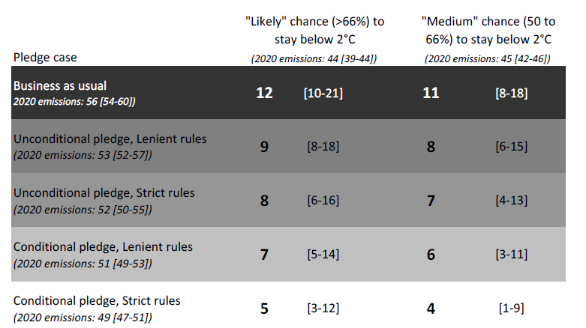
Pledge after Copenhagen
As a part of Copenhagen Accord, countries pledged to reduce GHG emissions for the year 2020
42 industrialized countries and 44 developing countries submitted pledges by Cancun meeting in Dec 2010 (conditional-unconditional)
Was it enough for emission in2020 needed for 2⁰C (>66% likelihood)? No; how big is gap? huge
Can we reduce the gaps: Yes but needs massive energy efficiency and accelerating introduction of renewables
UNEP Emission Gap Report 2011

Slide 30
The Durban achievement (2011- COP17)
Agree to set up the process to come to some kind of global agreement by 2015 to be enforced by 2020 (Ad hoc Working Group on the Durban Platform for Enhanced Action, AWG-ADP)
Kyoto Protocol under threat !!
    Japan signalled to opt-out from second commitment period
    Canada withdrew from earlier commitment in 2011 December
The two track-approach
  The Durban Plate-form: mandate to develop “a protocol, another legal instrument or an agreed outcome with legal force under the Convention applicable to all Parties”
  Kyoto continuation: To agree on ambitious action between now and 2020

Slide 31
2012 December COP-18: Doha outcomes
Doha amendment to the Kyoto Protocol
  Kyoto not-dead: Continuation of Kyoto Protocol
  Reduction pledge till 2020- essentially Europe and Australia- parties agreed to cut emission by at least 18 % below 1990 levels in the commitment period 2013 to 2020
  But: Canada, Japan, New Zealand, and Russia did not sign-in their continuation; US did not ratify 1st commitment too and no continuation
Continue negotiation in Durban Platform for future targets
Continue negotiation for other issues such as financial pledge of 100 bn US$
One major achievement was “agreement to look’ at the possibility of setting up an international mechanism in future to compensate vulnerable communities for the loss and damage caused by climate change

Slide 32
UNFCCC COP-21- Paris Agreement
Universal nature of mitigation agreement: For the first time, all nations irrespective of developed and developing, have agreed to the mitigation commitments
A hybrid structure of global climate governance: Composed of a mix of bottom-up pledge-based agreement structure coupled with top-down oversights, A shorter NDC review cycle, namely five years.
Successfully raising the mitigation aim to the higher bar of dangerous-climate-change threshold: The agreement aimed at ambitious climate stabilization goals, namely aimed to keep climate stabilization below 2°C and aimed 1.5°C.
A clear signal to broader stakeholders for early peaking of emissions and envisioning the world after 2050 as a GHG-neutral one: Especially to policy makers, investors and business communities for peaking of emissions as soon as possible and for decarbonizing the energy sector, that involve less/no fossil energy mix, ramping-up renewable energy deployments, carbon capture and storage, and reforestation.
The commitment of 100 billion US$ by 2020 by developed countries: The idea of 100 bn US$ as a financing ‘floor’ has opened up avenues to mobilize more support for developing countries.
Challenges: “Implementation of commitments” and “progressively moving to higher level of commitments”

Slide 33
Global state of Paris COP-21 pledges
The mitigation pledges by 2030 are diverse in nature - absolute emission reduction from reference year; reduction of emissions/GDP; reduction from BAU future scenario; no quantified emissions but only policies and actions
Conditional and unconditional mitigation pledges
Priority mitigation areas: Renewable energy; Energy efficiency; Sustainable transport; Carbon capture and storage; Conservation and sustainable management of forests; Reducing non-CO2 gases
Priority adaptation areas: Long-term goals or visions guiding the adaptation; Impacts and vulnerability assessments; Legal and regulatory frameworks, strategies, programmes and plans necessary for informed adaptation actions; Measures/actions in specific areas; Loss and damage associated past and projected climate change
Focal means of implementation- finance, technology and capacity-building; Monitoring and evaluation of adaptation

Slide 34
Status of ratification
197 parties to Paris Agreement
160 Parties have ratified as of now (August 2017)
The Paris Agreement entered into force on 4 November 2016 – “thirty days after the date on which at least 55 Parties to the Convention accounting in total for at least an estimated 55 % of the total global greenhouse gas emissions have deposited their instruments of ratification, acceptance, approval or accession with the Depositary.”
Meeting of the Parties to the Paris Agreement (CMA 1) took place in Marrakech, Morocco from 15-18 November 2016.
http://unfccc.int/paris_agreement/items/9444.php

Slide 35
Scope of this Lecture
Three Questions
1. How Sustainable Development Evolved : Key Global Milestones
2. What are the Key Focus Areas for Sustainability
3. How do you translate principles
and concepts in “Real World”

Slide 36
Key FOCUS AREAS FOR SUSTAINABILITY drivers of change and action agenda
Notes:
Part III - Key Environmental Trends & Drivers
Against this backdrop of policy approaches to support sustainable development, let’s now consider in more detail the current “state of the environment” in Asia and the Pacific, and the key drivers of change.

Slide 37

Three Dimensions of Sustainable Development
Sustainable Development
Environmental
Economic or Financial
Social

Slide 38
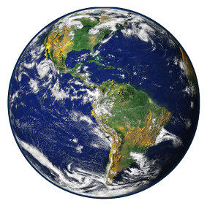

How many planets do we need?
- Ecological Footprint (2012)
2012
= 1.6 planets
2050
= 2.9 planets
2100
?
Source: WWF, 2012
Notes:
Ecological footprint
First, let’s consider the ecological footprint of humans on the planet.
This represents the impact of human activities measured in terms of “the area of biologically productive land and water required to produce the goods consumed and to assimilate the wastes generated.”
Currently, according to estimates by WWF and the Global Footprint Network, humans are using about 50 per cent more resources than the Earth can sustainably provide. By 2050 we’ll need almost 3 planets.
In Asia-Pacific however, the per-capita footprint is about 60% below the global average. With rising consumption levels, this may change rapidly if the drivers of environmental degradation are not addressed.

Slide 39
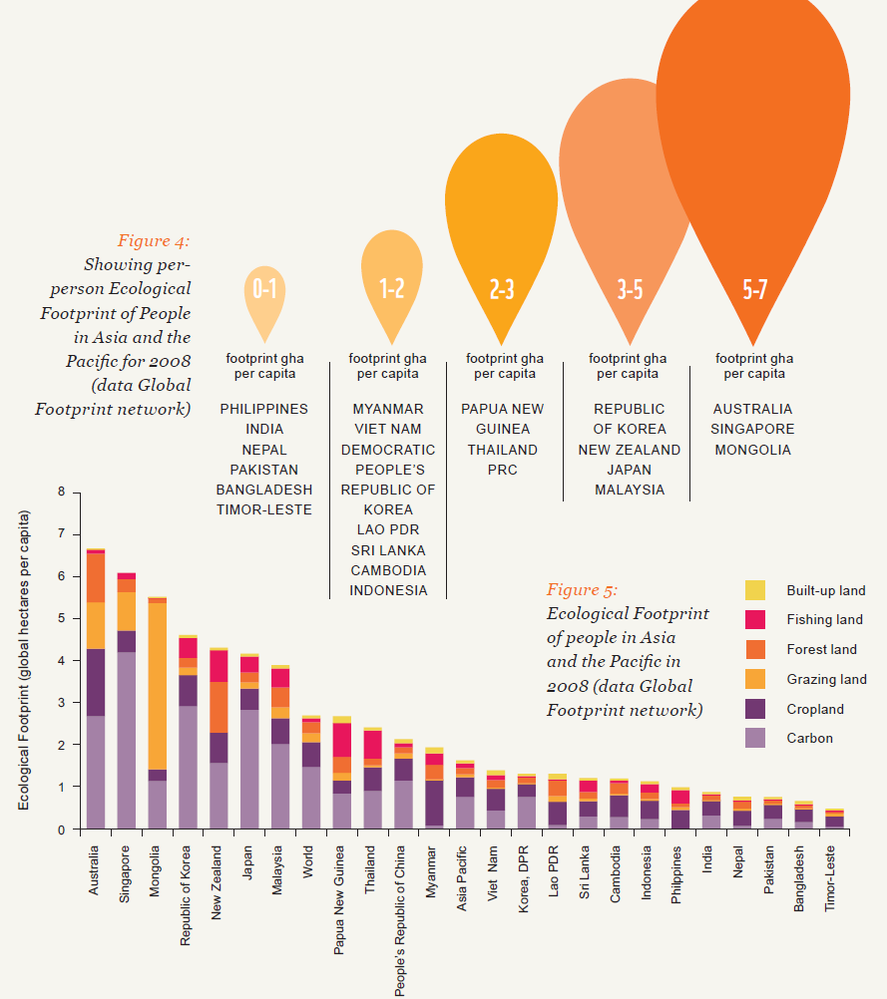
Ecological footprint per capita
Ecological footprint per capita by country ➔
Ecological footprint composition
Notes:
Ecological footprint – Asia-Pacific
In Asia-Pacific, there are however wide disparities between people of different nations, and per capital footprints are rising with expansion of the Asian middle class and changes in consumption patterns.
At the one end, people in Australia, Singapore and Mongolia have the greatest ecological footprint per capita at 5-7 global hectares per person per year.
At the other end, countries such as the Philippines and India, have lower footprints, but are likely to see significant increases by 2015 given economic growth projections and changing consumption patterns.

Slide 40
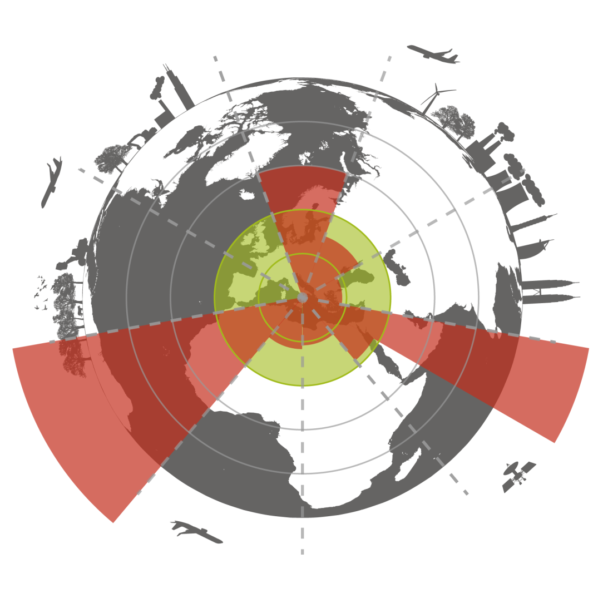
Environmental Context for the SDG? Planetary Boundaries
Climate
350 ppm CO2
+1 W/m²
Ocean
acidification
Aragonite saturation
ratio > 2.75
Chemical pollution
Not yet quantified
Aerosol loading
Not yet quantified
Ozone depletion
276 DU
?
?
Nitrogen &
Phosphorus loading
35 MT N/yr
11 MT P/yr
Biodiversity loss
10 E/MSY
Land use
15%
Freshwater use
4000 km³/yr
Illustration: Erik Rosin, based on Rockström and others. Nature, 2009
Notes:
So what about the environmental context for the SDGs?
In the past, many have been critical of MDG 7 on environmental sustainability, highlighting that it provides only a limited view on sustainability issues. So what other options could be considered?
One option being discussed, is to integrate a concept of environmental limits or “planetary boundaries” into the post-2015 development framework. This is based on a concept published by Rockström and others in Nature in 2009, which considered 9 planetary boundaries that should not be transgressed in order to maintain a “safe operating space for humanity”.
According to Rockström’s work, 3 of the 9 boundaries have already been exceeded – biodiversity, climate, and nitrogen loading. Others are being approached or are still to be fully quantified.

Slide 41
Focus for Asia-Pacific Region
Energy: demand is projected to almost double in the Asia and Pacific region by 2030.
Transport: Asia’s fastest growing source of CO₂. Vehicle fleet has more than doubled in the past decade.
Urban: 44 million people/yr are added to Asian cities.
Water: Demand is expected to significantly exceed sustainable supply in India and PRC by 2030.
Biodiversity: Key populations declined by 60% in 30 years. Trends likely to continue without mitigation
Climate vulnerability: 7 of the world’s 10 countries at greatest vulnerability to climate change and variability.
Sustainable Consumption and Production: Life-style change and industrial design change (for example, 3R, Circular Economy, Industrial Ecology).
Notes:
Environmental trends in Asia-Pacific
Next, I’d like to look at some of the key drivers of change related to:
Energy
Transport
Urban development
Water demand
Biodiversity loss; and
Climate change vulnerability

Slide 42
Poverty, Environment, and Development Nexus
Sustainable Development
Poverty
Development
Environment problems
Pollution
Land degradation
Climate change
Pollution of poverty
Pollution of affluence
Poverty alleviation
Meeting basic needs (health/education/shelter)
Productive employment
Control over common property resources
Population control
Integration of environment into development
EIA of development projects
Technology for development
Renewable energy issues
Regional and international co-operation
Reduction of income gap
Source: Jalal, 1993.

Slide 43
EIA Inputs to Projects Lifecycles
Detailed assessment of significant impacts, identification of mitigation needs, input to cost/benefit analysis
Feasibility
Prefeasibility
Design and Engineering
Implementation
Monitoring and Evaluation
Project Concepts
Site selection environmental screening, initial assessment, scoping of significant issues
Detailed design of mitigation measures
Implementation of mitigation measures and environmental management strategy
Monitoring and post-auditing lessons for future projects
Source: Asian Development Bank, 1993.

Slide 44


1. Energy: Developing Asia’s Share in Global Energy-Related CO₂ Emissions
Rest of the Word
Rest of the Word
37%
47%
63%
53%
2010
Actual (World)
Total = 31,305 million tons CO₂
2035
Projection (World)
Total = 43,220 million tons CO₂
Source: ADB, APERC 2013
Notes:
Energy and CO2 emissions
A majority of the historical GHG buildup is a result of emissions from OECD countries.
DMCs are now the fastest growing source of new emissions and they will soon be the largest absolute source, although their per capita emissions remain low.
The dominance of fossil fuels in Asia has increased the region’s share in worldwide energy-related CO2 emissions from 8.7% in 1973 to 30% in 2006. The region’s share is expected to continue to increase to about 43% by 2030.
Today, the People’s Republic of China (PRC), India, and Indonesia are among the top 10 emitting countries globally due to the combined effects of their fossil fuel consumption and deforestation but their per capita emissions remain low.
Therefore, without increased and urgent GHG mitigation action in the region, reduction in global GHG emissions at the level necessary to prevent dangerous climate change will not be possible.
(slide 32)

Slide 45














2010: 12,730 MTOE
Asian Energy Outlook: Next Two Decades
Other
RE
Hydro
Oil
Coal
Gas
Biomass
Nuke
32.3%
27.3%
21.5%
10.0%
5.6%
2.3%
0.9%
2035: 18,677 MTOE
Other
RE
Hydro
Coal
Oil
Gas
Biomass
Nuke
2.7%
2.5%
9.3%
5.5%
29.6%
27.1%
23.5%
Source: IEA, 2013
Notes:
Asia Energy Outlook
According to ADB’s latest Asia Energy Outlook, which was just released this month, fossil fuels – oil, coal and natural gas – will continue to meet most of the world’s energy needs in 2035.
Fossil fuels, which represented 81% of the primary fuel mix in 2010, remain the dominant sources of energy through 2035 in all scenarios.
In the Current Policies Scenario, the persistent demand for fossil fuels is there, however, demand for renewable sources of energy rises at a faster rate.

Slide 46
China and India are driving world energy consumption energy
- 56 percent in the next three decades
Notes:
China and India are driving world energy consumption
According to the International Energy Outlook, world energy consumption will also rise 56 percent in the next three decades, with China and India accounting for half the gain.
China, which used 3.4 percent more energy than the U.S. in 2010, is expected to double U.S. demand by 2040.
This will have a profound effect on the development of world energy markets.

Slide 47





Market Transformation:
Unlock Asia’s Clean Energy Future
EE&RE
Energy Efficiency
EE&RE
Gas
Gas
RE
Coal/Oil/
Nuclear
Fossil
Fuels
Coal/Oil/Nuclear
Current
Near-Future
2050
Notes:
Market transformation
Greater market transformation is needed unlock a clean energy future for Asia.
In an alternate scenario, fossil fuels’ share of total primary energy demand would can be reduced from 83.2% to 74.3% by for 2035 through the deployment of advanced low-carbon technologies.
This would lead to a reduction in CO2 emissions in the region by 27.6%.
Energy efficiency improvements and switching to renewable energy and other low-carbon technologies would account for about 50% of the total CO2 reduction.
This result implies that energy conservation and optimization of the fuel mix are essential factors for further CO2 abatement in the region.

Slide 48
2. Transport: Asia-Pacific Trends
Cars and motorcycles
Mode share (p-km)
Public transport, walking, and cycling
Source: ADB and IEA, 2011
Notes:
Transport Trends
ADB and the International Energy Agency recently conducted research on transport sector trends for the region.
We found that the mode share of cars and motorcycles in the Asia and Pacific region will outnumber the combined mode share of public transport, walking, and cycling for the first time in history by the end of this decade.
A revolution in mobility is happening in the region, but it is not in the direction that any of us would prefer.

Slide 49
Lag times
Public transport
The trend for the next 5 to 8 years is fixed
Mode share (p-km)
Cars and motorcycles
Notes:
Transport Trends (2)
Can we stop this trend? In the short term, the answer is no.
In fact, it has already happened based on the decisions (or non-decisions) already taken.
Investment decisions and priorities in transport take many years if not decades to reach full potential.

Slide 50
Transport
Need to transform the transport sector( public transport , EVs ,…)
Metro projects , e-vehicles , Railways, Inland waters ,Non-motorized transport and Integrated Urban transport
Need for a new approach to transport financing and investment
Notes:
Transport Summary
Need to transform the transport sector
Need for a new approach to transport financing and investment

Slide 51
Electric Vehicles
Worldwide stock surpassed 2 million units in 2016.
China, US and Europe account for 90% of all EVs sold around the world.
Projected 30 million by 2025 and 150 million in 2040( reducing oil demand by around 1.3 mb/day)
India target 2030, France and UK in the next 20 years , Sri Lanka started charging stations and commitments Manufacturers
Major car manufacturers (BMW, Ford, Honda, etc) have targets to produce at least 1-2 million EVs by 2025.

Slide 52
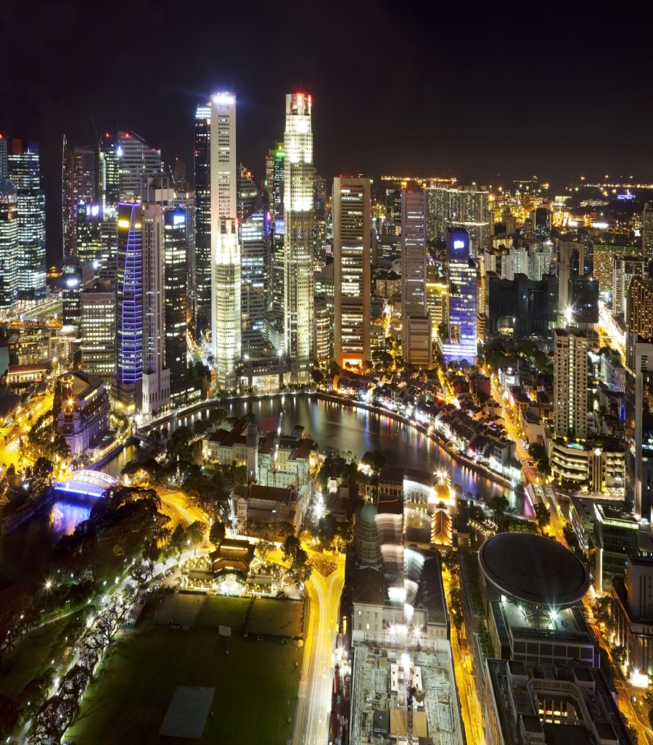
3. Urbanization: growth at an unprecedented rate
Urban areas account for 84% of global GDP
600 cities account for 60% of GDP (50% of these cities are in Asia)
577 second-tier cities to account for 50% of global GDP by 2025
Source: McKinsey Global Institute. 2011. Urban world: Mapping of the economic power of cities.
Notes:
Urbanization trends
The high speed of urban expansion in Asia has created huge demand and large scale economies.
About 84% of GDP globally comes from urban areas.
Urbanization is expected to grow by 3% every year in Asia.
About 1.1 billion people will move to cities in the next 20 years, which is equivalent to 120,000 people each day.
Cities are the key drivers of economic growth and poverty reduction.
300 cities that account for 60% of global GDP are in Asia.
Half of the world's 23 megacities are in Asia.
577 of the top 600 cities are second-tier cities, and they will account for half of global GDP by 2025.

Slide 53
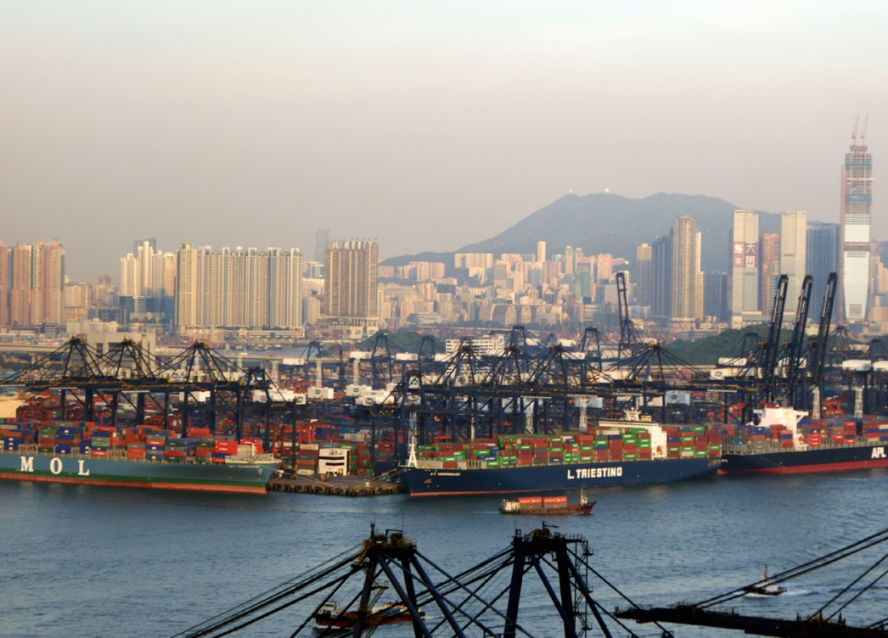
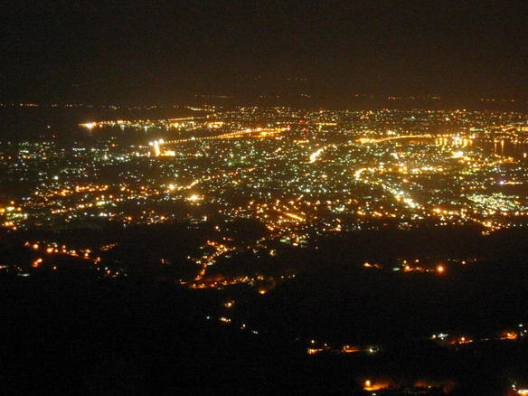
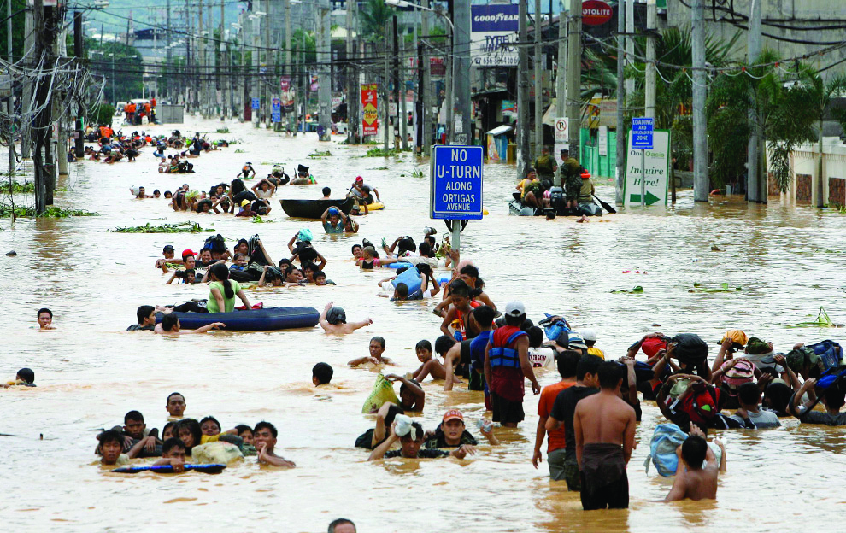
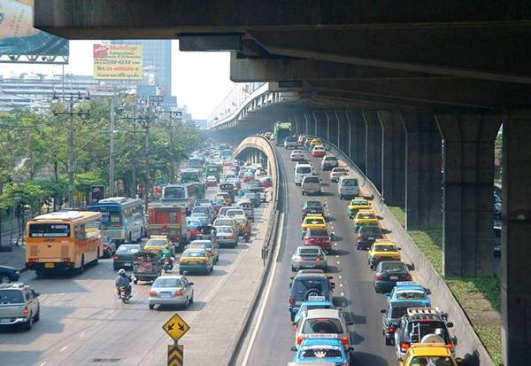
Economy
Energy
Asian URBAN Challenge
  Cities produce 80 % of GDP
  Drivers of economic growth
  Cities use about 85% of energy
  Asia - 35% CO2 emissions
  Vulnerable to impacts of CC- inundation, sea level rise
  Air pollution can have estimated 2%-4% negative impact on GDP
Climate Change
Environment
Notes:
Urbanization challenges
I see several main urbanization challenges relating to:
rising demand for resources,
growing consumption patterns,
depleting natural resources,
climate disruptions and the rise in extreme weather events.

Slide 54
Asia’s Urban Challenges (1)
Two faces of Asian urbanization: economic prosperity of cities and increasing urban poverty
  Out of 1.6 billion urban people in Asia, more than 500 million are urban poor
  Growing inequality
High levels of environmental stress
  Urban areas account for 60-80% of energy consumption and 75% of carbon emissions.
  Climate change brings a new layer to environmental unsustainability.
Notes:
Asia’s urban challenges (1)
First, is what I call the two faces of urbanization. Economic prosperity is one face of urbanization in Asia, the other is increasing urban poverty.
Nearly a third of urban people in Asia live in slums.
Not only are social and health conditions unacceptable, they are highly vulnerable to climate change. If nothing is done, that figure may rise to one billion by 2050.
Second, our cities are facing high levels of environmental stress.
By 2015, 55% of global greenhouse gas emissions will come from cities in Asia. We need to deal with urban air quality and river pollution, which have public health implications. Let me emphasize that the "let's grow first and clean later" attitude is no longer an option in Asia.
Climate change brings a new layer to environmental unsustainability. We have seen the increasing frequency, intensity and impact of climate change and natural disasters.

Slide 55
Asia’s Urban Challenges (2)
Urbanization is placing an enormous strain on urban mobility
  Economic cost of up to 2%-4% of GDP in many countries
  650,000 lives lost annually in region
Cities face more complex public financial management challenges
Notes:
Asia’s urban challenges (2)
Third, urbanization is placing an enormous strain on urban mobility. Uncontrolled growth in urban road traffic and rising congestion imposes an economic cost of up to 2%-4% of GDP in many countries. We also see increasing motorization in transport, and we need to deal with this.
Finally, cities face more complex public financial management challenges. The rapid urbanization has put extra demand for infrastructure investment, which made the financial situation even worse as many cities have limited revenue sources.

Slide 56
Urbanization
Need to turn cities to green, smart, inclusive and competitive cities
Make them livable cities
Need for a New Urban Agenda
Notes:
Urbanization summary
In summary, we therefore need to:
turn cities to green, smart, inclusive and competitive cities
make them livable cities

Slide 57
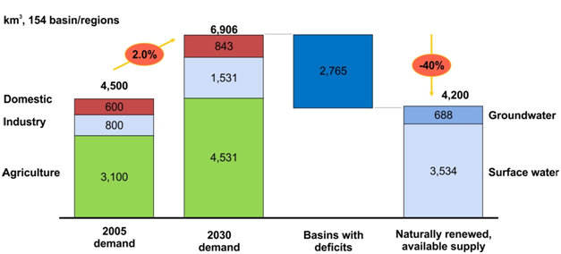
4. Water demand & security
40% supply gap projected by 2030
Source: The 2030 Water Resources Group. 2009. Charting Our Water Future
Notes:
Water demand and security
Analysis by the 2030 Water Resources Group presented within Charting Our Water Future (2009 ) shows that that the total annual sustainable supply of freshwater (based on current trends) will remains static at 4,200 billion m2, with an annual deficit forecast for 2030 of 40% of unconstrained demand.
This supply gap (refer to figure) has become the starting point for much of the current narrative surrounding water security.
Note: The analysis determined that today’s naturally renewable and available supply is about 4,200 cubic kilometers (km³), being about 16% groundwater and 84% surface water. Based on the demand of the domestic (or municipal), industrial, and agriculture sectors, demand of about 6,906 km³ in 2030 would outstrip supply by that year. This shortfall of approximately 2,765 km³ is known as the “supply gap.”

Slide 58
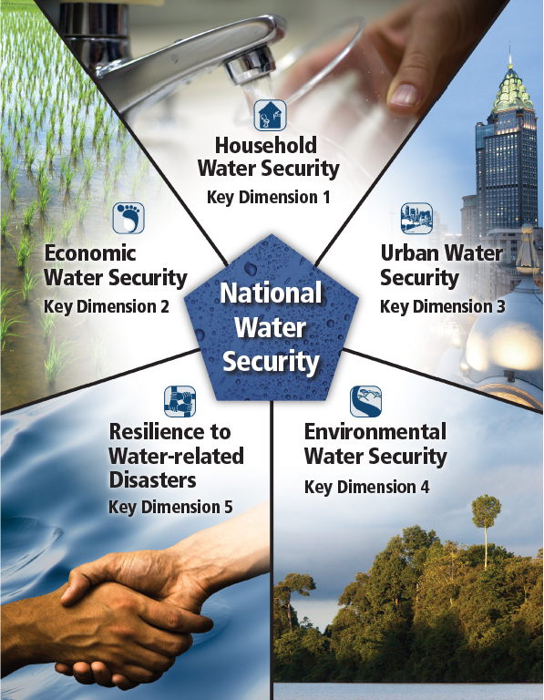
Water Security
Notes:
Water security
Addressing water security issues is therefore a key issue for the region.
This will require a balance of competing demands and pressures on the water sector, considering:
Domestic and urban water supply
Economic water uses
Environmental water requirements and flows; and
Resilience to water related stresses and disasters.

Slide 59
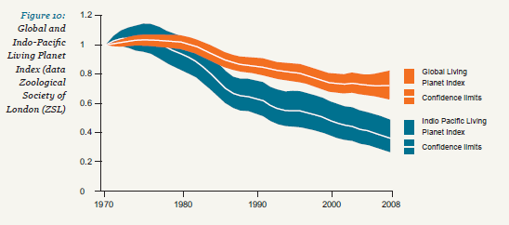
5. Declining biodiversity
Populations of mammals, birds, fish, reptiles & amphibians have declined by 64% in Asia-Pacific
(twice the global average!)
Notes:
Biodiversity
The Asia-Pacific region has around 60% of the world’s plants and animals, 50% of the planet’s remaining coral reefs and 17% of its wetlands.
Natural ecosystems provide services that benefit human welfare, including provisioning services (fuel, fiber, fisheries, fresh water), and regulating services (air quality maintenance, carbon storage and climate regulation, erosion control, and water purification).
However, the Living Planet Index (WWF, 2012) shows that populations of 6000 key indicators species in Asia and the Pacific have been declining at twice the global average.
59

Slide 60
Forest Trends (1990-2010)
Overall: Forest cover increase since 2000
Significant reforestation in the PRC driving regional trends
Ongoing loss of primary forest in Indonesia, PNG, Lao PDR
Notes:
Forest cover trends
With respect to forest cover, the region has seen an overall positive trend since, largely due to reforestation programs in the People’s Republic of China
Ongoing loss of primary forest remains a critical issue, particularly in countries such as Indonesia, PNG, Lao PDR, which has extensive forest cover and high rates of deforestation.
60

Slide 61
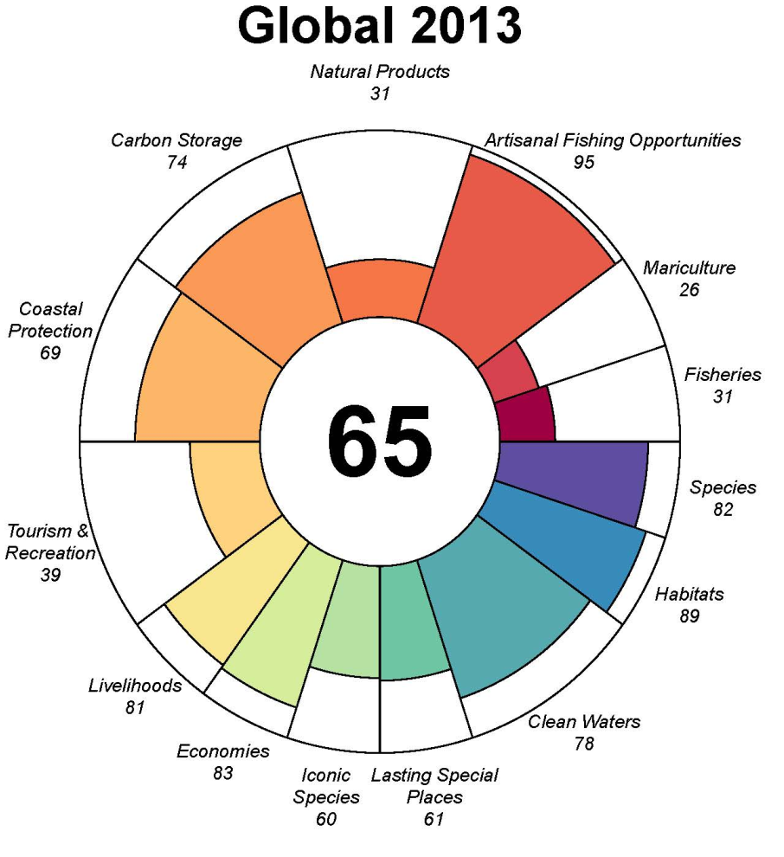
Ocean Health
(Asian performance: MIXED)
Ocean Health Index
Seafood captured or raised in a sustainable way
Increasing sustainability
Source: Ocean Health Index, 2012
http://www.oceanhealthindex.org
Notes:
Health of oceans and coasts
The impacts of land based pollution, coastal development, unsustainable fishing practices and climate change are having a dramatic affect on our oceans and coasts.
The Ocean Health Index measures the global state of the world's oceans. The Index scores tell us what is working and what needs attention.
The Food Provision Index, combines data on mariculture and fisheries ad considers food sustainability. This is the worst performing indicator globally. Seafood helps more than half the world's population meet their need for protein.
In Asia and the Pacific, performance is mixed, with fisheries sustainability in the Pacific being generally high (eg Solomon Is) compared to South and Southeast Asia.
Note: The Index is calculated based on their Exclusive Economic Zones (EEZs). Each EEZ is evaluated by the 10 public goals and is globally ranked according to the average of its 10 goal scores. A score of 100 would indicate perfect health. Lower scores indicate increased degradation.

Slide 62
Biodiversity
Need to protect, restore and enhance the management of ecosystems
Greater attention needed on oceans and coasts
Economic valuation of ecosystems services needs to be integrated in decision-making
Notes:
Biodiversity
Given relationships between the health of natural ecosystems and their ability to provide stocks and flows or goods and services to humanity it is imperative that we take greater efforts to protect, restore and enhance the management of ecosystems, including our oceans.
Greater use of economic tools such as the valuation of ecosystems services will be needed to more effectively integrated biodiversity into decision-making.

Slide 63
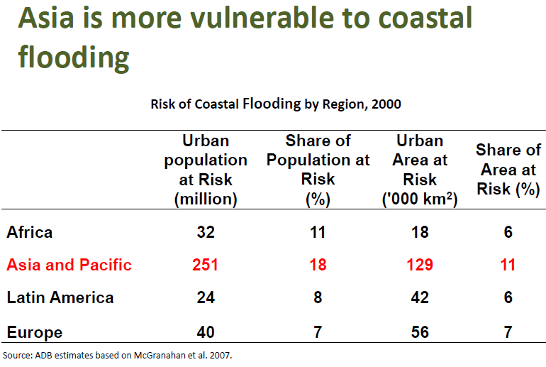
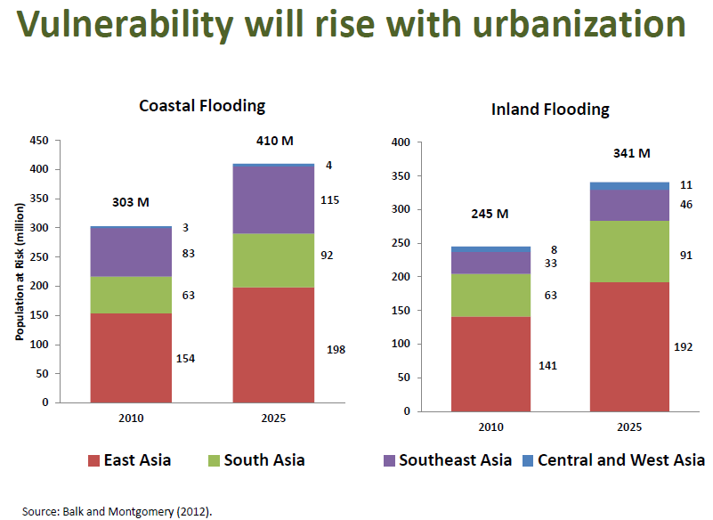
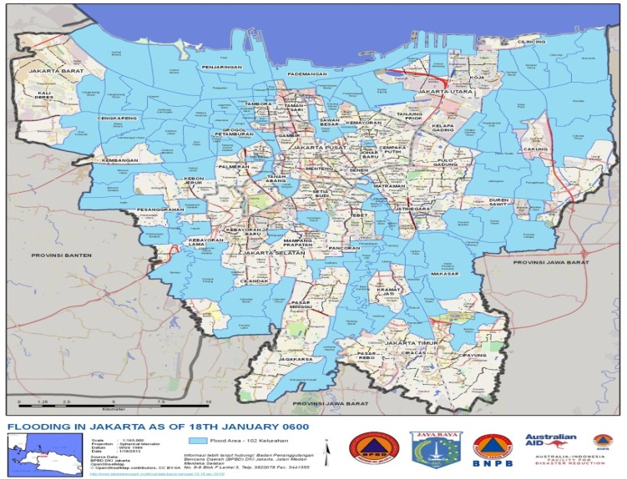
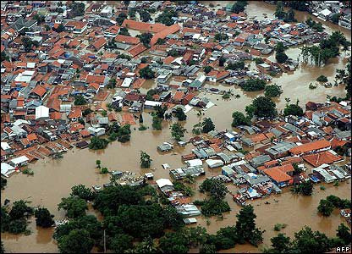
6. Climate vulnerability in Asia
Notes:
Climate vulnerability in Asia
Asia and the Pacific are highly vulnerable to climate change.
Vulnerability will rise with urbanization, with a projected 410 million urban Asians likely to be at risk of coastal flooding by 2025 (up from around 300 million in 2010).
A further 350 million will be at risk from inland flooding (up from 250 million).
More than half the population in large cities like Dhaka, Ho Chi Minh City and Tianjin are at risk from both inland and coastal flooding.

Slide 64
Most Affected Asian Countries by Climate-Related Threats
Droughts | Floods | Storms | Sea Level rise (1m) | Agriculture
Malawi | Bangladesh | Philippines | low-lying Island States | Sudan
Ethiopia | China, PR | Bangladesh | Viet Nam | Senegal
Zimbabwe | India | Madagascar | Egypt | Zimbabwe
India | Cambodia | Viet Nam | Tunisia | Mali
Mozambique | Mozambique | Moldova | Indonesia | Zambia
Niger | Lao PDR | Mongolia | Mauritania | Morocco
Mauritania | Pakistan | Haiti | China, PR | Niger
Eritrea | Sri Lanka | Samoa | Mexico | India
Sudan | Thailand | Tonga | Myanmar | Malawi
Chad | Viet Nam | China, PR | Bangladesh | Algeria
Kenya | Benin | Honduras | Senegal | Ethiopia
Iran | Rwanda | Fiji | Libya | Pakistan
Note: The typology is based on both absolute effects (e.g., total number of people affected) and relative effects (e.g., number affected as a share of GDP). Source: IPCC data
Notes:
Asian countries most effected by climate change
Asia-Pacific countries are also among those predicted to suffer most from climate-related threats.
The types of threats and Asian countries at risk are highlighted in the slide. The region is most susceptible to floods, storms and sea level rise.

Slide 65
Economics of Climate Change
The costs and risks of climate change is equivalent to losing at least 5-20% of global GDP per year
Economics of containing the global warming below 2°C will mean an annual cost of 1% GDP
India and S.E. Asia could lose on average 2-3% and as much as a 9-13% (95 percentile) of GDP by 2100
Based on ADB studies, economy-wide loss by 2100 can be as high as:
  6.7% of GDP per year for Indonesia, Philippines, Thailand and Viet Nam
  8.8% of GDP per year for Bangladesh, Bhutan, India, Maldives, Nepal, Sri Lanka
  5.3% of GDP per year PRC, Japan, Republic of Korea, and Mongolia.
Notes:
Economic losses caused by climate change
We know that the likely economic losses and social costs associated with climate change are enormous.
“The Economics of Climate Change” by Sir Nicholas Stern tells us that the economic costs could range from 5-20% of global GDP per year.
In contrast, the cost of cutting emissions will only be around 1% of GDP every year, on average.
India and Southeast Asia could lose 2-3% of GDP and as much as 9-13% GDP by 2100.
ADB studies on impacts of climate change indicate that economy-wide loss by 2100 could be as high as (i) 6.7% of GDP per year for 4 Southeast Asian countries – Indonesia, Philippines, Thailand and Viet Nam; (ii) 8.8% of GDP per year for six South Asian countries - Bangladesh, Bhutan, India, Maldives, Nepal, Sri Lanka;
(slide 52)

Slide 66
Growth in direct physical losses is outpacing growth in GDP in Asia and the Pacific
5,000
Disaster Losses
4,000
Fitted
Loss
Curve
3,000
Index (1970=100)
2,000
1,000
GDP
0
1970
1975
1980
1985
1990
1995
2000
2005
2010
Notes:
Disaster impacts and risks
We know already that growth in direct physical losses from natural hazard events are outpacing growth in GDP in Asia and the Pacific.
With expected increases in the frequency and intensity of climate extreme events, prospects for continued strong economic growth are in jeopardy if resilience is not strengthened.
Increasing regional connectivity implies that disasters are no longer confined to immediately affected areas, as clearly illustrated by the 2011 Thai floods.
The 2011 floods in Thailand caused total damage and losses of $46.5 billion, equivalent to 13.5% of GDP, and resulted in a 9% contraction in the Thai economy in the last quarter of the year.
As a consequence of regional integration, their trade partners were also affected, showing that strengthened resilience is an important goal for all.
(from slide 53) Additional notes:
The major disasters in value terms behind the spikes are as follows:-
1995 - Kobe earthquake, Japan
1998 - Yangtze River floods, PRC
2004 - Chuetsu earthquake, Japan; typhoon, Japan; Indian Ocean tsunami
2008 - Sichuan earthquake, PRC
Although Japan features a lot, losses in developing countries are also increasing and the rising trends are not driven by events in Japan alone.
The major disasters in terms of loss of life look very different, of course, with the biggest loss of life over the past 12 years occurring in 2004 (Indian Ocean tsunami) and 2008 (Sichuan earthquake and Cyclone Nargis in Myanmar).

Slide 67
Climate Vulnerability
Need to address climate vulnerability
  Mitigation
  Adaptation
Need to strengthen disaster risk management and financing
Notes:
Climate vulnerability summary
Given the extent of exposure in the region and the significance of potential impacts for human welfare, it is imperative that we address climate vulnerability through both Mitigation and Adaptation
At the same time, we need to strengthen disaster risk management and financing

Slide 68
PATHWAYS to Green Growth
What approaches do we need?
Notes:
Part IV – Transitions to Green Growth – ADB’s Approach
Now that we have considered the key environmental issues and drivers facing the region, let’s look at what can be done.

Slide 69
Green growth
Alternative paths that will bring about transformational change
  Shift to more resilient infrastructure development
  Achieve gains in resource-use efficiency
  Achieve resilience against climate change and other shocks and stresses
  Life-style change
  Adopting green technologies
  Others
Notes:
Green growth definition
First, let’s consider briefly what we mean by green growth, which I shall define as:
An alternative path that will bring about transformational change
Shift to more resilient infrastructure development
Achieve gains in resource-use efficiency
Achieve resilience against climate change and other shocks and stresses
Source: ADB, UNEP, UNESCAP (2011) Green Growth, Resources and Resilience
69

Slide 70

Decoupling growth?
Year n = 100
Rapid climate change
Increasing resource risks
Declining biodiversity
Reduced resilience
200
175
Economic activity (GDP)
Relative decoupling
150
Growing Resource Use
125
100
Absolute decoupling
Less climate change
Resource risks mitigated
Biodiversity maintained
Increased resilience
75
Declining Resource Use
50
25
Year n Year n+10 Year n+20 Year n +30
Notes:
Decoupling growth?
Given the linkages between economic growth and environmental degradation that have been shown during this presentation, we need to consider how we can “decouple” growth from resource use and environmental degradation.
The choices that Asia and the Pacific make in relation to economic strategies over the next few decades are critically important for the future of the planet.
Under a business-as-usual scenario, the region’s economies would continue to use less materials, energy, water and land per GDP –achieving relative decoupling – but these efficiency gains will be unable to keep pace with growing populations and per capita consumption.
As a result, the region would continue to witness a rapid growth in material and energy use, along with carbon dioxide emissions. Such a path could lead the region, and the world, into deeper economic and environmental challenges.

Slide 71
Sustainable Consumption and
Production

Slide 72
Sustainability Operational Framework
: An illustration of an Organization
Promoting a shift to sustainable infrastructure
Investing in natural capital
Strengthening governance and management capacities
Climate change (mitigation and adaptation)
Notes:
ADB’s approach – Environment Operations Directions (2013-2020)
ADB has identified environmental sustainability as one of its key strategic agendas in the region, along with inclusive economic growth and regional integration.
Under our Environment Operations Directions, we are supporting this agenda through 4 mutually supportive objectives:
Promoting a shift to sustainable infrastructure
Investing in natural capital
Strengthening governance and management capacities
Responding to the climate change imperative

Slide 73
Thank You !!!!

