Slide 1
SUSTAINABLE DEVELOPMENT & INTERNATIONAL POLITICS
PROF. KAZI F JALAL Ph.D (Harvard)
Visiting Professor, School of Government and Public Policy, O.P Jindal Global University, INDIA
&
Former Lecturer, Program of Sustainability and Environmental Management
Harvard University, USA
--------------------------------------------------------------------------------------------------------------------------------
Reference Materials:
1. SUSTAINABLE DEVELOPMENT IN ASIA by D.V SMITH & KAZI F.JALAL (2000)
2. An INTRODUCTION TO SUSTAINABLE DEVELOPMENT by Peter Rogers, Kazi Jalal & John Boyd (2005)

Slide 2
Financing SD: International Politics
How much money do you need?
Current preferences of IFIs
Economic Hit Man (EHM)

Slide 3
Financing Sustainable Development
There is a global consensus that achieving SD requires susbstantial mobilization of financial resources *
On the demand side, estimates have been made at various stages of development of action plans by the UN (1992-2012)
Similarly on the supply side several estimates exist as to how much financing may be available and from which sources
*UN systems(2013): “Financing SD in the global partnership beyond 2015”

Slide 4
Financing SD
Earth Submit, Brazil, 1992 : $625b/yr
UN system(2013): “Financing SD in the global partnership beyond 2015”: 1%-2.5% of global GDP/yr. from 2010-2050.
1% of global GDP in 2010 = $630 b/yr
Total estimated demand for SD: $630 b/yr

Slide 5
Poverty & Global Priorities in Spending
Items of Expenditure | US$b/yr
Cosmetics in USA | 8
Perfumes in Europe & USA | 12
Ice cream in Europe | 11
Pet foods in USA & Europe | 17
Business entertainment, Japan | 35
Cigarettes in Europe | 50
Alcoholic drinks in Europe | 105
Narcotic drugs in the World | 400
Military spending, Global | 780
Total: | 1418
Basic Needs | US$ b/yr
Basic Education for all | 6.0
Water & sanitation for all | 10.0
Basic health & nutrition for all | 13.0
Reproductive health for all women | 12.0
Total: | 41.0
1.Poverty facts; State of the world(2004);
2. Globalisssues.org/traderelated/facts (2005)

Slide 6
Who Consumes?
D. Smith & K.Jalal(2000) Sustainable Development in Asia, Asian Development Bank
Product | Developed Country(%) | Developing Countries(%) | Cons.per capita US/India
Population | 24 | 76
Energy | 75 | 25 | 35
Food(meat) | 64 | 36 | 52
Metals(Cu) | 86 | 14 | 245
Chemicals | 85 | 15 | 28
Cars | 92 | 8 | 320

Slide 7
Current preferences of IFIs
 | High/middle Income countries | Low income countries
Hard sector | XXXX | XX
Soft sectors | XXX | X

Slide 8
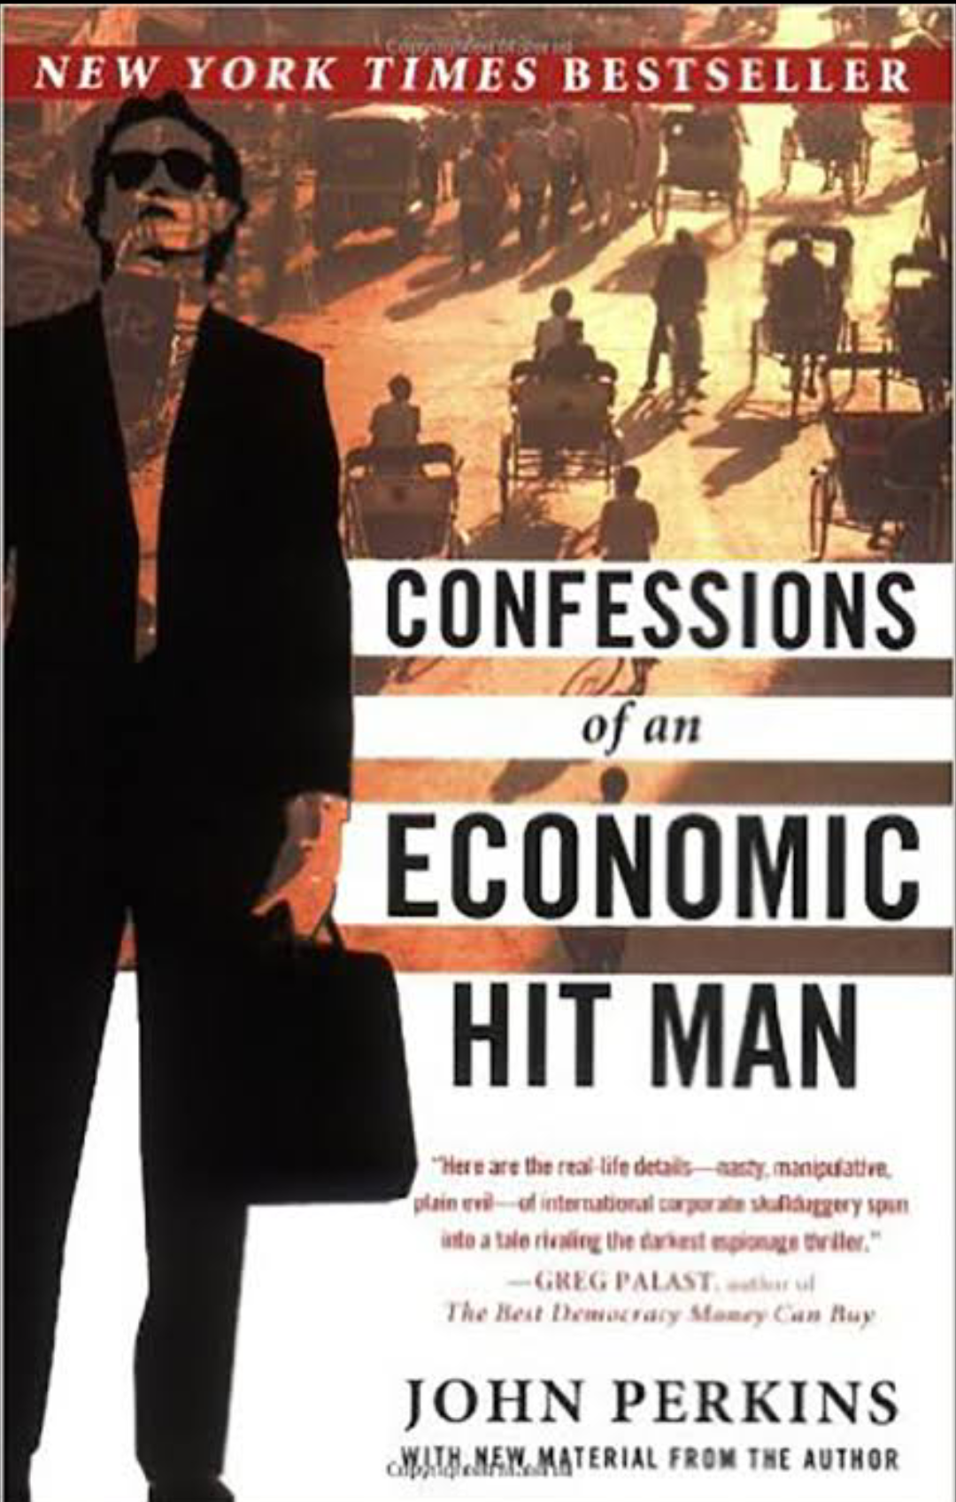

Slide 9
Definition of EHMs
“Economic hit men (EHMs) are highly paid professionals who cheat countries around the globe out of trillion dollars. They funnel money from the World Bank, the US Agency for International Development (USAID), and other foreign “aid” organizations into the coffers of huge corporations and the pockets of a few wealthy families who control the planet’s natural resources….”

Slide 10
TOR of EHMs
“Claudine told me that there were two primary objectives of my work. First, I was to justify huge international loans that would funnel money back to MAIN and other U.S. companies (such as Bechtel, Halliburton, Stone and Webster, and Brown and Root) through massive engineering and construction projects. Second, I would work to bankrupt the countries that received these loans (after they had paid MAIN and the other US contractors, of course) so that they would be forever beholden to their creditors, and so they would present easy targets when we need favors, including military bases, UN votes, or access to oil and other natural resources.”

