Slide 1

IPCC Special Report on 1.5ºC regional perspectives - Asia
Strengthening the global response in the context of sustainable development
Joyashree Roy, Bangabandhu Chair Professor
Asian Institute of Technology, Thailand
5th Dec. 2018, at COP24 WMO/IPCC Pavilion

Slide 2


The report in numbers
91 Authors from 40 Countries
133 Contributing authors
6000 Studies
1 113 Reviewers
42 001 Comments

Slide 3
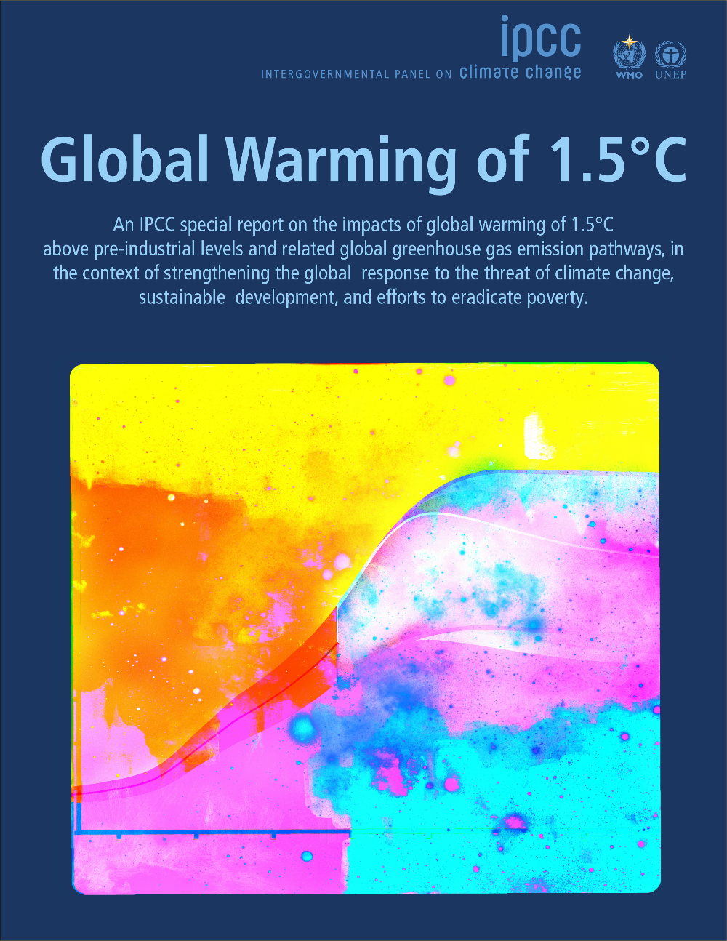
Key findings
Climate change is already affecting people, ecosystems and livelihoods all around the world. Every bit of warming matters
Limiting warming to 1.5°C is not impossible but would require unprecedented transitions in all aspects of society
There are clear benefits to keeping warming to 1.5°C compared to 2°C , or higher.
Limiting warming to 1.5°C can go hand-in-hand with achieving other world goals, such as achieving sustainable developments and eradicating poverty

Slide 4

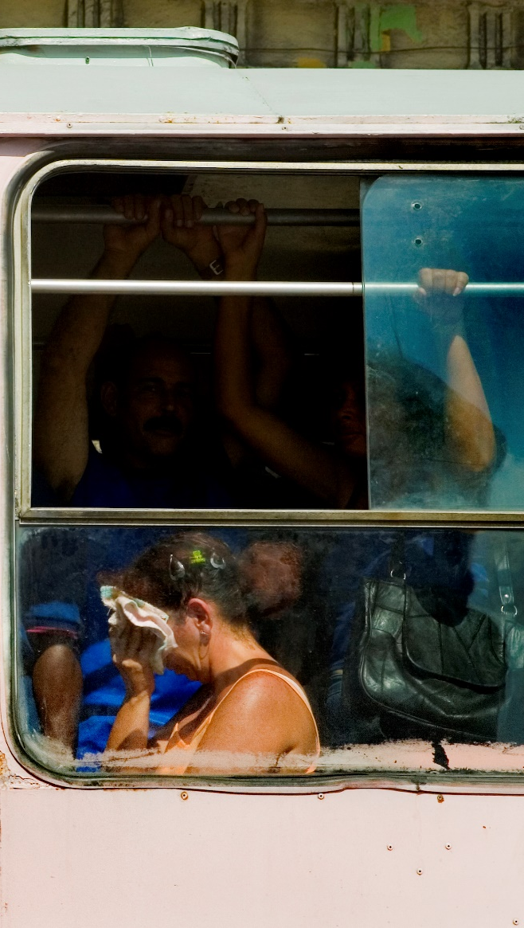
Impacts of global warming 1.5°C
At 1.5°C compared to 2°C
Less extreme weather where people live, including extreme heat and rainfall
By 2100, global mean sea level rise will be around 10 cm lower but may continue to rise for centuries
10 million fewer people exposed to risk of rising seas
Jason Florio / Aurora Photos

Slide 5
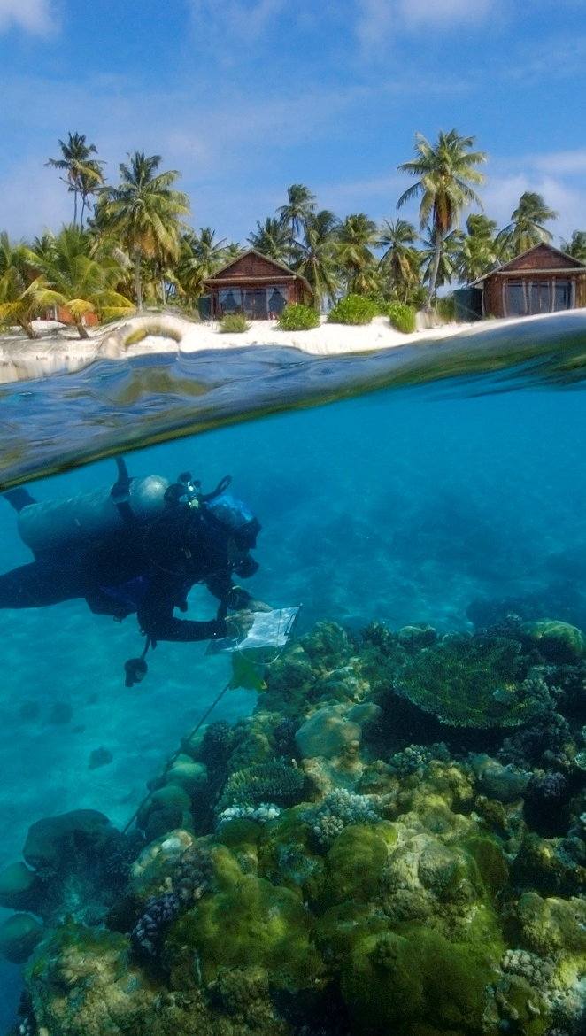
Impacts of global warming 1.5°C
At 1.5°C compared to 2°C:
Lower impact on biodiversity and species
Smaller reductions in yields of maize, rice, wheat
Global population exposed to increased water shortages is up to 50% less
Andre Seale / Aurora Photos

Slide 8
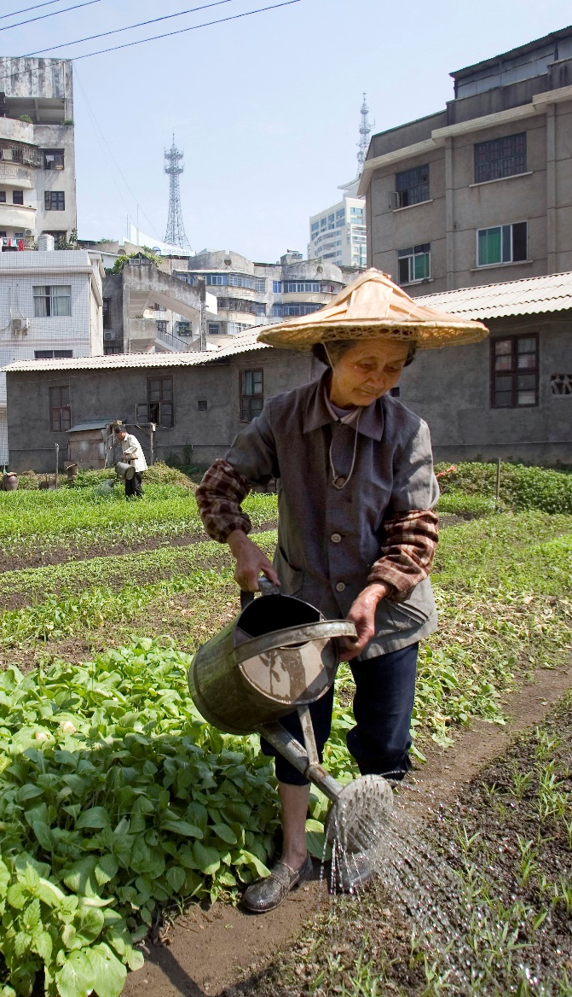
Impacts of global warming 1.5°C
At 1.5°C compared to 2°C:
Lower risk to fisheries and the livelihoods that depend on them
Up to several hundred million fewer people exposed to climate-related risk and susceptible to poverty by 2050
Natalie Behring / Aurora Photos

Slide 9
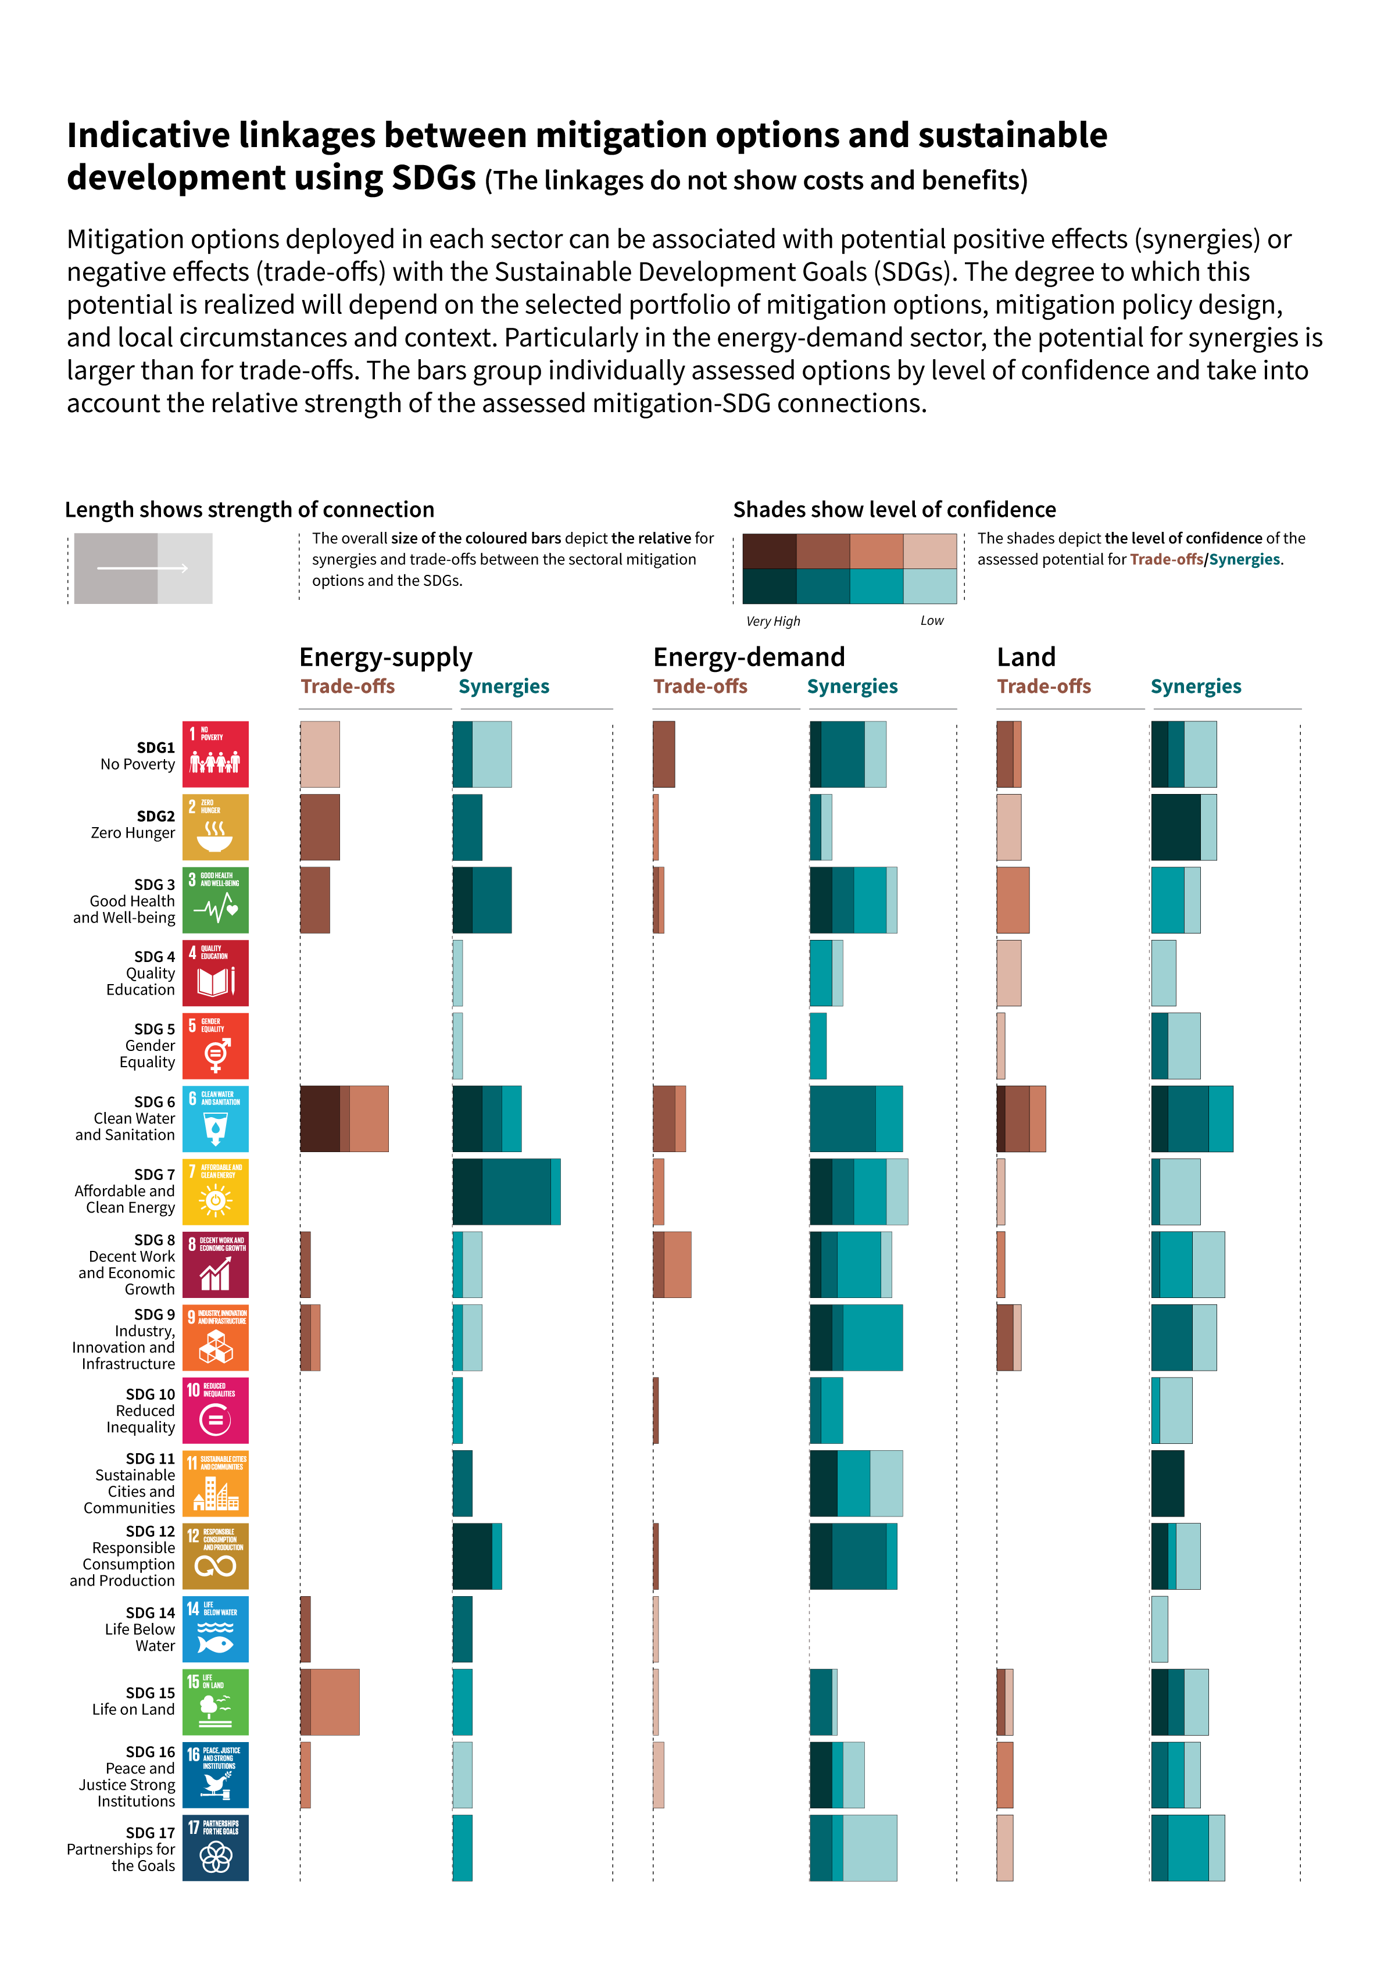
2

Slide 10

Strengthening the Global Response in the Context of Sustainable Development and Efforts to Eradicate Poverty: Special Reference to Asia

Slide 11
Impacts of global warming 1.5°C
Local yields are projected to decrease in major food producing areas South-East Asia, South-Asia.
Adaptation options that include conservation agriculture, improved livestock management, increasing irrigation efficiency, agroforestry and management of food loss and waste, complementary adaptation and mitigation options, for example, the use of climate services, bioenergy, biotechnology can also serve to reduce emissions intensity and the carbon footprint of food production.
Natalie Behring / Aurora Photos

Slide 12
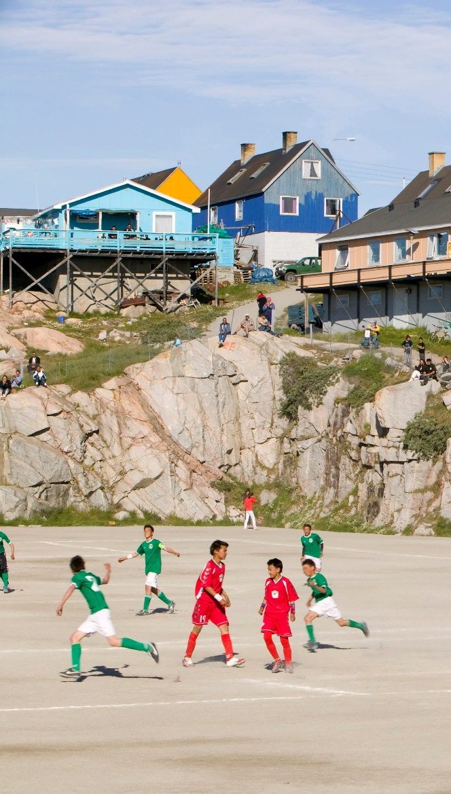
Poverty Impact
At approximately 1.5°C (2030), climate change will be a poverty-multiplier: makes poor people poorer, increases poverty head count. Most severe impacts projected for urban areas, some rural regions in sub-Saharan Africa and Southeast Asia.
Climate change will negatively affect childhood undernutrition and stunting through reduced food availability, will negatively affect undernutrition-related childhood mortality and increase disability-adjusted life years lost, with the largest risks in Asia and Africa.
Ashley Cooper/ Aurora Photos

Slide 13
Extremes
The strongest warming of hot extremes is found in Western and Central Asia. Highly unusual hot days increase the most in the tropics, extreme heatwaves emerges the earliest in these regions, where they become already widespread
Largest increases in heavy precipitation events for 1.5°C to 2°C global warming include several high-latitude regions such as northern Asia; mountainous regions (e.g. Tibetan Plateau); as well as Eastern Asia (including China and Japan)
Ashley Cooper/ Aurora Photos

Slide 14
Governance Issues
Risks of costal flooding are projected to be the highest in south and south-east Asia, assuming there is no upgrade to present protection levels, for all temperatures of climate warming
Significantly increased run off and high flows are expected to occur in South and Southeast Asia at 1.5°C , the region currently facing water shortage
Ashley Cooper/ Aurora Photos

Slide 15
Governance Issues
Run off increase and hydro power potential
Water resources availability for livestock are expected to decrease due to increased runoff and reduced groundwater resource
Moderate and high multi-sector impacts are prevalent where vulnerable people live, predominantly in South Asia (mostly Pakistan, India, and China) and South East Asia at 1.5°C
Ashley Cooper/ Aurora Photos

Slide 16
Scalable experiments, governance
In 43 Asian cities Transit Oriented Development (TOD), has emerged as an organising principle for urban growth and spatial planning reducing demand for private cars. In India TOD has been combined with localized solar PV installations and new ways of financing rail expansion.
Mitigation pathways show that synergies for air pollution increase with the stringency of the mitigation policies. The synergies for air pollution are highest in the developing world, particularly in Asia.
Low-carbon supply-side investment needs are projected to be the largest in OECD countries and those of developing Asia.
Ashley Cooper/ Aurora Photos

Slide 17
Opportunities
Built environment, spatial planning, infrastructure, energy services, mobility, urban-rural linkages necessary in rapidly growing cities in South Asia in the next three decades present mitigation, adaptation and development opportunities that are crucial for a 1.5°C world
Realising these opportunities would require the structural challenges of poverty, weak and contested local governance, and low levels of local government investment to be addressed on an unprecedented scale.
Ashley Cooper/ Aurora Photos

Slide 18
Climate change and people
Close links to United Nations Sustainable Development Goals (SDGs)
Mix of measures to adapt to climate change and reduce emissions can have benefits for SDGs
National and sub-national authorities, civil society, the private sector, indigenous peoples and local communities can support ambitious action
International cooperation is a critical part of limiting warming to 1.5°C
Ashley Cooper/ Aurora Photos

Slide 19

Questions?
Q&A

