Slide 1
DEEP DECARBONIZATION PATHWAYS AND CARBON NEUTRALITY UNDER 1.5 DEGREE AND OTHER SCENARIO FOCUSING ON ENERGY SECTOR
IN 00.41: Climate Change Challenges and Responses
Dr Bindu Lohani
Prof. Shobhakar Dhakal
Prof . Rajendra Shrestha
Asian Institute of Technology
January 2021

Slide 2
Key Questions
What is Carbon Neutrality? What is Deep Decarbonization? How can we achieve them?
What are some of the technological options for deep decarbonization of the energy sector?
This lecture focuses on the need for deep decarbonization and carbon neutrality that needs to be achieved for limiting temperature rise. It discusses the concepts of carbon neutrality and deep decarbonization highlighting role in the Energy Sector.

Slide 3
The Paris Agreement
Sets out a global framework to reduce impacts of climate change by limiting global warming to well below 2°C and putting efforts to limit it to 1.5°C.
Aim is to strengthen countries’ ability to deal with the impacts of climate change and support them in their efforts.
First universal global climate change agreement, adopted at the Paris climate conference (COP21) in December 2015.
190+ Parties were part of the Paris Agreement.

Slide 4
THE IPCC SPECIAL REPORT on GLOBAL WARMING of 1.5 ° C
.Published by Intergovernmental Panel on Climate Change ( IPCC) on 8 October 2018
. The report approved in Incheon , Korea, includes over 6000 scientific references, and was prepared by 91 Authors from 40 countries

Slide 5
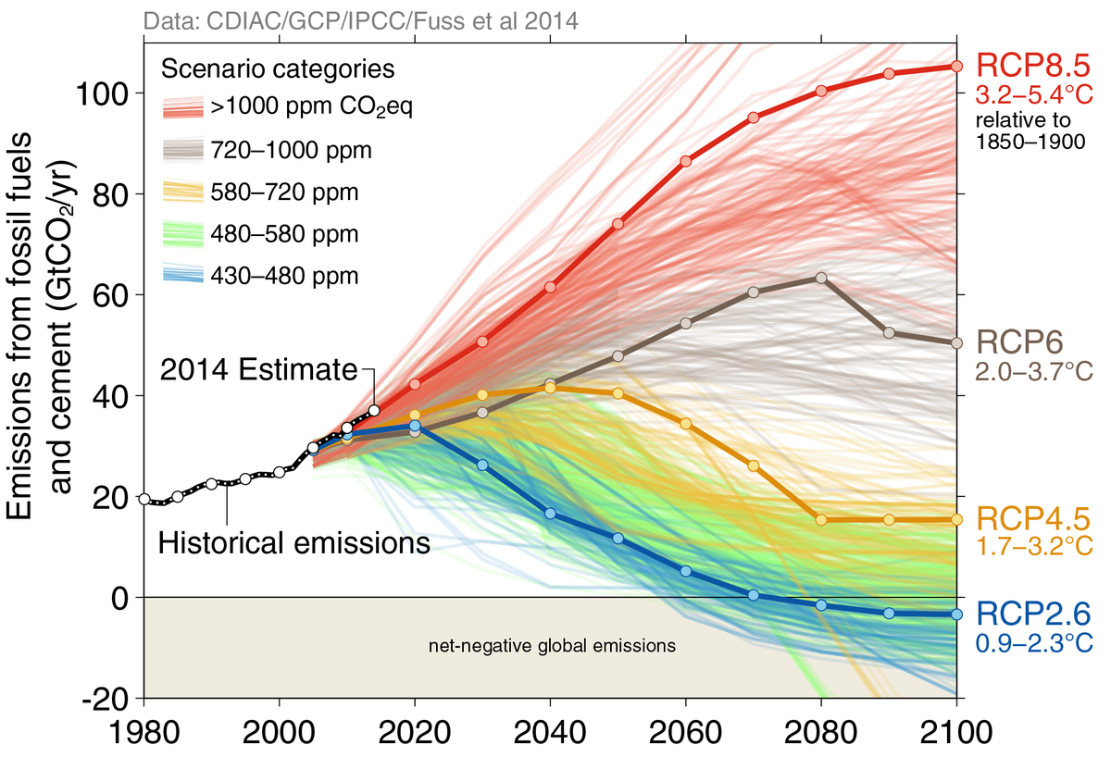
IPCC AR5 Scenarios
We need zero emissions by 2070 and net negative emissions by the end of the century

Slide 6
8 Things You Need To Know* ( IPCC 1.5°C Report )
1. Limiting warming to 1.5˚C requires major and immediate transformation.
annual emissions need to be about half (1/2) that is (25-30GtCO₂e/yr on average) by 2030 to limit to 1.5°C in temperature
behavior and technology will need to shift across the board in order to achieve these emission reduction
for example, by 2050, renewable are projected to supply 70-80% of electricity in 1.5°C pathway
2. The scale of the required low-carbon transition is unprecedented
the report finds that if the 1.5˚C goal is to be met, investments in low-carbon energy technology and energy efficiency will need increase by roughly a factor of five by 2050 compared to 2015 levels
Source: WRI*

Slide 7
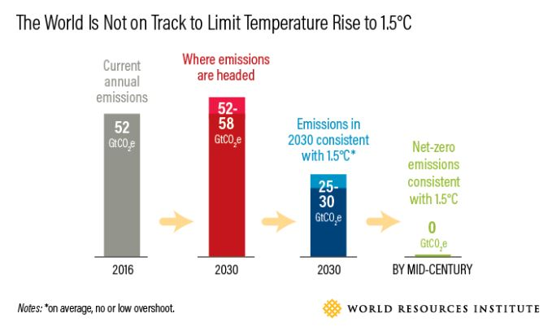
Emissions trends are only growing…
They must be cut

Slide 8
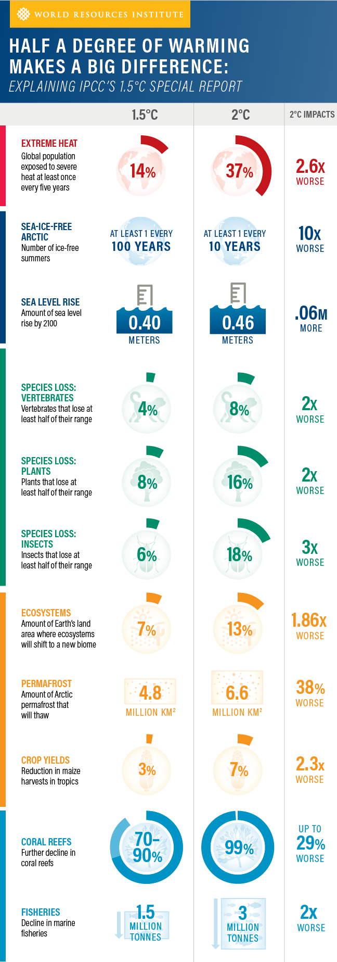
3. “Limiting warming to 1.5˚C” can mean different things—with different results
the majority (81 out of 90) of the modeling scenarios for limiting warming to 1.5˚C exceed this temperature threshold before dropping back down. The results of these scenarios are very different from those that never overshoot 1.5˚C
if the 1.5˚C goal is exceeded for many years at a significantly higher temperature, irreversible impacts, such as species extinction, may result even if warming is eventually brought down to 1.5˚C.
the impacts of 1.5˚C of warming will also depend on the chosen emissions-reduction activities.
4. A 1.5˚C limit to warming is not safe for all…
significant climate impacts already occur at 1.5˚C, especially in regards to low-lying areas, human health and oceans
the impacts will hit the poor and most vulnerable the hardest due to loss of livelihoods, food insecurity, population displacement, health effects and more
5. …but risks associated with warming are substantially lower at 1.5˚C than 2˚C.
Source: WRI

Slide 9
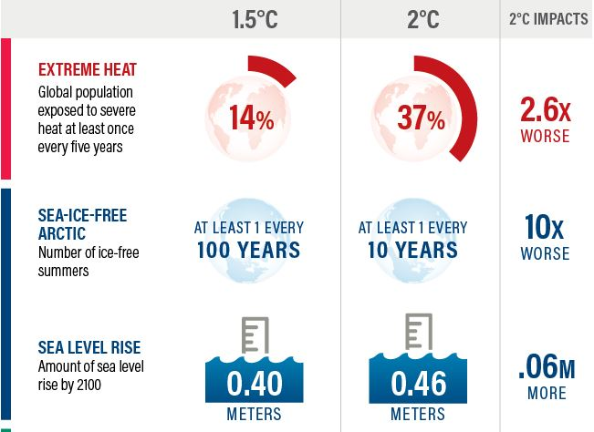
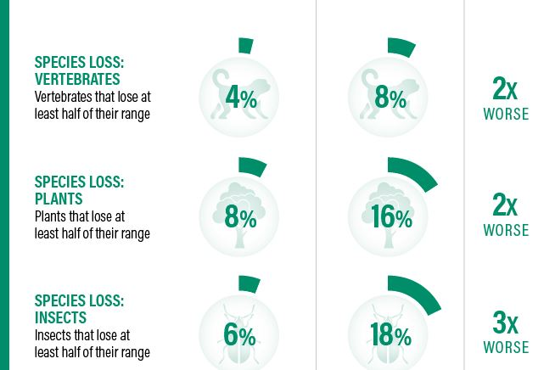
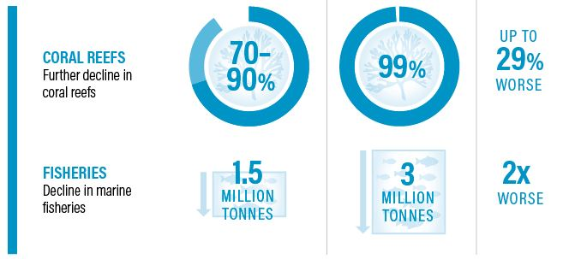
Impacts of half a degree warming
Severe impacts on the earth’s physical and eco system
Source: IPCC’s 1.5 deg C Special Report

Slide 10
6. Emissions will need to reach net-zero around mid-century
the sooner emissions peak before 2030 and the lower the level at which they do so, the less daunting the challenges will be
the critical role of short-lived but highly potent climate pollutants, such as methane and hydrofluorocarbons (HFCs) must be addressed
7. All 1.5˚C emissions pathways rely upon carbon removal to some extent
we will need to focus efforts not only on reducing emissions, but also removing and storing carbon from the atmosphere
carbon removal is necessary for both moving to net-zero emissions and for producing net-negative emissions to compensate for any overshoot of 1.5˚C
feasibility and sustainability of carbon removal could be enhanced if a portfolio of carbon-removal approaches is pursued i.e. different levels of carbon removal (ranging from 100-1,000 GtCO2 over the 21st century for scenarios with limited or no overshoot

Slide 11
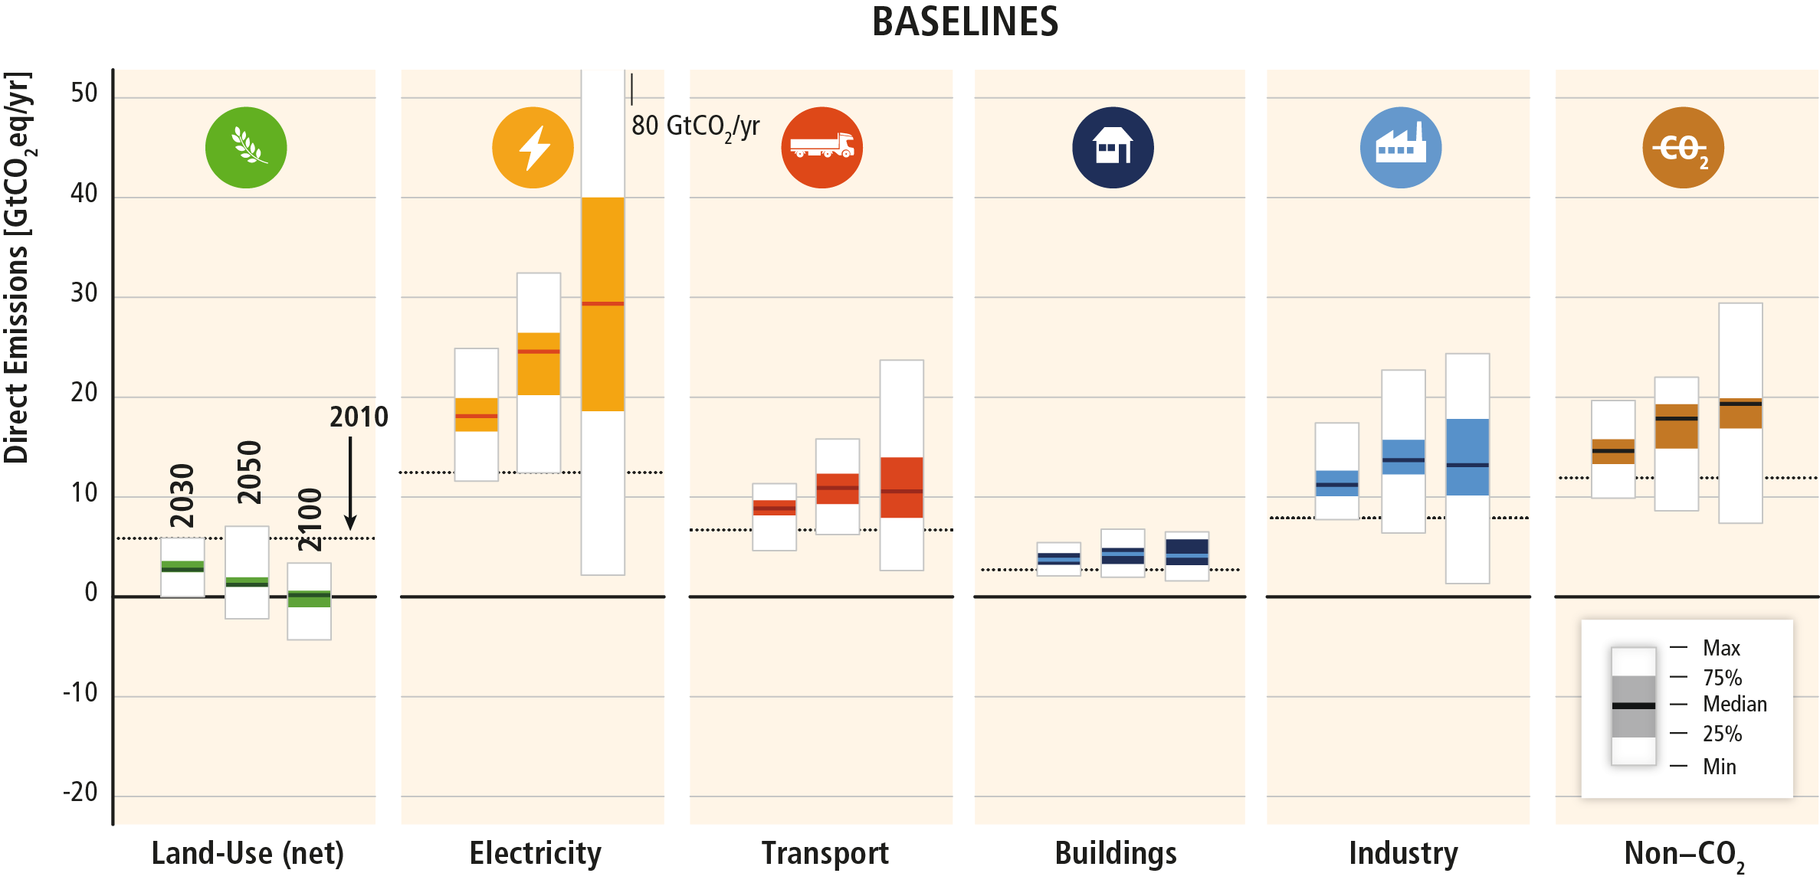
IPCC AR5 base scenario: GHG emissions rise in all sectors, except LU settor
Based on Figure TS.17
Notes:
Since 2000, GHG emissions have been growing in all sectors, except AFOLU. Annual anthropogenic GHG emissions have increased by 10 GtCO2eq between 2000 and 2010, with this increase directly coming from energy supply (47%), industry (30%), transport (11%) and buildings (3%) sectors.
Of the 49 (±4.5) GtCO₂eq emissions in 2010, 35% (17 GtCO₂eq) of GHG emissions were released in the energy supply sector, 24% (12 GtCO₂eq, net emissions) in AFOLU, 21% (10 GtCO₂eq) in industry, 14% (7.0 GtCO₂eq) in transport and 6.4 % (3.2 GtCO₂eq) in buildings.
In baseline scenarios, GHG emissions are projected to grow in all sectors, except for net CO2 emissions in the AFOLU sector.
Energy supply sector emissions are expected to continue to be the major source of GHG emissions, ultimately accounting for the significant increases in indirect emissions from electricity use in the buildings and industry sectors.
In baseline scenarios, while non-CO₂ GHG agricultural emissions are projected to increase, net CO₂ emissions from the AFOLU sector decline over time, with some models projecting a net sink towards the end of the century.

Slide 12
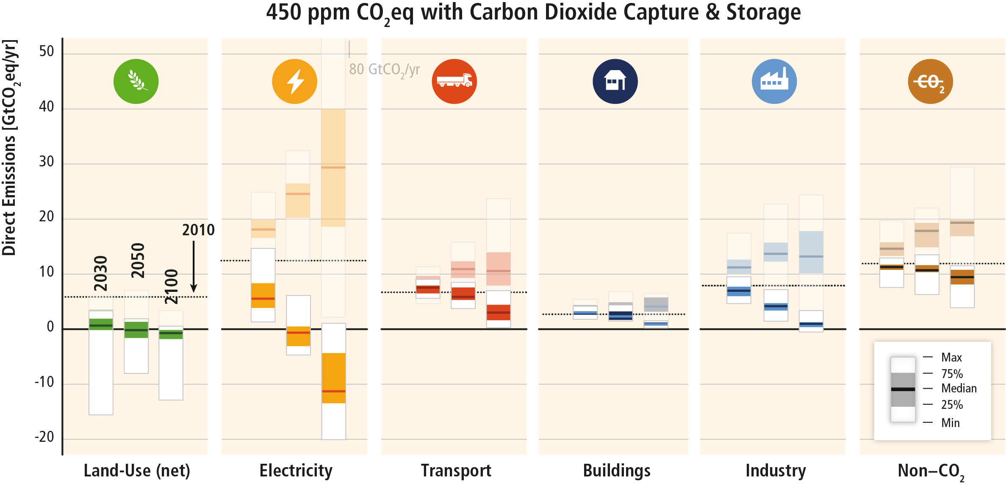
For 2⁰C stablisation: With CCS
Based on Figure TS.17
Notes:
Emission need to be reduced from baselines in all sectors in ambitious mitigation scenarios.
Well-designed systemic and cross-sectoral mitigation strategies are more cost-effective in cutting emissions than a focus on individual technologies and sectors. At the energy system level these include reductions in the GHG emission intensity of the energy supply sector, a switch to low-carbon energy carriers (including low-carbon electricity) and reductions in energy demand in the end-use sectors without compromising development

Slide 13
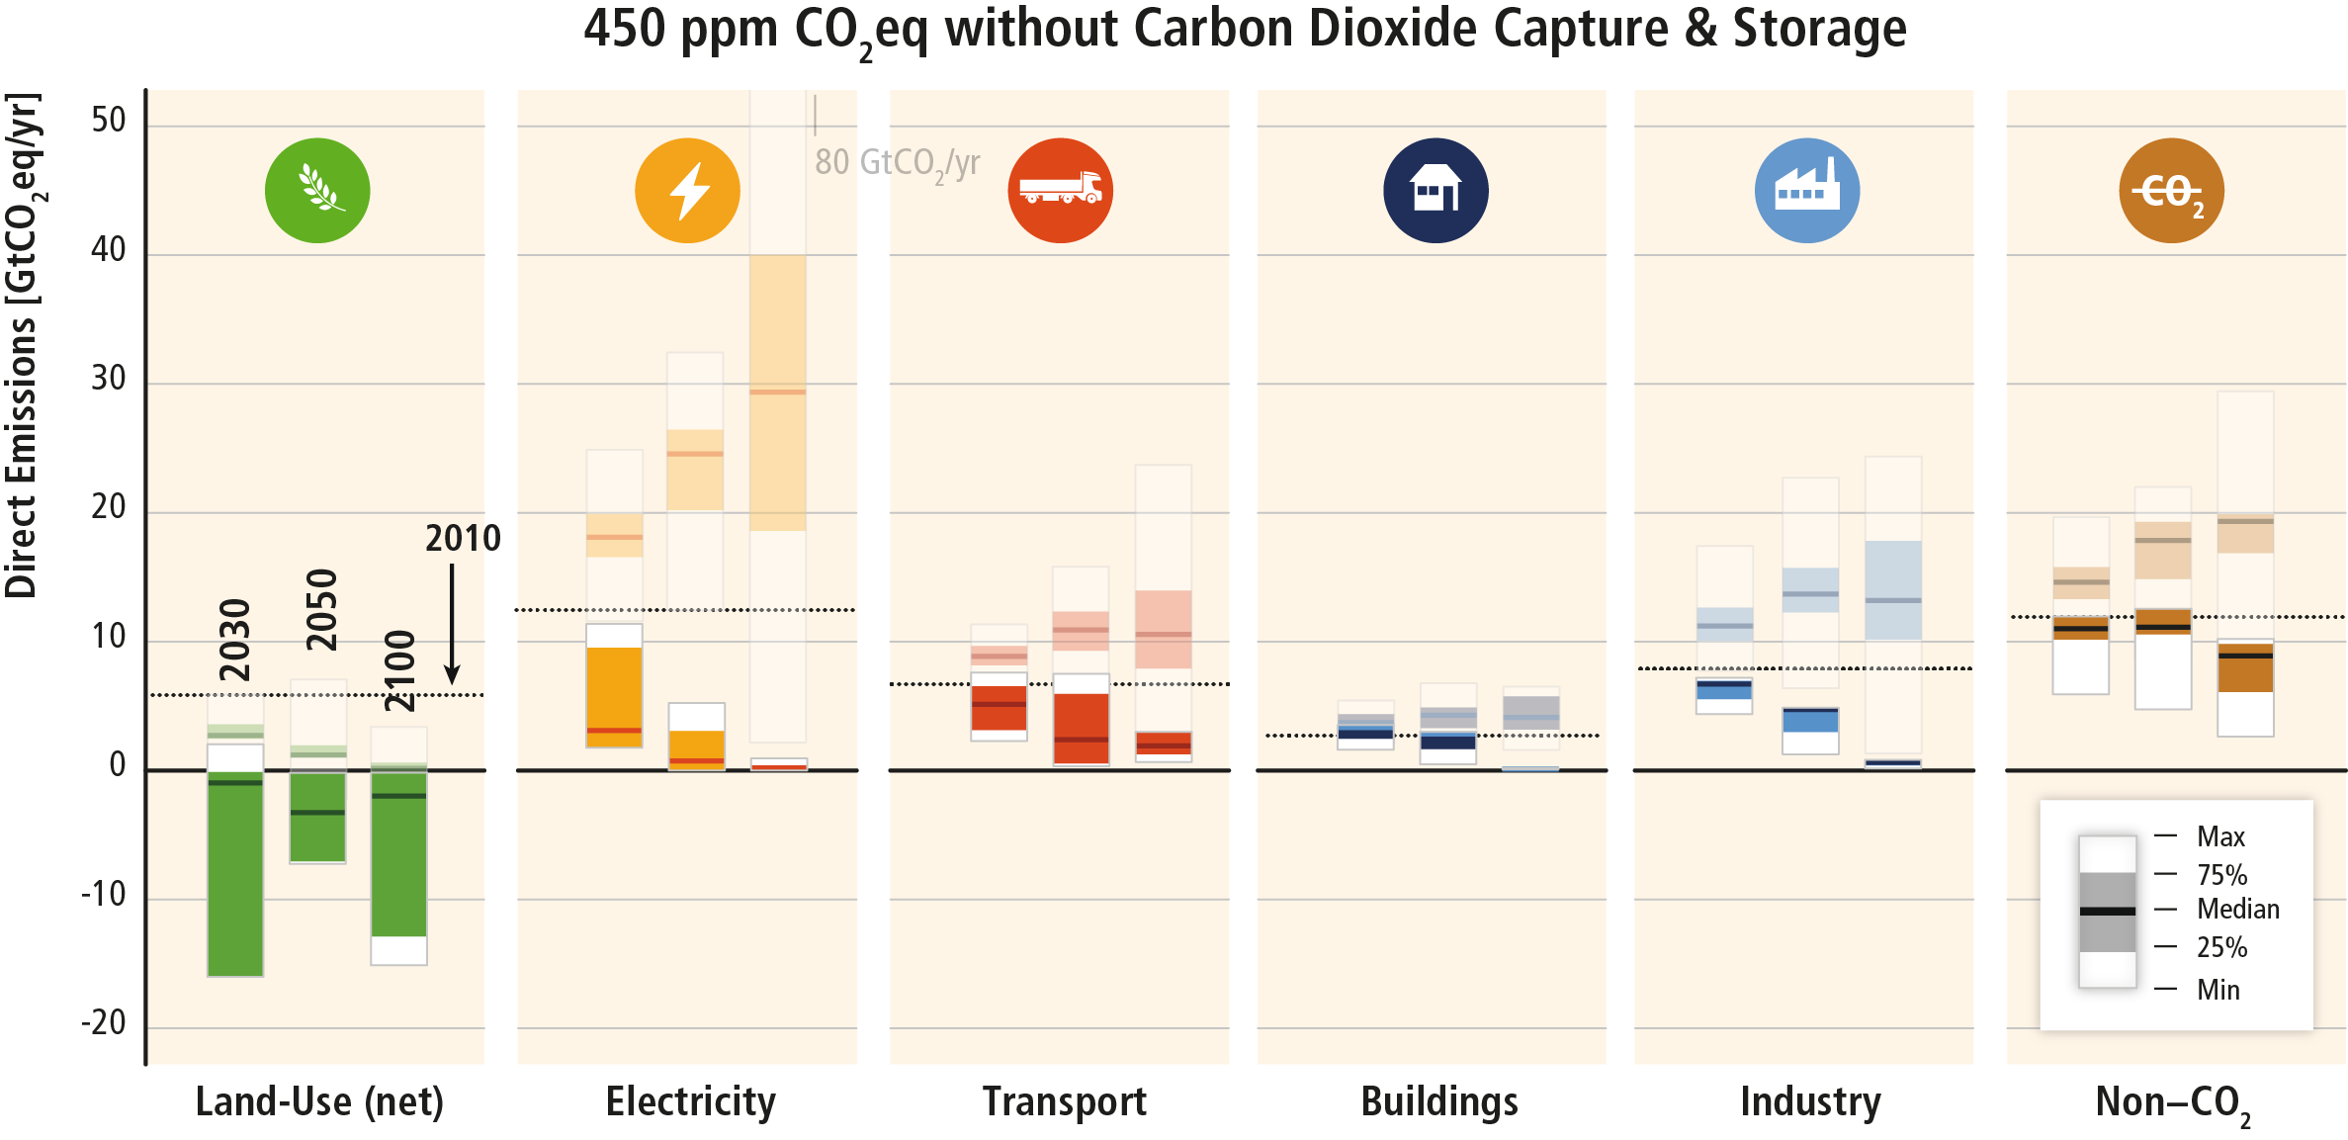
For 2⁰C stablisation: Without CCS
Based on Figure TS.17
Notes:
There are strong interdependencies in mitigation scenarios between the pace of introducing mitigation measures in energy supply and energy end-use and developments in the AFOLU sector. The distribution of the mitigation effort across sectors is strongly influenced by the availability and performance of BECCS and large scale afforestation. This is particularly the case in scenarios reaching CO2eq concentrations of about 450ppm by 2100.
It is important in ambitious mitigation scenarios to have a „negative emission option“.
If BECCS is not available, this needs to be compensated by AFOLU (afforestation – as negative emission option). Equally, more needs to be done in the energy end-use sectors.

Slide 14
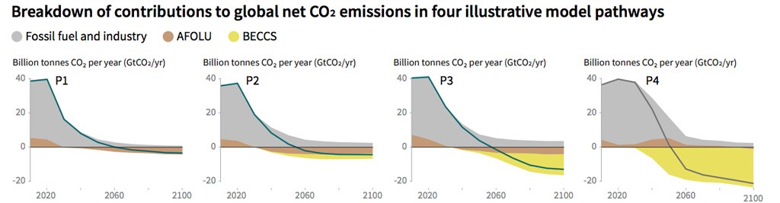
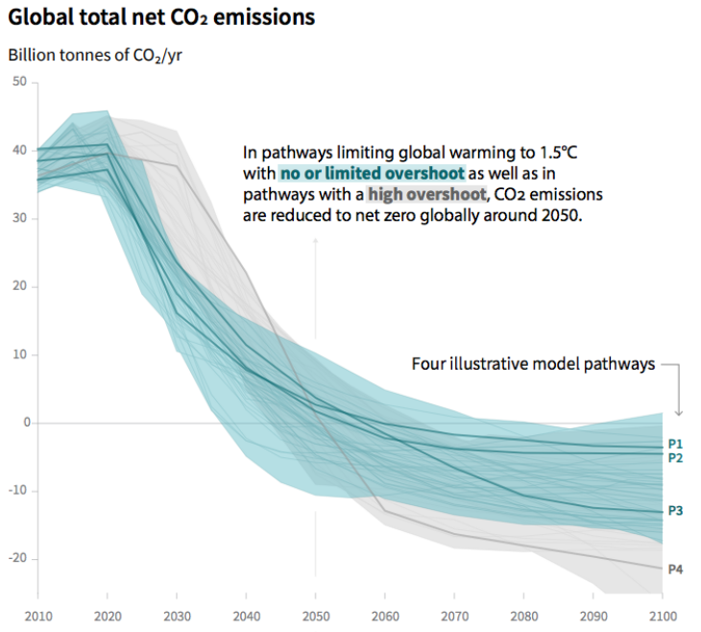
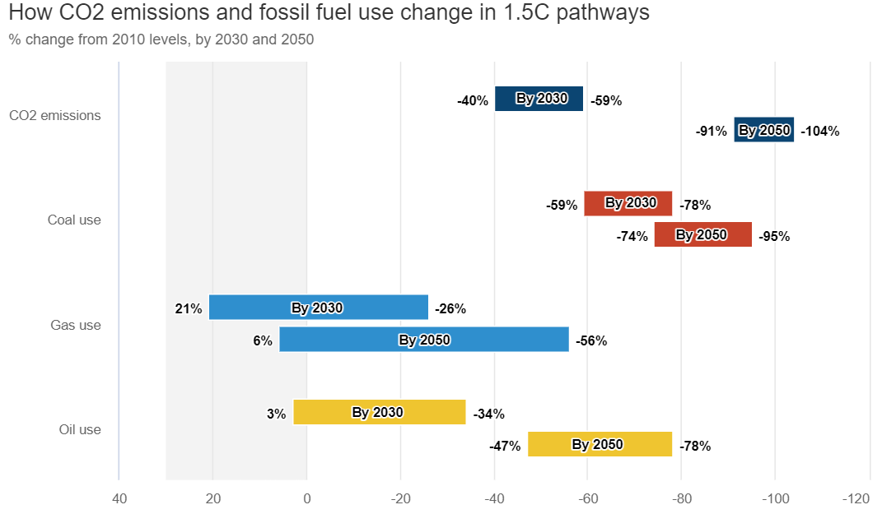
Source: IPCC SR15 SPM
Compared to 2010 levels (%), in pathways that limit temperatures in 2100 to 1.5C
Source: IPCC SR15 SPM
https://www.carbonbrief.org/in-depth-qa-ipccs-special-report-on-climate-change-at-one-point-five-c (Source: IPCC SR15 SPM figure 3b. Chart by Carbon Brief)

Slide 15
8. Everyone – countries, cities, the private sector, individuals — will need to strengthen their action, without delay
without transformation in society and rapid implementation of ambitious emissions cuts, limiting warming to 1.5˚C while achieving sustainable development will be exceedingly difficult, if not impossible
even if countries fulfill their current national climate goals and make deep emissions cuts after 2030, warming would still very likely exceed 1.5˚C, given the challenges associated with dropping emissions to net-zero well before 2045
therefore, all countries and non-state actors will need to strengthen their contributions without delay

Slide 16
What is carbon neutrality?
Another equivalent term for carbon neutrality is net zero emissions
Maintaining balance between emitted carbon and absorbed carbon from the atmosphere in carbon sinks (ocean, atmosphere etc.).
Storage of carbon also known as carbon sequestration
For achieving net zero emissions, the global greenhouse gas emissions will have to be counterbalanced by carbon sequestration.
To reduce the threatening and costly impacts of climate change, current levels of greenhouse gas emissions must be decreased by half by 2030 and reach net zero by mid-century.
(Source: wri.org, europarl.europa.eu, carbonbrief.org)

Slide 17
Myths about net zero targets and carbon offsetting
Myth 1: Net zero by 2050 is sufficient to solve the climate crisis. Misleading.
Myth 2: We can compensate for fossil fuel emissions using so-called “nature-based solutions” (such as carbon sequestration in vegetation and soils). Misleading.
Myth 3: Net zero targets as well as carbon offsetting increase the incentives to reduce emissions because emissions are allocated a cost. Misleading.
Myth 4: Carbon offsetting in low-income countries must increase to meet the Paris agreement. Misleading.
Myth 5: Funding renewable energy projects is a good way to compensate for fossil fuel emissions. Problematic.
climatechangenews.com

Slide 18
Myths about net zero targets and carbon offsetting
Myth 6: Technological solutions for carbon dioxide removal will solve the problem. Overly optimistic.
Myth 7: Tree plantations capture more carbon than leaving old forests undisturbed. Misleading.
Myth 8: Planting trees in the tropics is a cost-effective win-win solution for both nature and local communities. Oversimplified.
Myth 9: Each ton of carbon dioxide is the same and can be treated interchangeably. False.
Myth 10: Products and travel can be “climate neutral” or even “climate positive”. False.
climatechangenews.com

Slide 19
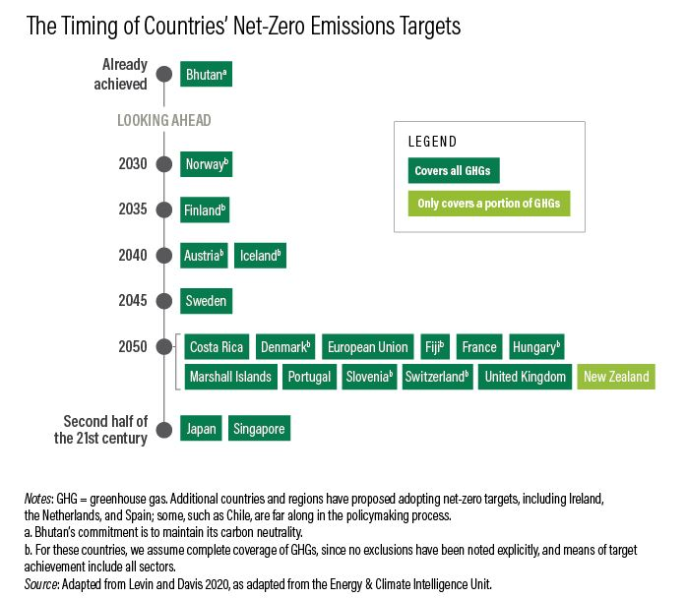
Carbon Neutrality of Countries
 | Net-zero target in place by law | Pledge in | Status
Sweden | 2045 | June 2017 | In law
UK | 2050 | June 2019 | In law
France | 2050 | June 2019 | In law
Denmark | 2050 | June 2019 | In law
New Zealand | 2050 | Nov 2019 | In law
Hungary | 2050 | June 2020 | In law
China | 2060 | Sep 2020 | Statement of intent
Japan | 2050 | Oct 2020 | Statement of intent
South Korea | 2050 | Oct 2020 | Submission to the UN
Many other countries have also pledged for carbon neutrality
Already Carbon Neutral: Bhutan & Suriname
https://www.nsenergybusiness.com/news/countries-net-zero-emissions/
https://www.climatechangenews.com/2019/06/14/countries-net-zero-climate-goal/

Slide 20
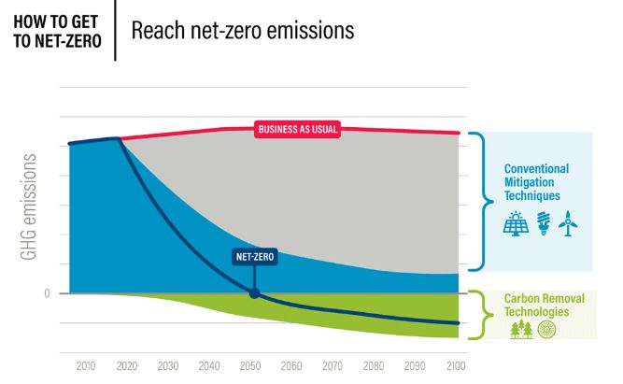
Renewables, Energy Efficiency
Forestation, CCS, BECCS, Direct Air Capture
Source: wri.org
https://www.wri.org/blog/2020/06/6-ways-remove-carbon-pollution-sky

Slide 21
How can we achieve carbon neutrality by 2050?
Minimize or zero use of fossil fuel in transport, industry, power plant
Promote EV especially that rely on perennial energy source such as solar, wind etc.
Industries to use eco-friendly technologies that will help to reduce emission
Protect existing forests and plant locally suitable trees to expand the forest areas. Sustainable agriculture and forest protection together could deliver over US$2 trillion each year in economic benefits.”
Develop energy efficient and low carbon heating/cooling system
Better urban planning and strategic infrastructure investment, particularly the expansion of public and non-motorized transport networks, can overcome bottlenecks to economic growth—such as congestion and air pollution—for more livable cities
OTHERS

Slide 22
How can we achieve carbon neutrality by 2050?
Well planned waste management and explore innovative ways to convert waste into energy
Use of low carbon machineries and technologies to improve agriculture productivity
Incentives for using low carbon technologies
Conservation and management of natural and artificial wetlands and water bodies
Use of improved technology (example: drip irrigation, remote sensors, water-efficient crops), planning and governance, use of water prices with targeted support to the poor, or by investing in public
Life style changes: walking/cycling; less meat consumption
OTHERS

Slide 23
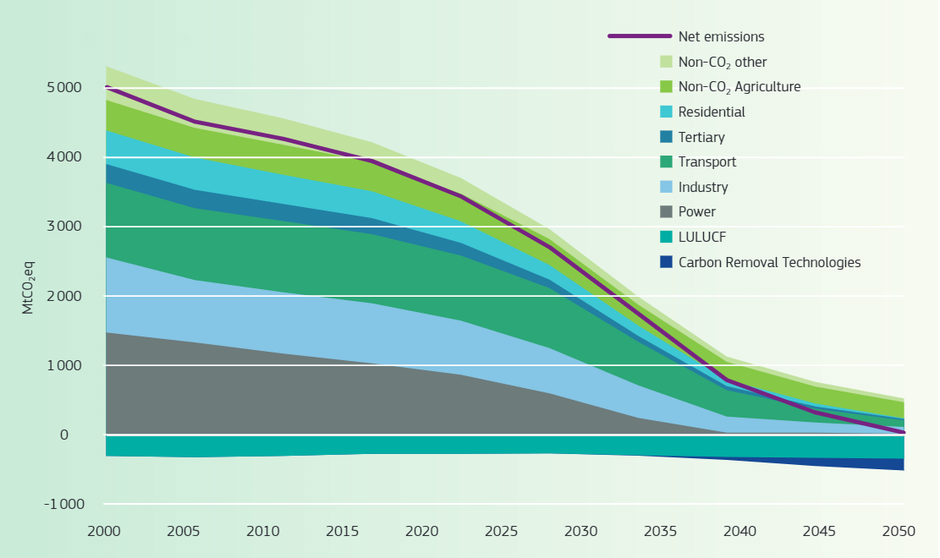
EU GHG emission trajectory in 1.5⁰C scenario
European Climate Law → the EC has proposed a legally binding target of net zero greenhouse gas emissions by 2050 https://ec.europa.eu/clima/policies/eu-climate-action/law_en
EC proposed new EU target for 2030 of reducing greenhouse gas emissions by at least 55% compared to levels in 1990.
Going climate-neutral by 2050: A strategic long-term vision for a prosperous, modern, competitive and climate-neutral EU economy, European Commission, 2019. https://op.europa.eu/en/publication-detail/-/publication/92f6d5bc-76bc-11e9-9f05-01aa75ed71a1

Slide 24
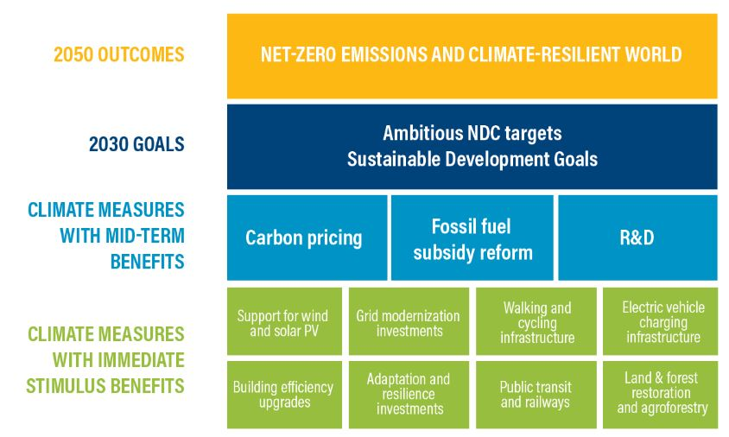
The building block approach
A framework for understanding the linkages between a COVID-19 recovery and NDC enhancement, as well as how they jointly build toward broader social and development objectives (including the Sustainable Development Goals) and ultimately a zero-carbon future by 2050.
Source: WRI

Slide 25
Asia and carbon neutrality
Together China, Japan and Korea emitted one third of all global carbon emissions in 2018
These three countries committed to 100% carbon neutrality by 2050 (Japan and Korea) and 2060 (China) in 2020
China must halt the construction of all new coal-fired power plants, continue to boost the renewable sector, and implement a low-carbon transition across all aspects of society.
Japan should target 50% renewable energy by 2030 and introduce policies to make it easier for renewable energy providers to enter the market.
Korea needs to strengthen its 2030 greenhouse gas emissions target by agreeing to reduce emissions by at least half by 2030, compared to 20% as currently planned. In addition, Korea must also commit to scrapping all coal-fired plants.
https://www.greenpeace.org/eastasia/blog/6219/china-japan-and-korea-promised-carbon-neutrality-now-we-need-them-to-make-it-happen/

Slide 26
China Carbon Neutrality Pledge
President Xi Jinping made ambitious pledge at the UN General Assembly on 22 September 2020 for China to be carbon neutral by 2060 → green, low-carbon, circular and sustainable economic system
China’s carbon neutrality target as a “game-changer” for the global climate (Mark Levine, Lawrence Berkeley National Laboratory)
Required (Zhang Xiliang, Tsinghua University)
Massive rise of renewable electricity generation by 2060
A 16-fold increase in solar; a 9-fold increase in wind
Replace coal-fired power generation by 6-fold increase in nuclear power, and 2-fold increase in hydroelectricity
Some fossil fuels (coal, oil and gas) still will persist; need CCS or offset by new forest growth
Emission peak in 2025, plateau till 2035 and steeply decline
Nature 586, 482-483 (2020)
https://doi.org/10.1038/d41586-020-02927-9

Slide 27
WHAT IS DEEP DECARBONIZATION ?
De-carbonization refers to the reduction or elimination of carbon dioxide from ENERGY SOURCES
Full de-carbonization of our energy systems is the only way to climate stabilization ( WEF)
In practice , getting to zero net emissions requires switching to clean energy sources and shifting from fossil fuels to electricity

Slide 28
Deep Decarbonization in the Energy Sector
Investments in energy efficiency and enduse
Hydropower investments
Investment in non-hydro renewables – solar, wind etc
Growing wealth and economic modernization correlate with electrification of the energy sector
Building electrification has been significant
Transportation has lagged- EVs will help
Direct commitments to clean, efficient energy and decarbonization
https://www.wri.org/blog/2020/01/6-lessons-energy-decarbonization-countries-leading-way

Slide 29
The Deep Decarbonization Pathways Project
The Deep Decarbonization Pathways Project (DDPP),established in 2013, is a collaborative global research initiative seeking to understand how individual countries can transition, on a technological, socio-economic and policy “pathway”, to a low-carbon economy consistent with the internationally agreed goal of limiting anthropogenic warming to less than 2 degrees Celsius (2°C) or less .
The DDPP fills a gap in the climate policy dialogue by providing, in the form of deep decarbonization pathways (DDPs), a clear and tangible understanding of what will be required for countries to reduce emissions, consistent with the 2°C limit.
The focus of DDPP is on sustainable energy systems ,other sectors of economy , such as agriculture , and land use , are not directly comsidered.

Slide 30
DDPP COUNTRIES
Countries covering 74 %of global energy-related
greenhouse gas emissions
. Australia , Brazil ,Canada ,China, France, Germany ,India ,Indonesia, Italy, Japan, Mexico, Russia ,South Africa, South Korea , the UK , and the US
. 16 COUNTRIES
Coordinated by IDDRI( the Institute for Sustainable Development and International Relations) and Sustainable Development Solutions Network ( SDSN)

Slide 31
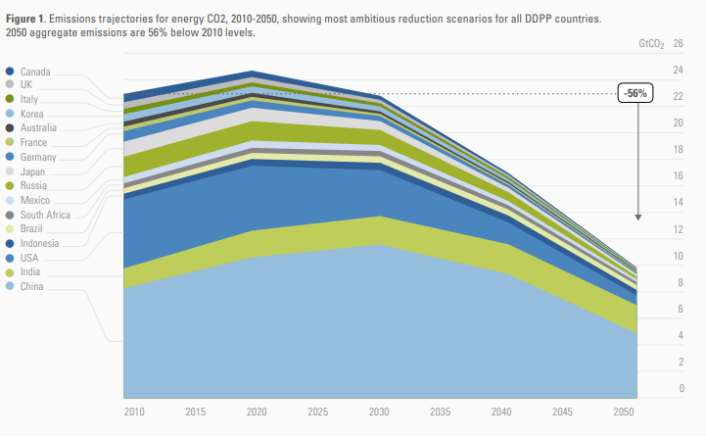
Emissions trajectories for energy CO2, 2010-2050
Most ambitions reduction scenarios
Top 16 Emitters covering 74% of global energy related-emissions
https://www.iddri.org/sites/default/files/import/publications/ddpp_2015synthetisreport.pdf

Slide 32
3 Pillars of Deep Decarbonization for the Energy Sector
Energy efficiency and conservation
Energy efficiency and conservation
Decarbonizing electricity and fuels
Decarbonizing electricity and fuels
Switching energy end-uses to lower-carbon, and eventually zero-carbon, energy carriers (e.g. electricity, hydrogen and biofuels)
https://www.iddri.org/sites/default/files/import/publications/ddpp_2015synthetisreport.pdf

Slide 33
Illustrations : DDPP – CHINA ( Selected Recommendations)
Deep carbonization pathways for the replacement of coal with electricity, penetration rate of electric cars ( EVs) in transport sector ,and potential od Carbon capture and storage (CCS)
Strong policy response is needed for China to transition towards a deep carbonization pathways .
Promote the transition from carbon intensity control to total carbon emissions control gradually
Rely more on market- based measures by developing a reasonable pricing system based on GHG emissions
Others (refer to China DDPP Report )

Slide 34
Illustrations : DDPP – USA ( Selected Recommendations)
There is still sufficient time for the U.S. to achieve 80% GHG reductions by 2050 relying on natural infrastructure turnover. However, to achieve emissions goals and avoid the costs of early retirement, it is critical to account for economic and operating lifetimes in investment decisions.
A deeply decarbonized energy economy would be dominated by fixed cost investments in power generation and in efficient and low-carbon end-use equipment and infrastructure, while fossil fuel prices would play a smaller role.
The recent U.S. government commitment to reduce U.S. total GHG emissions by 26–28% below 2005 levels by 2025 is consistent with the results of this report. Figure ES-1 shows the reduction in total GHG

Slide 35
Illustrations : DDPP – USA ( Selected Recommendations)
Study did not find any major technical or economic barriers to maintaining the U.S. long-term commitment to reducing GHG emissions consistent with limiting global warming to less than 2°C.
Fossil fuel use not controlled by CCS would be greatly reduced and limited to a smaller number of sources. Decarbonized energy systems of 2050 would look fundamentally different from those of today.
The majority of final energy would be delivered in a form that is currently delivered by network providers today (e.g. the utilities that operate the electricity grid and gas pipeline system).
Deep emission reductions would depend on interactions across sectors and fuel types that today may not share the same markets or regulatory environments, suggesting a need for policy innovation.

Slide 36
DDPP FINDINGS
DDPP analyses show that goal of limiting the rise of global temperature due to 2°c or less is barely possible using the existing technology

Slide 37
Carbon neutral and zero net emissions will be a priority agenda in COP 26 in November 2021 .
A timely topic

Slide 38
References
https://www.iddri.org/sites/default/files/import/publications/ddpp_2015synthetisreport.pdf
https://www.iddri.org/en/publications-and-events/blog-post/carbon-neutrality-key-political-attractor-reach-paris-agreement
https://www.nature.com/articles/d41586-020-02927-9

Slide 39
Thank you
Contact: Dr. Bindu Lohani (bnlohani@gmail.com)

Slide 40
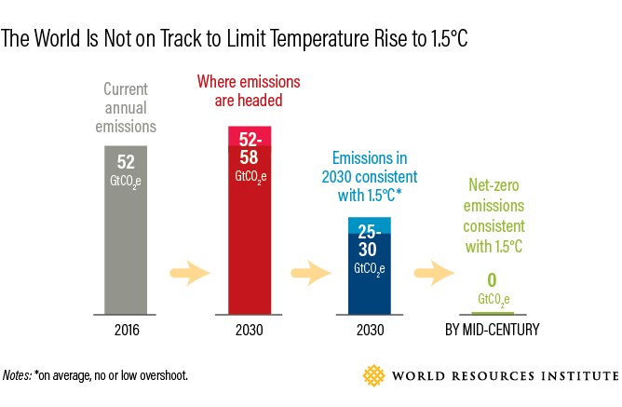

Slide 41
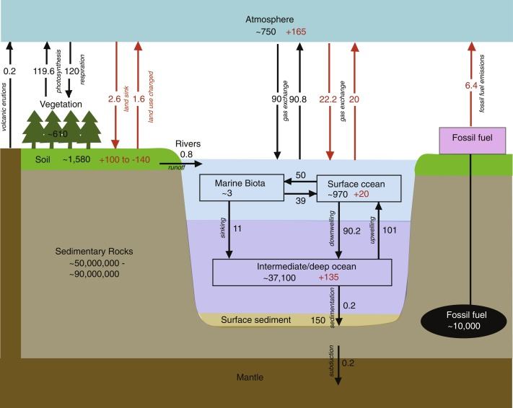
Carbon Cycle

Slide 42
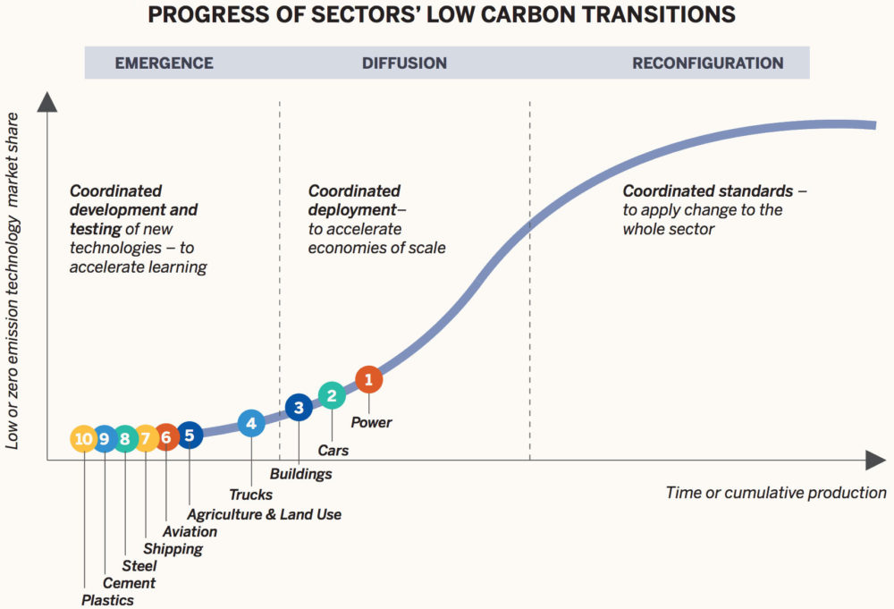
Progress of Sectors
https://e360.yale.edu/features/deep-decarbonization-a-realistic-way-forward-on-climate-change

Slide 43
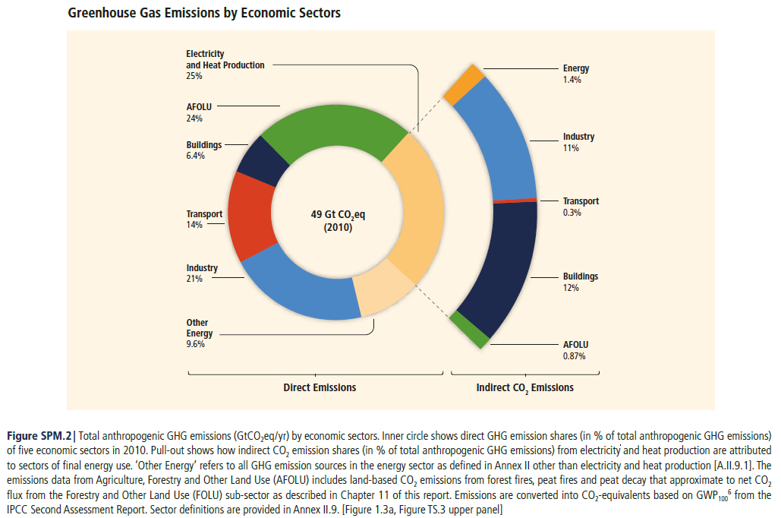
Emissions

