Slide 1
Circular Economy &
Climate Change
Prasad Modak
8th February 2022

Slide 2
Circular Economy
Regenerative and restorative economy that is inclusive
Aims to redesign the production and consumption systems
Integrates social, environmental, economic and cultural aspects, especially behavioral change
A paradigm shift

Slide 3
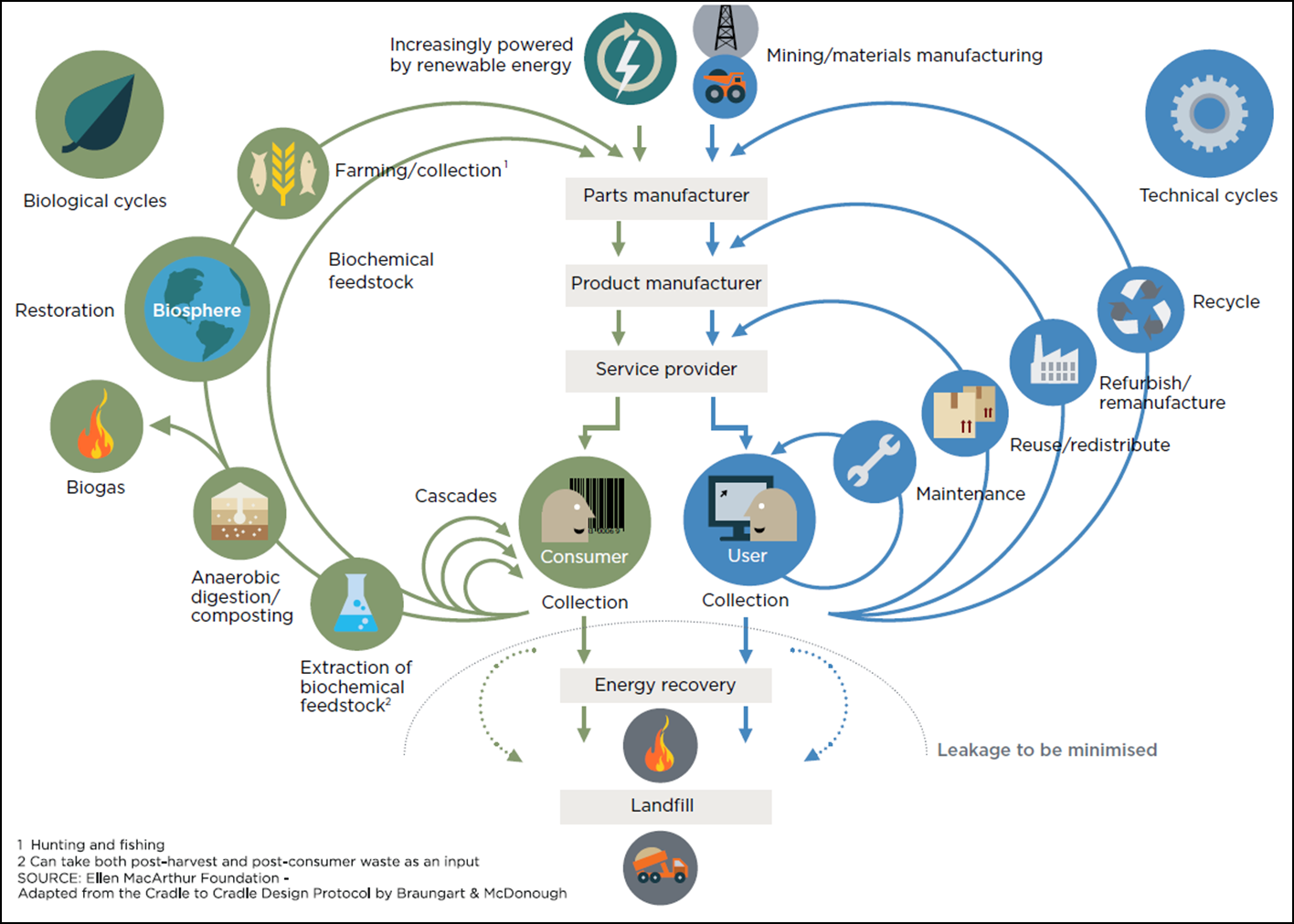
The Butterfly Diagram
Source: Ellen McArthur Foundation

Slide 4
Four Circles of Circular Economy
Transformative with innovation
Cutting down consumption of virgin resources
Re-Design, Rethink
Refuse , Reduce, Reuse
Adding value with tech/ creating green jobs
Extending product life
Return , Recycle, Recover, Remanufacture
Repair, Refurbish, Renovate

Slide 5
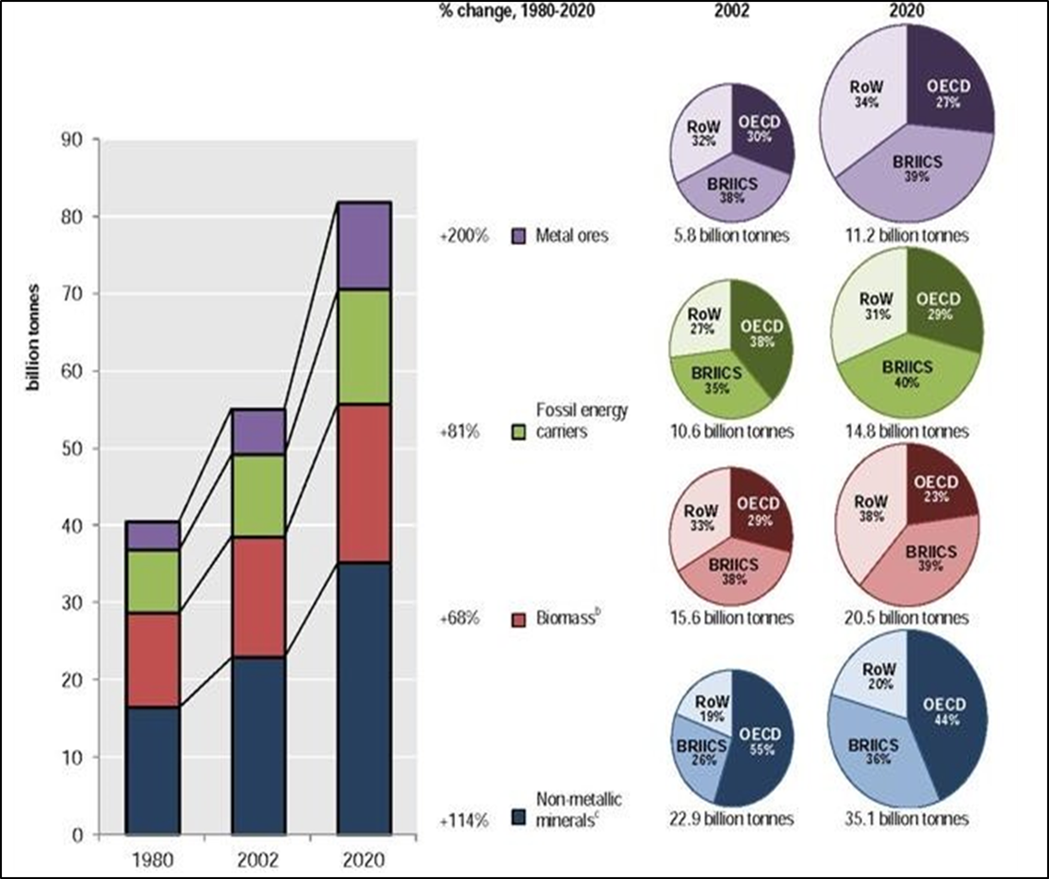
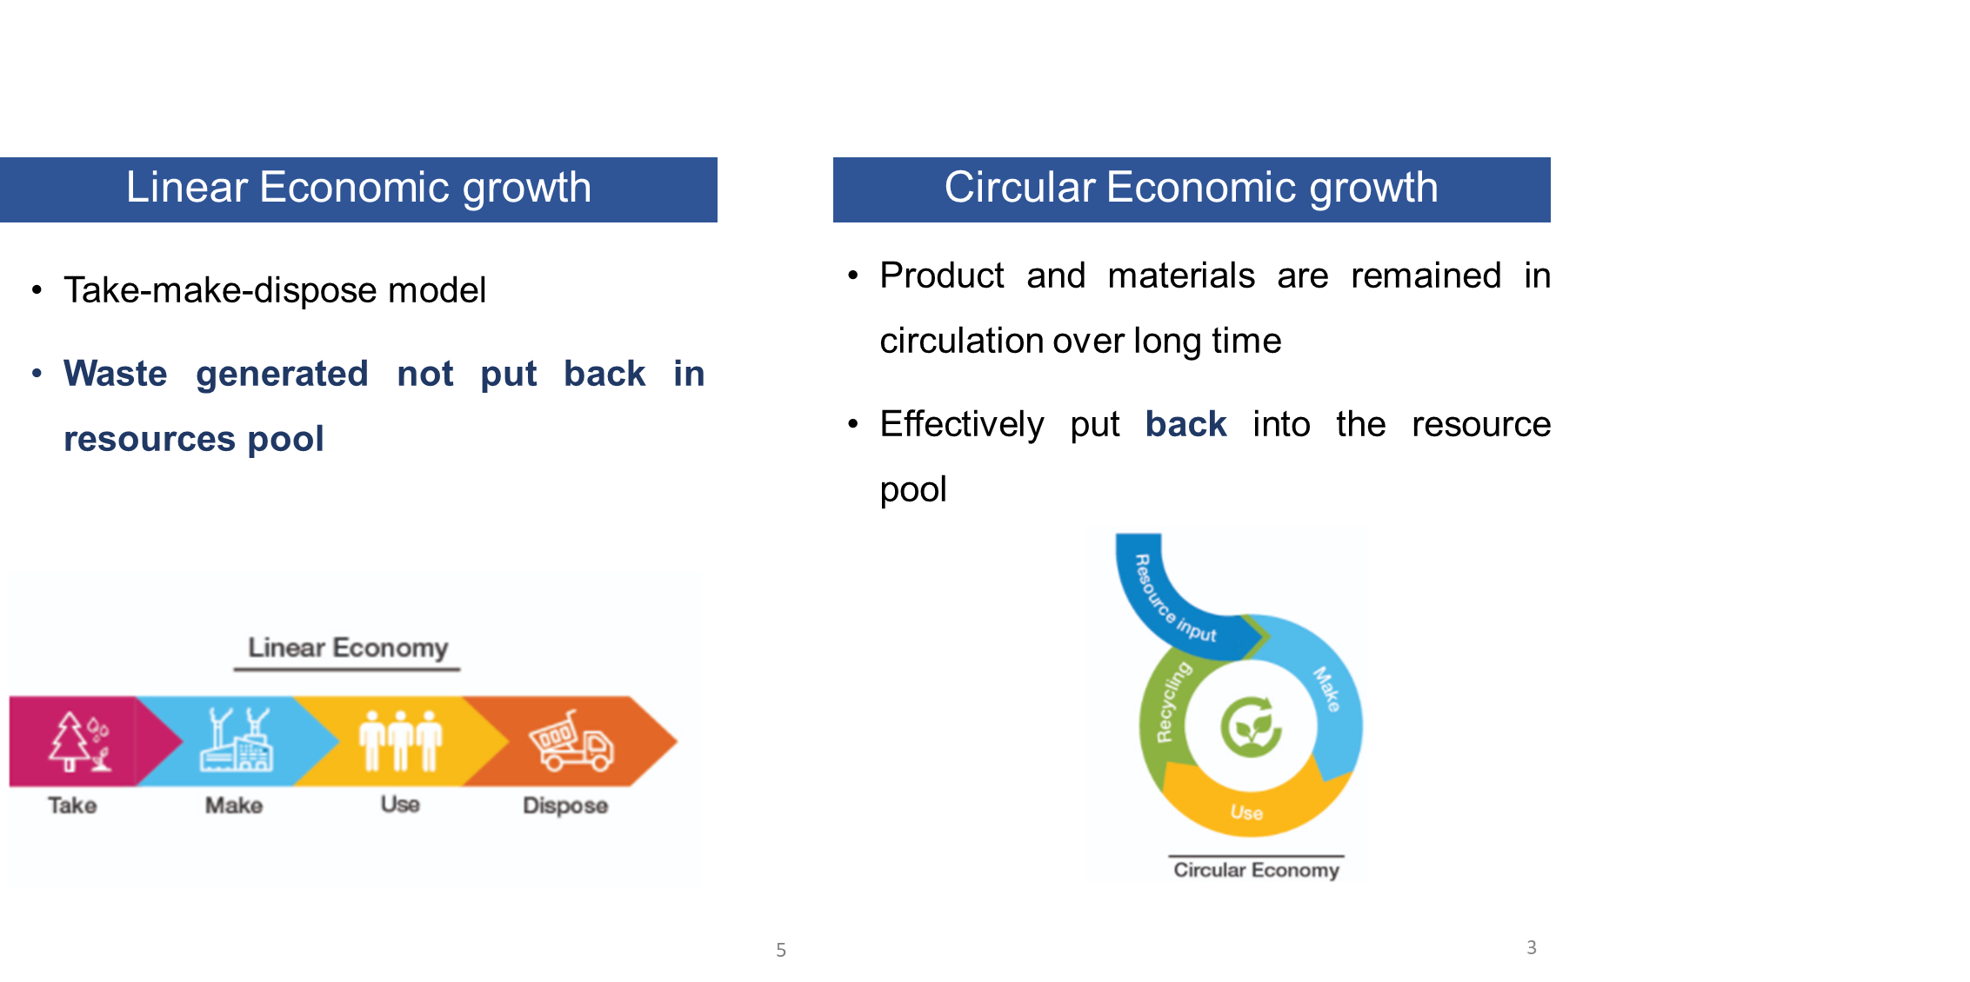

Why Circular Economy?
Increasing resource consumption
Need for Changing the Course

Slide 6
Climate and Circularity
Need for product cycles to become more efficient and closed in order to reach climate neutrality
Circle Economy calculates: 62% of global GHG emissions (excluding those from land use and forestry) are released during the extraction, processing and manufacturing of goods to serve society’s needs; only 38% emitted in the delivery and use of products and services
Source: The Circularity Gap Report 2019

Slide 7
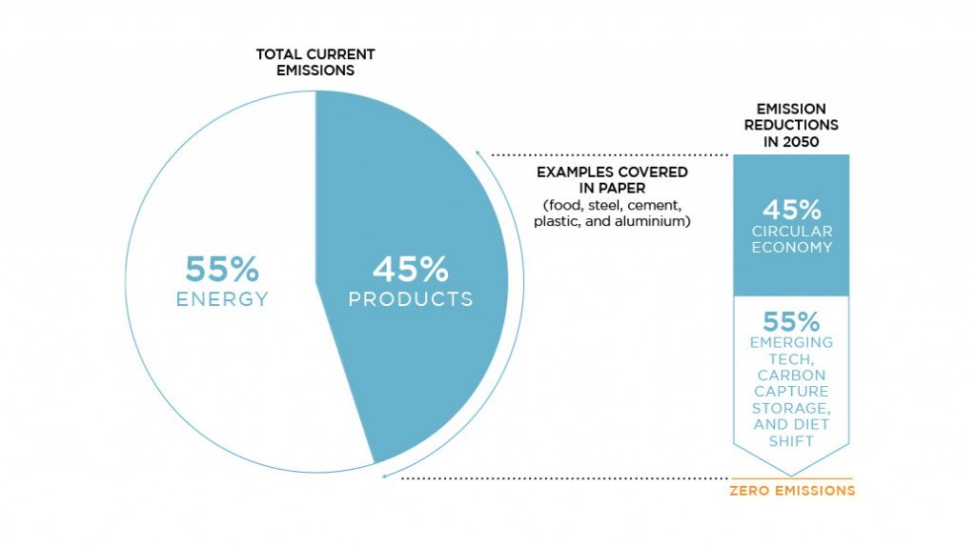
Circular economy –Critical role in Climate Mitigation Action
Source: Completing the Picture: How the Circular Economy Tackles Climate Change. Ellen MacArthur Foundation
and Materials Economics. https://www.ellenmacarthurfoundation.org/publications/completing-the-picture-climate-change

Slide 8
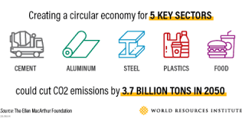

Slide 9
Material Efficiency Strategies for Climate Action
Using less material by design
Material substitution
Fabrication yield improvements
More Intensive use
Enhanced end-of-life recovery and recycling of materials
Product life extension
Recovery, reuse and remanufacturing components
Material efficiency is an essential part of the circular economy
Consists of the preservation of materials by making products more durable and repairable and facilitating recovery and recycling of material at the end of the product life
Source: Resource Efficiency and Climate Change: Material Efficiency Strategies for a Low-Carbon Future (resourcepanel.org

Slide 10
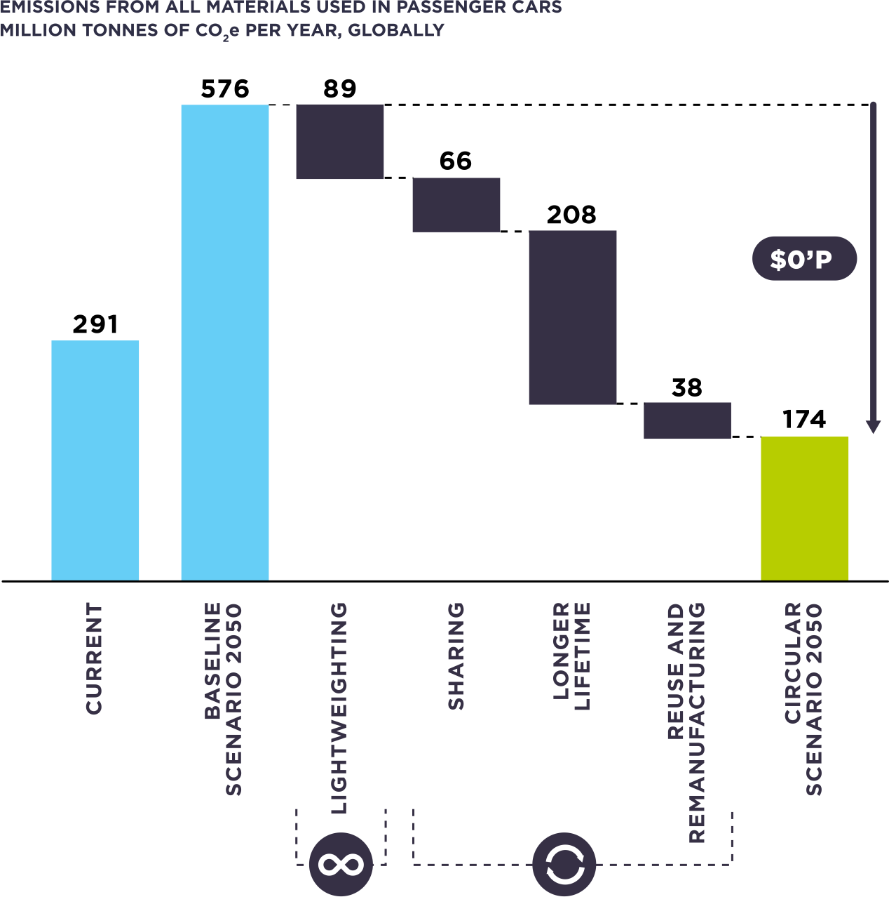
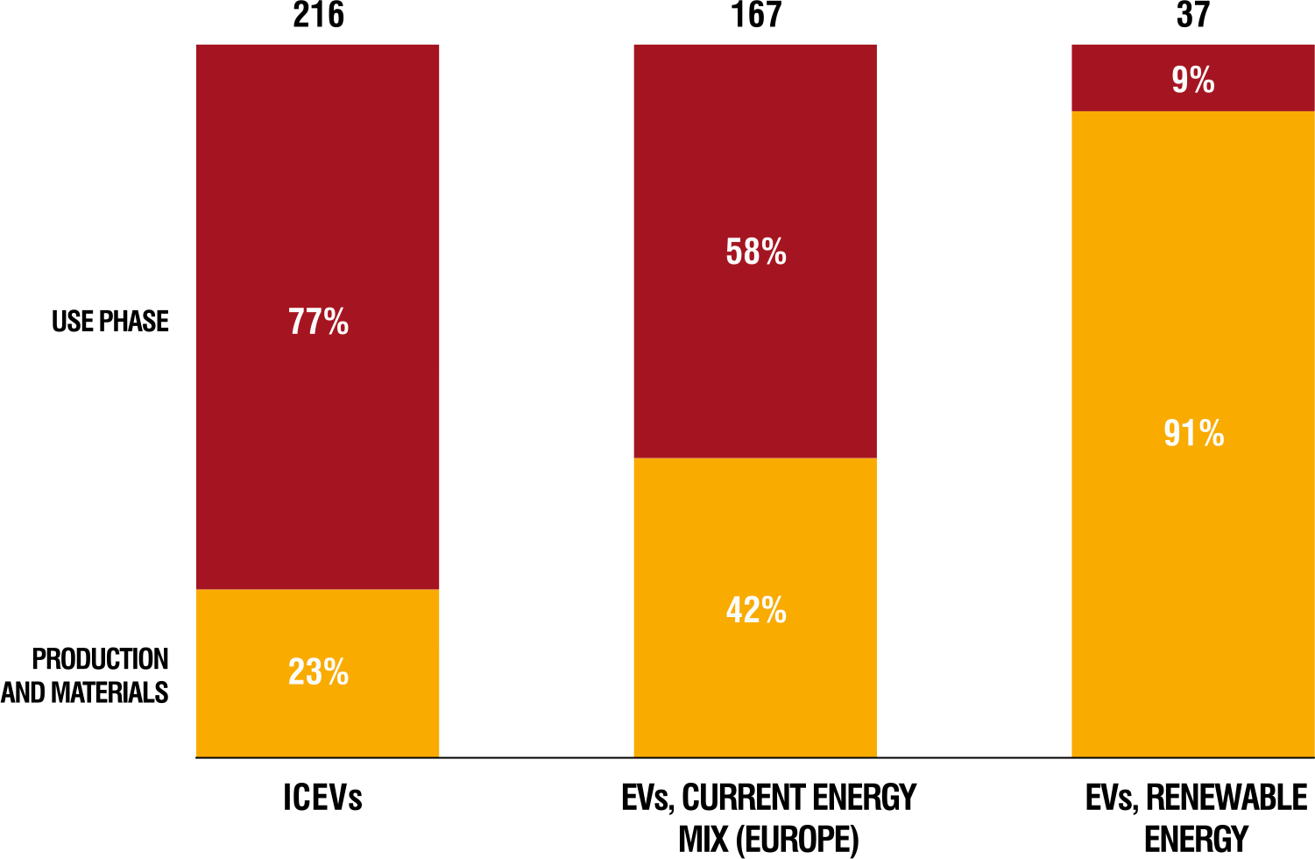
Circular economy leading to emission reduction: Potential for Mobility Sector
Circular scenario for passenger cars could reduce global CO2 e emissions by 70%
Lifecycle CO2 emissions from ICEVs versus EVs (g CO2 per car km)
Source: Material Economics. The Circular Economy. A Powerful Force for Climate Mitigation
Source: Completing the Picture: How the Circular Economy Tackles Climate Change. Ellen MacArthur Foundation and Materials Economics. https://www.ellenmacarthurfoundation.org/publications/completing-the-picture-climate-change

Slide 11
Circular strategies for decarbonization in Mobility
Incorporating the circular economy in electrification of transport
  Circular approaches can ensure that the dramatic increases in battery production required incorporate reuse and remanufacturing principles from the outset
Expanding shared mobility
  Emphasizing shared mobility (e.g. public transport)
  Ensuring transport connectivity are central to promoting zero-emission urban transportation systems.
Source: EN_GEF.STAP_.C.60.Inf_.02_Circular_Economy_and_Climate_Change_Mitigation.pdf (thegef.org)

Slide 12
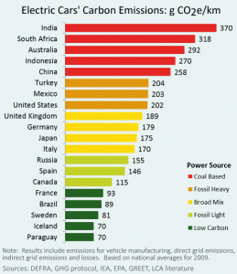
Put your thinking caps: Are electric Cars really greener?
Variation across countries
Country’s energy mix affects the environmental advantage of EVs.
Even dependence on time of the day for charging- night-time electricity is less dependent on coal
Recycling of special materials and components- need technology and finance
  Recycling EV batteries is an asset-intensive business in which high utilization is critical to operating efficiency
Should the focus be on development of a circular ecosystem for EVs?
Source: http://shrinkthatfootprint.com/wp-content/uploads/2013/02/Emissions-Equivalent-Petrol-Car.gif

Slide 13
Circular economy for Climate adaptation
Urban planning - nature-based solutions integrating green infrastructure and ecosystem services into the built environment to further boost resilience
Circular nature-based solutions is based on use of renewable resources, reuse or repurpose other resource streams and avoid unwanted by-products.
  Nature-based solutions also make adaptation measures circular and smarter by promoting multifunctional areas in cities. For example, green spaces in Stockholm are used for both heatwave protection and recreational activities
Supply chain management and raw material security
Future proofs society and businesses

Slide 14
Circular strategies for Construction sector and opportunity for emission reduction
Adoption of circular design principles - minimise waste, optimise buildings for energy efficiency and for usage, using regenerative materials and components (cross-laminated timber (CLT)), recycled (such as circular aggregates) or reused
Maximize their utilization, improving their energy efficiency and preventing their demolition through adaptive reuse, circular refurbishment and retrofitting
Circular construction and demolition criteria or green infrastructure—such as rainwater harvesting systems or green roofs—also present important opportunities both for material use reduction and to reach net-zero emissions.
Carbon footprint of built environment globally
Source: 20220128-Glasgow-Net-Zero-1.pdf (circularglasgow.com)

Slide 15
Enablers
Innovation
Regulation
Market instruments including Fiscal Measures
Procurement
Information
Partnerships and Collaborations
Infrastructure
Partnership Innovation
Process Innovation
Product Innovation
Packaging Innovation
Proposition Innovation
Digital Innovation
Source: Supporting Net Zero Through a Circular Economy - Anthesis (anthesisgroup.com)
Extended Producer Responsibility with mandated recovery and recycling targets
Regulation of pollution from recycling activities (for example in case of auto recycling)
Regulations around right to repair
Recycled content in product mandates
Incentives for sharing models of products and services
Carbon tax
Subsidies
Preferential purchasing by government departments and agencies of circular, and low embodied carbon content products
Procurement of refurbished or remanufactured products
Products as service model and extended warranties
Responsible disposal
Labelling and Certification for reuse and remanufacturing
Peer nudges to change behaviour
Product information about carbon intensity
Voluntary commitments
Sectoral strategies engaging key stakeholders
Common circular infrastructure
Science, Research and Technology parks
Infrastructure to support emerging/new technologies (for example, charging infrastructure for EVs)

Slide 16
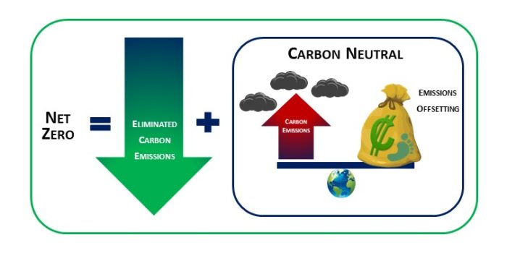
Circular Economy for Net Zero Targets
Net zero – key emerging sustainability trend
To meet net zero targets, circular economy approach can be part of the trajectory to meet net zero targets
Can be included in company strategy and governance in the form of mission statements, commitments, targets and plans, city plans, tapping circular opportunities in rural areas
Pilots, incubators and demonstration projects to test business solutions that address the twin objectives of circular economy and decarbonization
One-third of NDCs updated and submitted this year, largely across Europe and some other G20 countries, include mention of a circular economy (the Netherlands, Finland and Chile are few examples).
Circular economy, carbon neutrality and net zero : Yorkshire Circular Lab (leeds.ac.uk)
Source: How the Circular Economy Can Help Nations Achieve Their Climate Goals | World Resources Institute (wri.org)

Slide 17
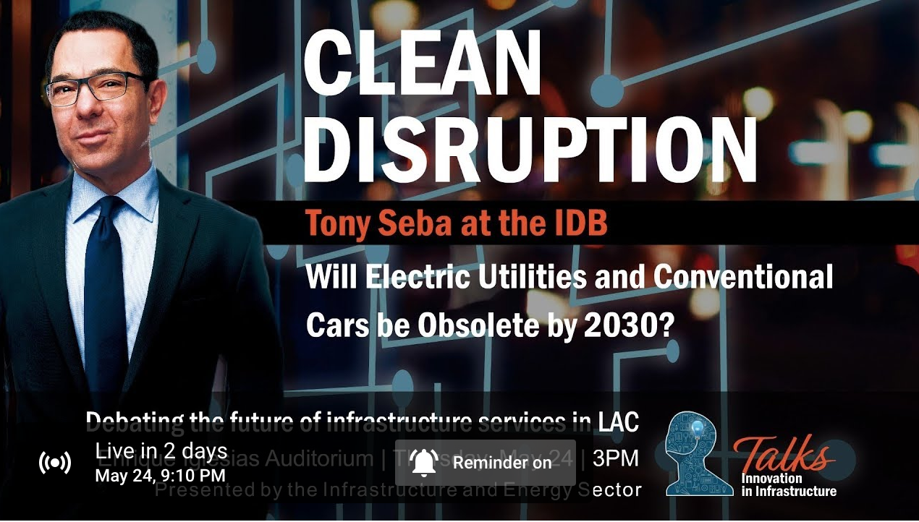
Not just technology,
market creation and financing
Is COVID-19 the time?
Will Behavior Change drive?
Will the change sustain?
Shouldn’t Climate Change Lead?

Slide 18

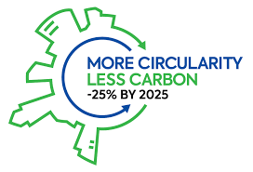

Slide 19
Thank you

