Slide 1

Cities are crucial elements for deep de-carbonization in the 1.5⁰C world
IN 00.41: Climate Change Challenges and Responses
Asian Institute of Technology
January 2021
Shobhakar Dhakal, Ph.D.
Professor, Department of Energy, Environment
and Climate Change
http://faculty.ait.asia/shobhakar/
shobhakar@ait.ac.th, shobhakar.dhakal@gmail.com

Slide 2
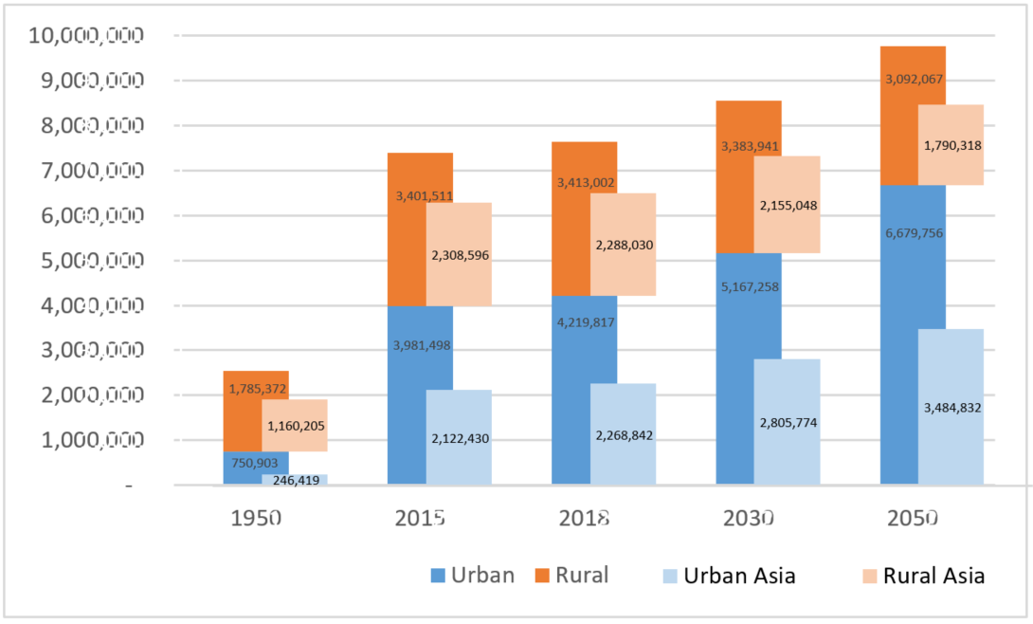
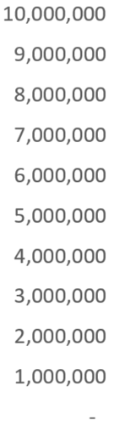
The demographic challenge
UN-DESA, WUP 2018 revision
Asia Population: Asia+ Oceania, excl Australia and New Zealand

Slide 3
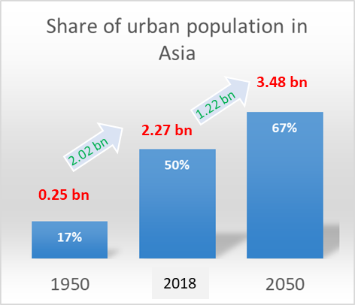
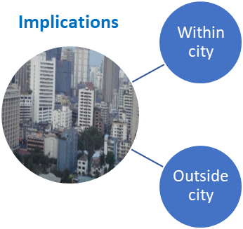
Geography of urbanization
Globally, 4.2 out of 7.6 bn population live in urban areas in 2018 (55.3%) → 1950(30%), 2050 (68%)
Within Asia, roughly 50% (2.27 bn) of population (4.56 bn) now living in cities (17% in 1950) → over 67% by 2050 → This means 1.22 bn new additions in 2019-50 in Asia (UN-DESA, WUP 2018 revision).
Rapid population growth expected in small (<300,000), 1-5 mn city, and the mega-cities (>10 mn) (UN-DESA, WUP 2018 revision).
If left un-checked, slum dwellers globally from 1 to 3 bn by 2030 (about 65% of them in Asia)
Notes:
Asia Population (Asia+ Oceania, excl Australia and New Zealand)
1950 2015 2018 2030 2050
Urban 246,419 2,122,430 2,268,842 2,805,774 3,484,832
Rural 1,160,205 2,308,596 2,288,030 2,155,048 1,790,318
Total 1,406,624 4,431,026 4,556,872 4,960,822 5,275,151
World population
1950 2015 2018 2030 2050
Urban 750,903 3,981,498 4,219,817 5,167,258 6,679,756
Rural 1,785,372 3,401,511 3,413,002 3,383,941 3,092,067
Total 2,536,275 7,383,009 7,632,819 8,551,199 9,771,823

Slide 4
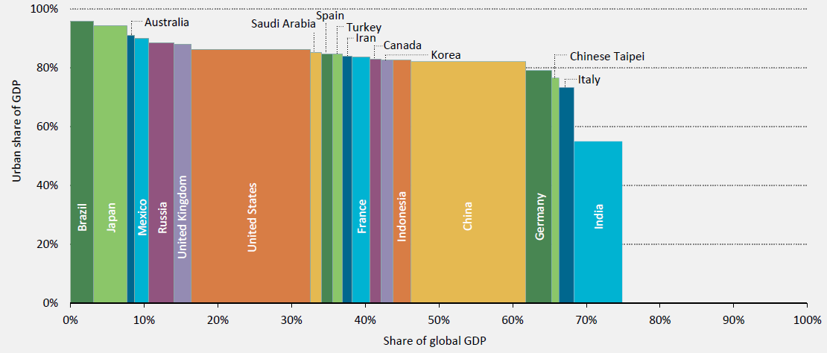
Urban contributions to GDP, 20 largest economies, 2013
(IEA, 2016)

Slide 5
Global land expansion challenge
Urban land occupy between 0.2 to 2.4% of global terrestrial land (2000)- Expansion of urban areas is taking place at twice the rate of urban population growth
Between 2000 and 2030, urban areas will expand between 0.3 million to 2.3 million km2 (56-310%) - 55% of the total urban land in 2030 is expected to be built in the first three decades of the 21st century
Nearly half of the global growth in urban land cover is forecasted to occur in Asia; 55% of the regional growth to take place in China and India
Schneider et al., 2009; Angel et al., 2011; Seto et al., 2011, 2012
Potere and Schneider (2007). GeoJournal 69: 55–80

Slide 6
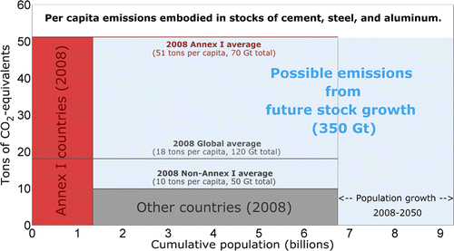
Infrastructure demands large emissions
The existing infrastructure stock
  Average Annex-I resident is 3 times that of the world average
  About 5 times higher than average non-Annex I resident
> a third of the 2°C emission budget by 2050 (1,000 GtCO2)
Müller et al., 2013
Notes:
In any case, next 2-3 decades present a window of opportunity for large mitigation in rapidly urbanizing areas of developing world, especially small and mid-size cities, fast economical growing regions, and where infrastructure is being built and yet not locked-in. The existing infrastructure stock of the average Annex I resident is 3 times that of the world average and about 5 times higher than that of the average non-Annex I resident. The catching-up in developing countries could result in as high as one third of the future remaining cumulative 2050 emission budget to stay under 2°C track. Guiding new urbanization now for right urban form, design and infrastructure is a key for future emission reductions.

Slide 7
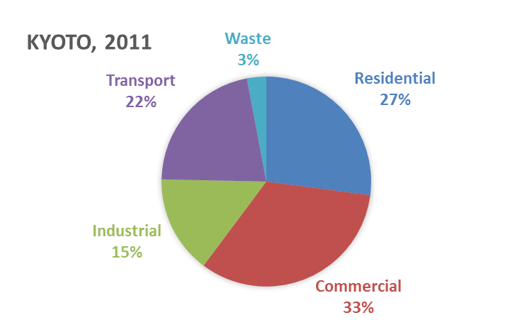
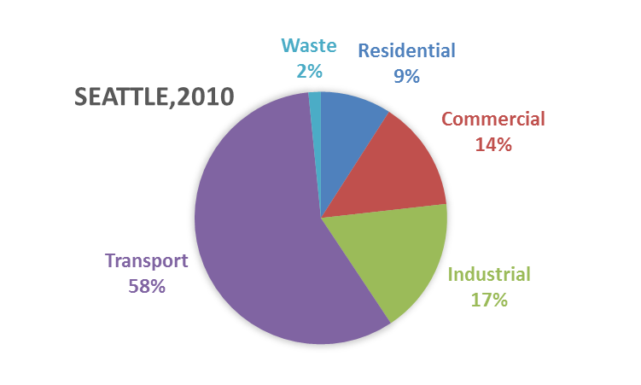
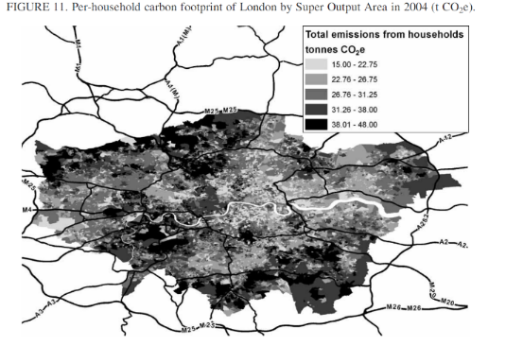
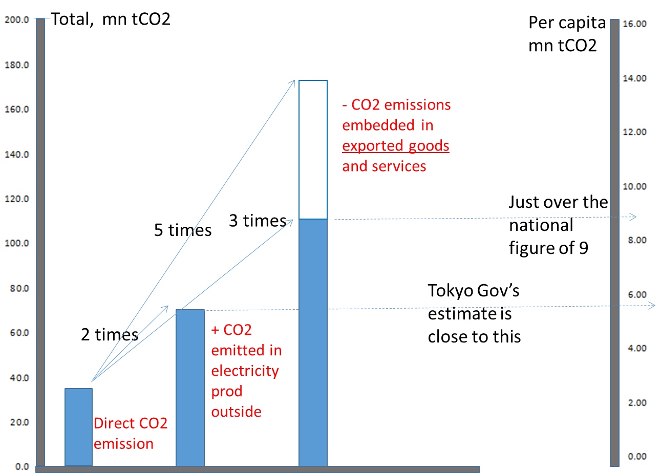
Role of cities in global GHG mitigation is enormous
71-76% of energy-related global CO2 emissions are from energy use in cities (IPCC, 2014; GEA 2012; WEO 2008)
Consumption driven upstream emissions makes cities even more important–e.g. over two-times in Tokyo and London
Emissions and contribution of sources vary greatly across cities – direct comparison often does not tell us much - cities are different from nation states
Prepared based on Carbonn Registry
LONDON, 2004
Consumption CO2
Minx et al. 2009, Economic Systems Research
TOKYO
Notes:
Urban areas already contribute between 71% and 76% of global CO2 emissions from energy use. If we account for embodied-emissions in the consumption-goods and services, cities become even more important, to give you an example- the emission attributed to consumption sides are over two times of direct emissions in Tokyo and London.
The per-capita city emissions vary across cities- it is not easy to compare what it means – because cities have different functional roles

Slide 8
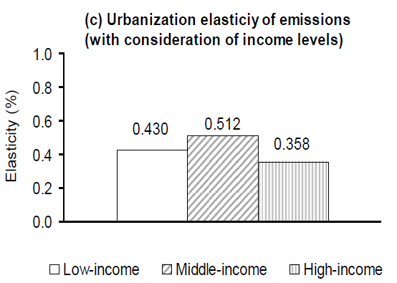
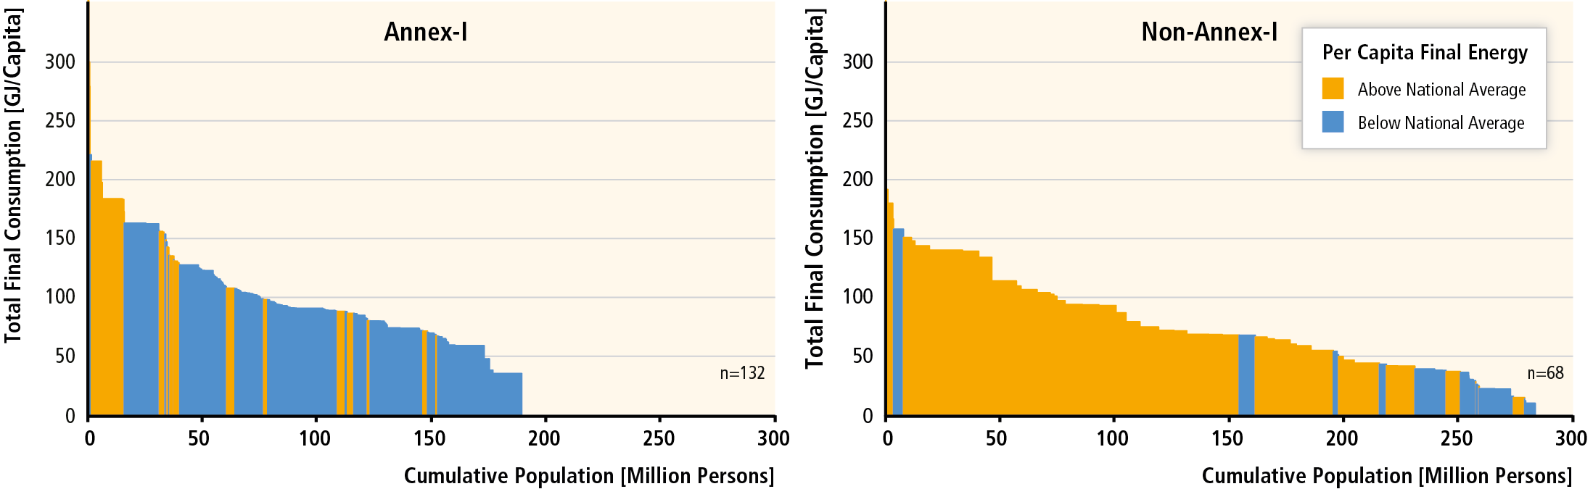
Implications of further urbanization
Urbanization-income nexus → higher urban incomes correlated with higher energy and GHG emissions (Poumanyvong and Kaneko, 2010; IPCC 2014, GEA 2012)
Bottom up analyses show that Cities in developing countries have, generally, higher per capita final energy use and CO2 emissions than respective national averages – majority of new urbanization will be in these countries
Stochastic Impacts by Regression on Population, Affluence and Technology (STIRPAT) model and a sample of 88 countries for the period 1975–2005
Poumanyvong and Kaneko, 2010, Ecological Economics.
Based on 254 cities final energy use
Source: GEA, 2012; Grubler et al., 2012; IPCC, 2014

Slide 9
What drives cities’ emissions/mitigation?
Key urban form related drivers of emissions are complex inter-mix of density, land use, connectivity and accessibility
No single factor explains per-capita emissions across cities and its ability to mitigate
Key factors include income, population dynamics, urban form, locational factors, development stage, economic structure, history, policies, technology, and governance

Slide 10
In summary
Our ability to deep-cut global GHG and global climate resiliency depends, to a large extent, on what kind of cities and towns we will build and how urban dwellers embrace carbon mitigation and resiliency
A large window of mitigation opportunities lie in guiding new urbanization in next 2-3 decades
Overcoming the size, governance and income dependency of mitigation solutions
Deploying far-reaching market-based solutions coupled with planning, such as pricing

Slide 11
In summary
Larger opportunities are in systemic and integrated solutions → must overcome governance and policy fragmentations → Overcoming the governance paradox and policy fragmentations
Smoothening the entry points: Demonstrating the best practice technologies and local co-benefits of urban-scale mitigation actions
Role for science in providing solution-oriented knowledge is extremely important - IPCC, GEA, UCCRN’s ARC3 and others
Thousand of cities are in urgent need of support

