Slide 1
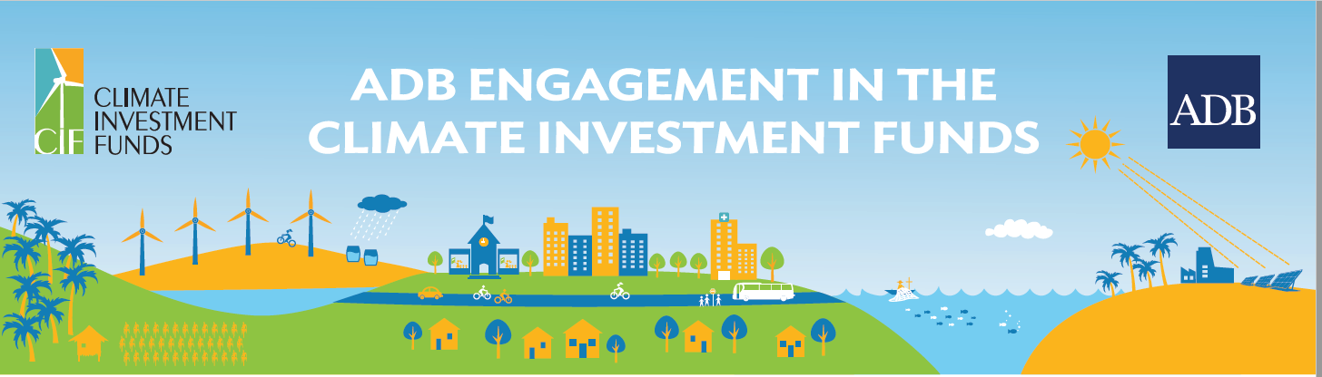
ADB - Climate Investment Funds
Climate Change Seminar
Bindu N. Lohani
AIT
February 2018

Slide 2
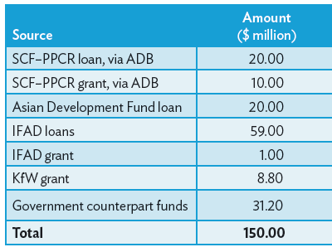
Bangladesh
Title: Coastal Climate-Resilient Infrastructure Project
Impact: Improved livelihoods in rural coastal districts that are vulnerable to climate change.
Funding Source:

Slide 3
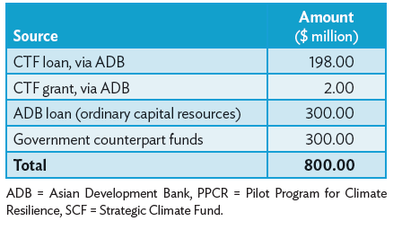
India
Title: Rajasthan Renewable Energy Transmission Investment Program–Facility Concept (Rajasthan Solar Park)
Impact: Improved livelihoods in rural coastal districts that are vulnerable to climate change.
Funding Source:

Slide 4
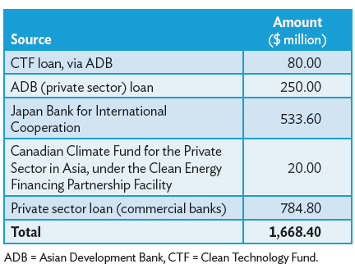
Indonesia
Title: Sarulla Geothermal Power Generation
Impact: A subproject under Indonesia’s Private Sector Geothermal Energy Program, this initiative will expand geothermal electricity generation capacity by about 320 MW.
Funding Source:

Slide 5
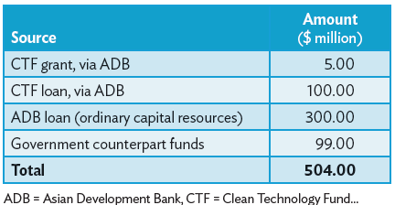
Philippines
Title: Market Transformation through Introduction of Energy-Efficient Electric Vehicles
Impact: Sustainable transport and energy security as a result of the development of non-tradable domestic renewable energy resources as transport fuel, and accelerated growth of the electric vehicle industry in the Philippines through the demonstration of new technology and business models.
Funding Source:

Slide 6
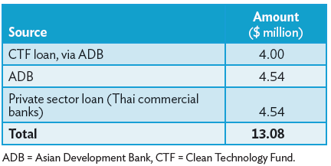
Thailand
Title: Theppana Wind Power Project
Impact: It entails the construction of a 7.5 MW windpowered electricity generation plant with three wind turbines, each with a capacity of 2.5 MW. The project is expected to generate over 14,000 MWh of electricity per year. It will reduce annual GHG emissions by 10,800 tCO2e.
Funding Source:

Slide 7
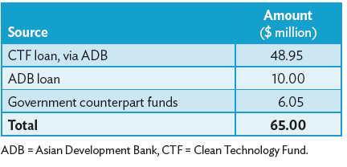
Vietnam
Title: Sustainable Transport, Ho Chi Minh City (Sustainable Urban Transport for Ho Chi Minh Mass Rapid Transit Line 2)
Impact: Integrated and sustainable public transport system, improved energy security as fuel consumption in the public transport sector drops by a projected 18 million liters per year, and strengthened urban transport policies and regulations encouraging a modal shift in public transport.
Funding Source:

Slide 8
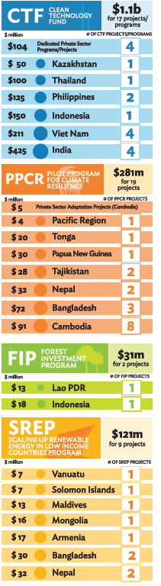
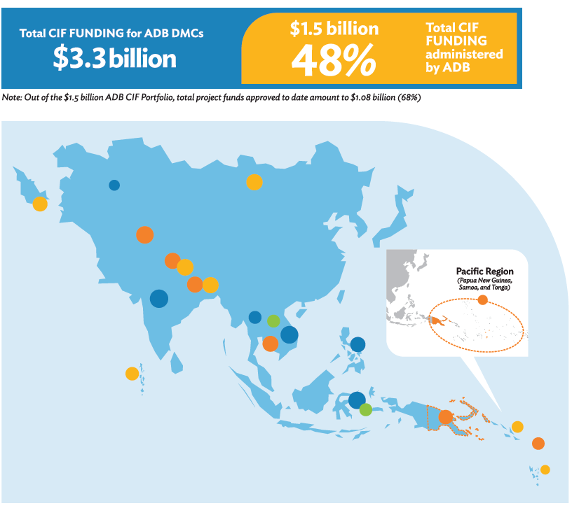
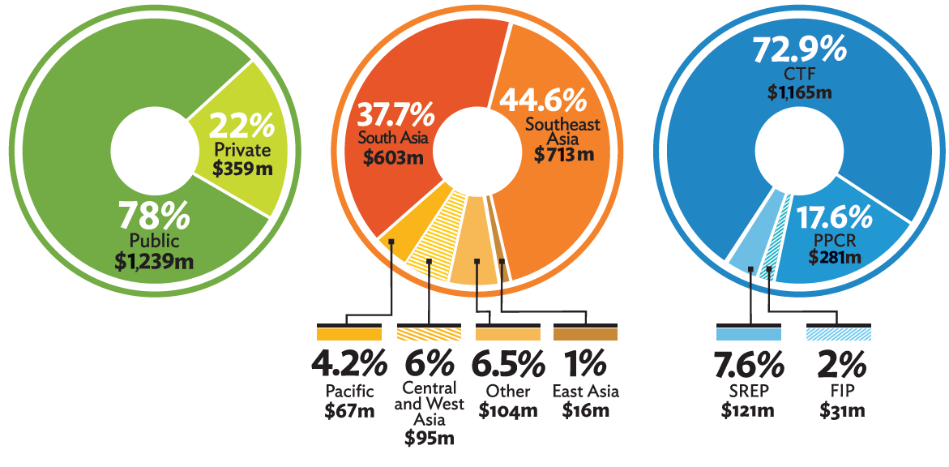
ADB Engagement in the Climate Investment Funds

Slide 9
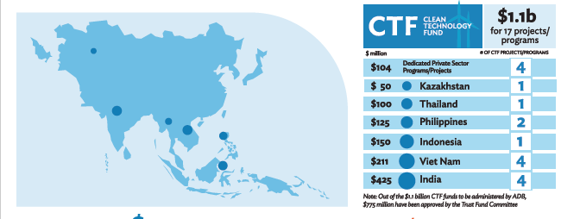
ADB Portfolio of CTF Projects

Slide 10
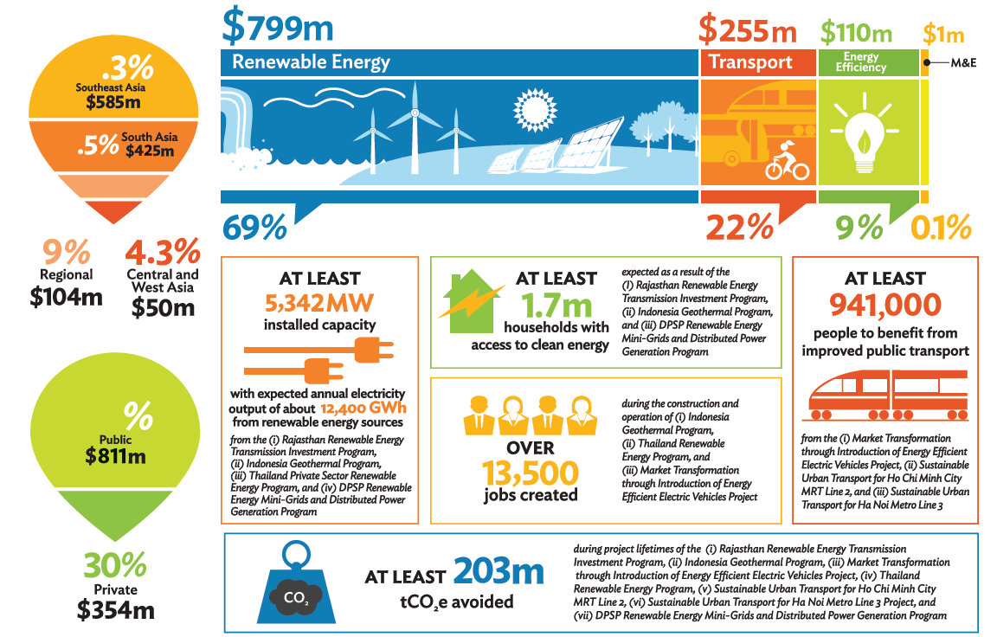
ADB Portfolio of CTF Projects

Slide 11
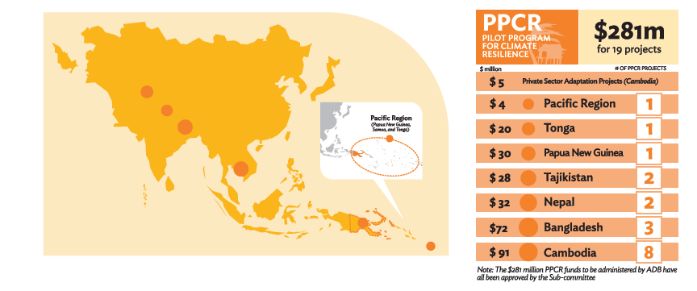
ADB Portfolio of PPCR Projects

Slide 12
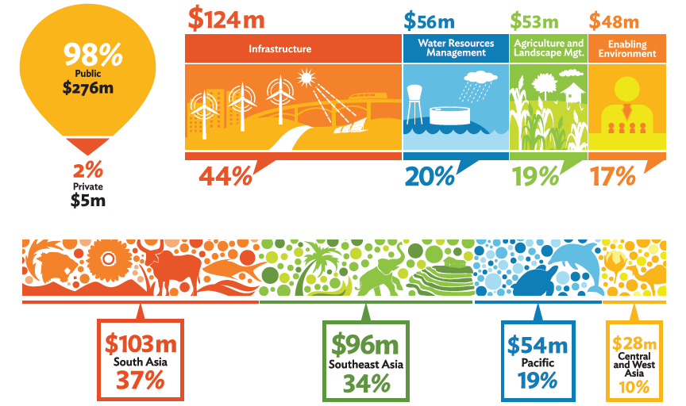
ADB Portfolio of PPCR Projects

Slide 13
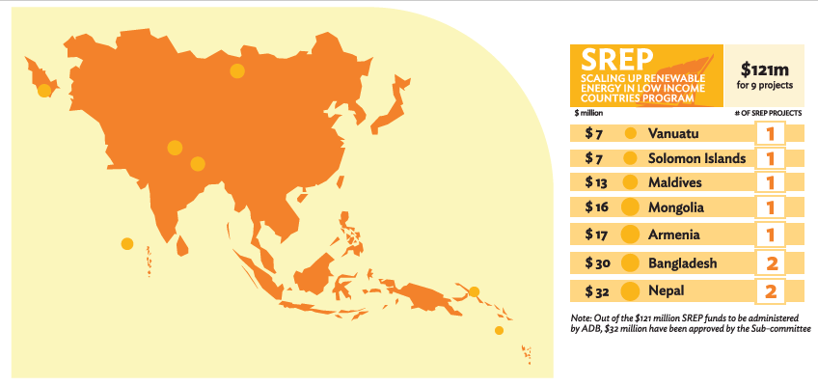
Scaling Up RE Program in Low-Income Countries

Slide 14
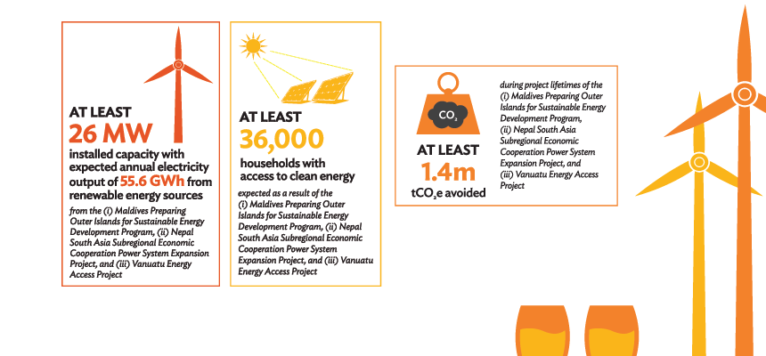
Scaling Up RE Program in Low-Income Countries

Slide 15
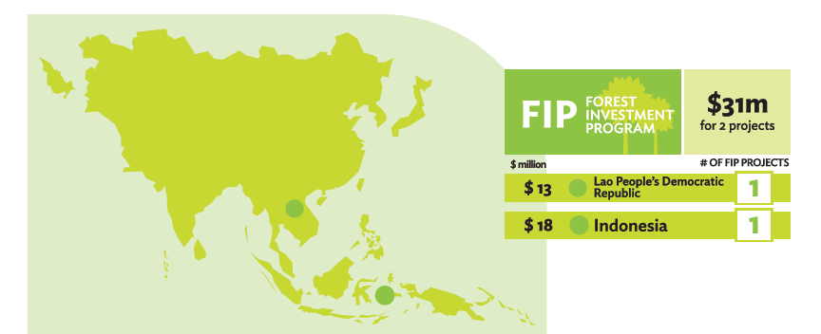
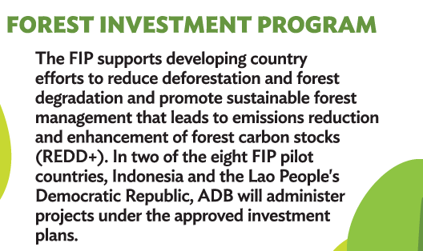
ADB Portfolio of FIP Projects

Slide 16
Thank You

