Slide 1
Adaptation Needs and Options
Climate Change Seminars
Asian Institute of Technology
March 2021
Dr. Peter King

Slide 2
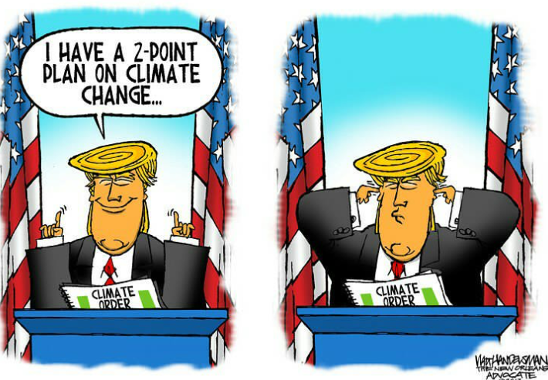
Adaptation versus Resilience
Adaptation is a practical response to reducing or minimizing the expected or existing impacts of climate change. Adaptation measures can be “hard” or “soft”.
Resilience is the intended outcome of the adaptation measures, so that a household, company, region or country is less vulnerable to the expected climate change impacts.

Slide 3
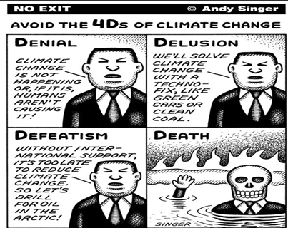
The Inevitability of Adaptation
Nationally Determined Contributions (NDCs) will not reach the Paris Agreement targets
IPCC report says that we will reach 1.5 degrees by about the mid-2040’s
Under business as usual, we may reach 3-4 degrees by 2100, or higher
Therefore, adaptation is inevitable – for all countries

Slide 4
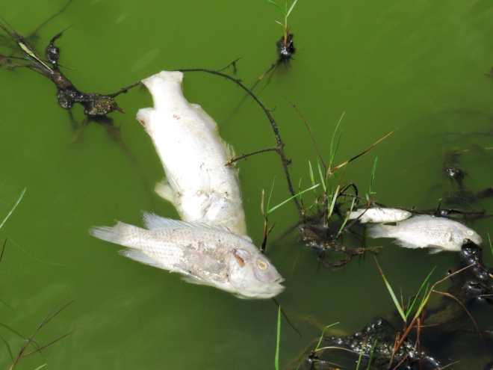
Not all climate change impacts are subject to effective adaptation
Most of the additional heat from the greenhouse effect is going into the oceans (approx. 90 percent)
This is bad news for coral reef ecosystems that have low tolerance for increased temperature
In addition, carbon dioxide dissolves in sea water causing ocean acidification
This is bad news for krill, zooplankton, and other species with carbonate exoskeletons
The combination of increased sea temperature and ocean acidification is not easily adapted

Slide 5
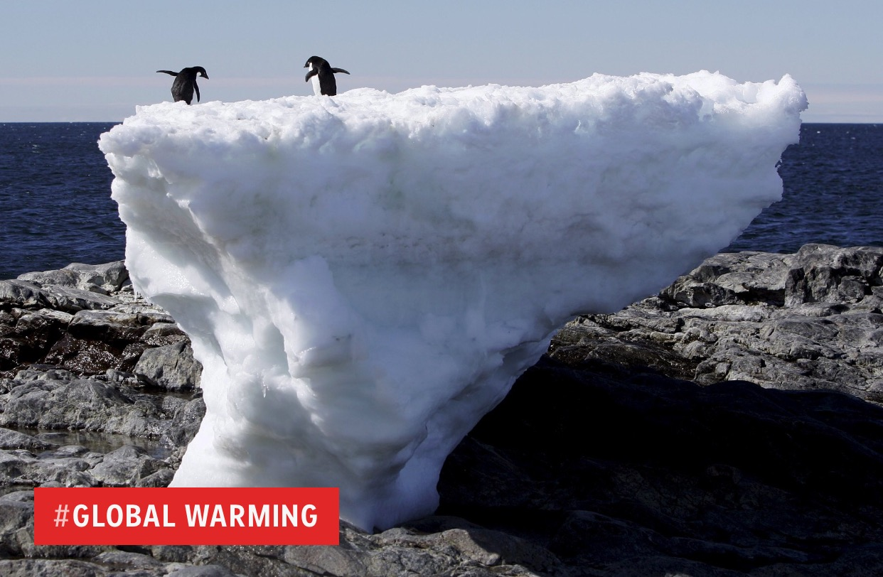
Arctic, Antarctic, Greenland, and Mountain Glaciers are also problematic
As temperatures increase, sea and land ice is being reduced at both poles, with disastrous impacts on polar bears and other species
Sea ice tends to hold back land-based glaciers at the poles, potentially accelerating sea level rise and making sea water less saline
Less saline and warmer waters may alter ocean currents, causing colder weather in some areas, drought in others
Permafrost is also thawing out, causing massive infrastructure damage and release of methane gas – a potent GHG
High altitude glaciers, such as in the Himalayas supply water for billions of people, and these are disappearing fast and threatening GLOFs too.

Slide 6

Which climate change impacts can be reduced by effective adaptation?
Impact
Increased urban heat waves
Adaptation Measures
Hard – retrofitting buildings with insulation, cooling stations, air conditioning, street shading, new building codes, green roofs etc.
Soft – “cool biz” clothing, tree planting, health and safety rules, relocation of vulnerable people etc.
Note: air conditioning may make climate change worse through increased emissions if the electricity is from fossil fuels.

Slide 7
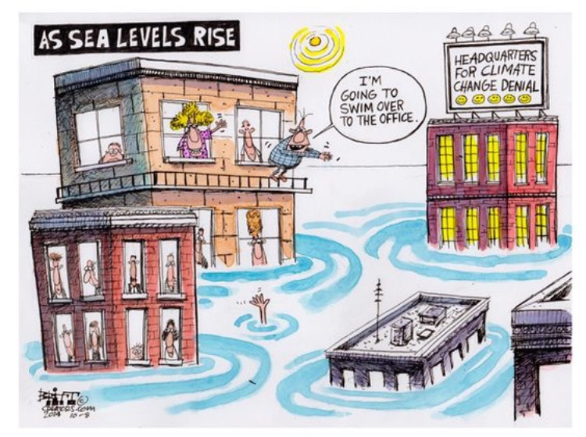
Which climate change impacts can be reduced by effective adaptation (cont.)?
Impact
Limited amounts of sea level rise
Adaptation Measures
Hard - sea walls, setbacks, higher road elevation, land buyback, stilt housing, landfilling etc.
Soft - coastal dunes, mangroves, coastal reforestation, beach replenishment, land use zoning etc.
Note: If all the ice melts, most major cities will be under water in the longer term. Relocation may be necessary.

Slide 8
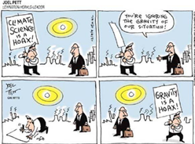
Which climate change impacts can be reduced by effective adaptation (cont.)?
Impact
Increased rainfall and flooding
Adaptation Measures
Hard – flood detention dams, rooftop rainwater storage, flood walls on rivers, elevated infrastructure, flood gates
Soft – flood insurance, sponge cities, absorptive pavements, increased green space in urban areas, flood zoning, etc.

Slide 9
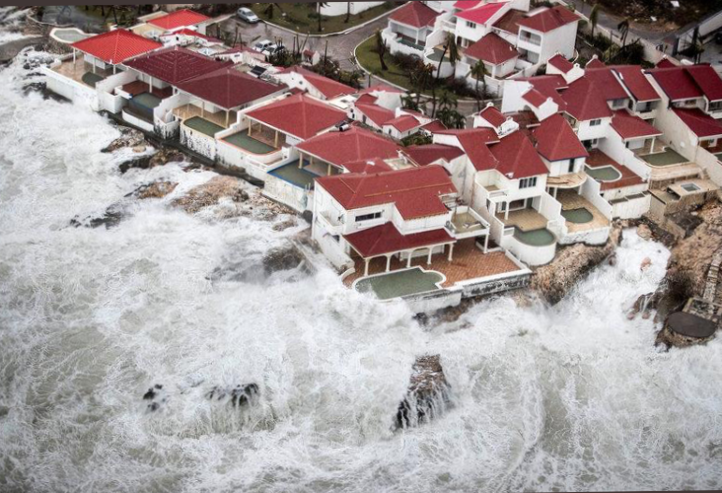
Which climate change impacts can be reduced by effective adaptation (cont.)?
Impact
Extreme climate events – cyclones, hurricanes, droughts, floods, windstorms, sea surge, wildfires
Adaptation Measures
Hard – Cyclone shelters, water reservoirs, irrigation systems, coast and river embankments
Soft – early warning systems, evacuation plans, emergency food reserves, evacuation centres etc.

Slide 10
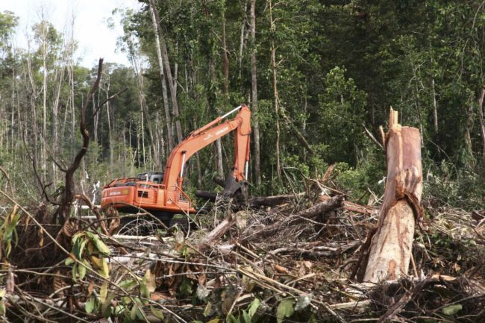
Which climate change impacts can be reduced by effective adaptation (cont.)?
Impact
Loss of forests (due to drought, fire and deforestation) and associated biodiversity loss
Adaptation Measures
Hard – increased plantations and protected areas, fire-fighting dams in plantation areas, improved equipment for rangers and plantation managers, airborne water tankers
Soft – controlled fuel burns, anti-poaching and control of wildlife trading, biodiversity inventories, retention of riparian zone forest cover, land use zoning

Slide 11
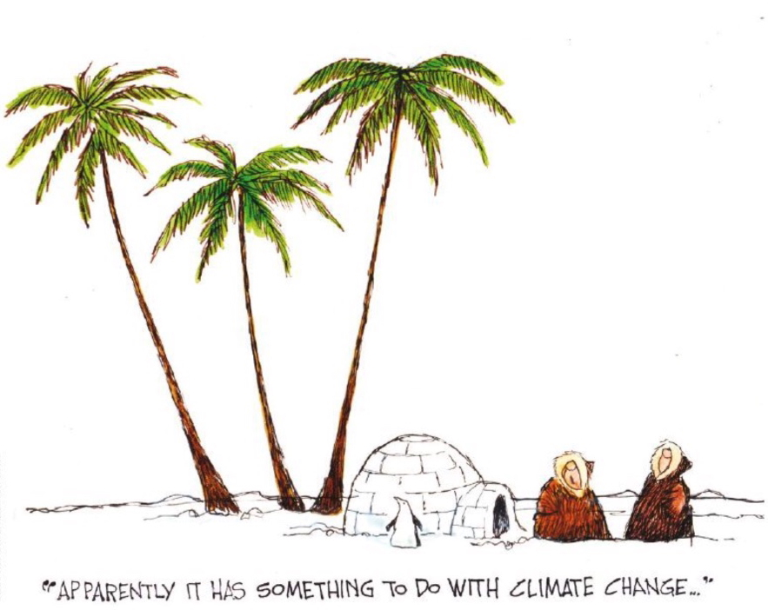
Which climate change impacts can be reduced by effective adaptation (cont.)?
Impact
Food security and agricultural productivity
Adaptation Measures
Hard – Expanded irrigation systems and reservoirs, all weather farm to market roads, lab grown food, hydroponics, etc.
Soft – development of resilient crop varieties, crop replacement, reduced food waste, diet changes, etc.

Slide 12
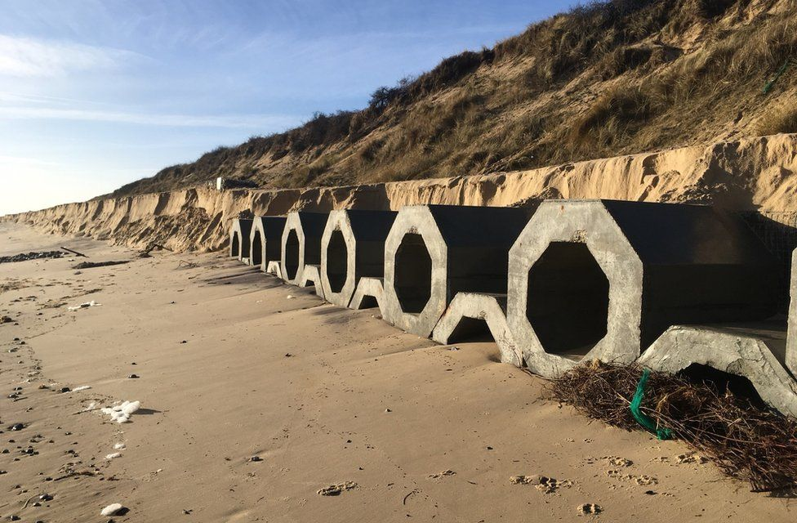
Selection and prioritising adaptation options
A huge challenge is to determine which of the thousands of adaptation options should be adopted first, which locations should be protected, and how the impact of those interventions should be measured.
Generally, adaptation options can be categorised into (i) increasing adaptive capacity (or resilience); (ii) reducing vulnerability to climate risks; and (iii) creating opportunities while also minimising climate risks (often involving no-regrets strategies).

Slide 13
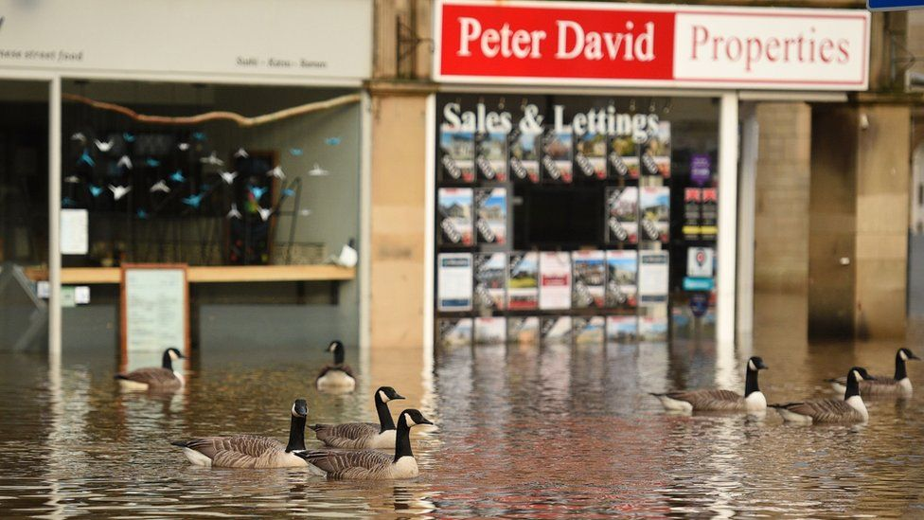
Planned vs. Autonomous Adaptation
Planned adaptation results from a specific policy or strategic decision (usually by national or local governments). These are usually documented in the National Adaptation Plan, Nationally Determined Contribution, or Local Adaptation Plans.
Autonomous adaptation is the kind of action that a private company or household might take to protect their assets against looming damage. These adaptation measures may actually cause maladaptation if they are planned outside official government plans. For example, industrial estates building ever higher flood protection walls may make flooding worse for surrounding communities.

Slide 14
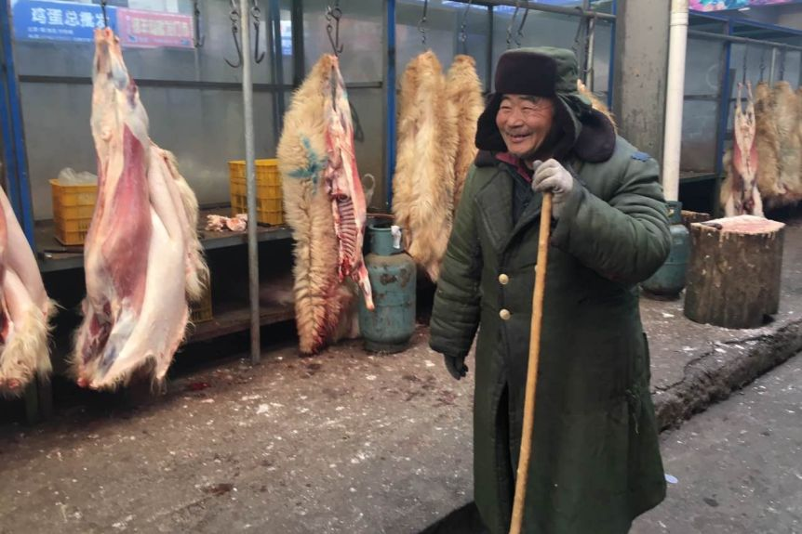
Sector Options - Agriculture
In the agriculture sector typical adaptation options include:
(i) changing to more climate resistant crops and/or livestock;
(ii) changing key cropping dates;
(iii) soil conservation measures;
(iv) water storage and/or irrigation systems for drought periods;
(v) flood protection;
(vi) stubble management;
(vii) land levelling; and
(viii) alternate wetting and drying for rice production, among others.
Collectively, these options are often referred to as climate-smart agriculture.

Slide 15

Sector Options – Water Resources
Some key water resource adaptation options include:
(i) water storage and conservation;
(ii) wastewater reclamation and reuse;
(iii) drip irrigation;
(iv) desalination;
(v) watershed management;
(vi) floodplain management;
(vii) riverbank erosion prevention;
(viii) evaporation control;
(ix) riparian vegetation management; and
(x) rainfall seeding.
Most of these options fall under the general term climate smart water resources management.

Slide 16
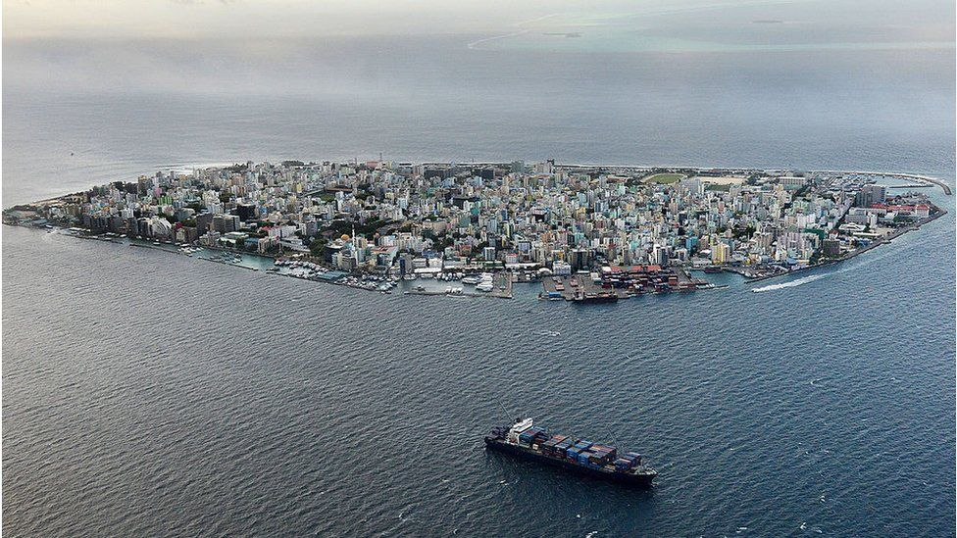
Sector Options - Tourism
Typical adaptation options for the coastal zone resorts include:
(i) beach replenishment;
(ii) mangrove planting;
(iii) ridge-to-reef conservation;
(iv) seawalls and revetments;
(v) dune replanting;
(vi) coral reef protection and/or restoration;
(vii) relocation away from the coast;
(viii) rainwater tanks; and
(ix) desalination.
Highland tourism, especially in ski resorts, is also being devastated by increasing temperatures due to climate change, with few adaptation options available other than artificial snow and changing from winter to summer tourism attractions.

Slide 17

Sector Options - Cities
Cities: Various adaptation options have been identified for cities including:
(i) increased tree planting to reduce temperatures;
(ii) cooling stations;
(iii) changes to building codes;
(iv) flood protection bunds;
(v) improved drainage systems;
(vi) rooftop greenery and water storage;
(vii) changes to zoning ordinances;
(viii) improved groundwater management; and
(ix) absorptive pavements and increased infiltration

Slide 18
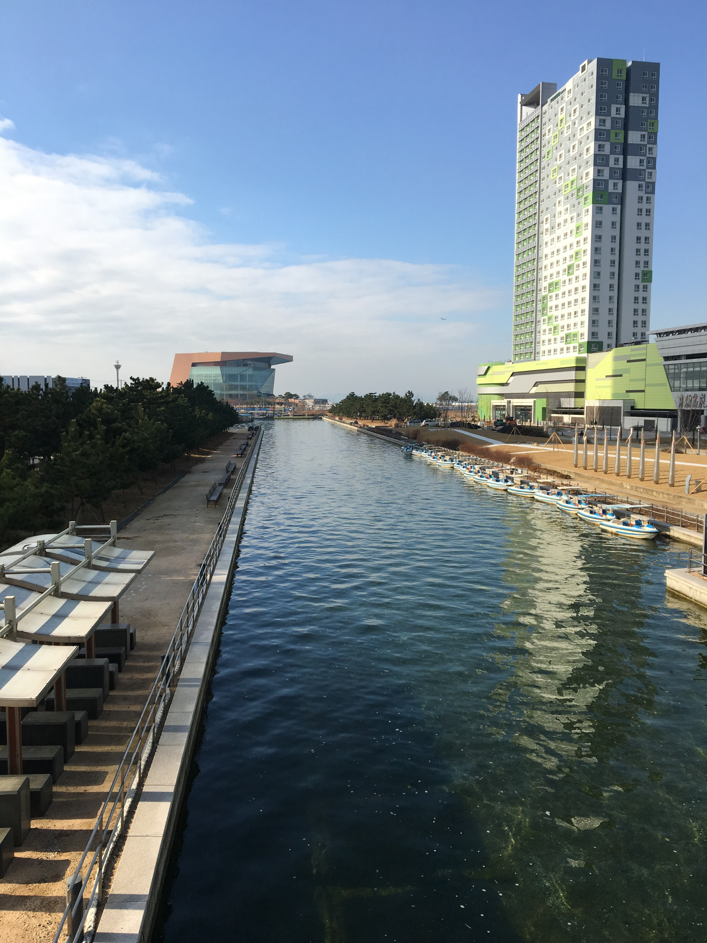
Sector Options - Infrastructure
All infrastructure now needs to be climate-proofed against future climate conditions. Climate proofing includes options such as
(i) increased bridge and road surface heights;
(ii) increased culvert and drainage dimensions;
(iii) climate resistant road surface materials;
(iv) increased protection against wind shear;
(v) relocation away from hazardous areas like floodplains or coastal zones;
(vi) elevating electrical and control equipment;
(vii) retrofitting infrastructure;
(viii) changing maintenance schedules;
(ix) using, enhancing or recreating natural systems such as wetlands, riparian vegetation, or dune revegetation to protect vital infrastructure; and
(x) physical protection such as seawalls or flood protection bunds.

Slide 19
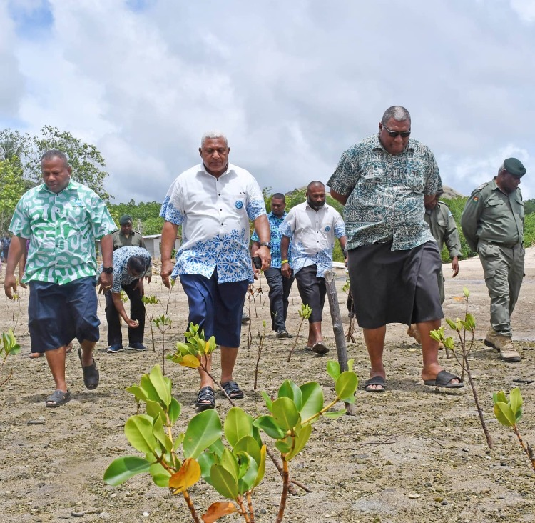
Prioritisation Tools
Whatever the selected range of adaptation options, the tools and techniques for prioritization generally fall into the following categories:
(i) economic, least cost, cost-effectiveness or cost-benefit analysis;
(ii) multi-criteria analysis;
(iii) qualitative matrices;
(iv) scenarios; and
(v) barrier analysis.
We don’t have time to discuss each of these in detail, but you may want to read up on each tool later on.

Slide 20
A Typical Climate Change Adaptation Project
Overall objective: strengthen the resilience of 50 villages on 11 of Kiribati’s most vulnerable Outer Islands, through improved access to sustainable potable water supply as well as improved health and sanitation conditions. Components cover:
Strengthening national and island-wide water resource, health, hygiene and sanitation response actions;
Strengthening community (village) water resource, sanitation and hygiene response action;
Providing water supply and sanitation support to the remaining 44 villages not covered under the KIRIWATSAN project on the same 8 islands;
Providing water supply and sanitation support to 6 villages in 3 additional new islands;
Procuring new weather stations and rehabilitating existing ones for reliable and updated information on weather and climate. Install small-scale Early Warning Systems; and
Conducting awareness raising, knowledge management and M&E of water resources, sanitation and hygiene response actions.
Total Cost $8.2 million
Source of funding: Adaptation Fund

Slide 21
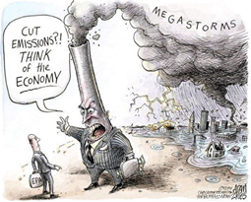
Combine Mitigation and Adaptation?
Mitigation and adaptation are not mutually exclusive
Hybrid projects are being developed that combine both aspects
For example, floating solar farms that reduce evaporative losses from reservoirs
Tree plantations that sequester carbon as well as protect the landscape from extreme events

Slide 22
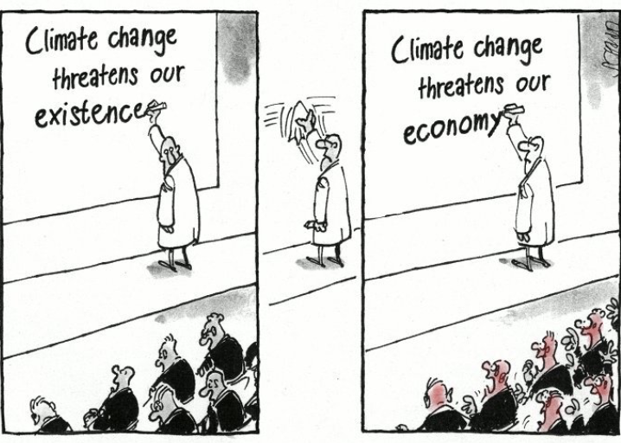
Global Cost of Adaptation?
UNEP claims that the cost of adapting to climate change in developing countries could range between $140 and $300 billion per year in 2030, and between $280 and $500 billion per year in 2050.
To meet finance needs and avoid an adaptation gap, the total finance for adaptation in 2030 would have to be approximately 6 to 13 times greater than international public finance today.
https://unepdtu.org/publications/the-adaptation-finance-gap-report/

Slide 23
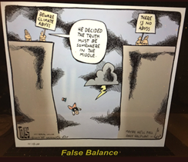
International Cooperation?
Apart from official development assistance, how can developed countries help less developed countries to adapt?
Finance – such as a carbon tax on international trade, aviation and shipping taxes etc. to top up adaptation funds
Climate refugees – provision of land or refugee status to people displaced by climate change
Research – increased R&D for crops and livestock affected by climate change
Early warning – for onset of extreme weather events, El Nino Southern Oscillation, tsunamis, or droughts, using satellite monitoring systems and AI

Slide 24
How can we build the necessary capacity at all levels of society?
Different types of training programs already exist for diverse targeted groups and are implemented by several organizations in the Asia-Pacific region.
To produce more effective impact, a platform is needed to enable these diverse training institutions to implement knowledge/tool sharing, mutual collaboration, and follow-up support.
Networking of capacity strengthening institutions;
Development of Knowledge Products and their sharing;
Collaboration with existing training programs and implementation of Supporting Activities;
Establishment of a New Fund to facilitate capacity building;
Launching Thematic Capacity Building Courses; and
Promoting Bottom-up CC adaptation actions.

Slide 25
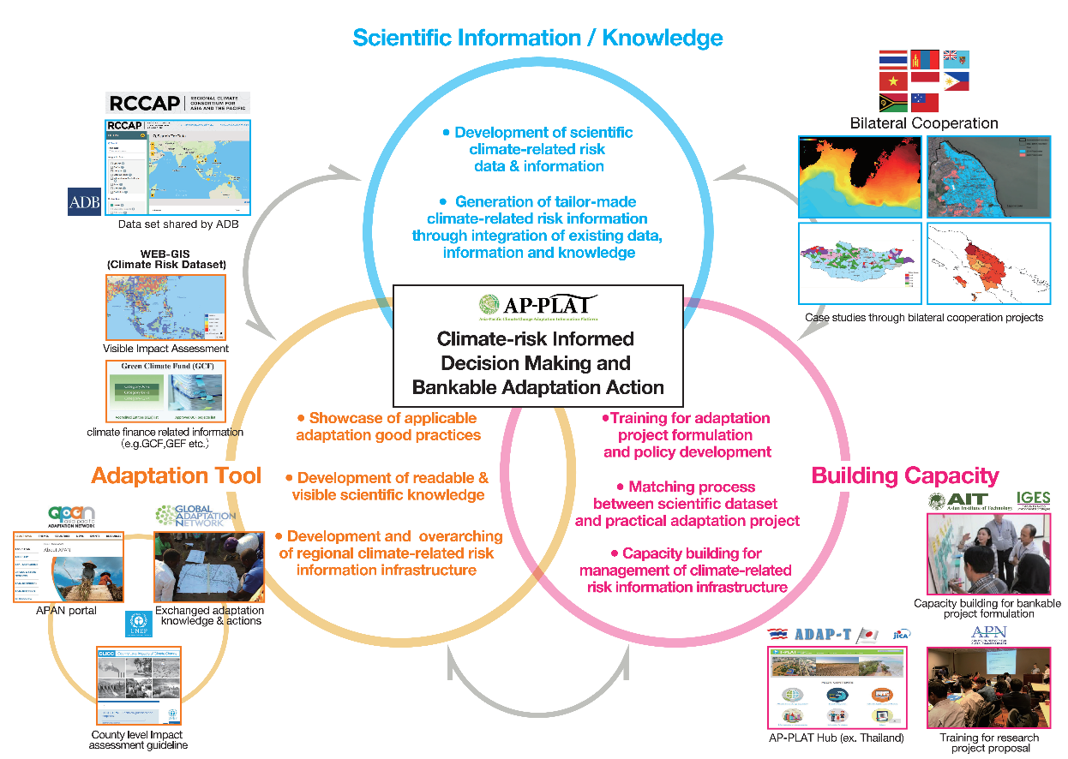
Asia-Pacific Climate Change Adaptation Information Platform(AP-PLAT)
Mission
Core Pillars of Activities
Enabling environment for climate-risk informed decision making and practical adaptation action

Slide 26
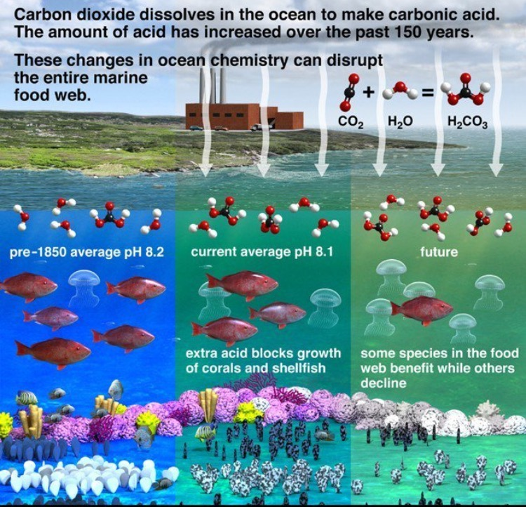
Sources of Information
For further information on best practices, events, themes and country information go to the APAN website:
http://asiapacificadapt.net
Or the EU adaptation portal:
https://climate-adapt.eea.europa.eu/knowledge/adaptation-information/adaptation-measures
Or Global Centre on Adaptation:
https://gca.org/

Slide 27
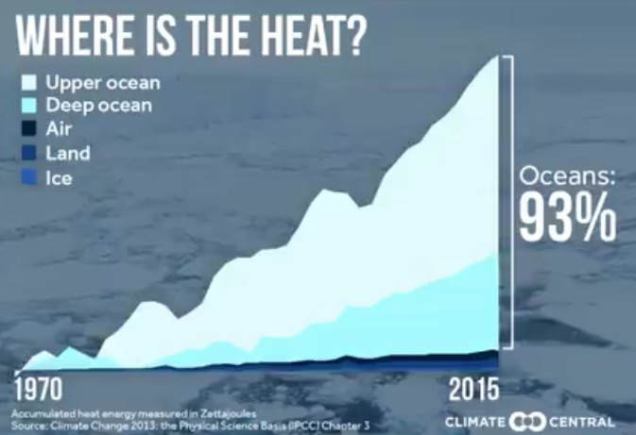
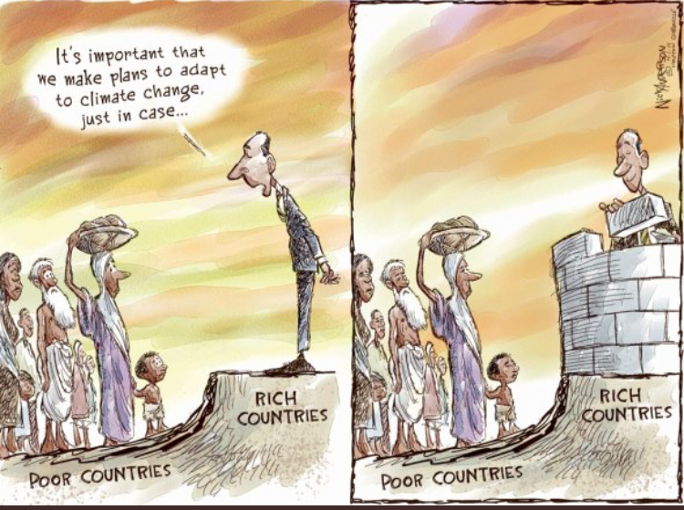
We are all in this mess together – it can only be solved together

Slide 28

Question and Answer Session
What adaptation options do you undertake in your own life?
Do you think there is enough adaptation being implemented and is it fast enough to keep in front of climate change?
Do you think the city planners in Bangkok are doing enough to adapt to climate change?
What about in your hometown?

Slide 29
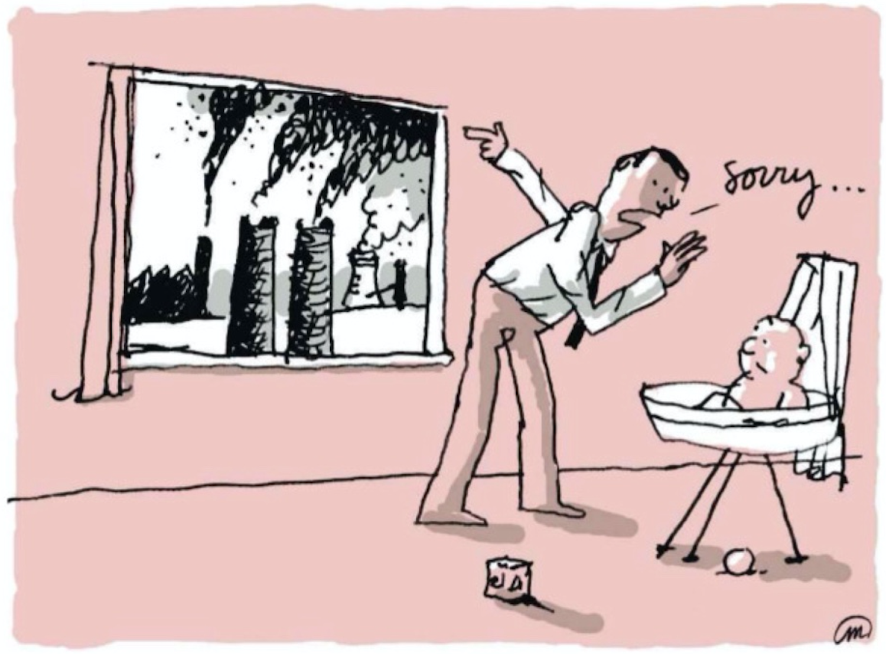

Loss and Damage

Slide 30
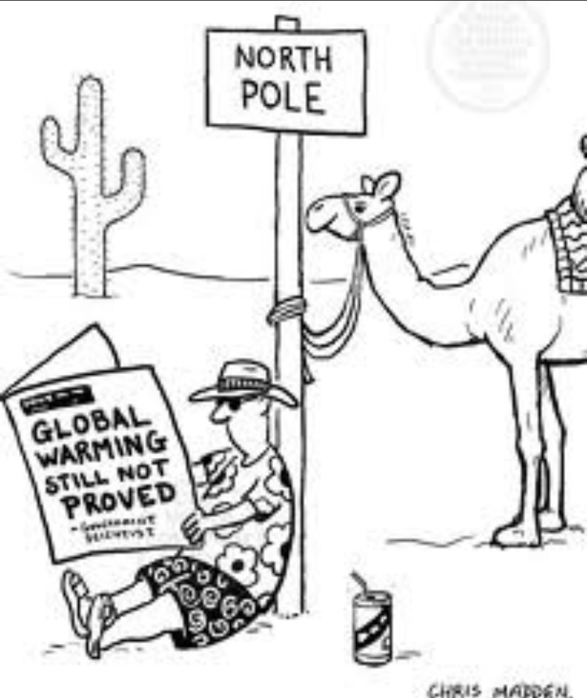
Warsaw International Mechanism (WIM) on L&D
At COP19 (November 2013) in Warsaw, Poland, the COP established the Warsaw International Mechanism for Loss and Damage associated with Climate Change Impacts (Loss and Damage Mechanism), to address loss and damage associated with impacts of climate change, including extreme events and slow onset events, in developing countries that are particularly vulnerable to the adverse effects of climate change.

Slide 31
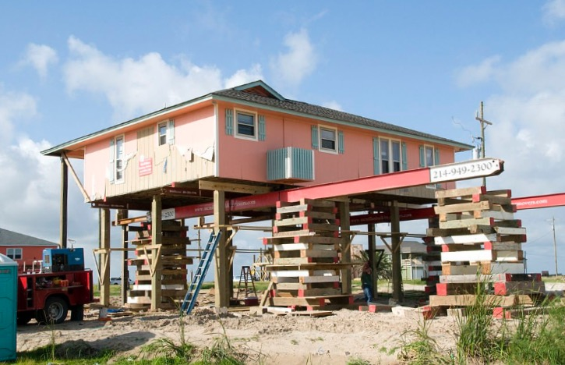
WIM in Paris Agreement
Loss and damage (Art. 8) – The Paris Agreement significantly enhances the Warsaw International Mechanism on Loss and Damage, which will develop approaches to help vulnerable countries cope with the adverse effects of climate change, including extreme weather events and slow-onset events such as sea-level rise. The Agreement provides a framework for Parties to enhance understanding, action and support with regard to loss and damage.

Slide 32
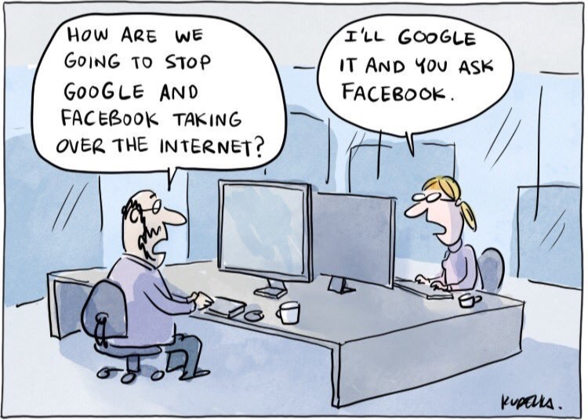
WIM Executive Committee
In 2016, the WIM Executive Committee (WIM Excom) issued a call for information on “best practices, challenges and lessons learned from existing financial instruments at all levels that address the risk of loss and damage associated with the adverse effects of climate change”

Slide 33
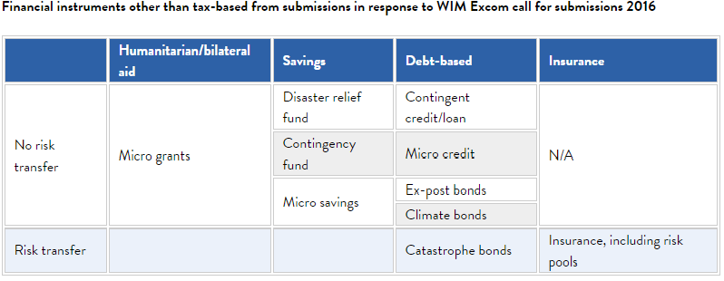
Financing Suggestions Received

Slide 34
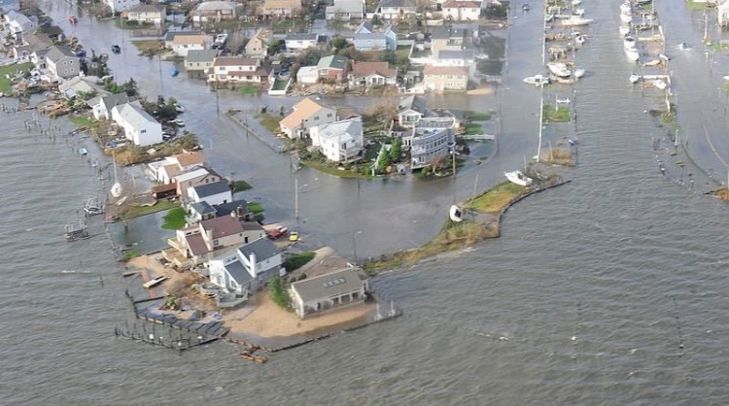
Reality Check
Most of the instruments in the table are of little use in solving the problem of climate change and are out of reach for developing countries that suffer from loss and damage.
With their economies already severely strained and negatively affected by climate change, there is little room to set aside savings.
As agricultural yields dwindle under heat extremes and health systems face the additional challenge of climate change, how can these countries redirect resources into a savings account?
Debt-based instruments require some sort of creditworthiness, often decreasing for countries severely affected by climate change. Why would anybody issue a loan or buy bonds from a country with an economy in shambles?

Slide 35
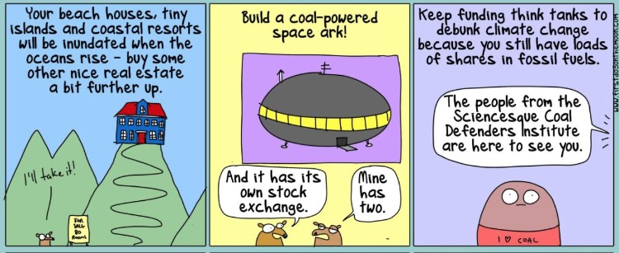
Why Not Sue the Rich Oil and Coal Companies?

Slide 36
Legal Cases Against Fossil Fuel Companies
Suing oil companies to pay for climate change? A new strategy!!!
Exxon, Shell and other carbon producers are being sued for sea level rises in California.
New York City filed a Climate Lawsuit against five biggest Oil Companies for climate change damages but failed.
Failed 2008 lawsuit against BP and Chevron by a small native Alaskan island community, was the first such case.
Urgenda case in the Netherlands was the first successful case, forcing the government to increase their climate change targets.
Scientists now believe they have better evidence of culpability and there are more than 90 lawsuits already engaged.
Big Oil says government climate change lawsuits are a “conspiracy” and they will fight back.

Slide 37
Prospects for success – climate attribution?
The New Evidence
Emissions traced to the 90 largest carbon producers contributed nearly 50 percent of the rise in global average temperature and around 30 percent of global sea level rise since 1880.
Emissions traced to the 50 investor-owned carbon producers (including BP, Chevron, ConocoPhillips, ExxonMobil, Peabody, Shell, and Total) contributed around 16 percent of the global average temperature increase from 1880 to 2010, and around 11 percent of global sea level rise over that period.
Emissions traced to these same 50 companies from 1980 to 2010—a period during which fossil fuel companies were indisputably aware their products were causing global warming—contributed about 10 percent of the global average temperature increase and roughly 4 percent of global sea level rise.
Oil companies have known about the greenhouse gas effect for at least 40 years – compared to tobacco companies that also knew smoking causes cancer – Tobacco Master Settlement Agreement – will pay $206 billion over 25 years.

Slide 38

Next generation success? Sue the Govt. too!!
Juliana vs US—initially filed in 2015, a group of children acting as trustees for future generations (in conjunction with a youth activist group and climate scientist James Hanson) have sued the United States government and a variety of federal agencies, alleging that they have failed to regulate carbon dioxide emissions from major sources such as power plants and vehicles over the past 50 years, despite knowing about the threat posed by climate change.

Slide 39
Urgenda case – An Historic Precedent
On 20 December 2019, the Dutch Supreme Court, the highest court in the Netherlands, upheld the previous decisions in the Urgenda Climate Case, finding that the Dutch government has obligations to urgently and significantly reduce emissions in line with its human rights obligations.
This successful precedent has inspired climate change cases in Belgium, Canada, Colombia, Ireland, Germany, France, New Zealand, Norway, the UK, Switzerland and against the EU.
The Urgenda Climate Case was brought on behalf of 886 Dutch citizens.
In 2015, the District Court of The Hague ruled the Government must cut its greenhouse gas emissions by at least 25% by the end of 2020 (compared to 1990 levels).
The Government appealed and lost in successively higher courts.
The Netherlands must now reduce its emissions by a minimum of 25% before 2020 compared to 1990 levels.
https://www.urgenda.nl/en/themas/climate-case/

Slide 40
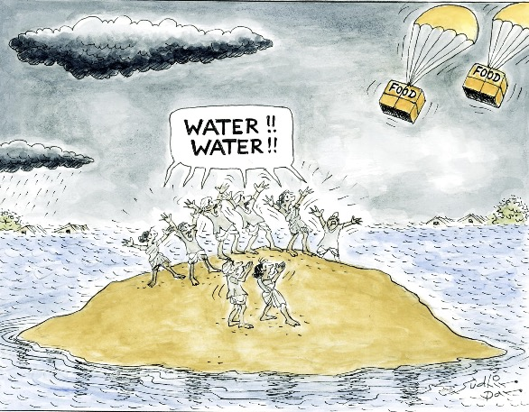
What about a global tax?
$4 trillion carbon tax is needed to save humanity from global warming, say economists Stern and Stiglitz.
Currently 85 per cent of carbon dioxide emissions are not subject to a tax – while the fossil fuel sector receives subsidies of up to an estimated $5.3 trillion.
The world’s largest carbon pricing scheme is in the EU, but it only charges about Euro 20 (Sweden > Euro 100, and GHG emissions decreased by 26%)
Tax on a tonne of carbon dioxide of $50 to $100 could raise $4 trillion by 2030.

Slide 41
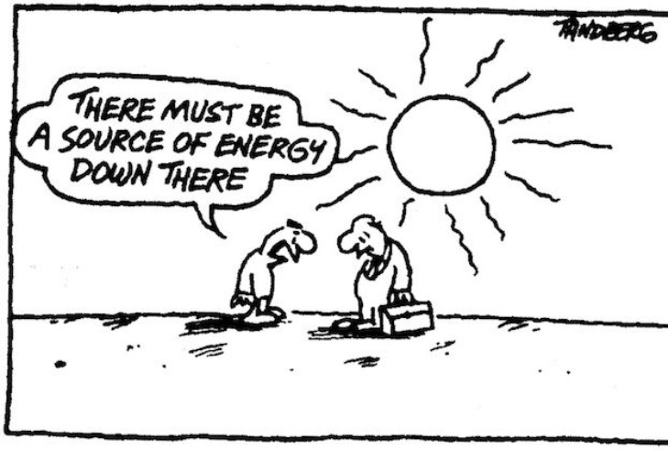
How would the money get to the most vulnerable people who are affected?
The revenue could be used to foster growth in an equitable way, by returning the revenue as household rebates, supporting poorer sections of the population, managing transitional changes, investing in low-carbon infrastructure, adaptation, and fostering technological change.
Ensuring revenue neutrality via transfers and reductions in other taxes could be another policy option.
Reducing fossil fuel subsidies is another essential step toward carbon pricing – in effect, these subsidies are similar to a negative emissions price.

Slide 42
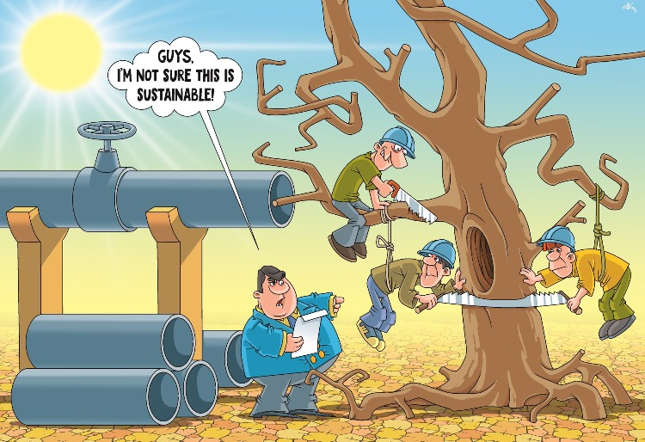
For discussion – What is the best solution?
Insurance
Official development assistance
Dedicated climate funds
Global taxation
Open borders
Global taxation
Cap and trade
National budget allocations

Slide 43
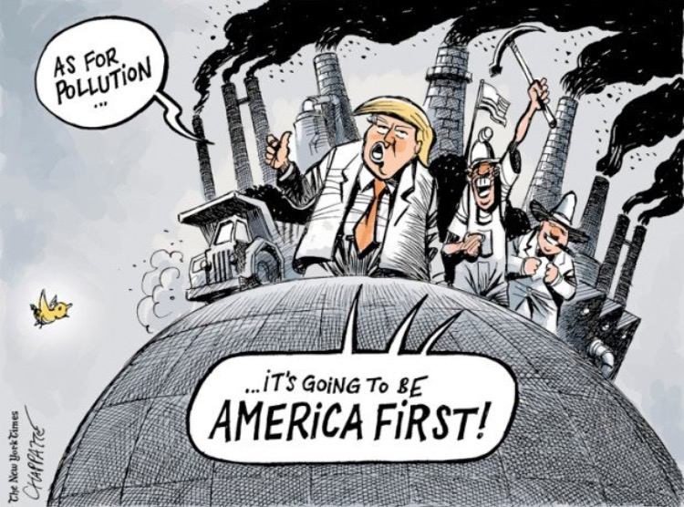
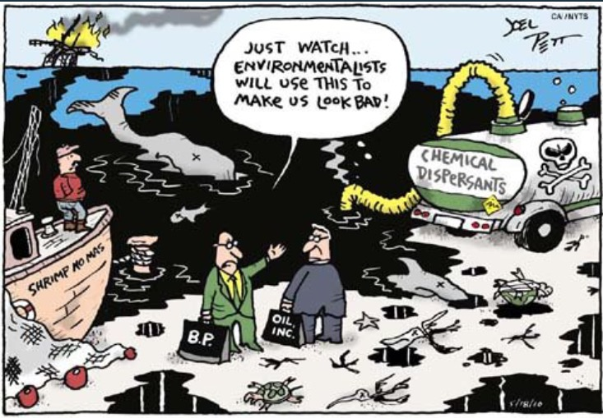
Thank you for your attention!

