Slide 1
Climate Change Seminar
Bindu N. Lohani
AIT
January 2019

Slide 2
Mitigation from Waste Management
Three topics:
Contribution of Waste Sector to GHGs
Waste to Energy Projects: What and Why?
3R and Circular Economy

Slide 3
Waste and Climate Change….some facts
Post consumer waste: a small contribution to global GHGs emission (<5%)
1,300 million tones of CO2 equivalent in 2005 (small in percent, significant in absolute number)
Waste related GHGs:
Landfill Methane
Nitrous Oxide
Carbon dioxide from incineration of waste containing fossil carbon
Importance of waste sector in reducing global GHG emission has been underestimated
Waste management decision often made locally without quantification of GHG mitigation

Slide 4
Global GHG emission
Contribution of Waste Sector looks small in comparison to other sectors but still has significance from climate change perspective as well as waste management (waste disposal, 3R, Circular Economy )
Waste and wastewater 2.8%
Energy supply 25.9%
Transport 13.1%
Residential and commercial buildings 7.9%
Industry 19.4%
Agriculture 13.5%
Forestry 17.4%
Source: Bogner et al, Working Group III, 4th Assessment Report, IPCC

Slide 5
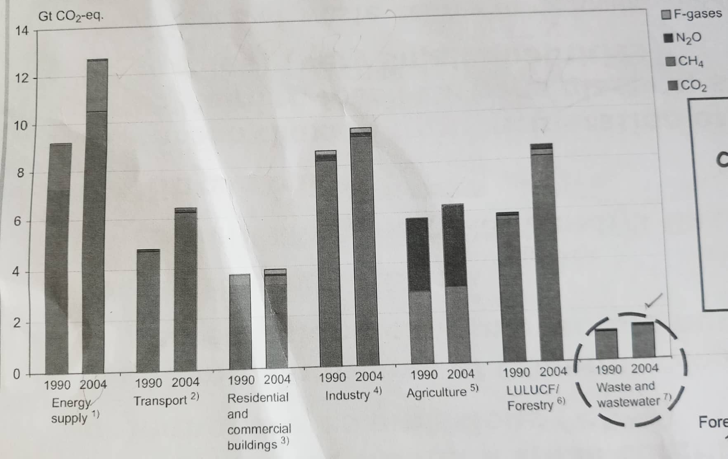
Global GHG emission

Slide 6
MSW Technologies and GHG
LOW/ INTERMIDIATE TECHNOLOGY COST OPTION
HIGH COST TEDDCHNOLOGY
Incineration and other thermal processes
Landfilling
SOLID WASTE
(post consumer)
Waste collection
Anaerobic digestion
Composting of waste fraction
Waste prevention and minimization
Waste diversion through recycle and reuse
Mechanical Biological Treatment
Residual Landfilling

Slide 7
Regional GHGs Trends (Incineration)
Incineration and other thermal process emit GHGs
Developed Countries | Developing Countries
Japan (70% of waste incinerated) | Incineration rare – high capital and operating cost
Germany , Scandinavian countries far ahead | Uncontrolled burning of waste for volume reduction is common
 | ????
Note
Incineration trades and emission higher in Developed Countries

Slide 8
FOOD WASTE
Energy from Food
Food contains energy in the form of “Carbohydrate” – Carbon, Hydrogen and Oxygen
Food Wastes (Impacts on CO2)
Carbon dioxide (CO2)
Methane (CH4)
Recycling and Reuse
Composting (organic waste)
Recycling paper, plastics, metals
Helps reduce GHGs and methane

Slide 9
Municipal Waste Management
Waste to Energy (W2E)
Any waste treatment that produces energy or heat from Waste
Waste Pathways
Incineration and Landfill to Gas

Slide 10
Disposal Options: Why W2E is attractive?
Renewable energy source
Environmental regulations
Investment subsidies
Waste disposal and landfill gate fees
Diminishing landfill capacity

Slide 11
W2E Examples
Europe
W2E has become a preferred method of waste disposal
Germany, Scandinavian Countries, (Norway is a leader) are in the forefront

Slide 12
WTE Examples
China
More than 100 WTE plants under operation
Target to treat 100% of Municipal Solid Waste (MSW) in large municipalities (larger than provincial capitals cities)
90% in smaller cities (in Five year plan)
China 4th largest in the world in W2E after the EU, Japan and the US
China is the 2nd largest in terms of generation of solid waste, 220 million tones annually

Slide 13
One W2E Project in China (name withheld)
Some silent features;
Total capacity up to 6,300 tones MSW/day
Plant generates 610 gigawatts of electricity annually by 2018
Financing $454m equivalent in Yuan
Exclusive right to operate WTE and agreement that guarantees a minimum of MSW supply
EIRR is higher than the weighted cost of capital and economically visible
EIRR is higher than the social discount rate of 12%
FIRR acceptable

Slide 14
Another W2E Project
Located in PR China
Treats a daily average of 1,200tons of MSW in 2008
Incineration (CDM) Project burning 1,200 tones of waste per day (CDM registration in 2010)
Estimated GHGs emission reduction is about 9,500 tCO2
Project Type
Thermal treatment of MSW
Technology (transferred from Japan) each unit of 400 tones of MSW/day
Steam turbine installed for producing electricity and generate about 117,000 Mwh using 400,000 tones of MSW

Slide 15
WTE Projects (Thailand/selected)
MSW Incineration – Samaui Island, Surat Thani
MSW Incineration – Phuket Island
Kamphaeng Saen Landfill (LFG)
Rechethewe Landfill (LFG)

Slide 16
Landfill Closure Project (India)
Close the dumping site
Install a methane capture as Clean Development Mechanism (CDM) Project to reduce GHGs
Project successfully registered, estimated Co2 savings up to 2012 was about 604,000 tCO2e
Power generation and gas flaring for generating electricity (3 engines of 1Mw each )

Slide 17
Circular Economy

Slide 18
3R…….
Reduce | ….choosing to use things to reduce the amount of waste generated
Reuse | ….repeated use of things so as to prevent them from being called waste
Recycle | ….systematic use of the waste itself as a raw material

Slide 19
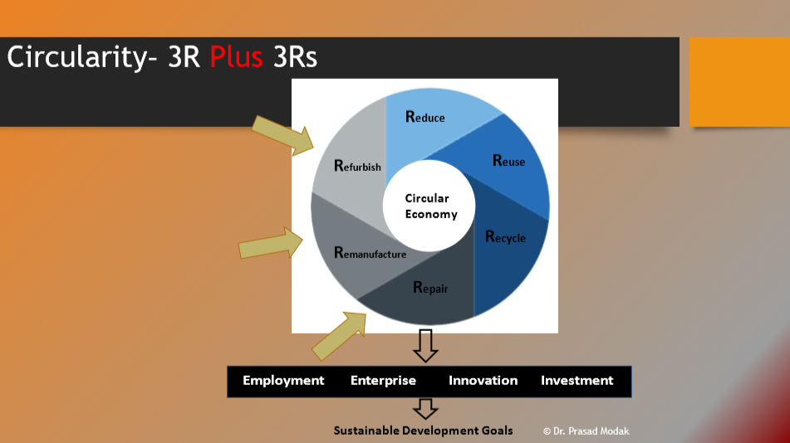

Slide 20
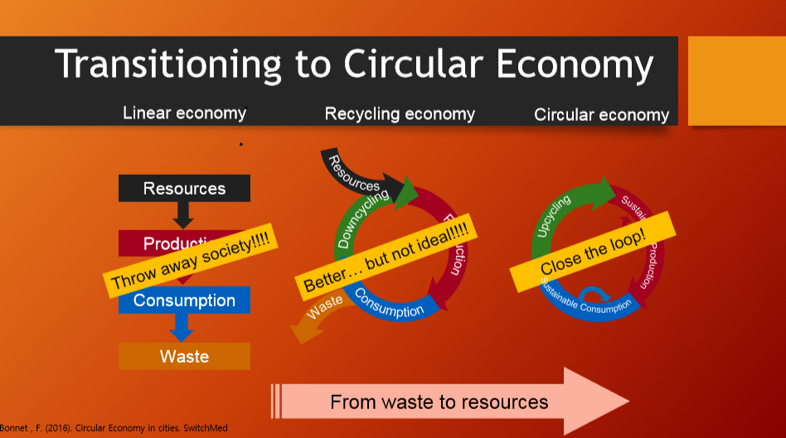

Slide 21
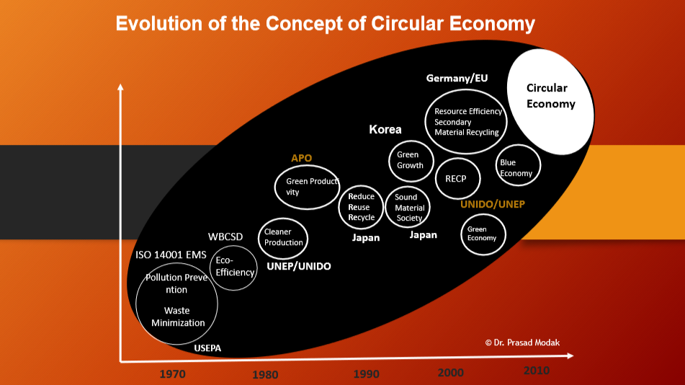

Slide 22
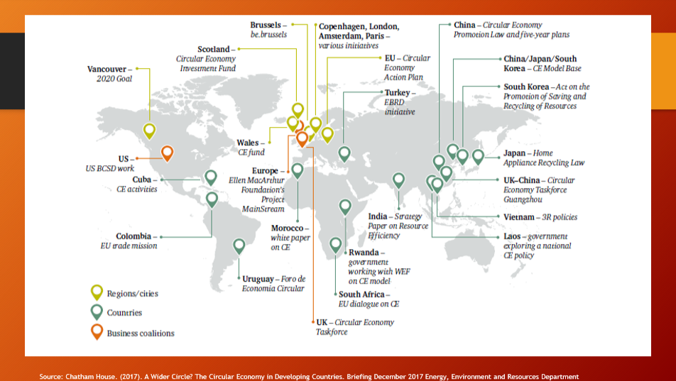

Slide 23
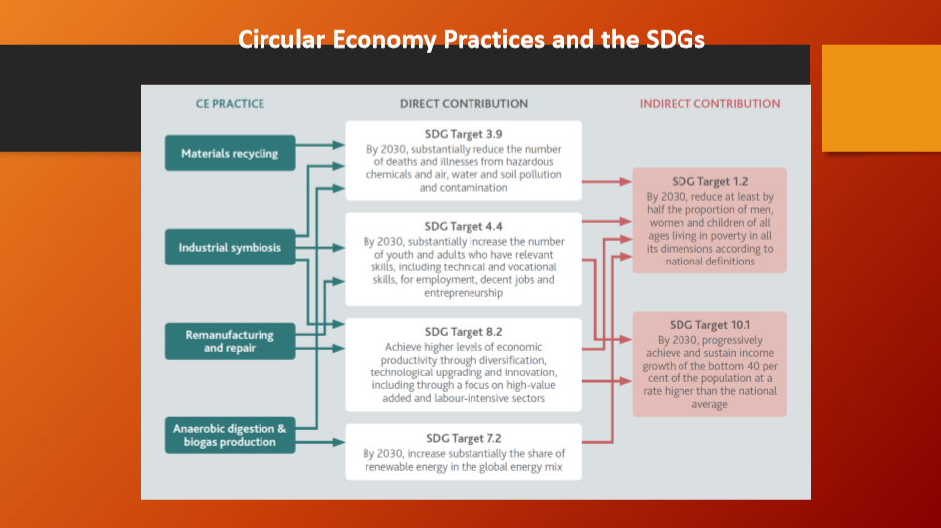

Slide 24
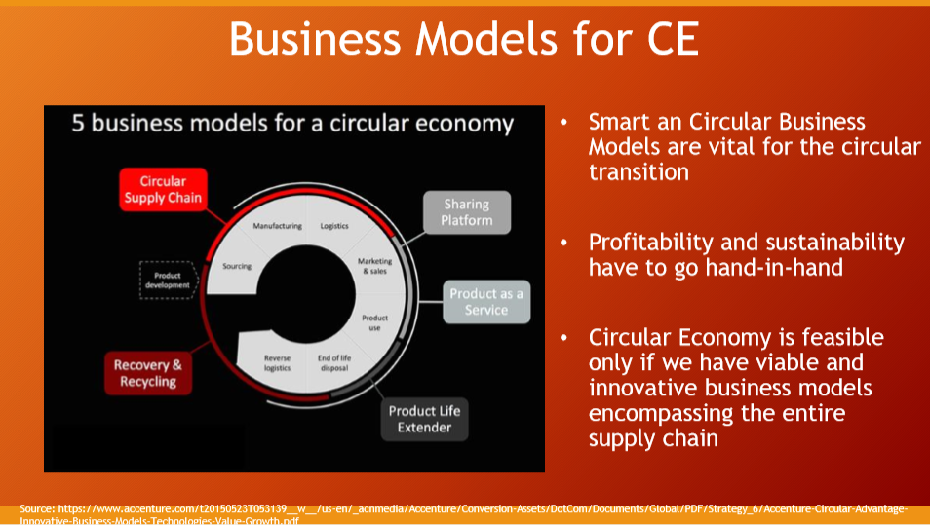

Slide 25
Thank You !!!

