Slide 1
Bioenergy for Climate Change Mitigation
Dr. P. Abdul Salam
Energy Field of Study
Asian Institute of Technology

Slide 2
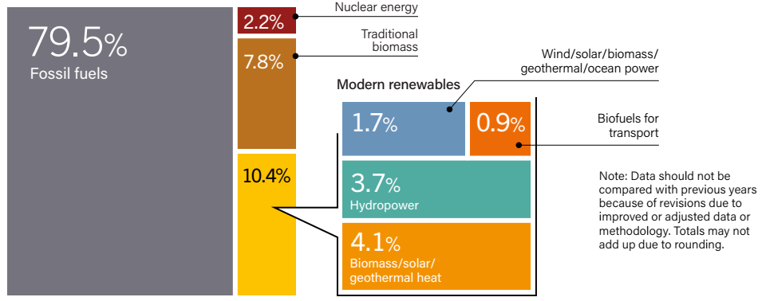
Share of renewable energy, 2016
Total energy consumption in 2016 was 362.5 exajoules (EJ)
Source: REN21, 2018

Slide 3
Biomass Consumption
Bioenergy contributed an estimated 12.8% (46.4 EJ) to total final energy consumption in 2016 (including traditional biomass)
Modern bioenergy (excluding the traditional use of biomass) contributed 5% to final energy consumption.
In developing countries biomass:
  provides basic energy requirements for cooking and heating of rural house holds.
  accounts for 20-90% of the total energy consumption.
Biomass is a renewable source and carbon neutral.

Slide 4
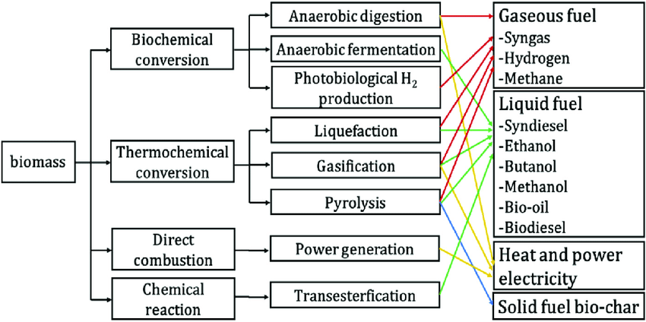
Biomass Conversion Technologies & products

Slide 5
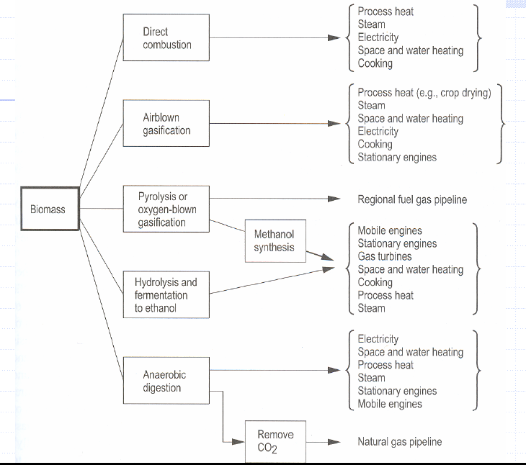
Biomass Conversion Technologies & Applications

Slide 6
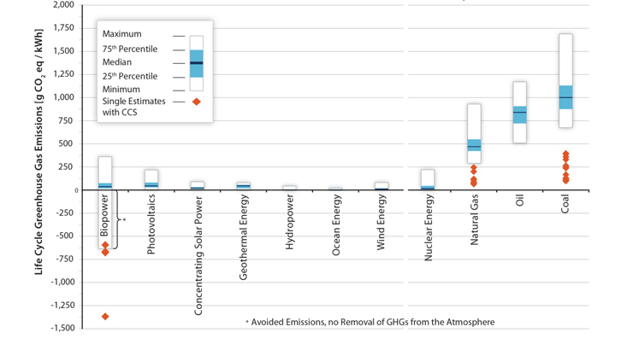
Lifecycle GHG Emissions
http://www.nrel.gov/analysis/sustain_lca_results.html

Slide 7
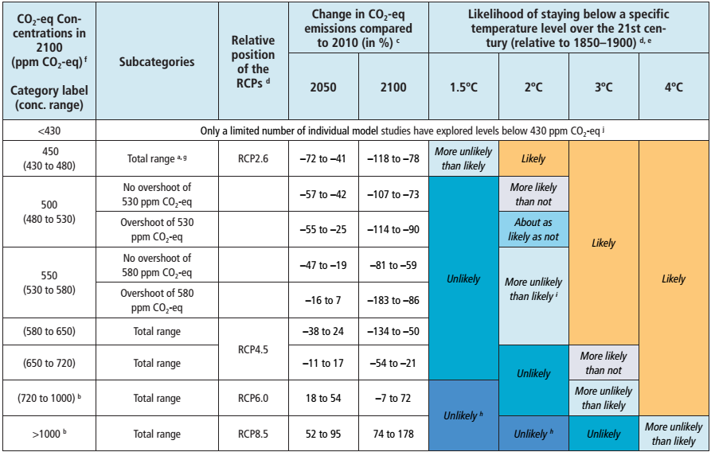
RCP: Representative Concentration Pathways
Source: IPCC AR5

Slide 8
Bio-Energy with Carbon Capture and Storage (BECCS)
Bioenergy combined with Carbon Capture and Storage (BECCS) is the only option for negative emission.

Slide 9
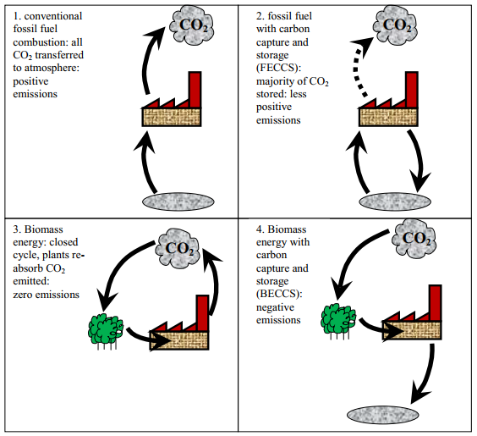
What is BECCS?
Source: Gough and Upham, 2010

Slide 10
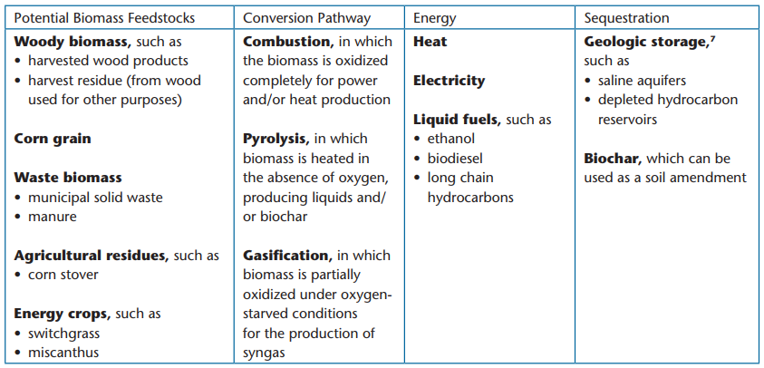
BECCS: Potential Feedstocks, technologies and sequestration methods
Source: THE NATIONAL ACADEMIES of SCIENCE, ENGINEERING & MEDICINE, 2018

Slide 11
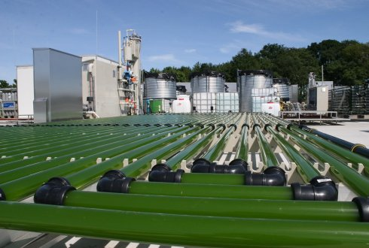
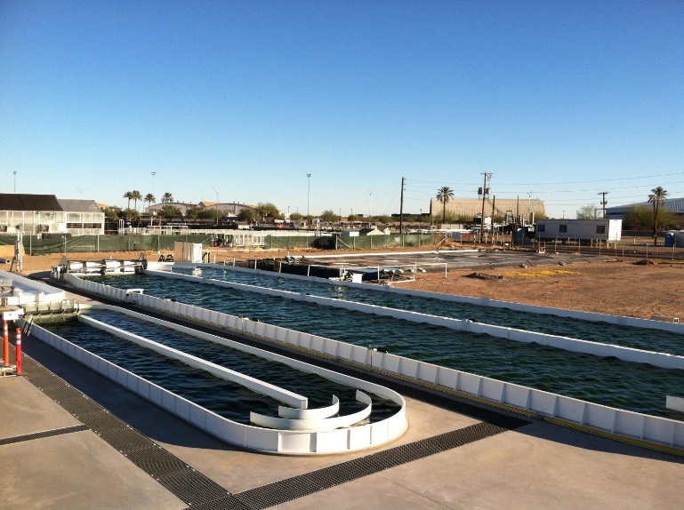
ABECCS: Algae with Bioenergy with Carbon Capture and Storage
BECCS has been criticized for threatening land and water resources that support natural forests and agriculture production.
Microalgae can be a solution of this challenge
Microalgae can be produced using seawater, freshwater, wastewater, grown faster and shorter cycle than land crops and in areas unsuitable for agriculture.
Microalgae has emerged as a promising source for food and biofuels.
The main drawback is that still now cost of algae production is high.
Microalgae cultivation in PBR
Microalgae cultivation in open pond

Slide 12
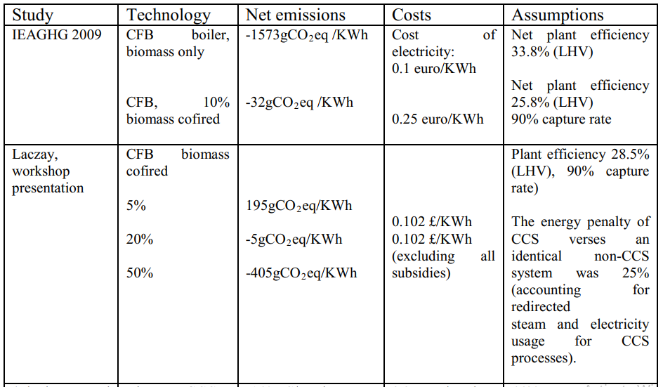
Emission reduction potential & electricity cost of different BECCS

Slide 13
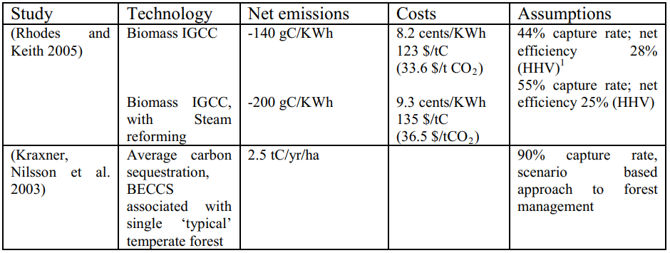
Emission reduction potential & electricity cost of different BECCS
Source: Gough and Upham, 2010

Slide 14
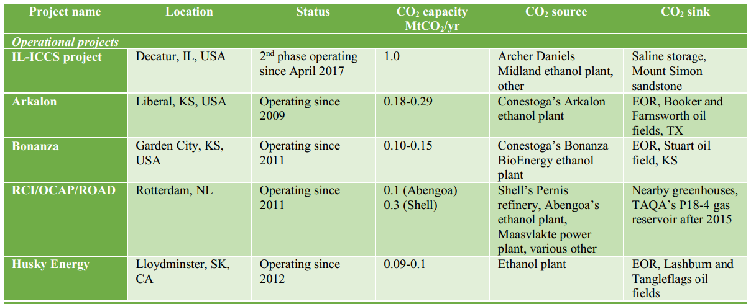
global BECCS operational projects
(Source: Kemper 2015)

Slide 15
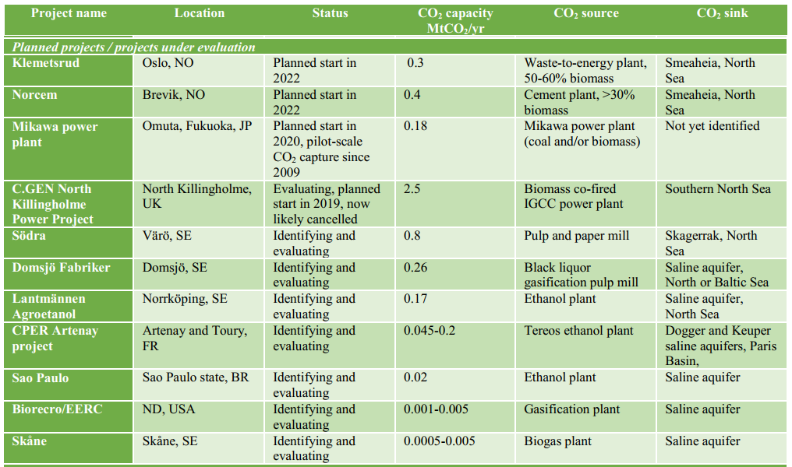
global BECCS planned/under evaluation projects
(Source: Kemper 2015)

Slide 16
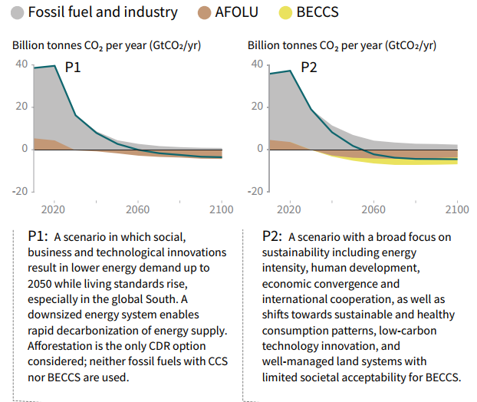
Importance of Beccs:
Different mitigation strategies in IPCC SR1.5
Different mitigation strategies can achieve the net emissions reductions that would be required to follow a pathway that limits global warming to 1.5°

Slide 17
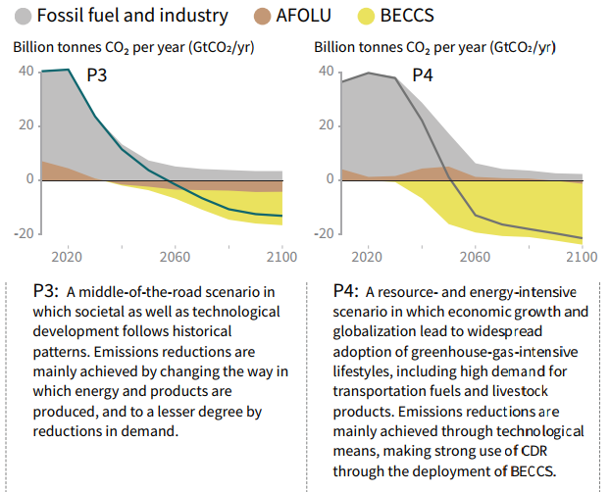
Different mitigation strategies in IPCC SR1.5
All pathways use Carbon Dioxide Removal (CDR), but the amount varies across pathways. The importance of BECCS is highlighted in scenario of P2, P3 and P4.

Slide 18
Current status of BECCS
BECCS uses existing technologies for biomass energy conversion coupled to carbon capture and sequestration.
There were several BECCS projects reported globally, however, none of these were commercialized plants.
The BECCS is not a mature technology as it lacks sufficient research and development investments.
The countries attempted to set up BECCS projects are: United States (Kansas, Texas, Illinois, North Dakota, Ohio, Washington), Netherlands, Sweden (Domsjo, Norrkoping, Skane), Brazil, France (Artenay), Germany (Ketzin), and Tanzania (Rufiji).
The current largest BECCS research project is in Illionois and is expected to inject 3.6 MtCO₂/year into the ground.

Slide 19
Challenges of implementing BECCS projects
Main challenges are as follows:
Fluctuating/lower price on carbon.
The absence of recognizing “negative emissions” in the existing CO₂ reduction incentive schemes (e.g., EU ETS), and hence adequate incentives for capturing CO₂ do not exist on a global basis.
Providing an adequate supply of biomass and the high cost of CCS.

