Slide 1
An Overview of the Climate Investment Funds (CIF) and ADB’s Strategy 2030 Operational Priority on Climate Change
Southeast Asia Department
Asian Development Bank

Slide 2
Urgency of Climate Action – IPCC Special Report on 1.5ºC
The climate consequences of a 2ºC world are far greater than that of 1.5ºC, especially for the poor and the vulnerable.
Limiting warming to 1.5ºC will require a major (unprecedented) economic transformation, is barely feasible now, and every year we delay the window of feasibility halves.
We have 11 years to enact the unprecedented, “rapid and far-reaching” transitions in land, energy, industry, buildings, transport, and cities needed to overcome the existential threat of climate change.
The world is expected to invest some $90 trillion on infrastructure by 2030. Much of this investment will be programmed in the next 2-3 years.

Slide 3
Challenges Ahead
Energy Transition:
To reach a 2°C world, energy-related CO2 emissions would need to peak before 2020 and fall by more than 70% by 2050.
Energy intensity of the global economy must be reduced by 2.5% a year, while wind and solar combined must become the largest source of electricity by 2030.
Energy Access:
1 billion people worldwide still live without electricity, while almost 3 billion people do not have access to clean fuels for cooking and heating;
Without accelerated progress, there will still be 674 million people worldwide living without electricity by 2030 and the gap for access to clean cooking fuels and technologies will be even higher.

Slide 4
Challenges Ahead
Sustainable Mobility:
In 2012, transport was the largest energy-consuming sector in 40% of countries worldwide, and the second largest in the remaining countries.
96% of global transport’s energy mix currently dependent on fossil fuels.
By 2035, transport is expected to be the largest GHG emitter, accounting for 46% of global emissions;
Transport sector is also highly vulnerable to the effects of climate change, and damage to transport systems can comprise a large share of the destruction caused by climatic events.
Adaptation and Resilience:
In 2015-2016, total average adaptation finance only amounted to USD 22 billion out of the USD 410 billion climate finance.
Adaptation finance requirement could range from USD 140 billion to 300 billion per year by 2030.

Slide 5
Challenges Ahead
Sustainable Landscapes:
1/3 of all land is moderately or severely degraded, and over 50% of the land used for agriculture is affected by land degradation;
1.6 billion people rely on benefits forests offer; 30 percent of global forest cover has been cleared, while another 20 percent has been degraded;
The agricultural sector (including forestry and land use) is the world's second-largest emitter, after the energy sector;
Climate-smart cities:
55% of the world’s population now live in urban areas, increasing to 75% by 2050;
Cities are key drivers of emissions – in 2013, 64% of global primary energy use originated in urban areas;
2/3 of world’s population will be living with infrastructure & planning decisions made today

Slide 6
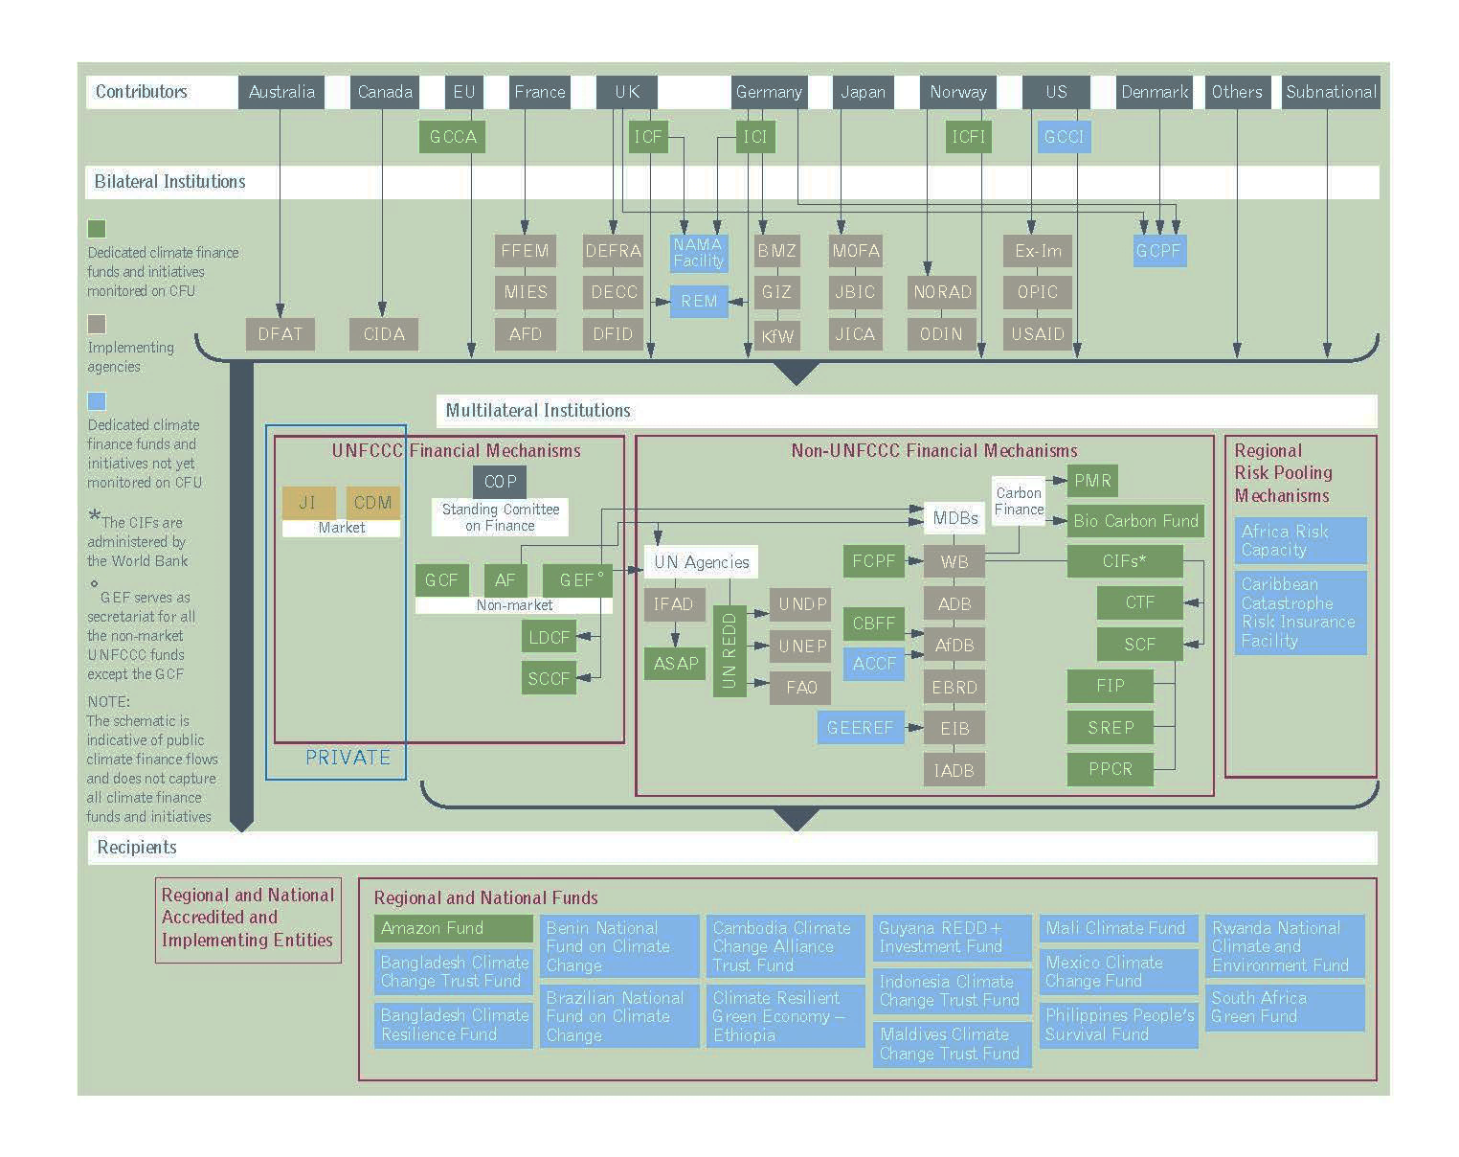

Slide 7
Overview of the Climate Investment Funds (CIF)
CIF’s GOAL = “transformational change towards climate resilient, low-carbon development in developing countries through scaled-up financing”
Established in 2008 to test, learn about and deploy climate finance at scale to advance clean technology and renewable energy; sustainable management of forests; and climate-resilient development.
Largest active multilateral climate finance vehicle worldwide: US$8.1 billion pledged from 14 donor countries, with est. co-financing of US$57 billion (e.g., from MDBs, private sector)
Funds earmarked to implement nearly 300 projects and programs in 72 developing and middle-income countries.
Operates as partnership of contributor and recipient countries; observers from civil society, indigenous peoples and private sector, and other development partners
Implemented through 5 multilateral development banks (MDBs) (i.e., AfDB; ADB; EBRD; IDB; and WBG, including IFC).
CIF’s scale and flexible approach helps countries mitigate and adapt to climate change in an integrated, programmatic fashion

Slide 8
CIF at a glance
$8.1 billion; >300 projects in 72 developing countries
26,500 MW in clean power, which is more than the total power capacity of Vietnam and almost the same as Netherlands (26.6 GW)
8.5 million people with improved access to energy, which is equivalent to the population of Switzerland or Sierra Leone
Over 10,000 GWh/year energy saved, which is the equivalent of total annual electricity production of Uruguay
Over 36 million ha of forests under improved management, the area of Congo or Germany
45 million people supported to cope with effects of climate change, more than the population of Argentina or Sudan

Slide 9
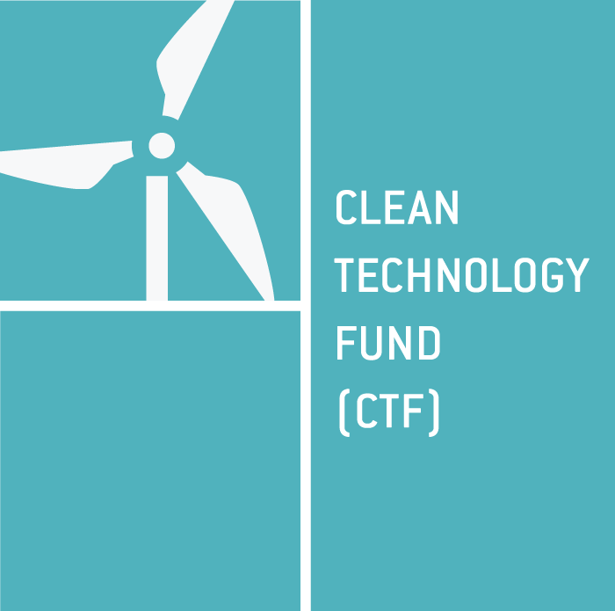
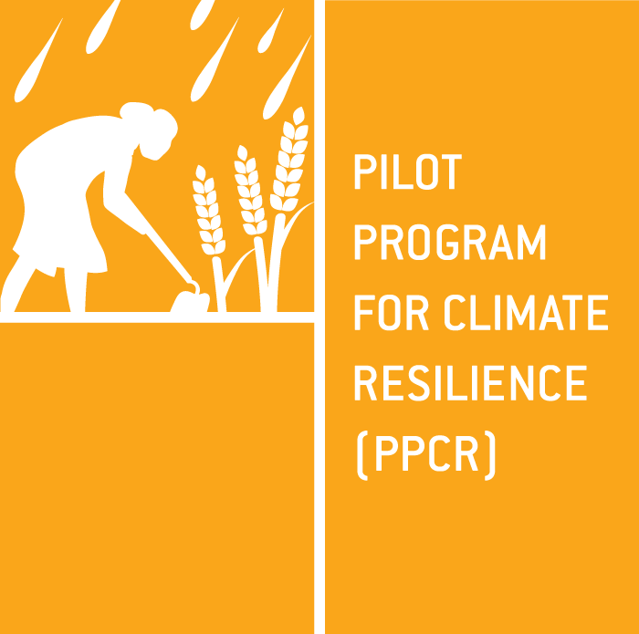
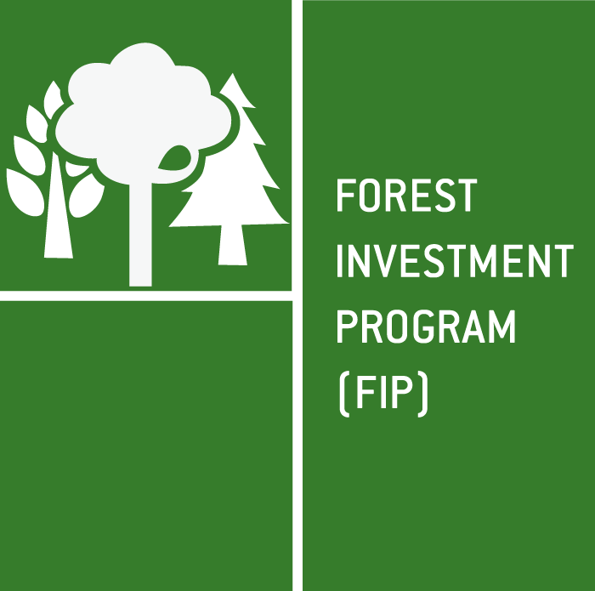
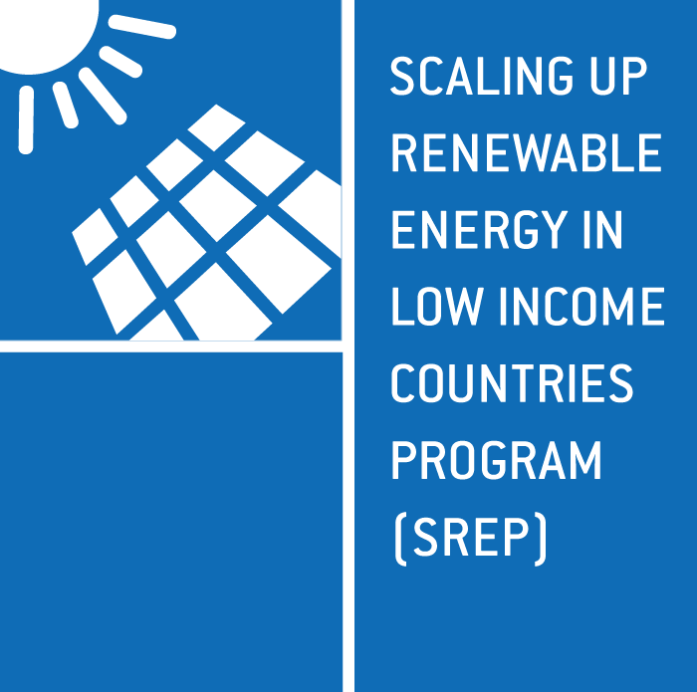
CLIMATE INVESTMENT FUNDS (CIF) $8.1 BILLION
$5.4
billion
$1.2
billion
$798
million
$720
million
Scaled-up demonstration, deployment, and transfer of low-carbon technologies in renewable energy, energy efficiency, and clean transport
Mainstream resilience in development planning and investments
Reduce emissions from deforestation and forest degradation, sustainably manage forests, and enhance forest carbon stocks
Demonstrate economic,
social, and environmental viability of renewable energy in low income countries
Chile
Colombia
Egypt
India
Indonesia
Kazakhstan
Mexico
Morocco
Nigeria
Philippines
South Africa
Thailand
Turkey
Ukraine
Vietnam
Middle East and North Africa Region
(Egypt, Jordan, Morocco, Tunisia)
Bangladesh
Bhutan
Bolivia
Cambodia
Ethiopia
Gambia
Honduras
Kyrgyz Republic
Madagascar
Malawi
Mozambique
Nepal
Niger
Philippines
Rwanda
Tajikistan
Uganda
Yemen
Zambia
Caribbean Region (Dominica,
Grenada, Haiti,
Jamaica,
St. Lucia,
St. Vincent and
the Grenadines)
Pacific Region
(Papua New Guinea,
Samoa, Tonga)
Bangladesh
Brazil
Burkina Faso
Cambodia
Cameroon
Congo Republic
Democratic Republic of Congo
Ecuador
Ghana
Guatemala
Guyana
Honduras
Indonesia
Ivory Coast
Lao People’s Democratic Republic
Mexico
Mozambique
Nepal
Peru
Rwanda
Tunisia
Uganda
Zambia
Armenia
Bangladesh
Benin
Cambodia
Ghana
Haiti
Honduras
Kenya
Kiribati
Lesotho
Liberia
Madagascar
Malawi
Maldives
Mali
Mongolia
Nepal
Nicaragua
Rwanda
Sierra Leone
Tanzania
Uganda
Yemen
Zambia
Pacific Region (Solomon Islands, Vanuatu)
STRATEGIC CLIMATE FUND (SCF) $2.8 BILLION

Slide 10
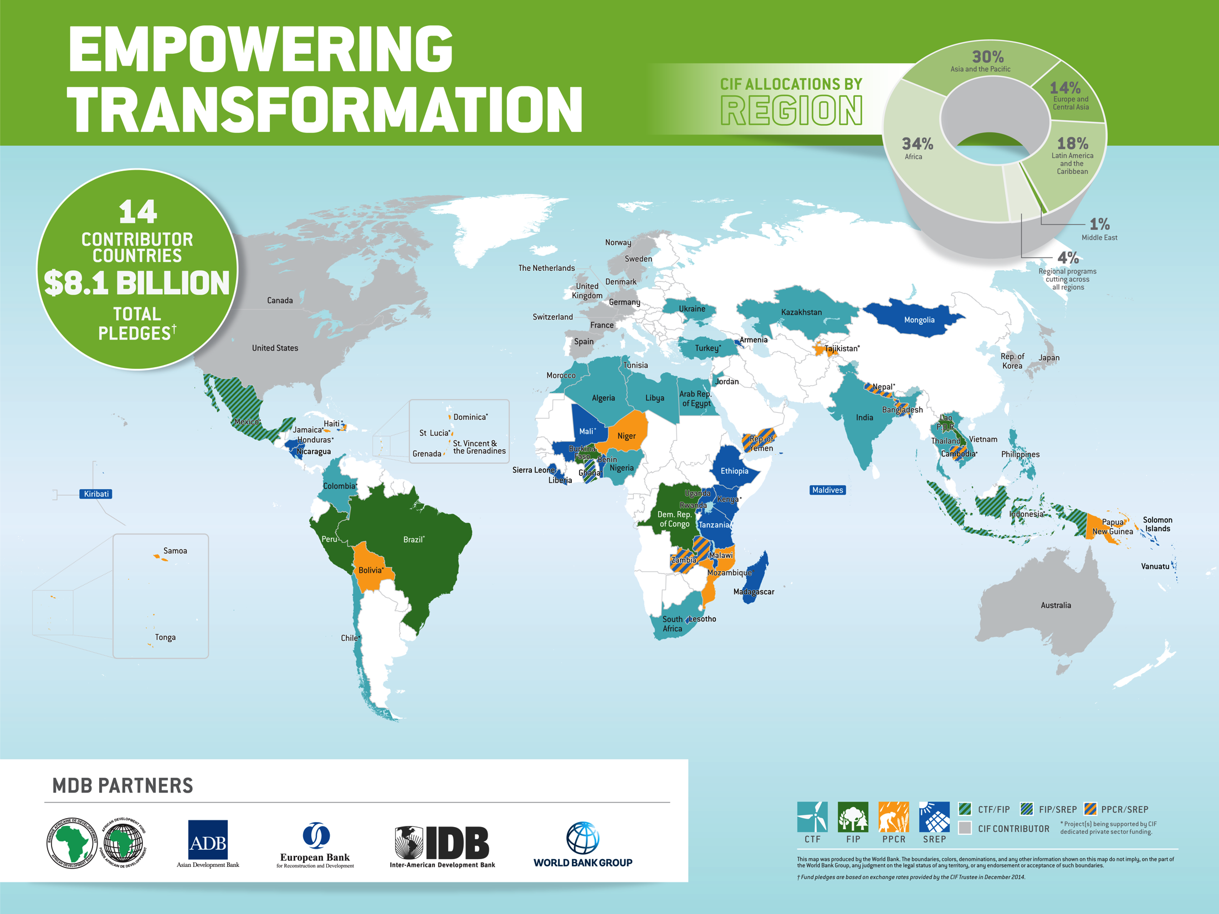

Slide 11
CIF Business Model: Five Key Elements Driving Transformational Change
Country-led model sets the stage for multi-sectoral, context specific transformation
Consideration of transformational change at design helps remove barriers
Large-scale investments that helped move markets; concessionality and predictability of funding
MDB coordination and delivery creates coherent intervention packages
Flexibility accelerates progress

Slide 12
CIF Programmatic Approach
Inter-MDB collaboration (MDBs offer: scale, convening power, & robust safeguard, procurement systems)
Country ownership of CIF programming process and results, embedding national goals/targets
Can move beyond project-by-project approach to programmatic approach with long-term, strategic arrangement of linked investment projects for national/ sector-wide transformation
Umbrella approach, maximizing synergies and co-financing opportunities
e.g., FIP: Looking across forest landscapes using integrated approach with range of stakeholders to address drivers of deforestation and forest degradation, within and outside the ‘forest’ sector, for triple win on poverty reduction + GHG mitigation + Climate resilience.
Two levels of design & implementation together
forming a CIF country program:
i.e., Investment Plan + Projects

Slide 13
ADB’s Strategy 2030 and Climate Finance

Slide 14










ADB Strategy 2030
Operational Priorities
Other Key Approaches
Addressing remaining poverty and reducing inequalities
Expanding private sector operations
Operational Priority 3
Tackling climate change,
building climate & disaster resilience, and enhancing
environmental sustainability
One-third of ADB operations by 2024
Catalyzing and mobilizing financial resources for development
Accelerating progress in gender equality
$1 in private sector operations financing matched by $2.50 of cofinancing
Making cities more livable
Strengthening governance and institutional capacity
Strengthening knowledge services
Promoting rural development and food security
Fostering regional cooperation and integration

Slide 15



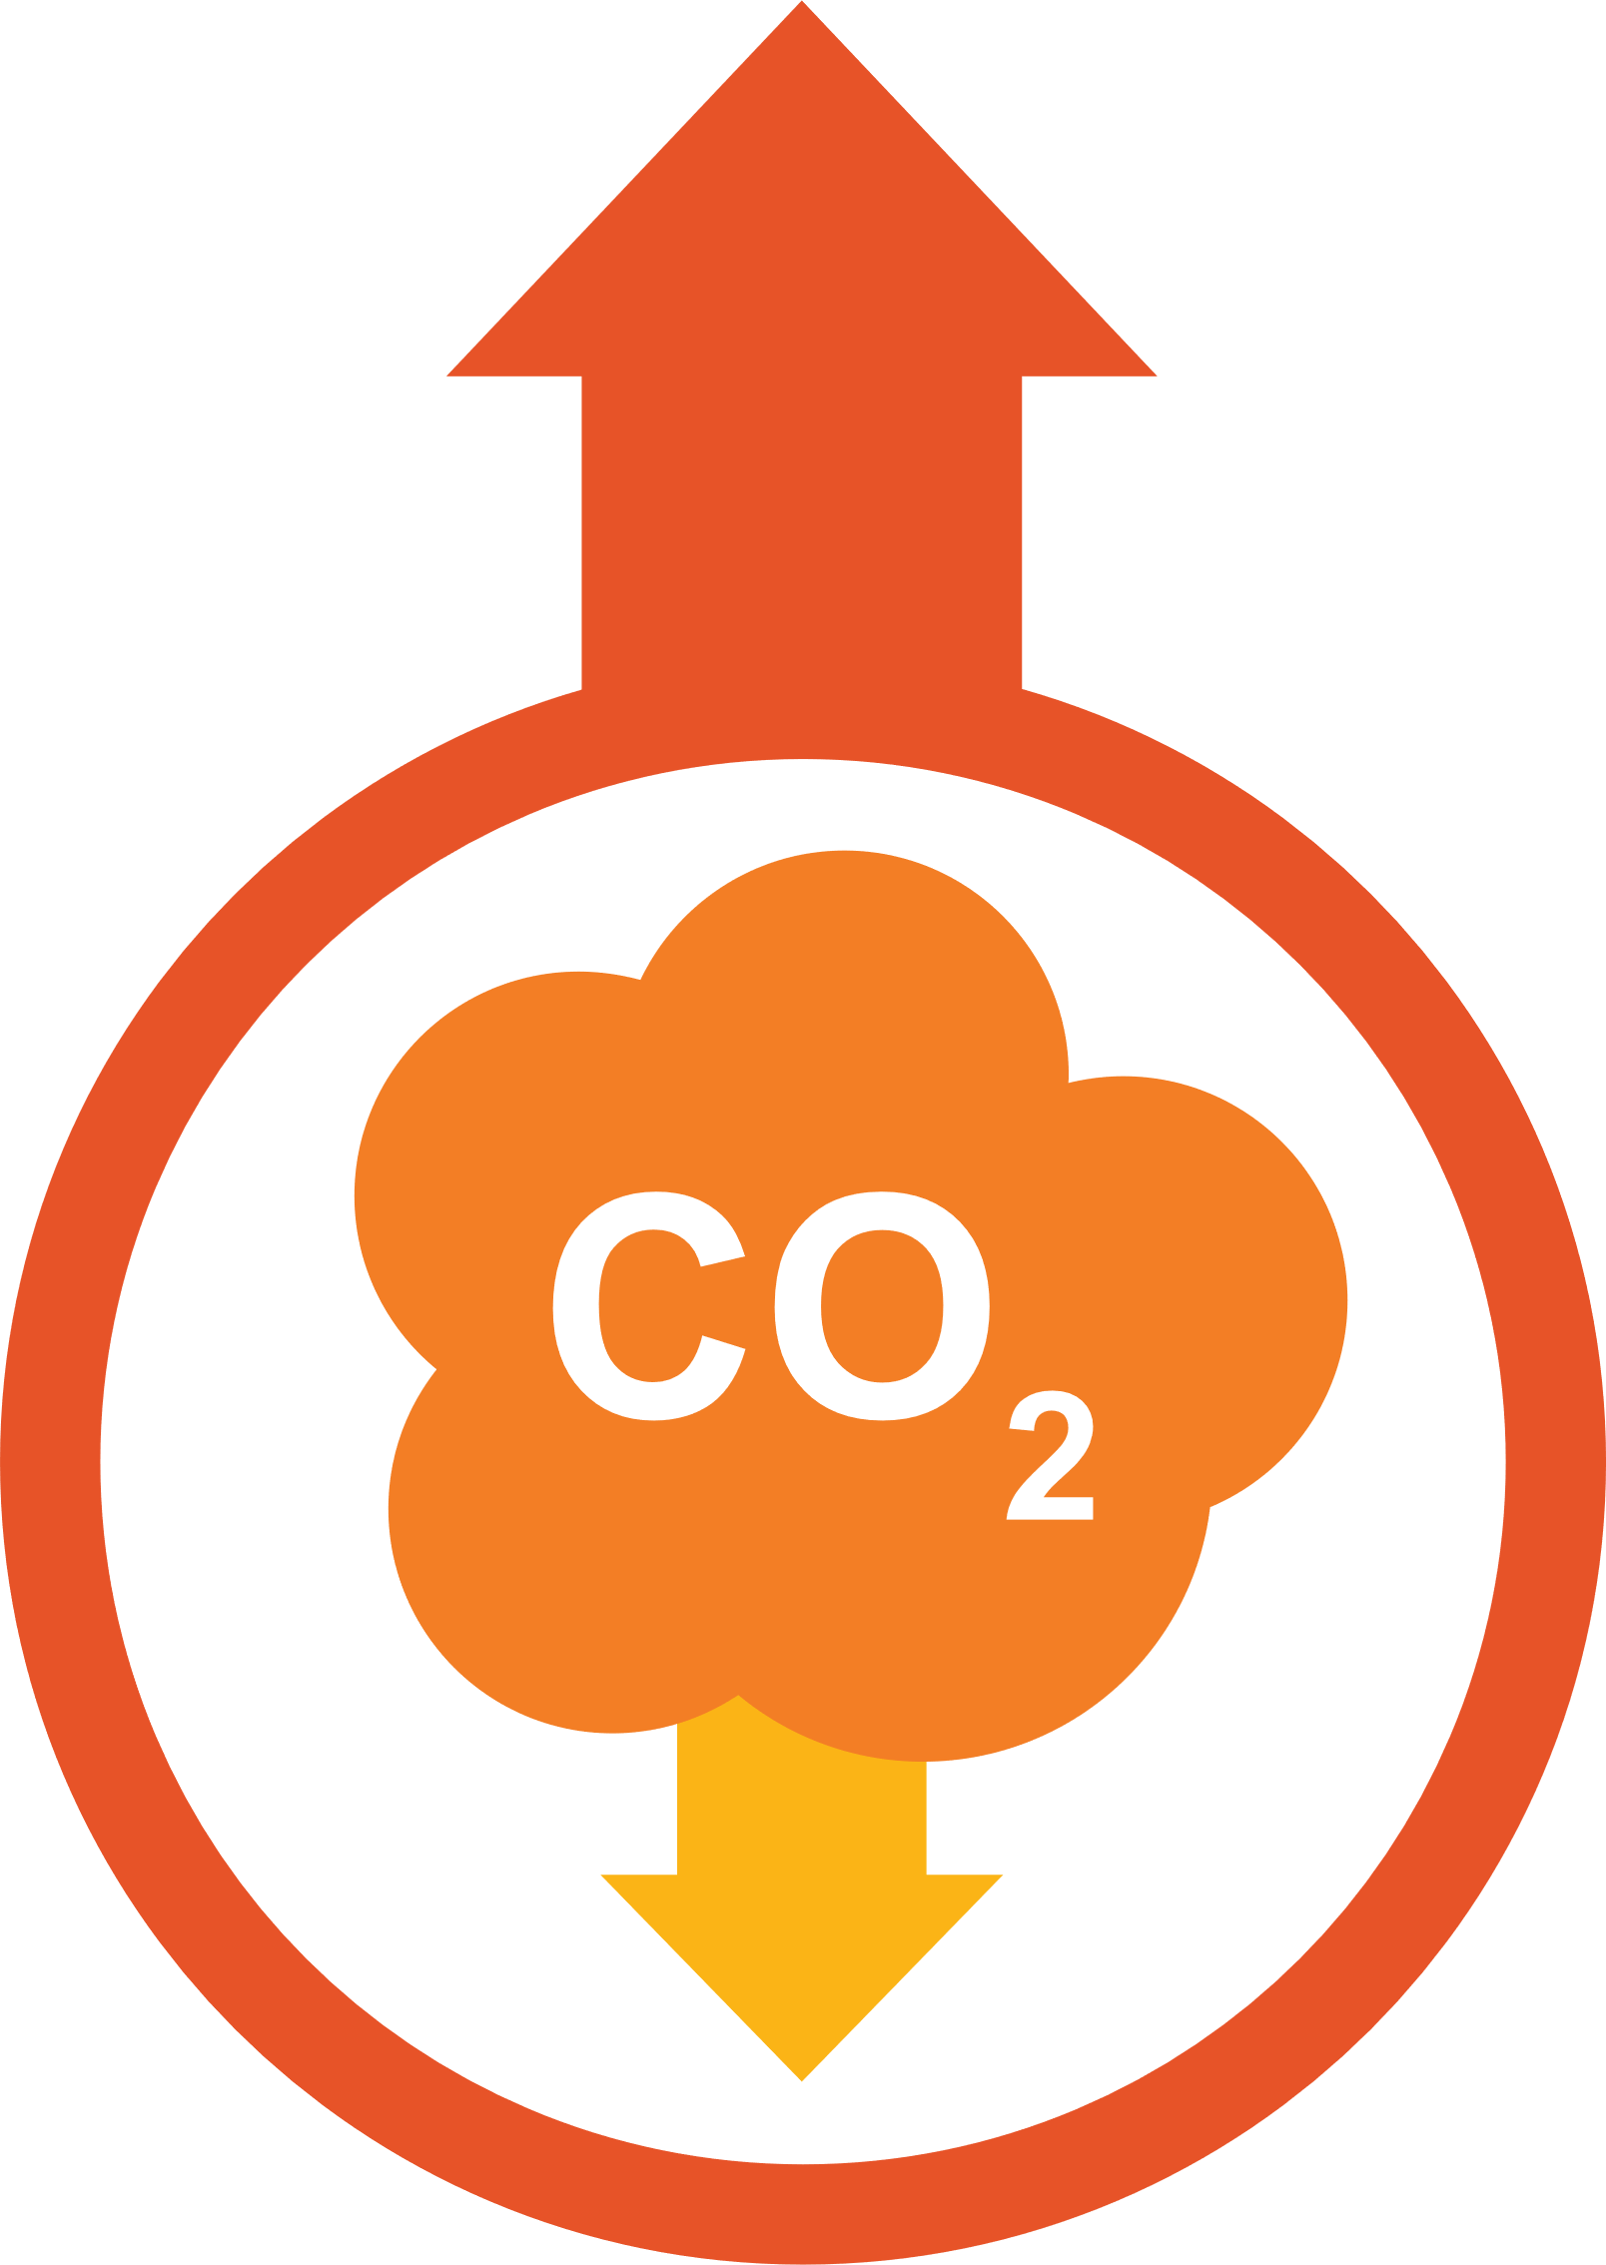
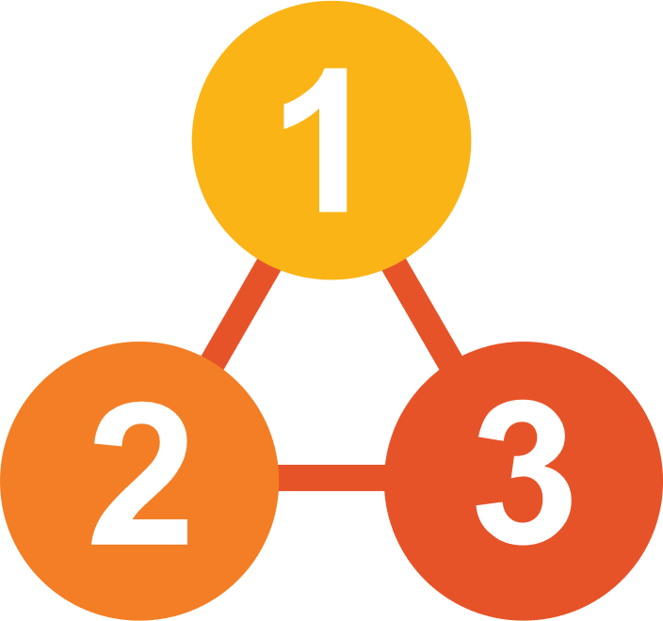



Overview of the operational priority
Scaling up support for addressing climate change, disaster risks, and environmental degradation
Climate and ESG operations targets
Accelerating low GHG development / green growth
Building climate and disaster resilience
Ensuring environmental sustainability
Increasing focus on water-food-energy security nexus
Phase 1: 2017-2023
Phase 2: 2024-2030
2017
2023
2024
2030
$6 billion annual climate financing from own resources by 2020
75% of the number of its committed operations supporting climate change mitigation and adaptation by 2030
$80 billion cumulative climate finance from own resources from 2019 to 2030.

Slide 16

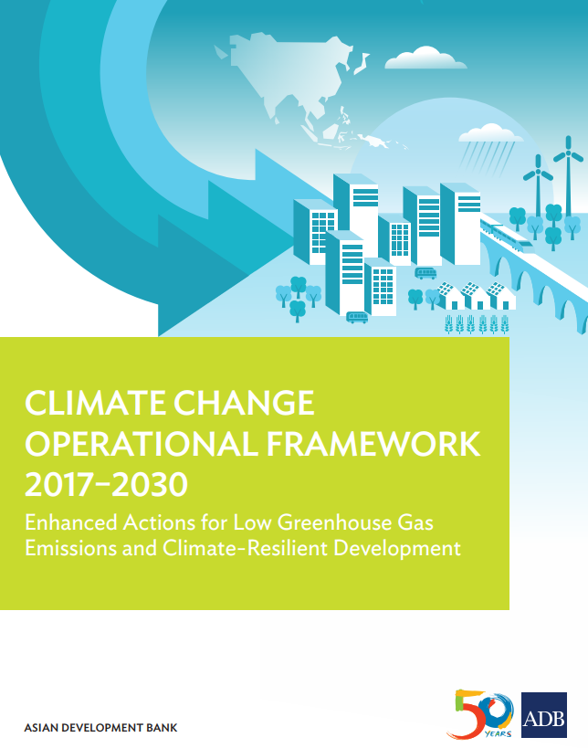
Climate Change Operational Framework 2017-2030
5 Principles
5 Actions
• Supporting ambitious climate objectives articulated in NDCs and other climate plans
• Accelerating low GHG emissions development
• Promoting climate change adaptation
• Integrating climate change adaptation and disaster risk management
• Linking climate actions to wider sustainable development agenda
• Supporting institutional development and policy frameworks conducive to ambitious climate action in DMCs
• Facilitating access to public and private, domestic and international climate finance
• Promoting use of climate technologies in operations
• Developing knowledge solutions and capacity development support
• Strengthening partnerships and networks
16

Slide 17





OP3 Operational Plan:
4 Key Activities to operationalize OP 3 – Climate Action
1
NDC ADVANCE:
Support DMCs translate commitments into investment plans
URBAN RESILIENCE PLATFORM:
Decreasing emissions
Building resilience
ADB’s Strategy 2030
2
Livable Cities Operational Priority Action Plan
Cities in Asia and the Pacific are more Livable
Inclusive Cities: providing appropriate livelihood, service, shelter and infrastructure solutions to poor and vulnerable communities
Integrated solutions to achieve competitive, inclusive, resilient and green cities
Resilient Cities: providing strategic physical, social and institutional infrastructure which enhances resilience to climate change and disasters
Green Cities: providing infrastructure which enables resource efficient and healthy lifestyles
Competitive Cities: providing strategic physical, social and institutional infrastructure for inclusive growth
Operational Support
Integrated Planning and data analytics
Capacity Development, Knowledge Management and Partnerships
Piloting of innovative concepts

Slide 18
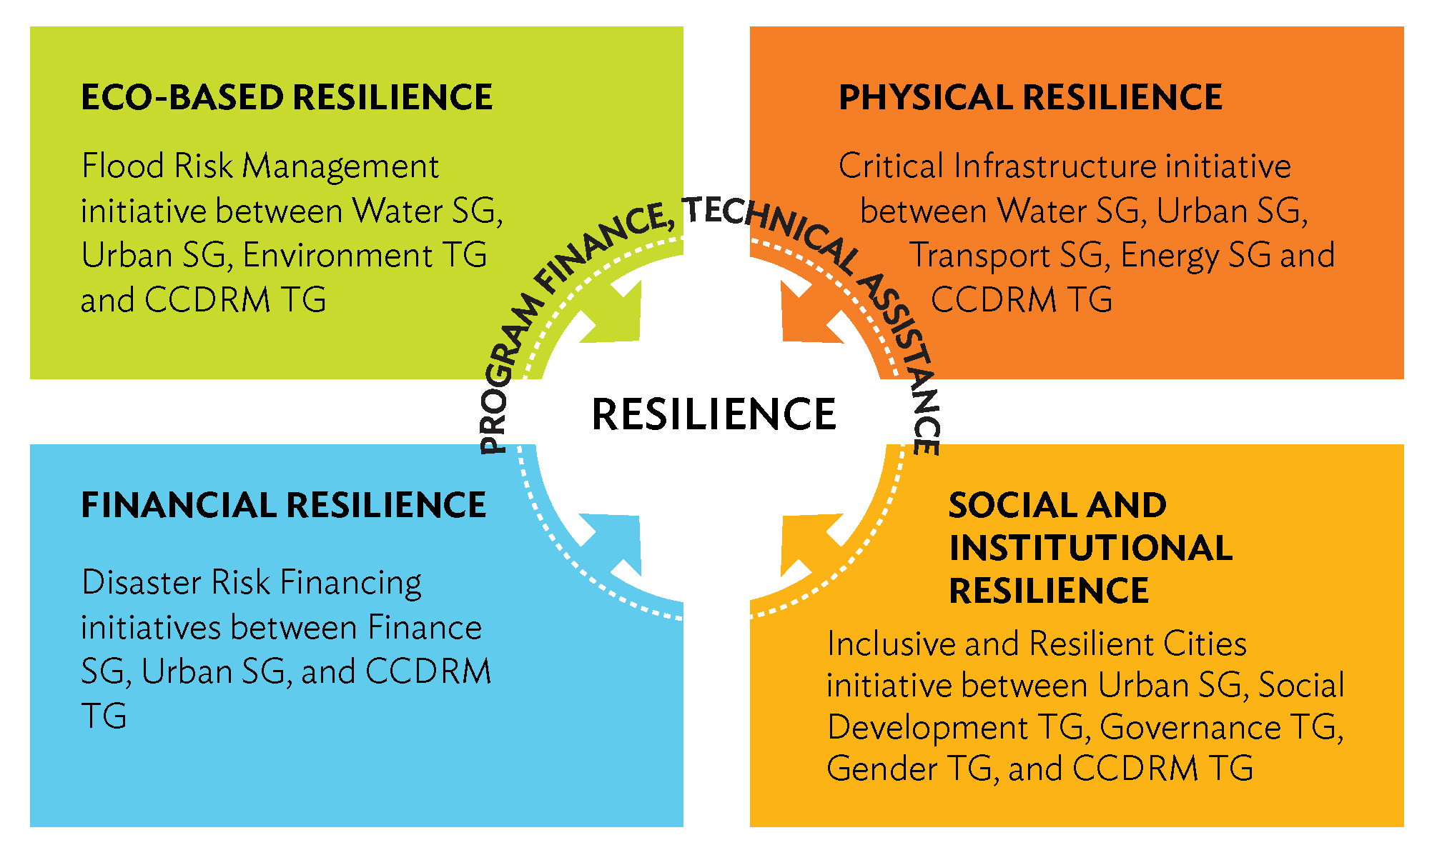


OP3 Operational Plan:
4 Key Activities to operationalize OP 3
3
4
BUILDING RESILIENCE:
ACCESS TO FINANCE:
Mobilizing private sector
Carbon markets
ACliFF
PSOD Climate Funds
Carbon Market Program
Developing Member Countries
ADB Operations Financing and Support
18

Slide 19






How it will be operationalized?
Further mainstreaming of climate action, and climate and disaster resilience and environmental sustainability in ADB operations
Facilitating access to finance
Enhancing access to concessional financing
Mobilizing private sector operations
Promoting green business
Developing capacity to access 2nd generation carbon markets
Responding to DMCs NDCs and SDGs (12, 13, 14 and 15)
Support DMCs translate commitments into investment plans
Employing integrated solutions
advancing low-carbon and resilient urban development
building resilience in 4 dimensions- ecological, physical, financial and social and institutional
Investing in environmentally sustainable infrastructure, including nature-based solutions
Integrating water resource management and water quality
Improving internal coordination, cooperation and knowledge sharing
Coordinated Mechanisms to leverage across Strategy 2030’s three targets: gender, private sector and climate change
Enhancing institutional capacity
Deploying high-level technologies
Clear delineation of roles and responsibilities across the institution

Slide 20
A menu of financial instruments
Emergency assistance loan
Project design advance loan
Additional financing
Co-financing
Balance of payment lending
Sector development program
Results based lending
Policy based lending
Multi tranche financing facility
Sector lending
Project lending
Transaction TA
Knowledge support TA
Notes:
What is co-financing? Financing from Bilateral (official development assistance), multilaterals, global funds, private sector (foundations and corporations), civil society are coursed through various co-financing vehicles of ADB such as project specific co-financing, trust funds, framework arrangements for sovereign and non-sovereign operations in the form of loans, grants, technical assistance and guarantees.

Slide 21
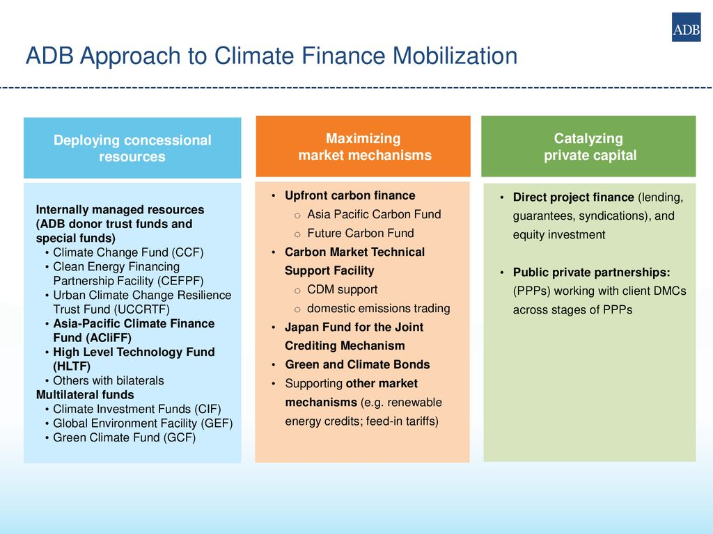
ADB’s Approach to
Mobilizing Climate Finance

Slide 22
ADB’s Role in Deploying Concessional Resources from Multilateral Climate Funds
Fund | Date Established | Total Global Fund Size | Allocated to ADB
 |  | ($ million) | ($ million)
A. Climate Investment Funds |  | 8,100 | 1,434
Clean Technology Fund (CTF) | 2008 | 5,400 | 1,000
Scaling-Up Renewable Energy Program for Low Income Countries (SREP) | 2008 | 720 | 127
Forest Investment Program (FIP) | 2008 | 798 | 31
Pilot Program for Climate Resilience (PPCR) | 2008 | 1200 | 276
B. Global Environment Facility (GEF) | 1991 | 8,238 | 116
GEF Trust Fund | 1991 | 6,620 | 91
Least Developed Countries Fund (LDCF) | 2002 | 1,311 | 14
Special Climate Change Fund (SCCF) | 2005 | 352 | 11
C. Green Climate Fund (GCF) | 2011 | 8,351 | 298
Total |  | 15,367 | 1,802

Slide 23
Internally-Managed Funds
Fund | Date Established | Fund Size $ million
ADB Climate Change Fund (ADB net income) | May-08 | 74.0
Clean Energy |  | 39.0
REDD and Land Use |  | 7.8
Adaptation |  | 27.0
Climate finance readiness |  | 0.3
Clean Energy Financing Partnership Facility |  | 304.5
Clean Energy Fund (multi-donor) | Apr-07 | 101.2
Asian Clean Energy Fund (Japan) | Jan-08 | 57.1
Carbon Capture & Storage Fund (Australia) Global CCS Institute & UK) | Jul-09 | 64.7
Canadian Climate Fund for the Private Sector in Asia | Apr-13 | 81.5
Canadian Climate Fund for the Private Sector in Asia II | Apr-17 | 150.0
Urban Climate Change Resilience Trust Fund | Nov-13 | 149.4
Asia Pacific Disaster Response Fund (ADB, from Asian Tsunami Fund) | 2009 | 80.0
Japan Fund for the Joint Crediting Mechanism | 2014 | 60.7
Integrated Disaster Risk Management Fund (Canada) | Feb-13 | 8.5
Carbon Finance (multi-donor)
Asia-Pacific Carbon Fund (up to 2012) | Nov-06 | 151.8
Future Carbon Fund (post-2012) | Jul-08 | 115.0
Asia Pacific Climate Finance Fund | Apr-17 | 33.6
Total |  | 1,127.5

Slide 24



Example of Multi-product, Multi-country Assistance Project
$276 million loan and grant and $2.5 million TA support across 3 GMS countries
$276 million
Multiple currency
loan
$62 million
donor cofinancing
$19.3 million
Counterpart financing
$2.5 million
technical assistance
Cambodia:
Rice
Maize
Cassava
Mango
Lao PDR:
Rice
Vegetables
Myanmar:
Rice
Pulses
Beans
Oilseeds
Loan and Grant: $90 and $40 million USD
Duration 6 years
Effective: 10.2018
Grant: $40.5 million USD
Duration: 6 years
Effective: 11.2018
Loan and Grant: $40.5 and $22 million USD
Duration: 7 years
Effective: 1.2019
Notes:
Objective is to transform transport into economic corridors by improving competitiveness through:
Resource efficiency
Climate resilience
Value addition
Safety and quality = e.g. Cambodia, Lab infrastructure for testing trace elements (public), quality testing kits (private), capacity building (Safety and quality standards, CamGAP, GMP, organic certification, geographic indication)
Rural household incomes

Slide 25
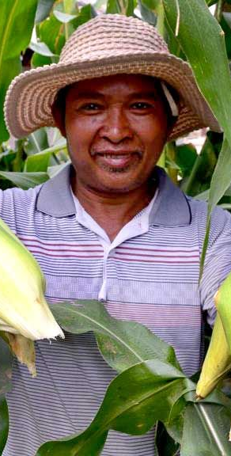
Case Study: Cambodia Climate-Friendly Agribusiness Value Chains Sector Project
Output 1: Critical agribusiness value chain infrastructure improved and made climate-resilient
Output 2: Climate smart agriculture and agribusiness promoted
Output 3: Enabling environment for climate-friendly agribusiness enhanced
Notes:
Output 1: Critical agribusiness value chain infrastructure improved and made
climate-resilient. This output bridges gaps in infrastructure to enhance the competitiveness of
the value chains of rice, maize, cassava, and mango in target provinces. Key activities involve (i) rehabilitating irrigation and water
management infrastructure (off-farm irrigation systems, on-farm rainwater harvesting ponds, and
drip irrigation) to climate-resilient condition; (ii) upgrading agricultural cooperatives’ value chain
infrastructure (drying, processing, and storage facilities); (iii) improving the connectivity of farms
to cooperatives and markets through climate-resilient farm road networks; (iv) strengthening the
infrastructure for agricultural quality and safety testing; and (v) promoting renewable energy
(biodigesters and use of solar energy in target cooperative areas) to reduce GHG emissions.
Output 2: Climate-smart agriculture and agribusiness promoted. Key activities
include (i) deploying climate-resilient varieties; (ii) strengthening the capacity for climate-friendly
production practices and technologies; and (iii) promoting farm mechanization and extension. The
project will support the Cambodian Agricultural Research and Development Institute to produce,
multiply, and distribute climate-resilient varieties of rice and maize and to improve weaning and
acclimatization of mango and cassava. The project will train at least 40,000 farmers (of which
16,000 are women) on CSA practices.
Output 3: Enabling environment for climate-friendly agribusiness enhanced. The
project will support the Ministry of Agriculture, Forestry, and Fisheries (MAFF) and the Ministry of
Commerce in creating a favorable policy environment for agribusiness to mobilize the private
sector participation through PPPs and contract farming. Key activities include (i) formulating climate friendly
agribusiness policies and standards; (ii) promoting green finance and risk-sharing
mechanisms; and (iii) supporting climate risk management through ICT. The project will provide
support for farm product certification, quality, and resilience standards, including Cambodia’s
good agricultural practice and organic fertilizer standards.

Slide 26
Thank you.

