Slide 1

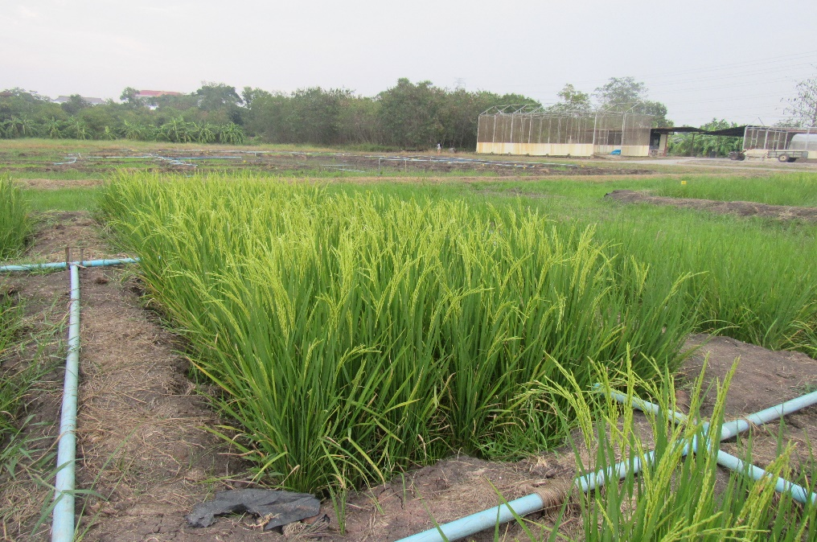
Climate Change Adaptation in the Agricultural Sector: Strategies for Rice Cultivation in Asian Context
Dr. Avishek Datta (datta@ait.ac.th)
Associate Professor
Department of Food, Agriculture and Bioresources
04 February 2020

Slide 2
Nutritional importance of rice
Important staple food crop
Main source of carbohydrates with a lower percentage of proteins, lipids, and fibers
also contains vitamins (B1, B2, and B6) along with some natural antioxidants and minerals
Human consumption in 2009 accounted for 78% of total production for rice compared with 64% for wheat and 14% for maize
Rice is the staple food of more than half of the world’s population – more than 3.5 billion people depend on rice for more than 20% of their daily calories

Slide 3
Food security and role of rice in Asia
> 90% of rice is produced and consumed in Asia
> 3 times increase in production during the last 4 decades
Per capita consumption increased from 85 (1960) to 100 kg (2010)
Based on UN 2010 projections, population of Asia will reach to ~ 5 billion by 2035 and 5.15 billion by 2050
To fulfill the growing global needs for rice, an increase of 1.2–1.5% per year is required to be maintained by 2020 and 1.0–1.2% per year beyond 2020

Slide 4
Major problems in rice production
Rapidly increasing population and trends towards urbanization
Increased competition for land and water recourses
Reduced investments in irrigation infrastructure
Large water withdrawals from groundwater
Constantly declining soil fertility and excessive use of agrochemicals
Existing technologies are no longer sufficient
to meet the constantly increasing global food demand due to shrinkage of natural resources

Slide 5
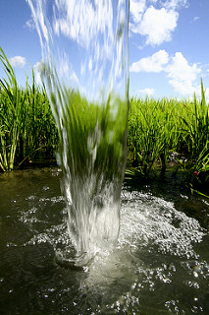
Water issues in rice production
World food security is dependent on irrigated lowland rice
largest consumer of freshwater in the agricultural sector
2500-3400 liters of water are needed to produce 1 kg of rice
~ 75% of global and 80% of Asian existing water resources are devoted to its production
(Source: IRRI)

Slide 6
Water issues in rice production
Global freshwater resources
rapidly declining due to CC and heavy extraction
Serious threat to agricultural productivity, especially in irrigated rice
with long-term consequences for regional and global food security
By 2025
2 mha of Asia’s irrigated dry-season rice and 13 mha of its irrigated wet-season rice may experience ‘‘physical water scarcity’’

Slide 7
Opportunities
More rice needs to be produced with less water
need alternative ways to increase water productivity in irrigated rice production system
In Asia, WUE of rice is very low
Yield gap in this area is very high
this gap could be narrowed through efficient use of resources and increasing WUE of rice

Slide 8
Opportunities
Popular water-saving techniques
alternate wetting and drying (AWD)
aerobic rice system
direct seeding method of cultivation
dry direct seeding
wet direct seeding
system of rice intensification (SRI)

Slide 9
Agricultural water management to cope with CC
Direct Seeding Method of Cultivation
Direct seeding of rice
a process of rice crop establishment from seeds directly sown in the field rather than by transplanting seedlings raised from the nurseries. Three methods:
Dry seeding – dry seeds are directly sown into dry soil
Wet seeding – sowing pre-germinated seeds on soil that is wet and puddled
Water seeding – sowing seeds in standing water

Slide 10
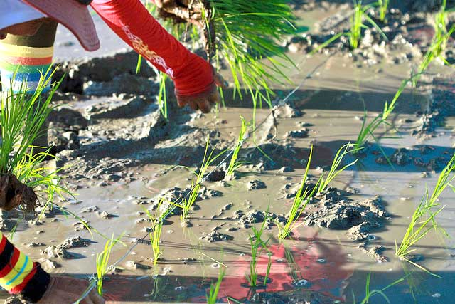
Transplanting (Source: IRRI)

Slide 11
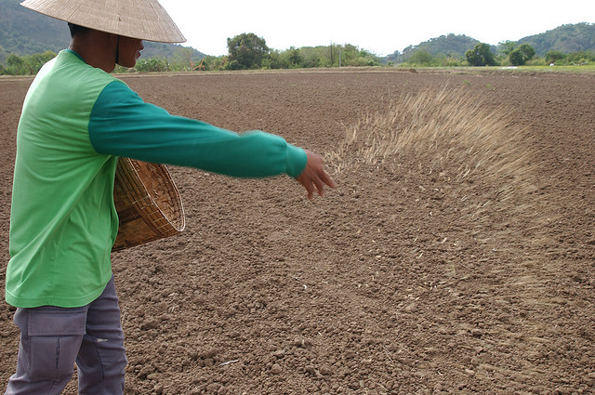
Dry direct seeding (Source: IRRI)

Slide 12
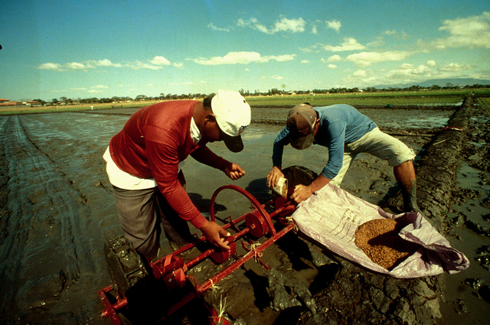
Wet direct seeding (Source: IRRI)

Slide 13
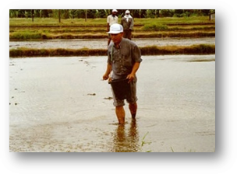
Water seeding (Source: IRRI)

Slide 14
Agricultural Water Management to Cope with CC
Alternate wetting and drying (AWD)
Widely promoted water-saving technique introduced by the International Rice Research Institute (IRRI)
Irrigation water of ~ 2–5 cm is applied after an interval of between 2 and 7 days
depending on soil type and environmental conditions
followed by disappearance of ponded water from the soil surface
Can reduce water demand by ~ 40 % with no adverse impact on yield

Slide 15
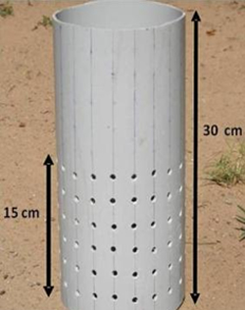
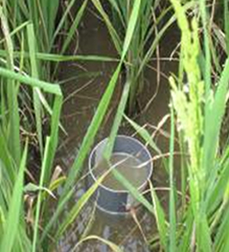
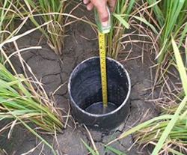
A field water tube in flooded field
Field water tube made up of PVC. Note the holes on all sides
(Source: IRRI)
Irrigation should be applied to re-flood the field to a depth of ~ 5 cm
when the water level has dropped to ~15 cm below the surface of the soil

Slide 16
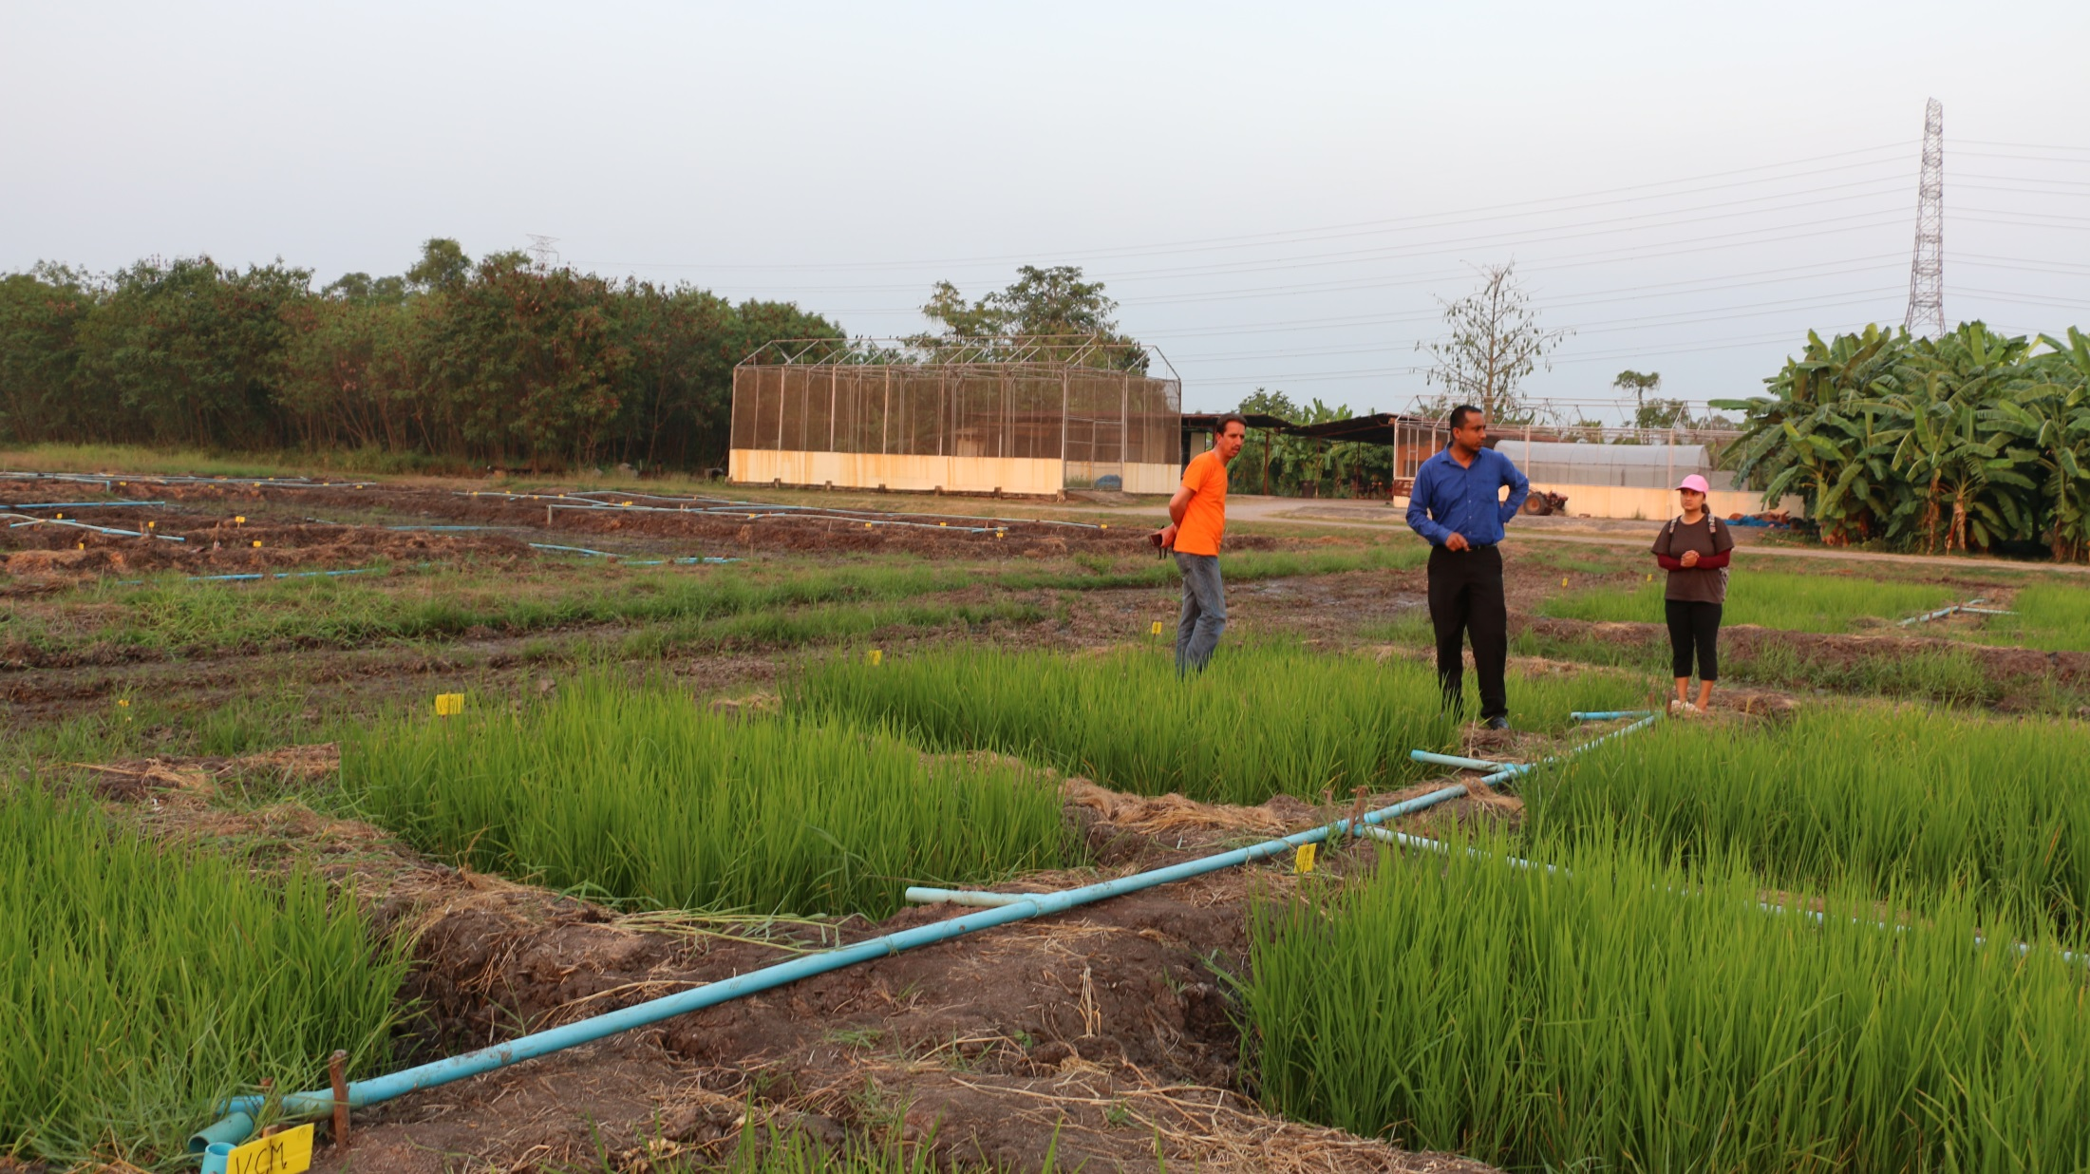
Experimental Findings

Slide 17
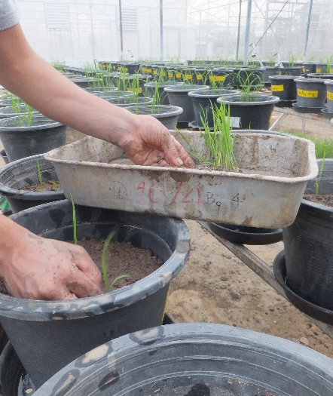
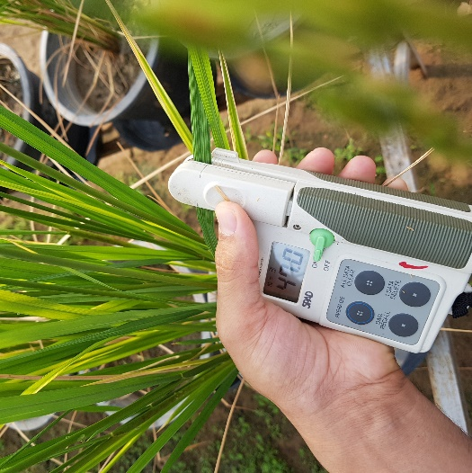
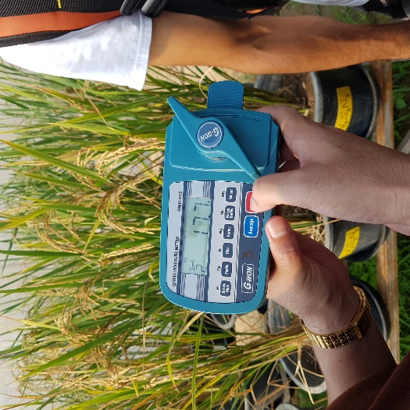
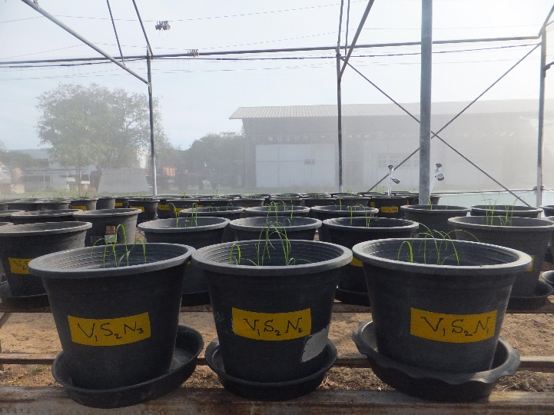
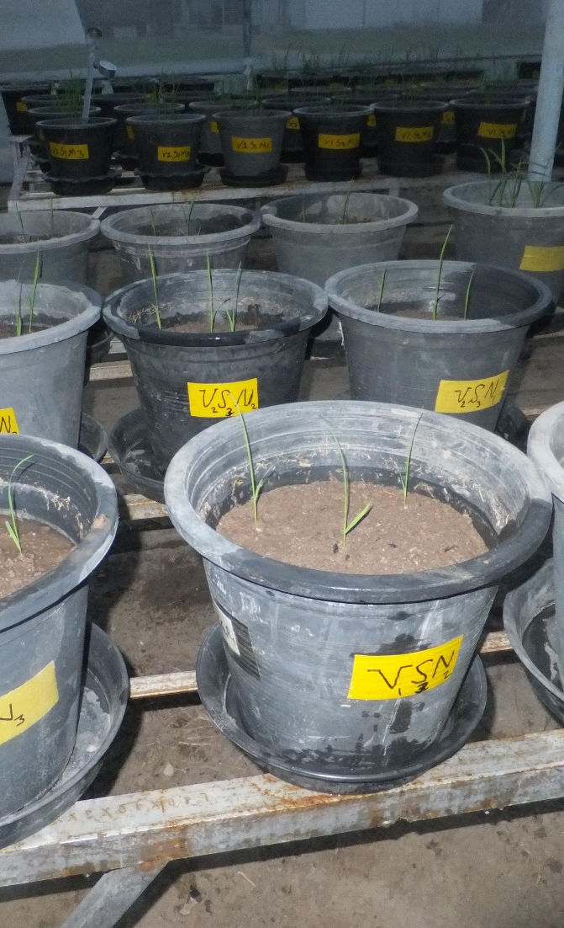
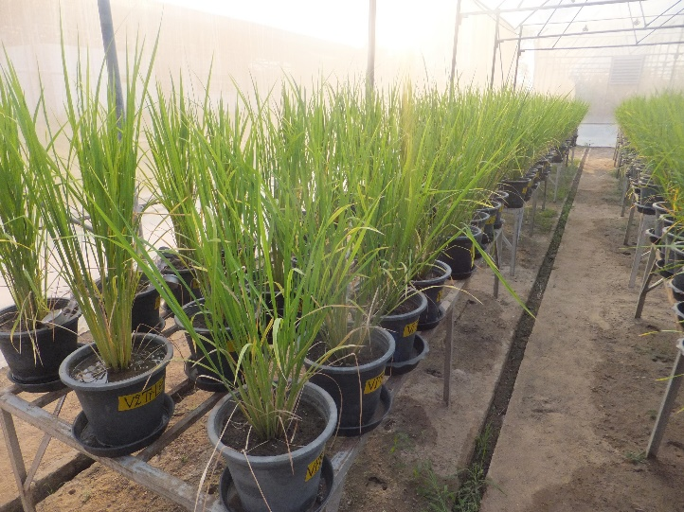
Polyhouse Experiments
Polyhouse Experiment

Slide 18
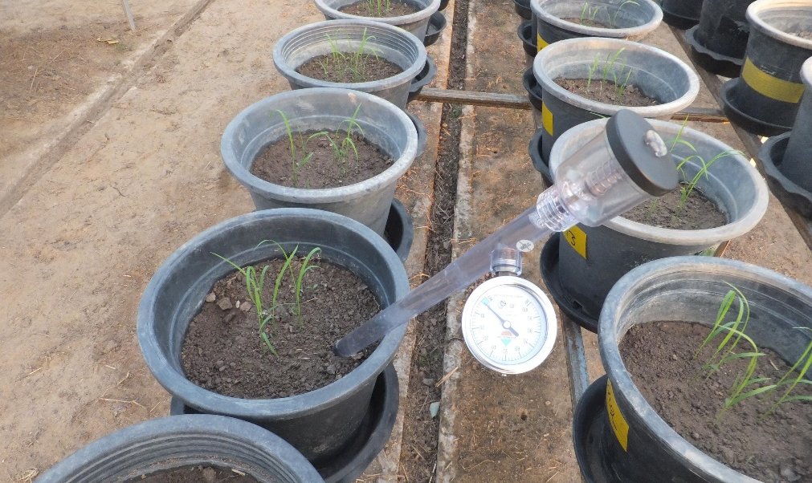

Growth, yield and water productivity of selected lowland Thai rice varieties under different cultivation methods and alternate wetting and drying irrigation
Ullah, Mohammadi, Datta. 2018. Ann. Appl. Biol. 173, 302–312
A pot experiment was conducted to evaluate the performance of selected lowland Thai rice varieties grown under different cultivation methods subjected to AWD irrigation
Treatments:
3 varieties (Pathumthani 1, RD57, and RD41)
3 cultivation methods (DDS, WDS, and TP)
4 AWD irrigation levels (re-watered when soil water potential reached at 0, −5, −15, and −30 kPa)

Slide 19
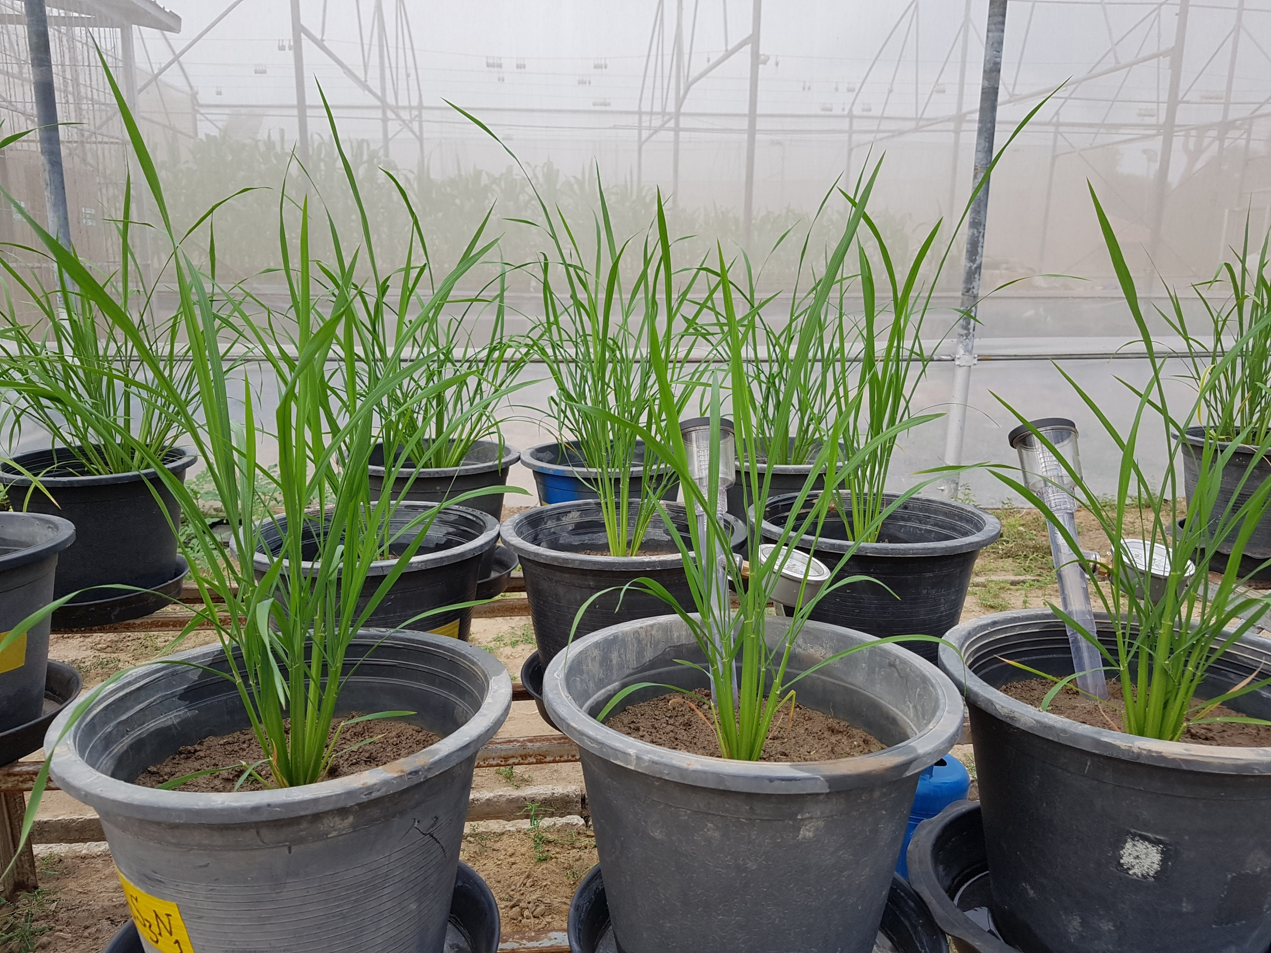
Results

Slide 20
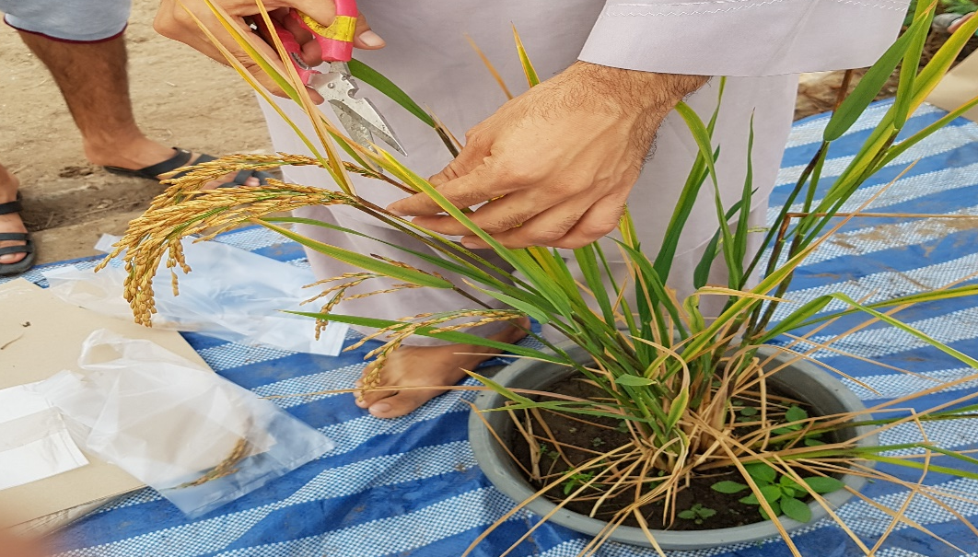
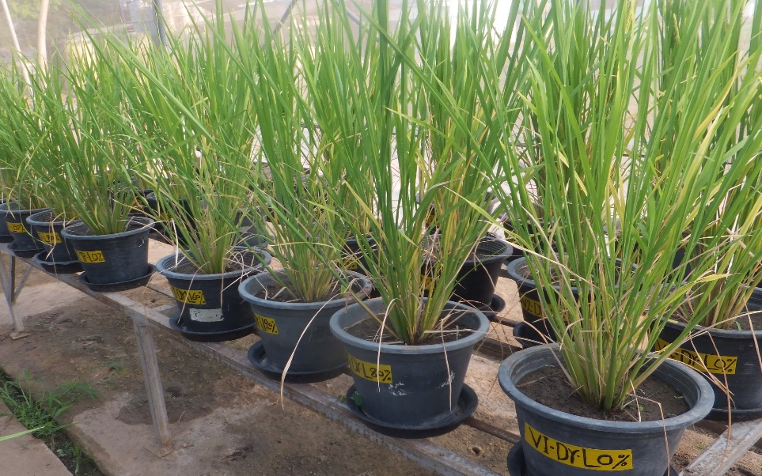

Slide 21
Grain yield
DDS resulted in higher grain yield at −5 and −15 kPa (74 and 68 g/pot, respectively)
respective reduction of 15 and 34% under WDS and TP at −5 kPa, and 15% and 28% at −15 kPa
Grain yield was the highest (74 g/pot) at −5 kPa under DDS
reduced by 26% at 0 kPa (55 g/pot) and 19% at −30 kPa (60 g/pot)
Grain yield between −15 and − 30 kPa was similar under the same cultivation method

Slide 22
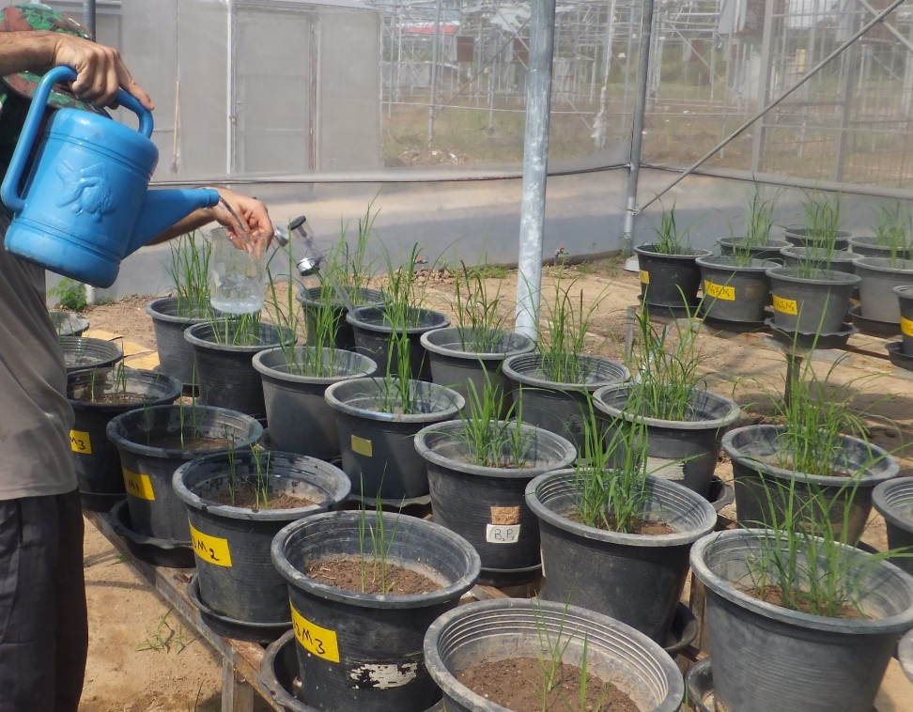
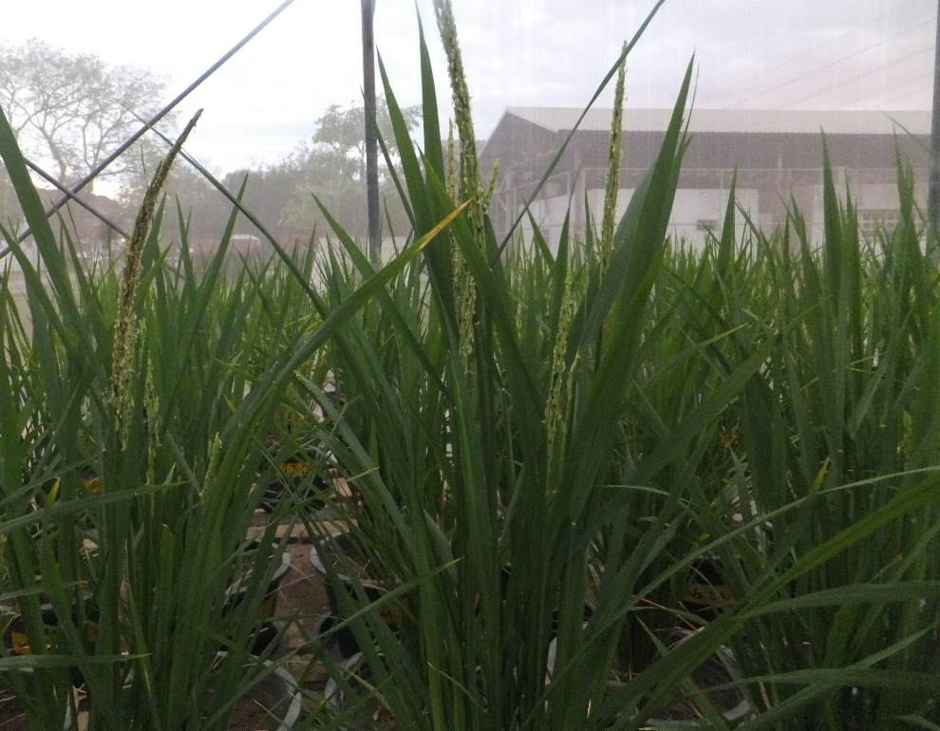

Slide 23
Water productivity
The highest water productivity was recorded at −30 kPa under DDS
reduced by 17–61% for other soil water potentials irrespective of varieties
grain yield was also reduced by 12–19% at −30 kPa
At −15 and −30 kPa
DDS had higher water productivity (1.04 and 1.26 kg/m³, respectively) than WDS (0.88 and 1.08 kg/m³, respectively) and TP (0.75 and 0.96 kg/m³, respectively)

Slide 24
Conclusions
All the tested three varieties showed similar response to water-saving management practice of direct seeding (dry) cultivation method and AWD irrigation
they are equally suitable for growing under these water-efficient techniques
Among four soil water potentials
most of the yield contributing characters and grain yield were higher at −5 kPa, whereas water productivity was higher at –30 kPa

Slide 25
Conclusions
Defining the threshold level for AWD should be based on soil texture and soil type
−15 kPa could be a threshold level as there was a combination of higher grain yield and water productivity
DDS had better performance for grain yield and water productivity
could be recommended as a potential cultivation method for these lowland Thai rice varieties

Slide 26
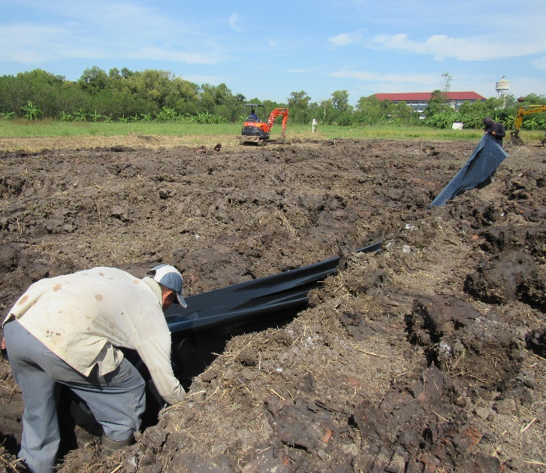
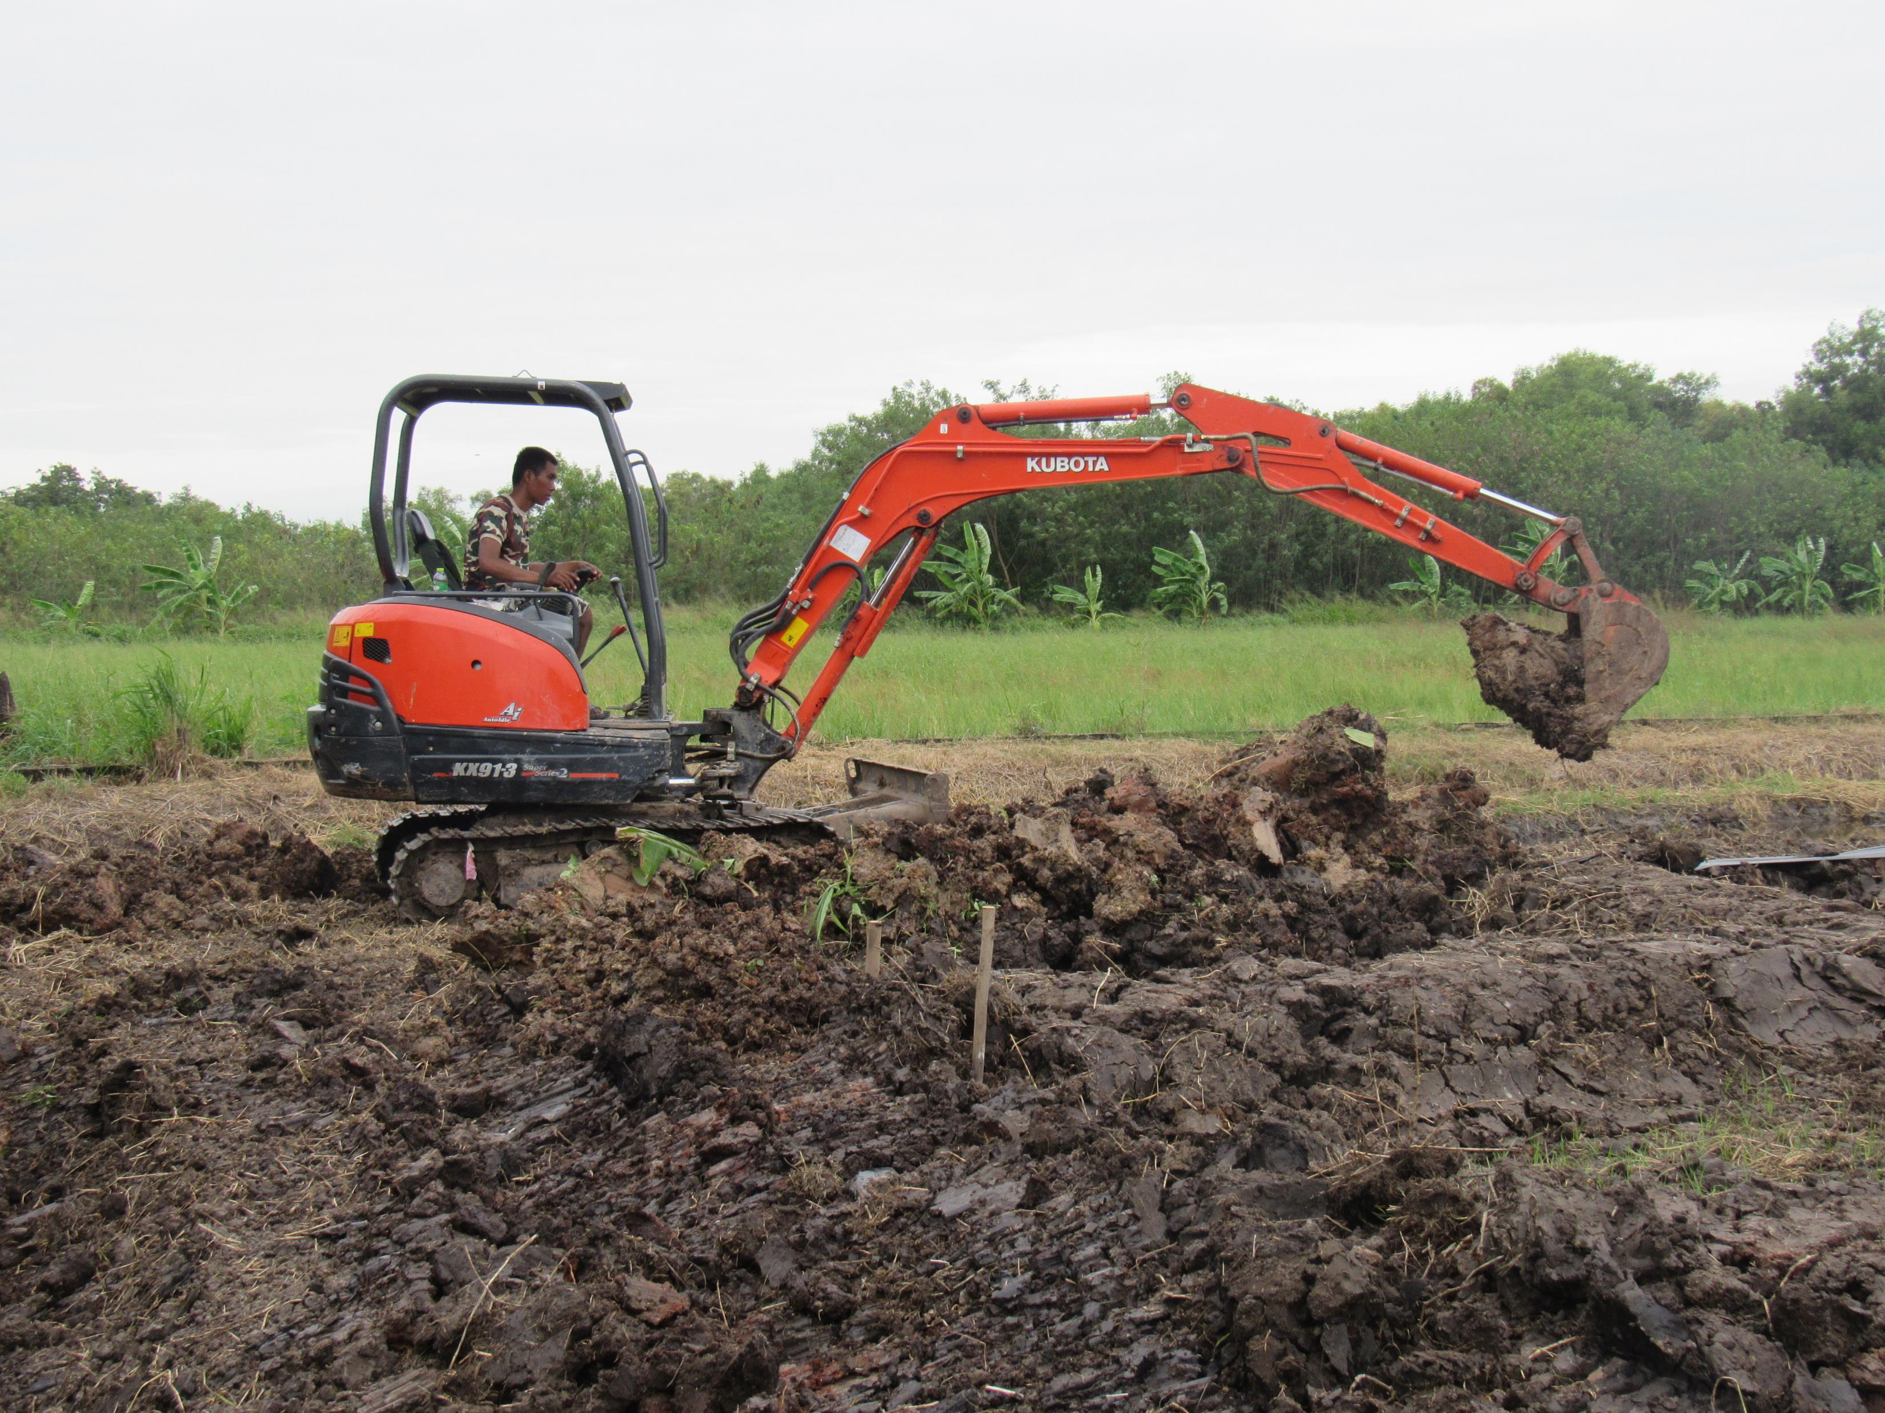
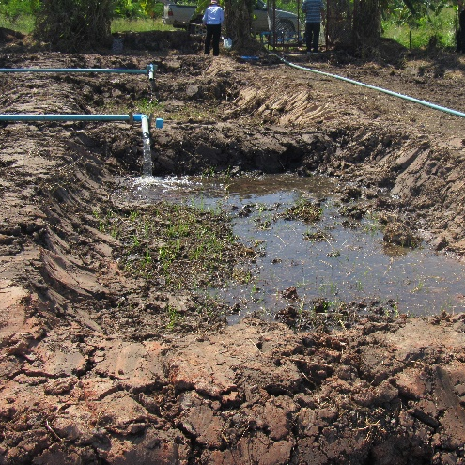
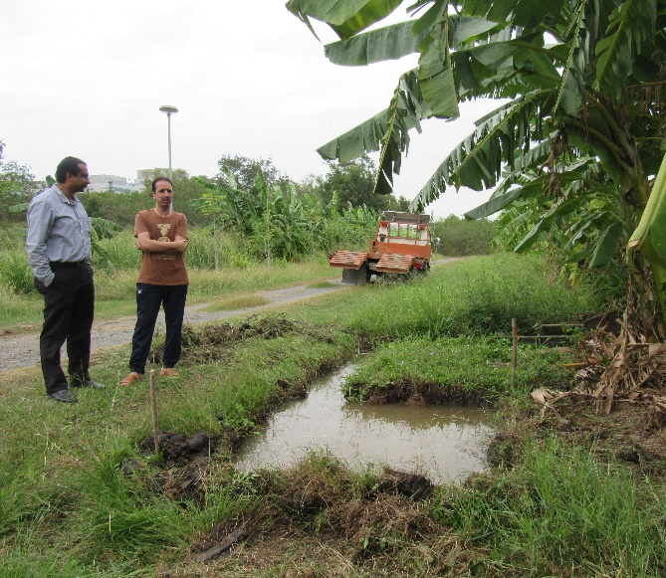
Field Experiment

Slide 27
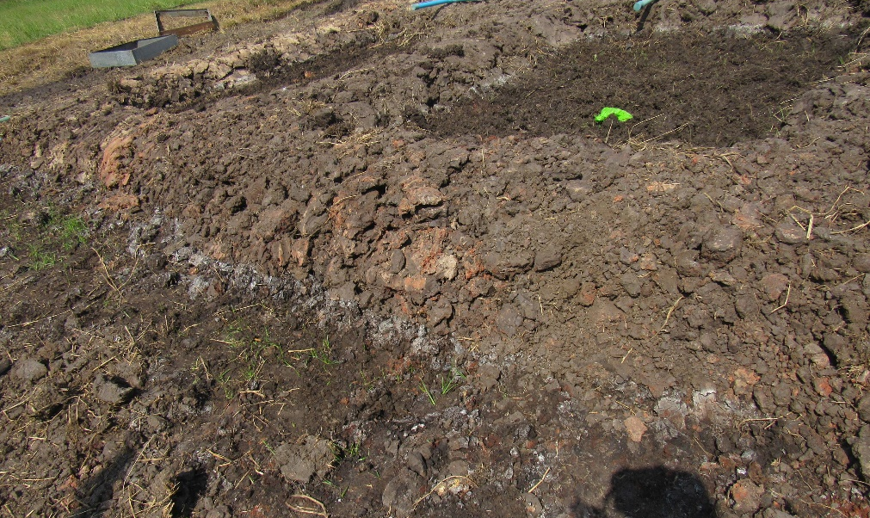
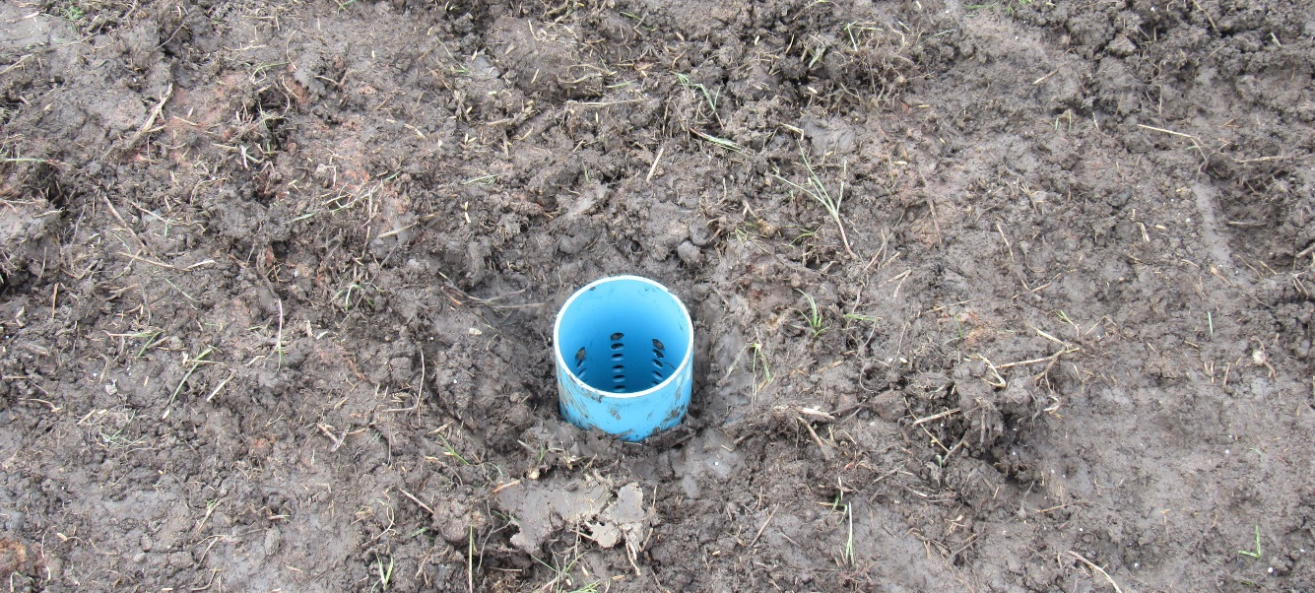
Effects of establishment method and water management on yield and water productivity of tropical lowland rice
Ullah, Giri, Attia, Datta. 2019. Experimental Agriculture doi: 10.1017/S0014479719000395
Treatments:
2 Thai rice cultivars (Pathumthani 1 and RD57)
2 establishment methods (DDS and TP)
3 irrigation levels (continuous flooding [CF], 15 cm threshold water level below the soil surface for irrigation [AWD15], and 30 cm threshold water level below the soil surface for irrigation [AWD30])

Slide 28
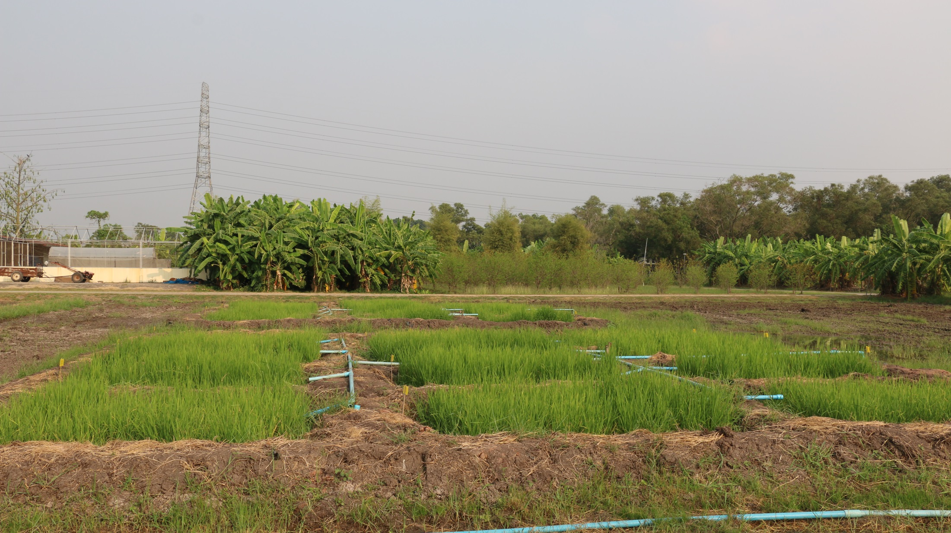
Results

Slide 29
Cultivar | Establishment method | Grain yield (kg ha^{–1}) |  |  |  | Water productivity (kg m^{–3})
 |  | CF | AWD15 | AWD30 |  | CF | AWD15 | AWD30
Pathumthani 1 | DDS | 3240 ± 638b A | 3750 ± 120b A | 2850 ± 634a A |  | 0.62 ± 0.01c B | 0.83 ± 0.05c A | 0.65 ± 0.04b B
 | TP | 4830 ± 423a AB | 6240 ± 330a A | 3330 ± 638a B |  | 0.89 ± 0.03b B | 1.32 ± 0.03b A | 0.72 ± 0.03ab C
RD57 | DDS | 4710 ± 482a A | 5610 ± 840a A | 2820 ± 624a B |  | 1.11 ± 0.03a B | 1.58 ± 0.08a A | 0.82 ± 0.07a C
 | TP | 4830 ± 760a A | 5520 ± 876a A | 2910 ± 79a B |  | 1.09 ± 0.01a B | 1.47 ± 0.07a A | 0.80 ± 0.05a C

Slide 30
Grain yield and water productivity
The performance of RD57 was better than Pathumthani 1 under DDS with 50% higher grain yield and 90% higher water productivity at AWD15
The highest grain yield and water productivity of Pathumthani 1 was observed at AWD15 under TP
The highest grain yield and water productivity of RD57 was observed under both establishment methods at AWD15
AWD15 saved 26% and 32% irrigation water under TP and DDS, respectively, compared with TP-CF treatment
Grain yield at AWD15 was not significantly different from that produced under CF, which indicates water savings without any yield loss

Slide 31
Conclusions
RD57 had higher grain yield and water productivity than Pathumthani 1 for most of the treatments combinations, especially under DDS
AWD15 could be safely recommended in maintaining yield stability and improving water productivity for both of the tested cultivars along with either establishment method for RD57 and TP for Pathumthani 1
These results were confirmed by an average irrigation water saving of 26–32% pooled over years by AWD15 compared with TP-CF combination

Slide 32
Recommendations
Adoption of water-efficient cultivation systems based on direct seeding method of cultivation (either dry or wet) and AWD should be encouraged among the farmers
to save water and labor input and increase the profit margin of the farmers
Variety-specific dose and timings of N application should also be recommended under different cultivation methods subjected to AWD irrigation
to minimize environmental problems, reduce production cost and increase the profit margin

Slide 33
References
Santiago-Arenas R, Hadi SN, Fanshuri BA, Ullah H, Datta A. 2019. Effect of nitrogen fertiliser and cultivation method on root systems of rice subjected to alternate wetting and drying irrigation. Ann. Appl. Biol. 175, 388–399
Maneepitak S, Ullah H, Paothong K, Kachenchart B, Datta A, Shrestha RP. 2019. Effect of water and rice straw management practices on yield and water productivity of irrigated lowland rice in the Central Plain of Thailand. Agric. Water Manage. 211, 89–97
Ullah H, Datta A, Samim NA, Ud Din S. 2019. Growth and yield of lowland rice as affected by integrated nutrient management and cultivation method under alternate wetting and drying water regime. J. Plant Nutr. 42, 580–594
Ullah H, Datta A. 2018. Root system response of selected lowland Thai rice varieties as affected by cultivation method and potassium rate under alternate wetting and drying irrigation. Arch. Agron. Soil Sci. 64, 2045–2059
Ullah H, Mohammadi A, Datta A. 2018. Growth, yield and water productivity of selected lowland Thai rice varieties under different cultivation methods and alternate wetting and drying irrigation. Ann. Appl. Biol. 173, 302–312
Ullah H, Datta A, Shrestha S, Ud Din S. 2017. The effects of cultivation methods and water regimes on root systems of drought-tolerant (RD6) and drought-sensitive (RD10) rice varieties of Thailand. Arch. Agron. Soil Sci. 63, 1198–1209

Slide 34
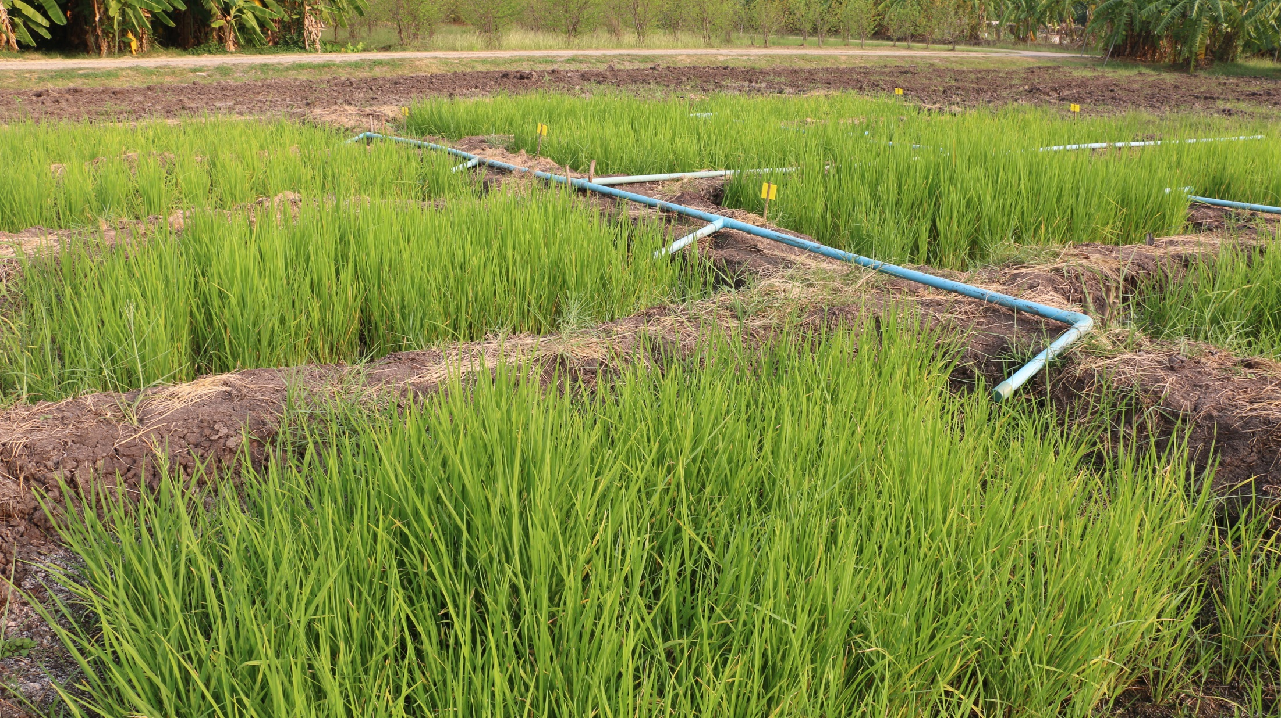
THANK YOU
QUESTIONS

