Slide 1
Climate investment, Climate Finance and Carbon Market in today’s World
Date: Tuesday, 11 February 2020
Time: 4.00 – 6.00 PM
Venue: Smart Classroom, AIT

Slide 2
Program
Panel Speakers:
  Mr. Bob Dobias, Advisor at Climate Change Center, National Research Council of Thailand; ‘Global architecture of climate finance’
  Dr. Frederic Asseline, Principal Climate Change Specialist (Climate Finance), Climate Change & Disaster Risk Management Division, Sustainable Development & Climate Change Department, Asian Development Bank; ‘Climate Change and Disaster Risk Management’
  Prof. Shobhakar Dhakal, Department of Energy, Environment and Climate Change, AIT; ‘Carbon markets’ experiences around the world’
Panel Moderators:
  Dr. Bindu Nath Lohani, Distinguished Adjunct Faculty, AIT
  Prof. Shobhakar Dhakal, Department of Energy, Environment and Climate Change, AIT

Slide 3
‘Carbon markets’ experiences around the world’
Shobhakar Dhakal

Slide 4
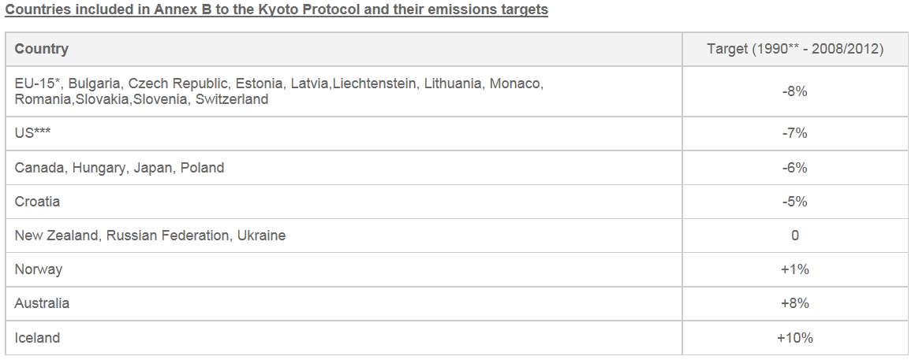
Kyoto Protocol Targets
  US signed but later not ratified
http://unfccc.int/kyoto_protocol/items/3145.php

Slide 5
The flexible mechanisms- Clean Development Mechanism
Projects in developing countries can earn certified emission reduction (CER) credits
Each CER credits are equivalent to one tonne of CO2
CERs can be traded and sold
CER can be used by developed-countries with emission-reduction-commitments to contribute (a part) of their Kyoto Protocol emission reduction targets
What CDM should do?
  Contribute to sustainable development in developing countries
  Reduce global emissions
  Give some flexibility to industrialized countries on meeting their emission reduction targets
  Supports adaptation fund (2%)

Slide 6
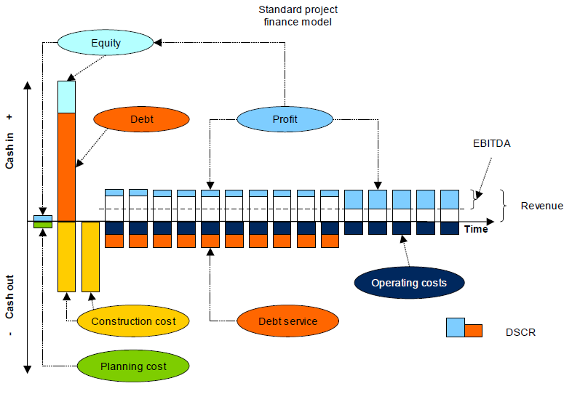
Financing CDM Projects: Elements of financial analysis
Typical project cash flows and key indicators
Project Net Present Value (NPV) and Internal Rate of Return (IRR)
Earnings Before Interest, Tax, Depreciation and Amortisation (EBITDA)- cash generation
http://cd4cdm.org/publications/financecdmprojectsguidebook.pdf
Notes:
Project Net Present Value (NPV) and Internal Rate of Return (IRR): The NPV of a project is
defined as the sum of the future discounted cash flows of the project (before making any assumptions
about how the project will be financed). Future cash flows are discounted by an appropriate
discount rate reflecting the cost of capital, in order to convert to an equivalent Present Value;
these Present Values are then summed to calculate the Net Present Value. Therefore calculating
the NPV requires an assumption to be made about the appropriate discount rate (this may be the
Weighted Average Cost of Capital for a firm, or a more project-specific discount rate). A positive
NPV indicates that (at the assumed cost of capital) the project is a good investment (i.e. will yield
a positive return).
The Internal Rate of Return of a project is a related concept, defined as the discount rate for which
a project’s NPV is equal to zero. Therefore the project IRR can be calculated and compared with
either the Weighted Average Cost of Capital for a firm, or the IRR of similar projects. In any case,
the project IRR should be higher than the prevailing long-term interest rate in the currency in
which the project is being financed (otherwise it would be more worthwhile to put the finance
on deposit at that interest rate, which would presumably have lower risk than investing it in the
project).
Equity IRR: The IRR can also be calculated specifically as the rate of return to the equity providers,
after deducting loan interest and repayments (this requires assumptions to be made about
the financing structure). Equity providers can only receive returns from post-tax profits (or sale
of their shares), and the issue of dividends is typically limited by covenants with the lender, to
ensure that debt repayment milestones are achieved first. This needs to be taken into account
when calculating the equity IRR (since later returns have a lower Present Value).
Earnings Before Interest, Tax, Depreciation and Amortisation (EBITDA): This is a measure
of the cash generating potential of the project. EBITDA is essentially the revenue of the project
minus its operating costs. In Figure 11 above, EBITDA is the amount above the dotted line.
Interest Cover Ratio: This is calculated as EBITDA divided by interest payments and represents
the ability of a project to meet its minimum financing costs (not including loan repayments). A
minimum interest cover ratio is often applied by a lender, both when assessing a project, and as
an ongoing requirement during the loan (after completion of construction and commencement
of earning). A normal interest cover ratio requirement would be around 4 or 5 (higher for riskier
projects).
Debt Service Cover Ratio (DSCR): This is calculated as the ratio of EBITDA to all debt servicing
requirements (i.e. interest plus loan repayments), shown as the ratio of the blue (EBITDA) to
orange (debt service) squares in Figure 11 above. There is usually some flexibility in how the loan
repayments are scheduled, such that the project will meet a minimum DSCR throughout the term
of the loan (and in particular, during the first few years), if it achieves a conservative performance
forecast. Such flexibility may include interest and/or loan repayment holidays and stepped interest
rates and/or loan repayments over the term of the loan. A lender’s minimum DSCR requirement
is always greater than 1. If the DSCR is less than 1 this means that the borrower cannot service
the debt. A lender to a relatively risky project might require a DSCR greater than 2, and the cost
of debt would be correspondingly higher.

Slide 7
The flexible mechanisms- Joint Implementation
Joint Implementation allows Annex B country (with emission reduction commitment in Kyoto Protocol) to earn emission reduction units (ERUs) from emission-reduction/removal project in another Annex B country
I ERU = One tonne of CO2
This can be used for meeting Kyoto target- thus provide flexible and cost-efficient means of fulfilling a part of their Kyoto commitments

Slide 8
The flexible mechanisms- Emission Trading
Annex B parties’ accepted targets are divided into “assigned amount units” (AAUs)
Countries with surplus emission units but not "used" can sell such surplus to countries that are over their targets
The other units
  A removal unit (RMU) on the basis of land use, land-use change and forestry (LULUCF) activities such as reforestation

Slide 9
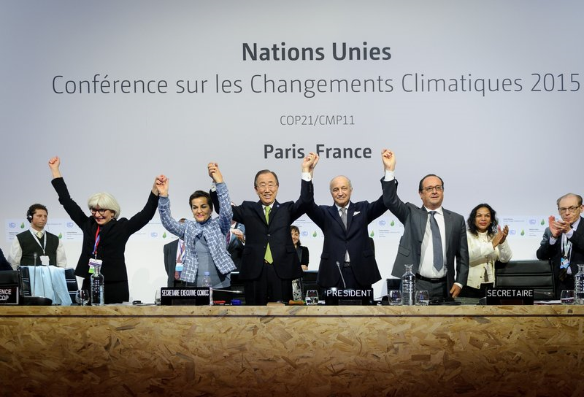
https://unfccc.int/process/the-paris-agreement/what-is-the-paris-agreement-0
http://time.com/4723481/donald-trump-paris-agreement-withdraw/
Executive Secretary of the United Nations Framework Convention on Climate Change Christiana Figueres, Secretary General of the United Nations Ban Ki Moon, Foreign Affairs Minister and President-designate of COP21 Laurent Fabius, and France's President Francois Hollande raise hands together after adoption of a historic global warming pact at the COP21 Climate Conference in Le Bourget, north of Paris, on Dec. 12, 2015. Anadolu Agency—Getty Images

Slide 10
Mitigation pledges of top emitters in COP-21
Country, % of global GHG emissions, 2012 | GHG emissions reduction target | Target year | Reference year | Period for implementation
USA | 26-28% | 2025 | 2005 | 2020-2025
China | 30-45% per unit of GDP | 2030 | 2007 | - 2030
EU | ≥40% | 2030 | 1990 | 2021-2030
India | 33-35% per unit of GDP | 2030 | 2005 | 2021-2030
Russia | 25-30% | 2030 | 1990 | 2020-30
Japan | 26% | 2030 | 2013 | 2020-30
South Korea | 37% | 2030 | BAU | 2020-30
12.1%
23.75%
8.97%
5.73%
5.35%
2.82%
1.28%
Top 5 emitters
See all INDCs here: http://climateobserver.org/open-and-shut/indc/

Slide 11
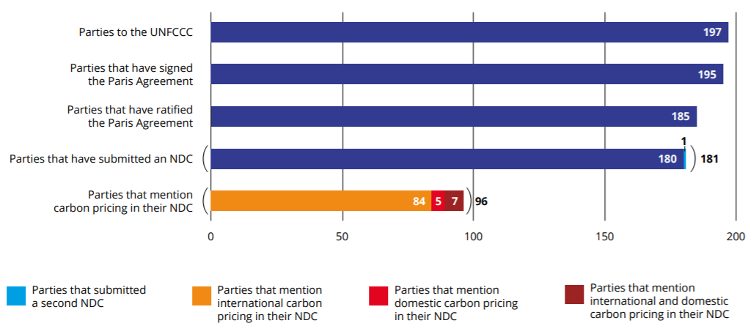
Status of NDC submissions (as of April 2019)
State and Trends of Carbon Pricing 2019, The World Bank, June 2019, Washington DC

Slide 12
Pricing carbon
‘Social cost of carbon’ approach
  For economic efficiency, carbon price should be equal to the ‘social cost of carbon’ which is its ‘damage cost’
  Based on damage costs assuming we do not abate carbon
Shadow price approach
  Mitigation target/goals oriented; not damage
  Carbon price = marginal carbon abatement cost (MAC)
  Need to estimate MAC function which sorts abatement measures in terms of $/tCO2e and inform how much mitigation can be achieved at what price?
For more discussions, see Bowen(2011)

Slide 13
Ways for pricing carbon
Carbon tax (price control)
  Government imposing a tax or duty or charge on commodity based on its ‘carbon content’ (or carbon equivalent)
    ‘Carbon content’ of commodity: CO2e emitted due to production as well as inputs to production (accounting direct and indirect emissions)
Cap-and-trade (quantity control)
  Government or somebody setting a desired cap in emissions based on aggregate level of emissions and devising ‘individual quotas’ that are tradable
  Perfectly competitive market: The price of a quota of one ton CO2e = marginal abatement cost in the economy for 1 ton CO2e
For more discussions, see Bowen(2011)

Slide 14
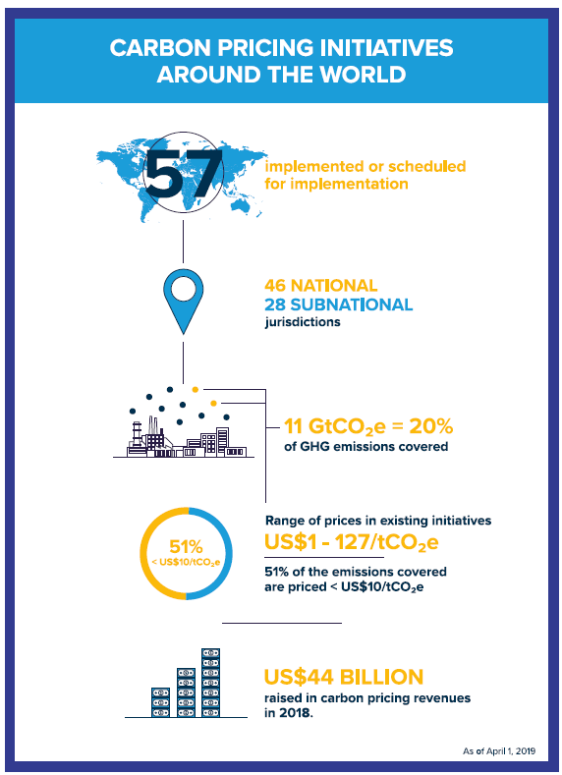
World Bank, 2019

Slide 15
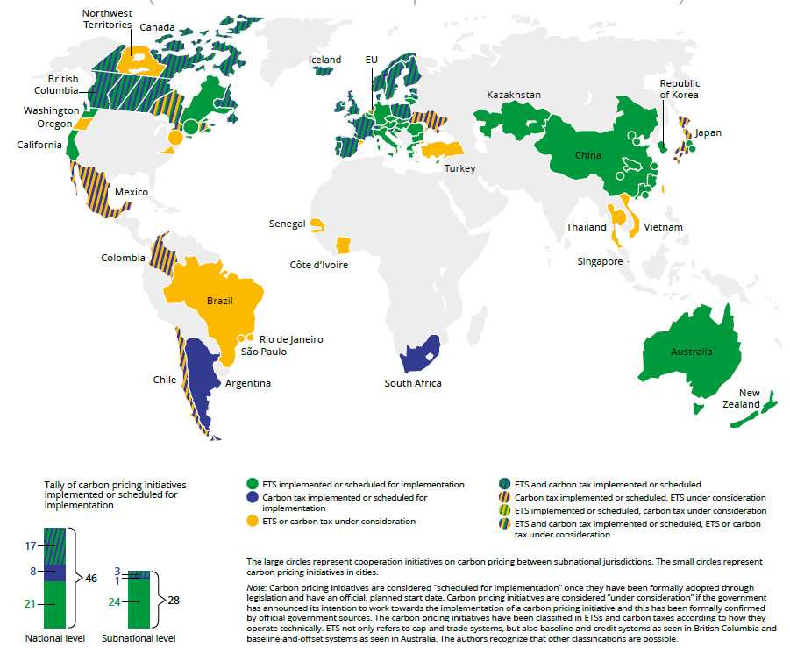

Slide 16
Types of carbon markets
Offset Market related to UNFCCC- Clean Development Mechanism
Regulated/Compliance Carbon Market (ETS/Cap-and-Trade)
Unregulated/Volunteer Carbon Market
CORSIA/ICAO Market/IMO/BOCM-JCM
REDD+ Carbon Market
Carbon-Insetting in Corporate Sector
Further Prospects under Paris Agreement

Slide 17
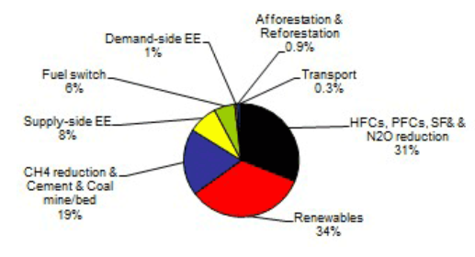
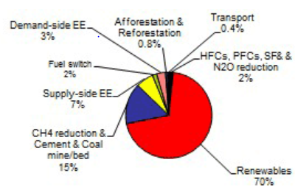
CDM Project history- end of 2012
Project type in pipeline by CERS by end of 2012
70% of the CDM projects are renewables
But they take 34% of the CERs
Energy efficiency takes 9% of the CERs for Supply-side EE and only 1% for Demand-side-EE
Project type in pipeline by number of projects
UNEP/RISO data, at http://cdmpipeline.org/overview.htm

Slide 18
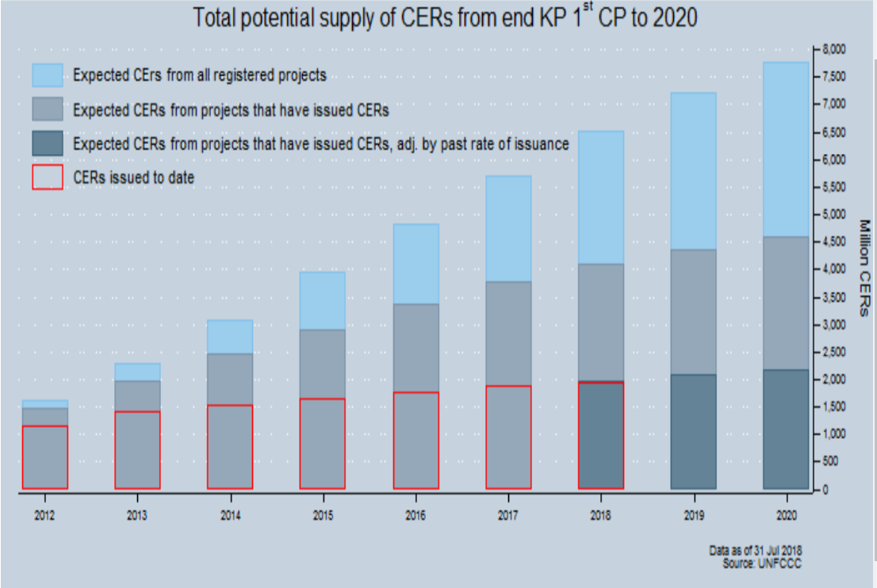
https://cdm.unfccc.int/Statistics/Public/CDMinsights/index.html

Slide 19
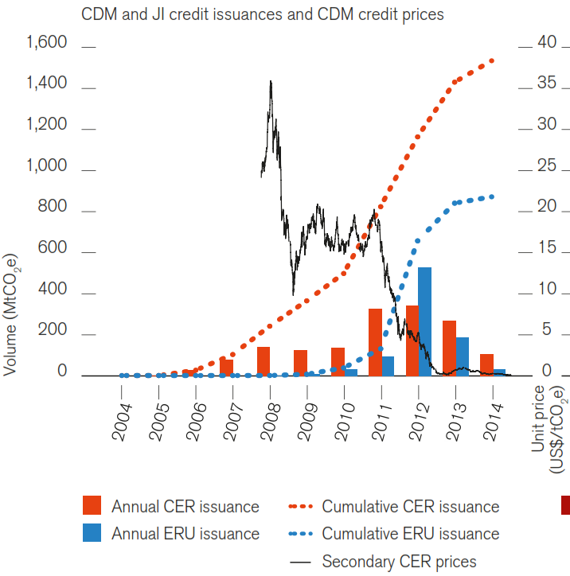
The World Bank, 2015

Slide 20
Types of carbon markets
Offset Market related to UNFCCC- Clean Development Mechanism
Regulated/Compliance Carbon Market (ETS/Cap-and-Trade)
Unregulated/Volunteer Carbon Market
CORSIA/ICAO Market/IMO/BOCM-JCM
REDD+ Carbon Market
Carbon-Insetting in Corporate Sector
Further Prospects under Paris Agreement

Slide 21
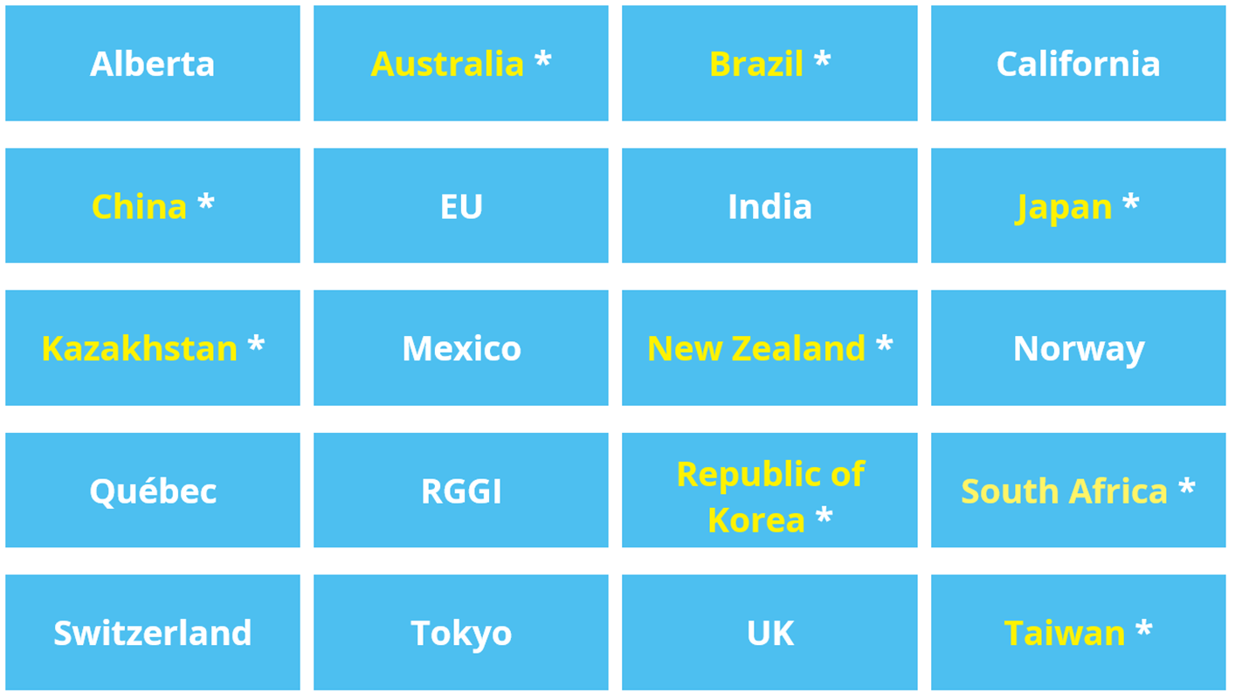
Many emission trading markets
http://www.ieta.org/The-Worlds-Carbon-Markets

Slide 22
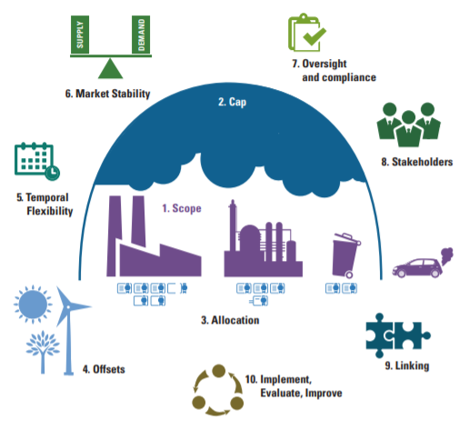
Partnership for Market Readiness (PMR) and International Carbon Action Partnership (ICAP). 2016. Emissions Trading in Practice: a Handbook on Design and Implementation. World Bank, Washington, DC.

Slide 23
Design features of ETS market
Regulator
Type of cap: absolute vs intensity
Total cap size and changes in cap over time
Sector/gases covered
Allowance allocation rule (how much allocated? Free or auction or hybrid, how allowance revenue used?)
Compliance period (s)
Compliant carbon units/commodities

Slide 24
Design features of ETS market
Trading methods
Monitoring, reporting and verification (registry and oversight, regulation)
Banking and borrowing provisions’ (inter and intra-phases)
Offsets and flexibilities
Price containment measures
Punitive measures for non-compliance
Allocation rules for new entrants and rules for opt-out
Linkages with other ETS markets- and other carbon commodity

Slide 25
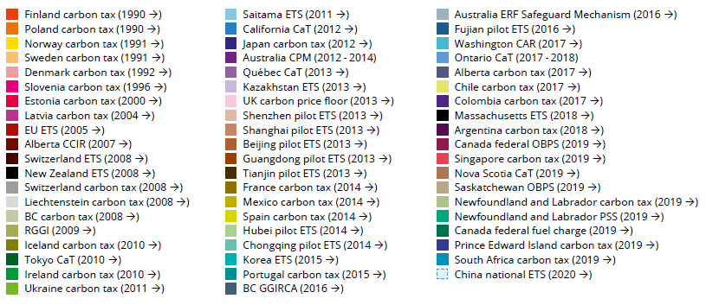
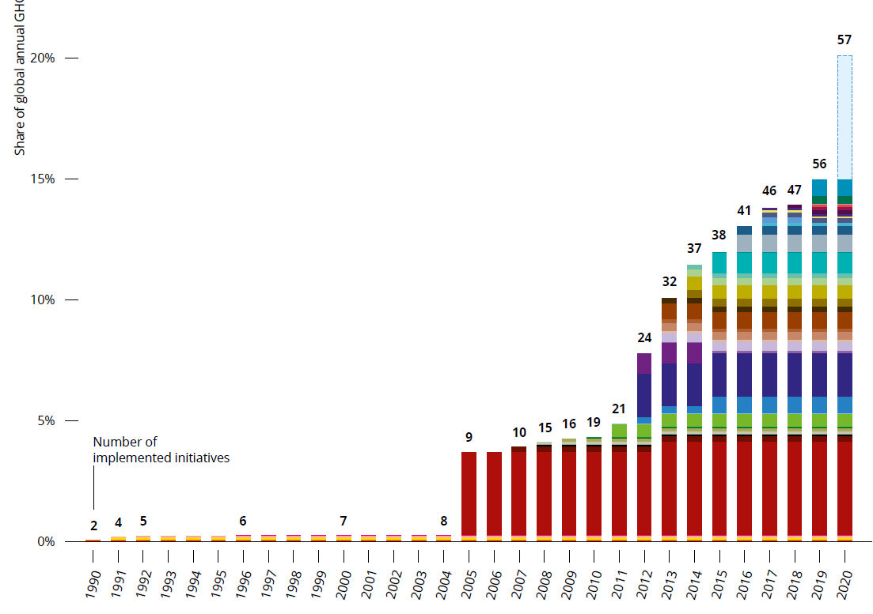
World Bank, 2019

Slide 26


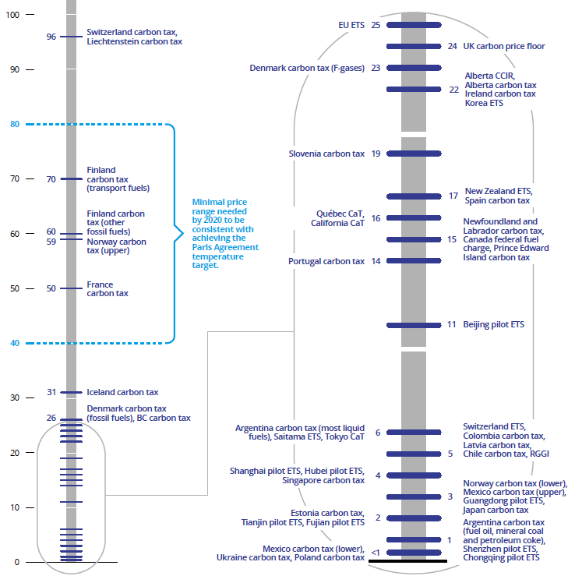
Carbon prices in markets
The World Bank, 2019

Slide 27
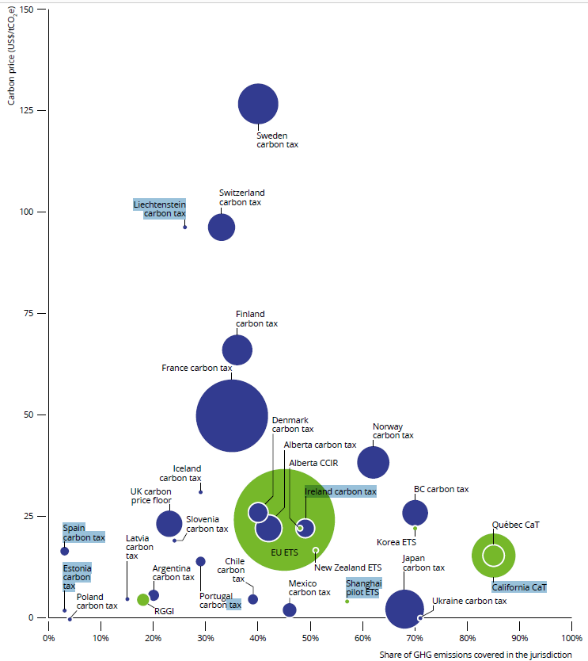
Carbon price, share of emissions covered and carbon pricing revenues of implemented carbon pricing initiatives
→ far lower than the price that economic models have estimated as needed to meet the 2°C climate stabilization goal
World Bank, 2019

Slide 28
EU-ETS: General introduction
EU-ETS Began operation in 2005
EU28 plus 3 (Liechtenstein, Norway and Iceland); over 11,000 industrial installations and airlines operating between them
Goal: 21 percent reduction by 2020 from 2005 levels (43% by 2030)
Covers about half of Europe’s CO2 emissions (@ 45% GHG)
Traded sector of industry:
  carbon dioxide (CO2) from
    power and heat generation, energy-intensive industry sectors including oil refineries, steel works and production of iron, aluminium, metals, cement, lime, glass, ceramics, pulp, paper, cardboard, acids and bulk organic chemicals
    commercial aviation
  Nitrous oxide (N2O) from production of nitric, adipic and glyoxylic acids and glyoxal
  Perfluorocarbons (PFCs) from aluminium production
Non-traded sector: Others such as transportation sector (except aviation), agricultural sector
https://ec.europa.eu/clima/policies/ets_en

Slide 29
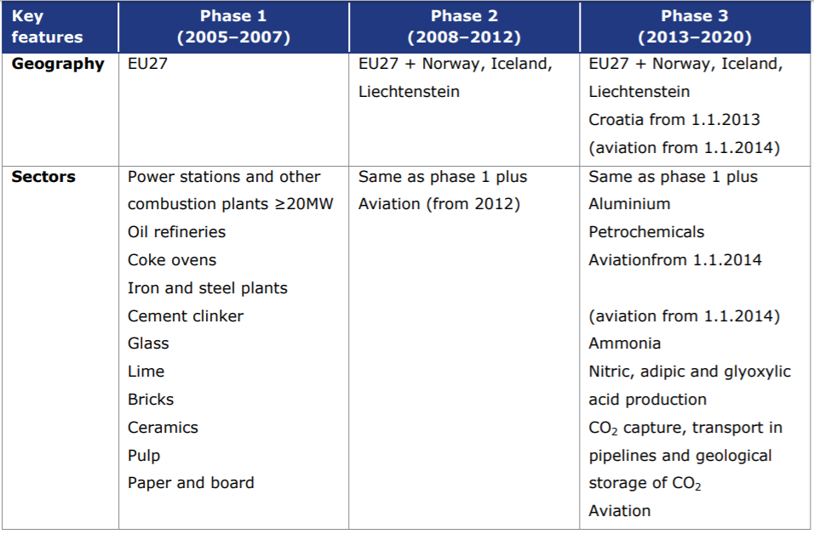
EU-ETS developments
https://ec.europa.eu/clima/sites/clima/files/docs/ets_handbook_en.pdf

Slide 30
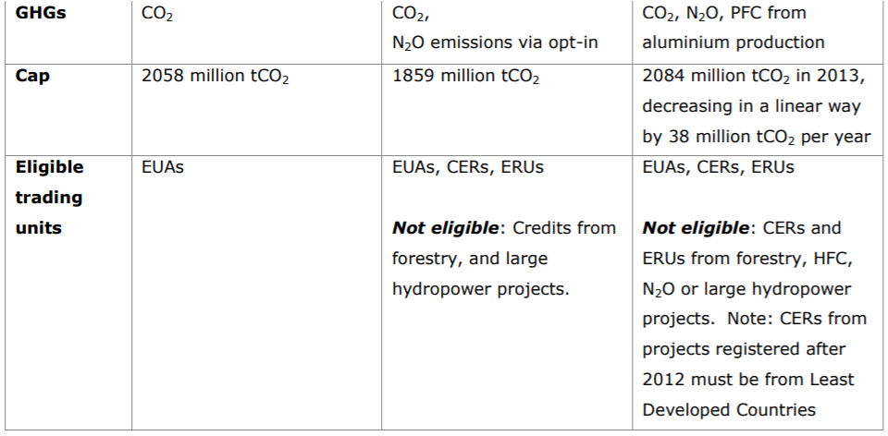
EU-ETS developments
https://ec.europa.eu/clima/sites/clima/files/docs/ets_handbook_en.pdf

Slide 31
EU-ETS Fourth phase: 2021–2030
In February 2018, European lawmakers approved the EU ETS phase 4 (2021–2030) reforms
  Changing the linear annual cap reduction from 1.74 per cent to 2.2 percent
  A temporary doubling of the yearly withholding rate of surplus allowances into the Market Stability Reserve (MSR) to 24 percent until 2023
  Share of allowances to be auctioned is set at 57 percent; after 2026, this will decrease linearly to 0 percent in 2030
  Low-carbon funding mechanisms for phase 4: the Modernization Fund and the Innovation Fund
The World Bank, 2018

Slide 32
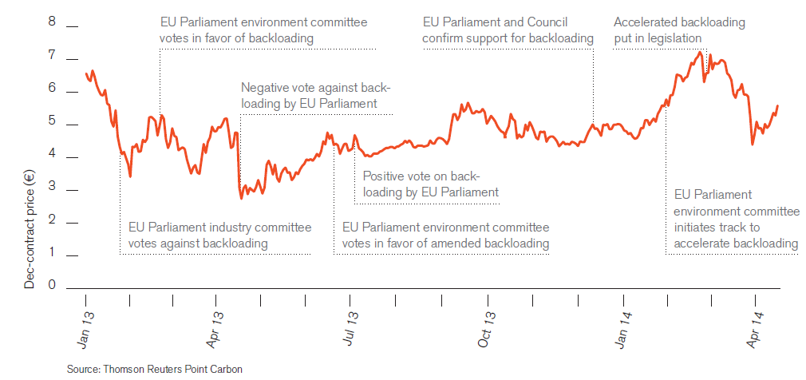
EU allowance price development labeled with key developments
World Bank 2014

Slide 33
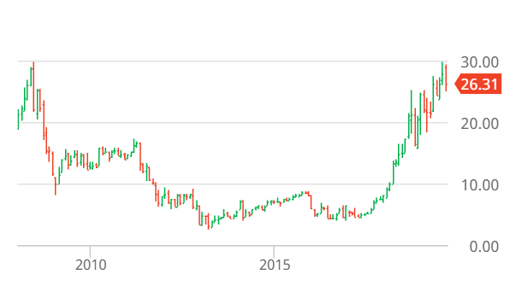
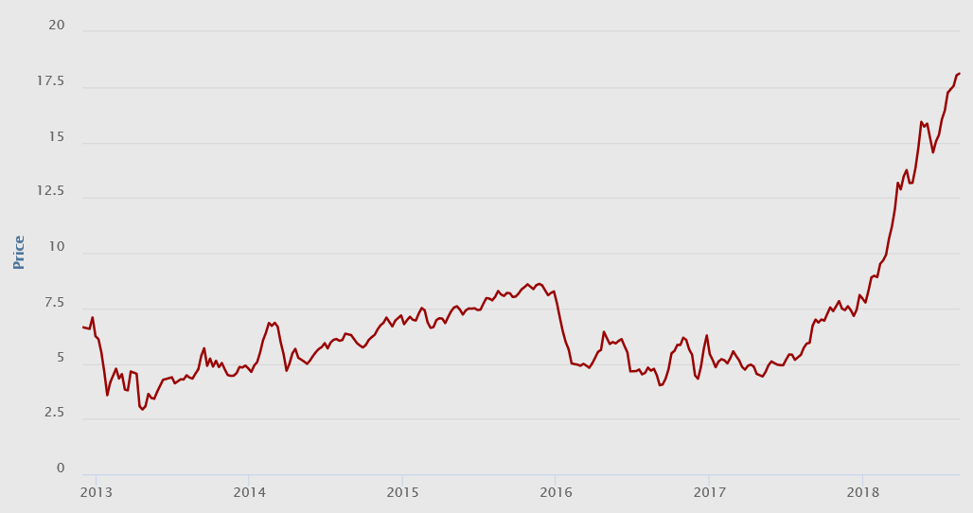
EUA prices in secondary spot market- EEX data (Euros/tCO2e)- recent data (till August 20, 2018)
26.31 Euro/tCO2e on 1 Sept 2019
ICE EUA Futures Dec '19
Market stability reserve
https://www.eex.com/en/market-data/environmental-markets/spot-market/european-emission-allowances#!/2018/08/20

Slide 34
California carbon market
State targets:
  By 2020: Return to 1990 GHG levels
  By 2030: 40% reduction from 1990 GHG levels
  By 2050: 80% reduction from 1990 GHG levels
https://icapcarbonaction.com/en/?option=com_etsmap&task=export&format=pdf&layout=list&systems[]=45

Slide 35
California carbon market
2008 Scoping Plan of AB32 establishes cap-and-trade scheme as the core aspect of California’s climate change strategy
The scheme overs 85% of California’s GHG emissions
The Cap-and-trade scheme compliments other ongoing measures such as standards for ultra-clean cars, low-carbon fuels, and renewable electricity
Started from 1 Jan 2013 → linked to Quebec from 1 Jan 2014 → linked to Ontario from 1 Jan 2018

Slide 36
California Cap-and-trade: Design features
Gases
  CH4, CO2, HFCs, NF3, N2O, PFCs, SF6
Sectoral coverage
  From 2012: stationary facilities emitting at least 25,000 tCO2e per year, in industry and power generation (including imports)
  From 2015: distribution (including imports) of fuels for combustion in the transportation and building sectors, whose combustion emits more than 25,000 tCO2e per year
  85% of California’s GHG emissions (by 2015), about 500 entities
Richard G. Newell, 2012, RFF
State of Carbon Market 2012, The World Bank

Slide 37
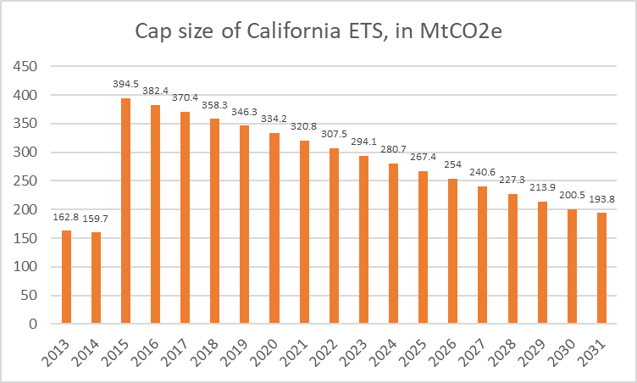
California Cap
The cap decline factor: 3.3% between 2018 and 2019; an average of over 4.1% in the 2021-2030 period
https://icapcarbonaction.com/en/?option=com_etsmap&task=export&format=pdf&layout=list&systems[]=45
every compliance period will be three years
1st Compliance Period
2nd Compliance Period
3rd Compliance Period

Slide 38
California Cap-and-trade: Design features
Compliance periods
  2013-2014; 2015-2017; 2018-2020
  Annual compliance: 30% of the compliance obligations of a year is due no later than 1 November of the following calendar year
  Triennial compliance: the balance of compliance obligations for the whole compliance period is due no later than 1 November of the year following the end of the compliance period (i.e. 2015, 2018, and 2021).
Richard G. Newell, 2012, RFF
State of Carbon Market 2012, The World Bank

Slide 39
California Cap-and-trade: Design features
Regulator
  California Air Resources Board (CARB).
Compliance units
  Emissions allowance issued by CARB.
  Offset credit issued by CARB, REDD allowed
  Early action offset credit issued by CARB following regulatory verification and review of an offset from an eligible program.
  Compliance instrument issued by another GHG linked program.
State of Carbon Market 2012, The World Bank
Richard G. Newell, 2012, RFF
Notes:
# EAOC helps create an initial supply of offset credits for the Cap-and-Trade Program
# These are credits with retroactively approve and issue offset credits for projects which started before, sometimes several years before, the enactment of AB 32 and the promulgation of offset protocols.

Slide 40
California Cap-and-trade: Allowance allocation
2/3 of permits auctioned in 2013
Free allowances for leakage prevention and transition assistance through four methods
Auction
  A small % of allowances is set-aside for the allowance price containment reserve, and the Voluntary Renewable Electricity Program
  Quarterly auctions. First auction on November 14, 2012
  Reserve price set at US$10/unit in 2012, increasing 5% per year plus inflation rate to be specified
https://ww3.arb.ca.gov/cc/capandtrade/allowanceallocation/allowanceallocation.htm

Slide 41
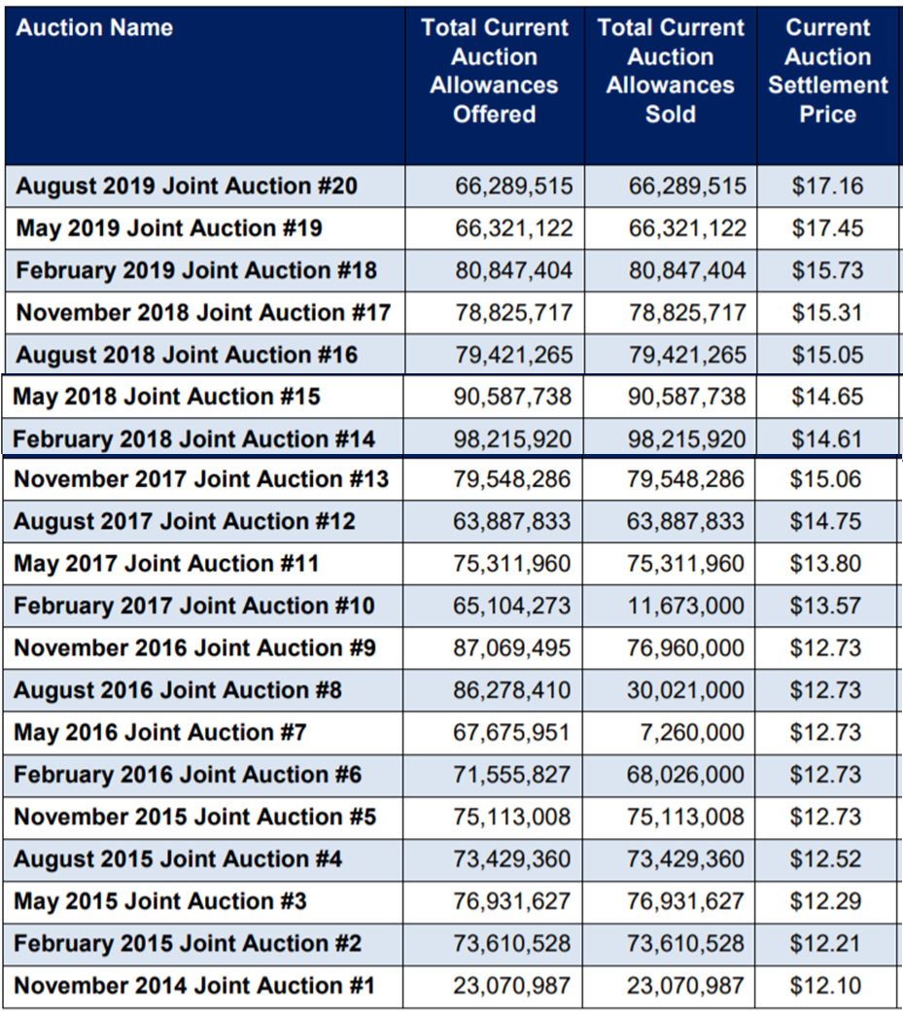
CALIFORNIA CAP-AND-TRADE PROGRAM
SUMMARY OF CALIFORNIA-QUEBEC JOINT AUCTION SETTLEMENT PRICES AND RESULTS
https://ww3.arb.ca.gov/cc/capandtrade/auction/results_summary.pdf

Slide 42
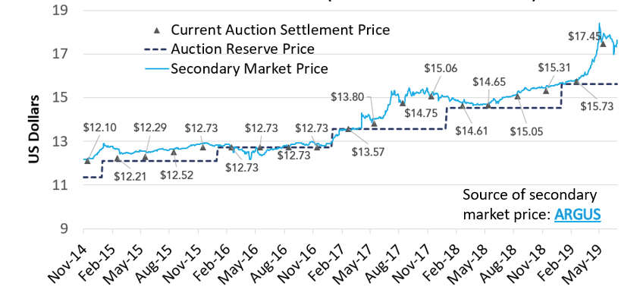
Joint CA-QC Carbon Market Allowance Price Data: Auction and Secondary Markets
CARB, (2019) - https://www.arb.ca.gov/cc/capandtrade/video/data_uses_and_overview.pptx

Slide 43
Understanding the differences
Kind of primary market
  Minimum auction price (or auction reserve price) of allowances – these are pre-determined minimum price of allowances by regulator on basis of which bid are made
  Auction clearing price – price at which eligible bids are actually sold in each auction- this could be same as reserve price or more depending on how people will bid- could be different each time
Secondary market
  Allowance price in the secondary market- this means the price of traded allowance (which were already acquired) in the market between the market players

Slide 44
California Cap-and-trade: Design features
Banking & borrowing
  Unlimited banking (but subject to holding limit)
  In strict sense- no borrowing, but advance auctions (on year N, auctions of 10% of the allowances from future budget year N+3), and an allowance price containment reserve (PCR)
Offsets
  Utilization Limit: 8% of compliance obligations for each compliance period
  Unused offset capacity cannot be banked across compliance periods
  CDM/JI not accepted; six types of domestic offsets issued by CARB (forest, urban forest, ozone depletion substances, livestock/manure mgmt., rice cultivation, mine methane capture)
State of Carbon Market 2012, The World Bank
Richard G. Newell, 2012, RFF

Slide 45
California Cap-and-trade: Design features
Offsets (from 2021 onwards)
  The share of offsets that can be used to fulfill the compliance obligation will reduce from 8% to 4% between 2021-2025 and will remain at 6% thereafter
  At least 50% offset usage limits would need to result in “direct environmental benefits” in the State of California

Slide 46
California Cap-and-trade: Design features
Mechanism for cost containment
  Auction Reserve Price: USD 15.62 per allowance in 2019 (average so far) → increases annually by 5% plus inflation (as per CPI)
  Effective ceiling price is controlled through Price Containment Reserve (PCR)
Allowance Price Containment Reserve (PCR)
  The risk of higher anticipated costs to be reduced by availability of allowances ‘reserve’
  The Reserve is created by diverting some allowances budget from the all three compliance periods (Cap is thus less)
    Share of total allowance budget feeding the reserve: 1% in 2013-2014, 4% in 2015-2017, 7% in 2018-2020 (218 MtCO2e over 2013-2020)
https://icapcarbonaction.com/en/?option=com_etsmap&task=export&format=pdf&layout=list&systems[]=45

Slide 47
California Cap-and-trade: Design features
  Reserve allowances are made available for sale at a fixed price
    First sale on March 8, 2013, and six weeks after each auction
    Sales only open to compliance participants
    Reserve divided in three equal-sized tiers in three fixed price categories; 40USD, 45USD, and US$50 per unit in 2013, increasing 5% per year plus inflation rate to be specified
    In 2021, two cost containment reserve trigger points and the price ceiling will be set at USD 41.40, 53.20, and 65.00, respectively
https://icapcarbonaction.com/en/?option=com_etsmap&task=export&format=pdf&layout=list&systems[]=45

Slide 48
Post-2020 reforms for California ETS to meet 2030 GHG emissions reductions goals
2030 Goal:
An addition of a price ceiling → estimated 2030 value of US$94 (real 2018)
The two allowance price containment reserve tiers below the price ceiling
No sustained free allocation
Reduced use of offsets (8% in 2021 to 4% in 2025)
→ These reforms enforced from April 2019
World Bank, 2019 (State and Trends of Carbon Pricing 2019)

Slide 49
California Cap-and-trade: Design features
Proceeds from auction
  9.47 billion US$ since beginning of the program
  2018 revenue: US$3.02 billion
  50% to be used to cover the state’s costs related to GHG mitigation activities
  50% to be invested in clean and efficient energy, low–carbon transportation, natural resource protection, and sustainable infrastructure development
https://icapcarbonaction.com/en/?option=com_etsmap&task=export&format=pdf&layout=list&systems[]=45

Slide 50
Types of carbon markets
Offset Market related to UNFCCC- Clean Development Mechanism
Regulated/Compliance Carbon Market (ETS/Cap-and-Trade)
Unregulated/Volunteer Carbon Market
CORSIA/ICAO Market/IMO/BOCM-JCM
REDD+ Carbon Market
Carbon-Insetting in Corporate Sector
Further Prospects under Paris Agreement

Slide 51
Voluntary carbon market since 2005
Voluntary carbon projects exist in 83 countries
2,008 projects have issued offsets during 2005-2018 (1st Q)
Asia (51%); North America (18%); Latin America and the Caribbean (11%), Europe (11%), and Africa (11%); Oceania (1%)
  → 72% in five countries: India (442), China (426), the United States (351), Turkey (124), and Brazil (97)
Voluntary Carbon Markets Insights: 2018 Outlook and First-Quarter Trends

Slide 52
Volume of voluntary market
437.1 MtCO2e of offsets issued to date since 2005 (39% Asia; 26% North America; 13% Africa)
In 2017: Projects issued 62.7 MtCO2e → eqv to avoiding 150 million barrels of oil
In 2017: Offset retirements was 42.8 MtCO2e → record high
(about 1.1 bn tCO2e cumulative might have produced total since 2000)
Voluntary Carbon Markets Insights: 2018 Outlook and First-Quarter Trends
State of the Voluntary Carbon Markets 2017

Slide 53
Voluntary Carbon Market Standards
All voluntary standards require that offsets be:
Real: there has to be evidence that the project actually removed or prevented emissions;
Additional: the emissions reductions would not have occurred without those project activities;
Measurable: the volume of emissions reductions can be accurately measured; and
Verifiable: a neutral, third-party auditor has verified the emissions reductions.

Slide 54
The international project standards
International standards: An organization or authority issue certificate who specify a clear standard to be meet to receive Carbon Offset Certificate
Over ten independent standards exist that offer methodologies to guide development of carbon offset project
Standardization of methodology, verification, tracking (registry) are extremely important to buyers and sellers
  Somebody has to ‘issue’ the credit certification with unique identifier
The ‘offset’ has to be marked ‘retire’ in registry if purchaser claim their own carbon offset

Slide 55
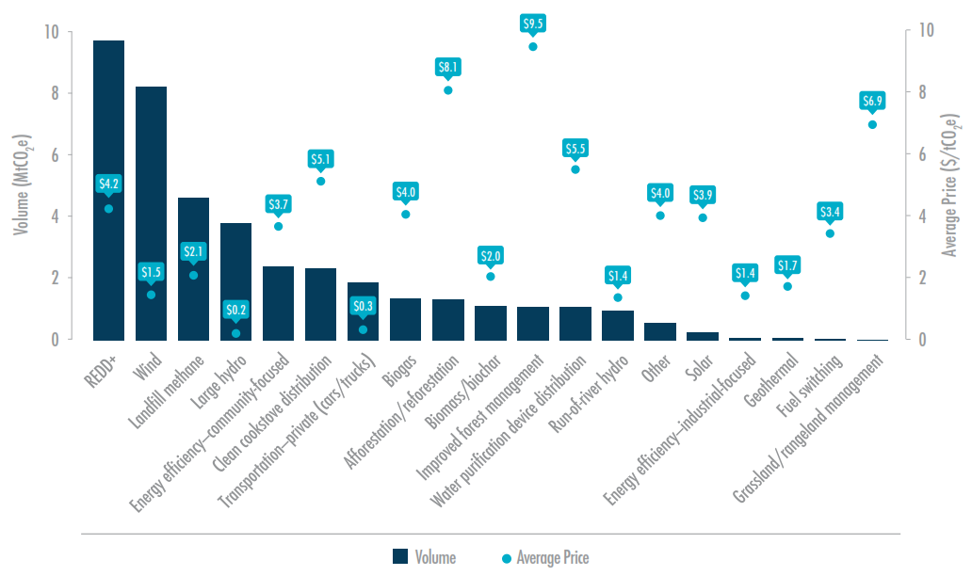
Transacted Volume, Average Price, and Price Range by Project Type, 2016
State of the Voluntary Carbon Markets 2017

Slide 56
Types of carbon markets
Offset Market related to UNFCCC- Clean Development Mechanism
Regulated/Compliance Carbon Market (ETS/Cap-and-Trade)
Unregulated/Volunteer Carbon Market
CORSIA/ICAO Market/IMO/BOCM-JCM
REDD+ Carbon Market
Carbon-Insetting in Corporate Sector
Further Prospects under Paris Agreement

Slide 57
CORSIA of ICAO
Carbon Offsetting and Reduction Scheme for International Aviation: At the 39th Assembly (Oct 2016) of the International Civil Aviation Organization (ICAO) adopted (66 states representing 87% of international aviation activities) the CORSIA
  Stabilize net emissions from international aviation at 2020 levels
  Pilot phase (2021-2023), phase 1 (2024-2026) and phase 2 (2027-2035)
CORSIA has the potential to generate demand for around 2.5 gigatons of CO2e offset between 2021 and 2035
World Bank 2017

Slide 58
International Maritime Organization
April 13, 2018: The International Maritime Organization’s Marine Environment Protection Committee adopted an initial strategy to reduce GHG emissions from international shipping
The strategy: Peaking GHG emissions from the sector as soon as possible, a reduction of annual GHG emissions by at least 50 percent by 2050 compared to 2008, while at the same time pursuing efforts toward full decarbonization
IMO adopted global data collection system for fuel consumption for ships from October 2016, which entered into force in March 2018.
World Bank, 2018

Slide 59
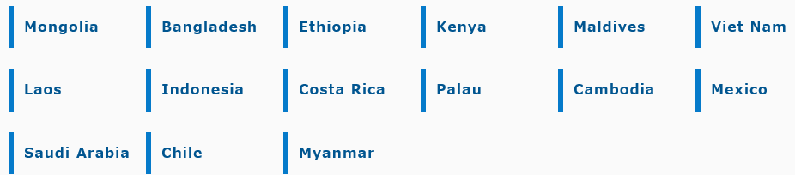
Joint Crediting Mechanism (JCM/BOCM) Japan
Thailand
Philippines
Compliments CDM as Japan is out from 2nd Kyoto period
Japan invests/provides low-carbon technology/products/service etc in emissions reduction projects/programs and get GHG offsets credits (similar to CDM)
Started as non-tradable credits but with trading possibilities
Signed bilateral document with 17 countries (Thailand Nov 2015, Philippines Jan 2017)
https://www.jcm.go.jp/
https://www.jcm.go.jp/
http://www.mmechanisms.org/e/initiatives/index.html; Ministry of Environment Japan

Slide 60
Joint Crediting Mechanism (JCM/BOCM) Japan
450 projects and studies (JCM Project Planning Studies) under JCM Support Programme as of Sept 2015 in 40 countries
32 project already operating and are at various stages (Oct 2017)
7 projects, credit already issued and shared with host country and Japan (Indonesia, Mongolia, Vietnam, Palau) https://www.jcm.go.jp/projects/issues
https://www.jcm.go.jp/
http://www.mmechanisms.org/e/initiatives/index.html; Ministry of Environment Japan

Slide 61
Types of carbon markets
Offset Market related to UNFCCC- Clean Development Mechanism
Regulated/Compliance Carbon Market (ETS/Cap-and-Trade)
Unregulated/Volunteer Carbon Market
CORSIA/ICAO Market/IMO/BOCM-JCM
REDD+ Carbon Market
Carbon-Insetting in Corporate Sector
Further Prospects under Paris Agreement

Slide 62
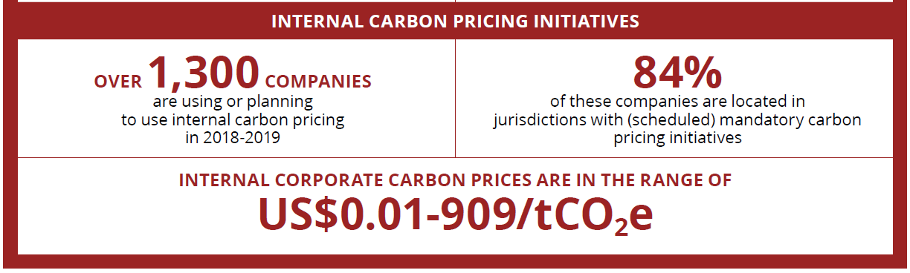
Updated in 2019 report: US$0.3/tCO2e to US$906/tCO2e
World Bank, 2018, 2019
“In 2017, over 1,300 companies—including more than 100 Fortune Global 500 companies with collective annual revenues of about US$7 trillion—disclosed to CDP that they are using an internal price on carbon to inform their decision making, or plan to do so in the
next two years, which is an increase of 11 percent compared to 2016”.
CDP, Putting a Price on Carbon, October 2017

Slide 63
Self-imposed internal carbon pricing
Disney, Microsoft and Shell imposed the carbon tax from 2009
  Internal carbon prices to reduce emissions, promote energy efficiency and encourage the use of cleaner sources of power
Disney created Climate Solutions fund, from its carbon tax. The tax, the price of which depends upon the costs of offsets and the volume needed by Disney to reach its emissions targets, has been set at between $10 and $20 a ton.

Slide 64
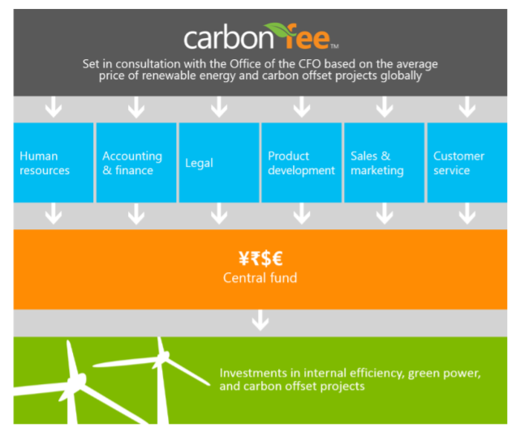
Microsoft
https://www.microsoft.com/en-us/environment/carbon/our-approach

Slide 65
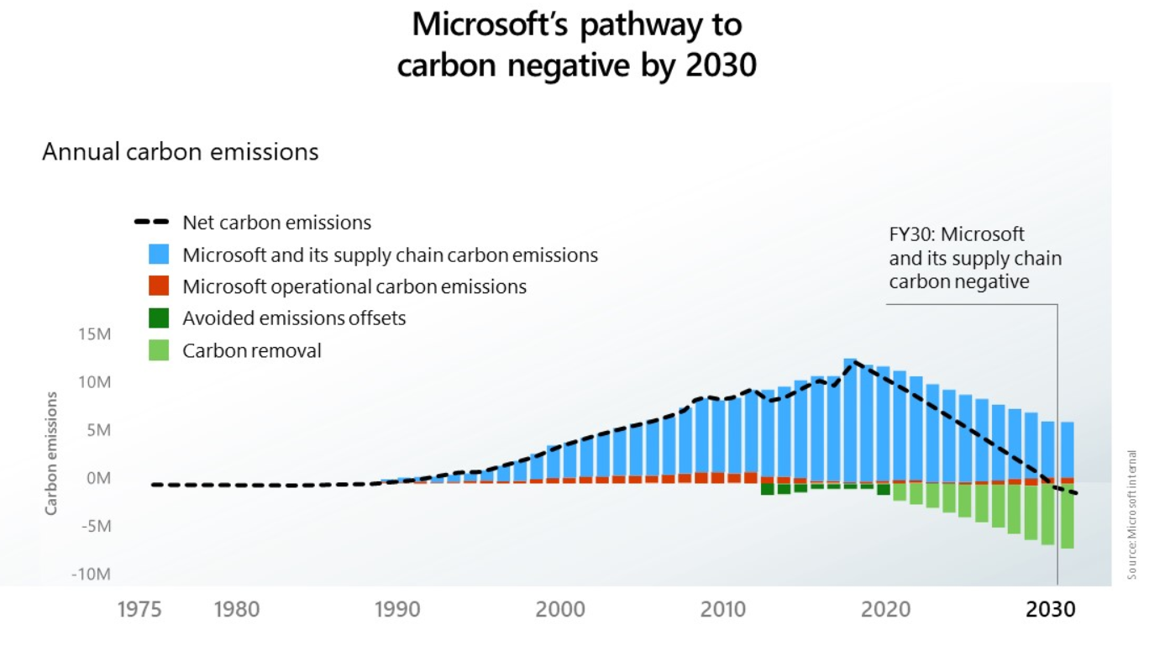
https://blogs.microsoft.com/blog/2020/01/16/microsoft-will-be-carbon-negative-by-2030/
file:///C:/Users/user/Downloads/Microsoft-Carbon-Blog-Jan16-2020.pdf

Slide 66
Microsoft’s announcement in 15 January 2020
By 2030: Carbon negative
By 2050: To remove all the historically emitted carbon (directly or by electrical consumption) since it was founded in 1975
New $1 billion climate innovation fund to accelerate the global development of carbon reduction, capture, and removal technologies
From beginning of 2021, carbon reduction to become an explicit aspect of procurement processes for supply chain
Annual Environmental Sustainability Report to report progress
In July 2020, to start phasing-in internal carbon tax to cover scope 3 emissions too. Currently, only cover scope 1 and 2 emissions, plus scope 3 travel emissions at $15/Metric ton.
https://blogs.microsoft.com/blog/2020/01/16/microsoft-will-be-carbon-negative-by-2030/

Slide 67
Types of carbon markets
Offset Market related to UNFCCC- Clean Development Mechanism
Regulated/Compliance Carbon Market (ETS/Cap-and-Trade)
Unregulated/Volunteer Carbon Market
CORSIA/ICAO Market/IMO/BOCM-JCM
REDD+ Carbon Market
Carbon-Insetting in Corporate Sector
Further Prospects under Paris Agreement

Slide 68
Carbon pricing in Paris Agreement
Article 6 of the Paris Agreement: Parties can voluntarily cooperate on the implementation of their NDCs to facilitate higher ambition in mitigation and adaptation actions.
  Article 6.2: Recognizes that a robust accounting framework for internationally transferred mitigation outcomes (ITMOs) needs to be developed
  The operationalization of the mechanisms under Article 6 is key for enabling carbon pricing
World Bank 2017

Slide 69
Key takeaways
Pricing carbon is key for transformative change – that realization are building up, and on multiple fronts
Carbon Market are evolving in many new ways despite that it might not be as fast as we want
The design features of ETS markets are getting more sophisticated
The price of carbon in these market are yet low but slowing building on
Post Paris Agreements developments are key

Slide 70
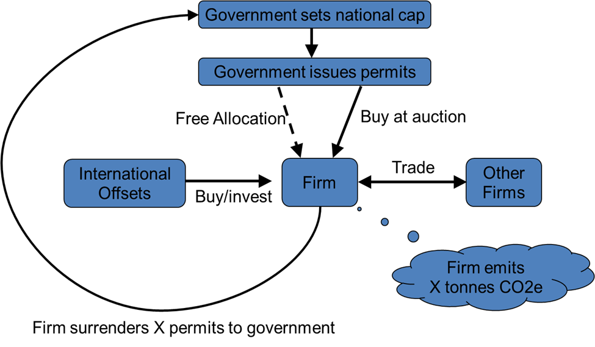
The basic mechanics of carbon trading scheme
Allocation: Regulator sets overall caps and allocates to installation under the cap
Trading: Firms buy more permits or sells excess permits to be under permit holdings
Monitoring: Regulator monitors total emission of firms
Compliance: Regulator checks if all installations under cap have enough permits for emissions
http://www.hacaustralia.com/carbonsignal/?p=2216

Slide 71
Market stability measures
Surplus of emission allowances built up since 2009 →Surplus of allowances is largely due to the economic crisis - led to lower carbon prices and thus a weaker incentive to reduce emissions
Back-loading measures to boost price (short-time)
  Postponed the auctioning of 900 million allowances until 2019-2020 → Reduced allowance auction volume: 400 mn (2014), 300 mn (2015), 200 mn (2016)
  Does not ‘reduce’ overall no of allowances to be auctioned during phase 3→only manage distribution of auctions over the period
Market Stability Reserve (MSR)- from “January 2019” (long-time)
  Back-loaded 900 mn allowance not to auctioned in 2019-20 but build as reserve; additionally unallocated allowances too
https://ec.europa.eu/clima/policies/ets/reform_en

